Slide 1
BUSINESS LEADERSHIP - I
SPHRi

Slide 2
Contents
Management
Organisational Structure
Group Dynamics
Organisational Climate and Culture
Organisational Life Cycle
Stages of Globalisation
Global Integration
Global Workforce

Slide 3
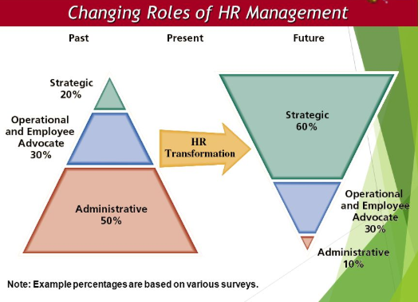
Changing Roles of HRM

Slide 4
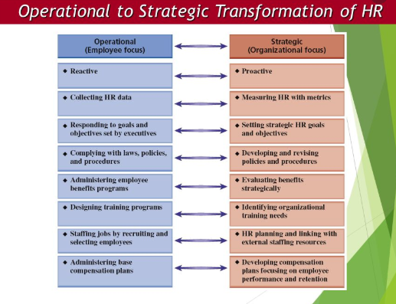
HR Transformation

Slide 5
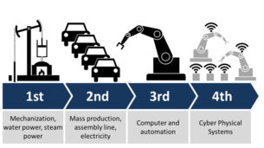
Historical Context
Industrial Revolution – Late 1700 to Late 1800.
Reasons :
Power
Machinery Innovations
Transportation

Slide 6



Three Primary Theories
Henri Fayol
Federick Taylor
Max Weber

Slide 7


Functions of Management
Notes:
Planning - where the organization wants to be in the future and how to get there.
Organizing - how the organization tries to accomplish the plan. Organizing involves assigning tasks, grouping tasks into departments, delegating authority and allocating resources across the organization.
Leading - use of influence to motivate employees to achieve organizational goals. Leading means creating a shared culture and values, communicating goals to employees throughout the organization, and infusing employees with the desire to perform at a high level.
Controlling is monitoring employees’ activities, determining whether the organization is on target toward its goals, and making corrections as necessary.

Slide 8

Bureaucracy
Authority is the right or power assigned to a job holder in order to achieve certain organizational objectives
Responsibility indicates the duty assigned to a position.
Accountability is the liability created for the use of authority
Responsibility may be bestowed, but accountability must be taken.

Slide 9

Essentials of Organisation
Goals of Management - attainment of organizational goals in an effective and efficient manner through planning, organizing, leading and controlling organizational resources.
Organizational effectiveness is the degree to which the organization achieves a stated goal, or succeeds in accomplishing what it tries to do
Organizational efficiency refers to the amount of resources used to achieve an organizational goal. It is based on how much raw materials, money and people are necessary for producing a given volume of output

Slide 10

Levels of Management

Slide 11
Organisational Structure
Structure is all the people, positions, procedures, processes, culture, technology and related elements that comprise the organization.
It defines how all the pieces, parts and processes work together .
This structure must be totally aligned with strategy for the organization to achieve its mission and goals. Structure supports strategy.
If an organization changes its strategy, it must change its structure to support the new strategy

Slide 12

Span of Control
The number of people who report to one manager in a hierarchy
The more people under the control of one manager – wider span of control

Slide 13

Chain of Command
Centralization is the retention of decision-making authority by a high-level manager
Decentralization is the process of distributing authority throughout an organization

Slide 14

Organisational Structure

Slide 15

Geographic Structure
Ethnocentric approach – fill key positions with parent country nationals
Polycentric approach – Recruit host country nationals to manage subsidiaries in their own country and parent country nationals for positions at headquarters
Geocentric approach seek the best people regardless of nationality
Regio centric staffing is a lot like polycentric staffing in that host-country nationals staff each foreign subsidiary to a high degree

Slide 16
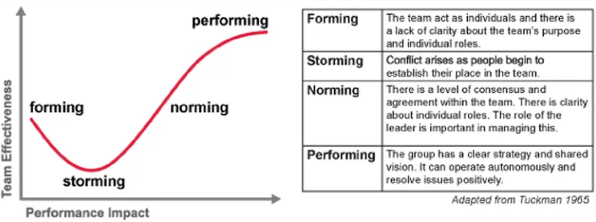
Group Dynamics
Bruce Tuckman first came up with the memorable phrase "forming, storming, norming, and performing" in his 1965 article, "Developmental Sequence in Small Groups." He used it to describe the path that most groups follow on their way to high performance. Later, he added a fifth stage, "adjourning"

Slide 17

Organisational Climate
Climate describes the shared perceptions of the people in a group or organization, while culture includes how people feel about the organization and the beliefs, values, and assumptions that provide the identity and set the standards of behaviour

Slide 18

Organisational Culture
    Artefacts
    Espoused Values
    Shared Tacit Assumptions

Slide 19

Organisational Life Cycle
Start-up
Growth
Maturity
Revival
Decline

Slide 20

Stages of Globalisation

Slide 21

Global Integration & Local Responsiveness
Notes:
Bartlett & Ghoshal

Slide 22

Global Workforce
Expartiation
Repartiation
Notes:
P V Morgan model of IHRM

Slide 23
Questions

