Slide 1
Brand Identity

Slide 3
What is a Brand?

Slide 4
What is brand identity?
It is the unique set of brand associations that represent what a brand stands for and promises to its customers.
Brand as product: Product scope, attributes, quality, uses, users, and provenance
Brand as organization: organization attributes, local vs global
Brand as person: personality, type of brand-customer relationship
Brand as symbol: visual imagery/metaphors and brand heritage

Slide 5
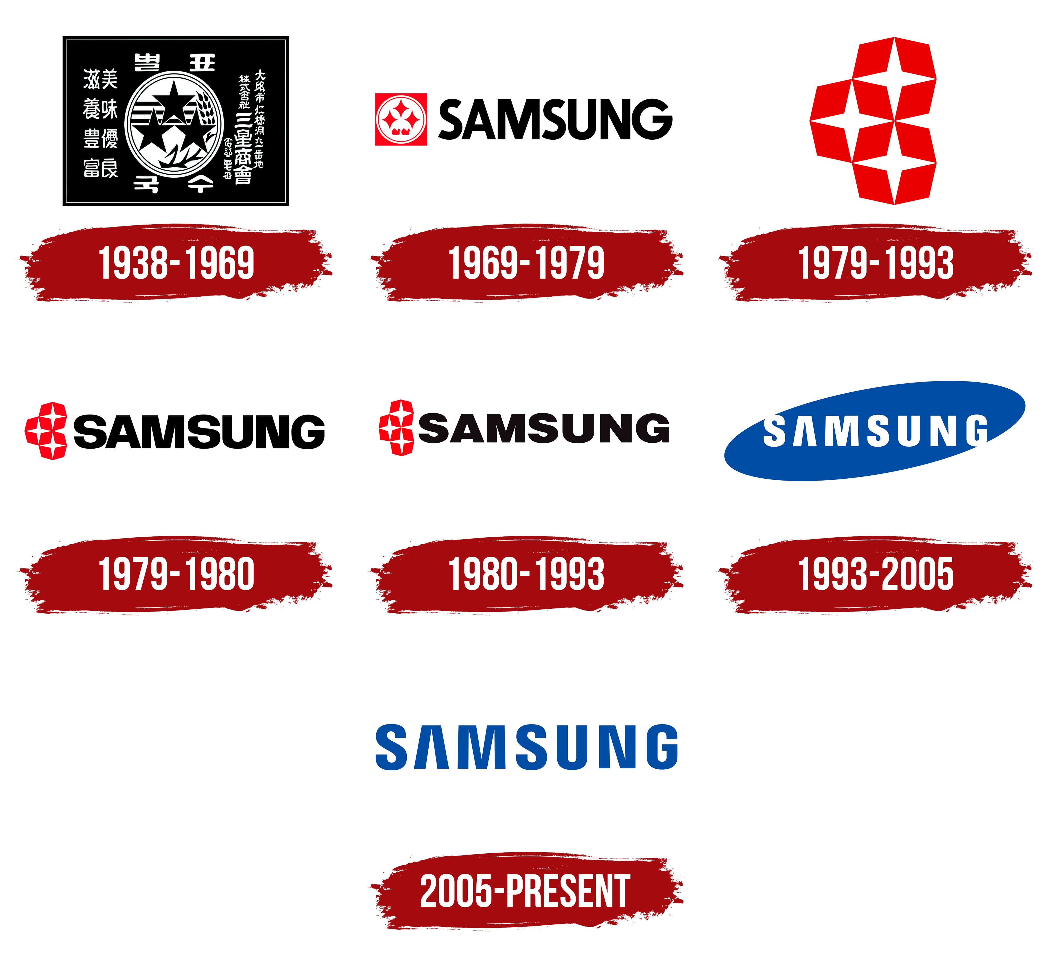
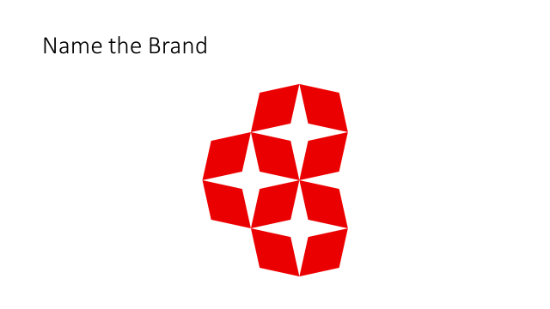
Name the Brand

Slide 6
Brand Heritage and Evolution

Slide 7
Concepts of Self
What are the four concepts of the self?
Ideal self: You aspire to be
Actual or behavioral self:
  The self created by your actions and habits
Public self:
  What is people's public knowledge/Perception of you

Slide 8
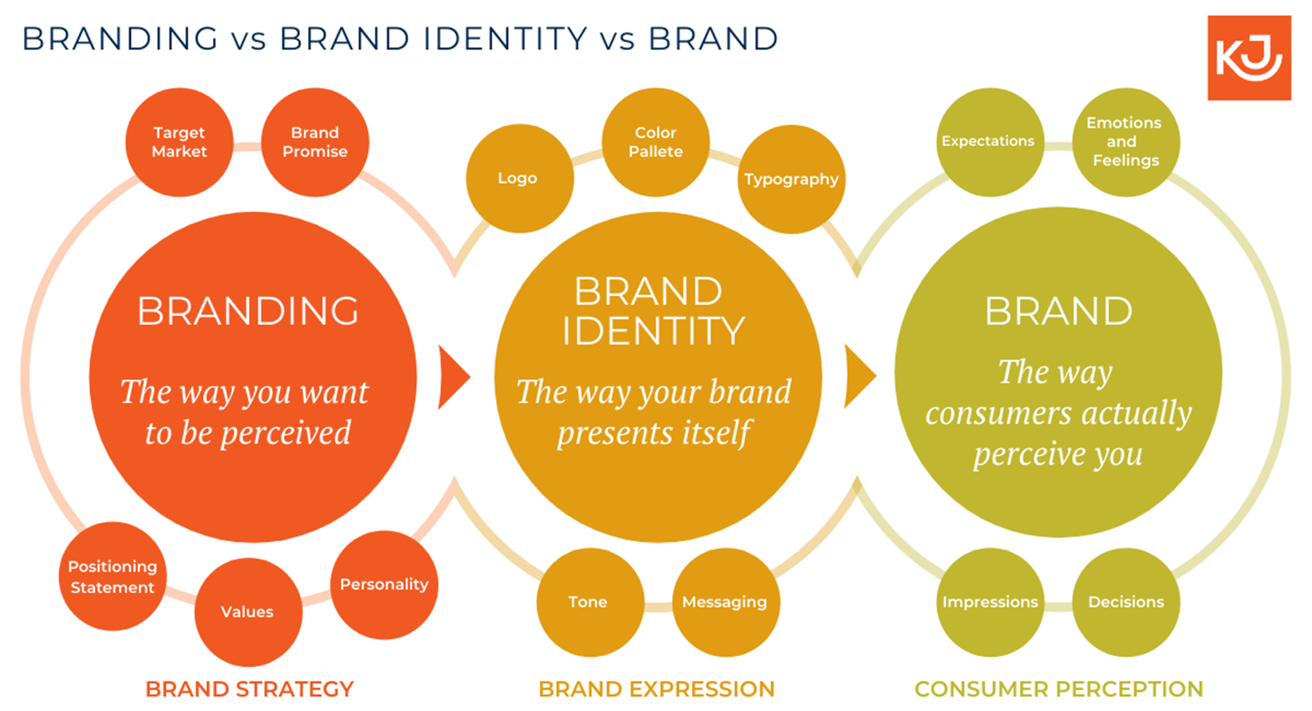
Understanding Brand Identity

Slide 9
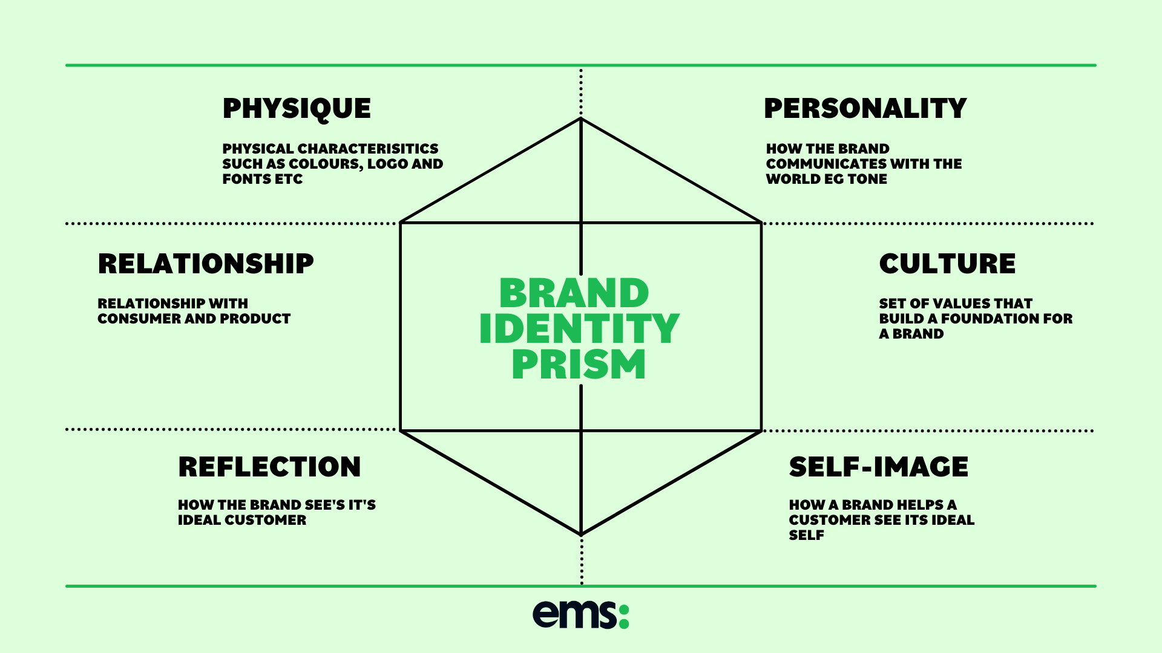
Brand Identity Prism by Kapferer

Slide 10
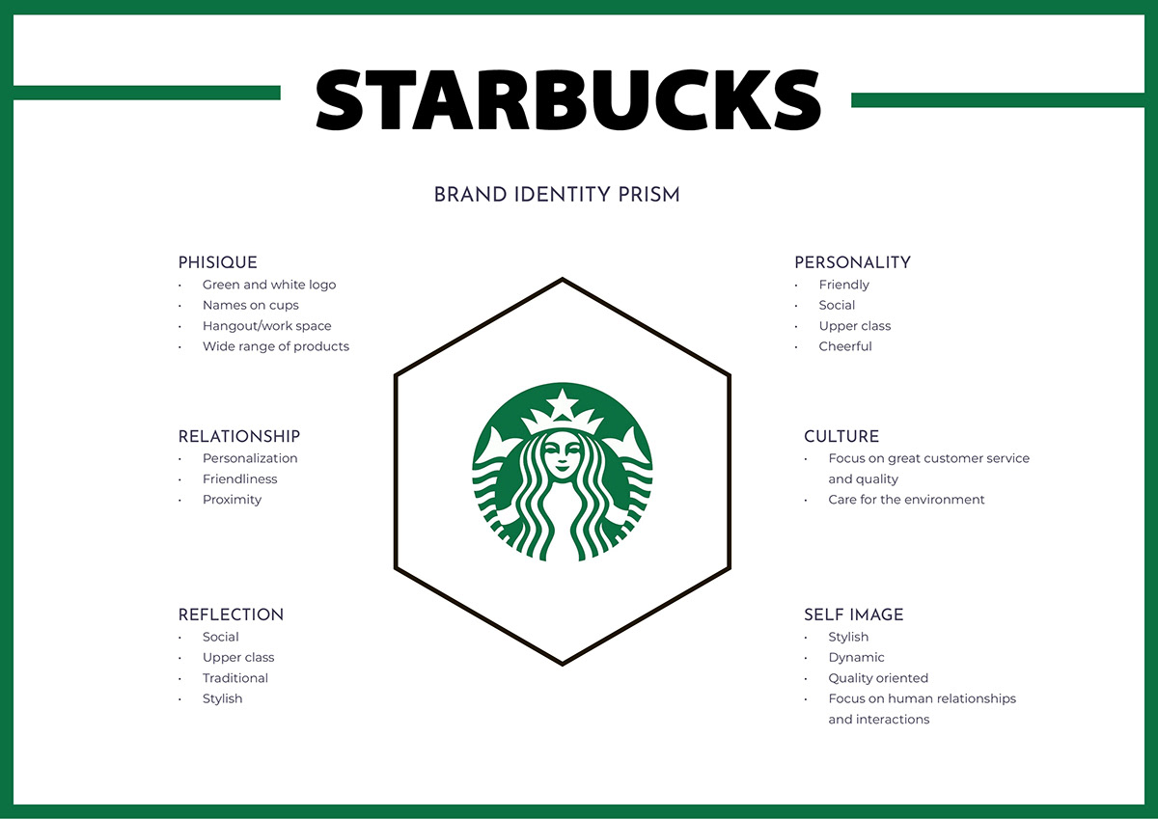

Slide 11
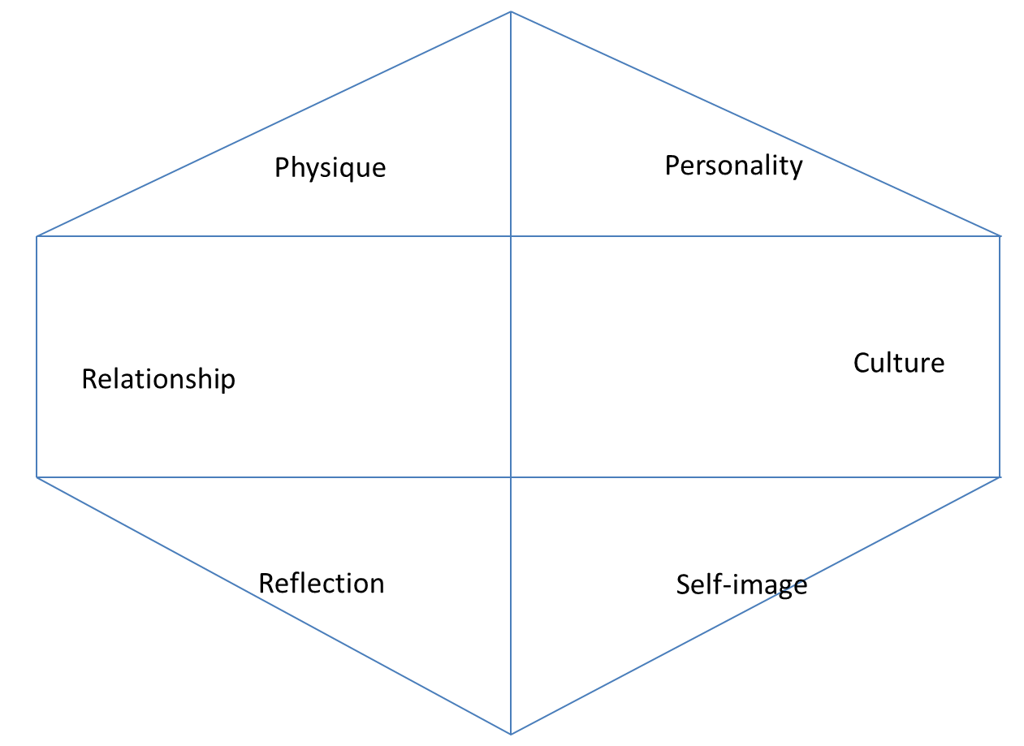
Develop a Brand Identity Prism of Mahindra Scorpio

Slide 12
Brand Identity Prism – Mahindra Scorpio
Physique:
SUV
Red/Black/White Big and Strong
“Nothing else will do”
Personality: Stylish,
Reliable, Comfortable & Quality oriented
Culture:
World-class manufacturing, retailing and customer service
Relationship: Off-road experience as well as city companion
Self Image:
Modern, Young, Luxurious and Quality Lifestyle
Reflection:
Sporty,
Value for money and Individual/Family oriented

Slide 13
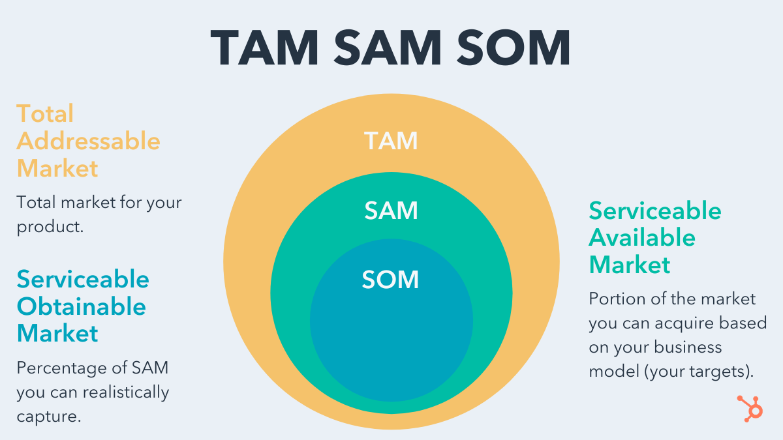

Slide 14
Dilemma of Rohan and Neha?
Rohan and Neha are young entrepreneurs. They want to launch a branding campaign (internet and TV) for their newly developed beauty soap business. Their beauty soap products is largely trying to target female gender and that too in India. They are puzzled over the following questions. Bath soap market US$ 2,885 Million in 2022. 35 % is beauty soap.
Name of the soap?
TAM / SAM / SOM
Brand identity (prism)?
Brand ambassador?

Slide 15
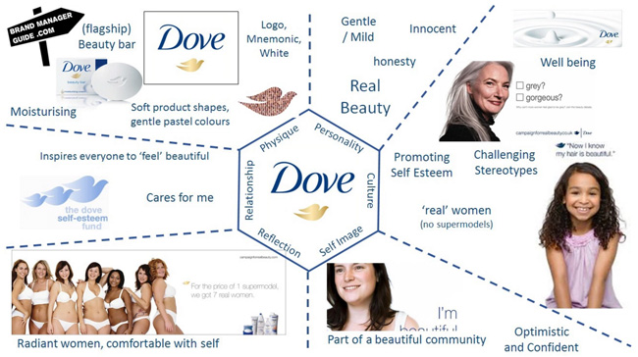
Dove: Beauty Soap

Slide 16
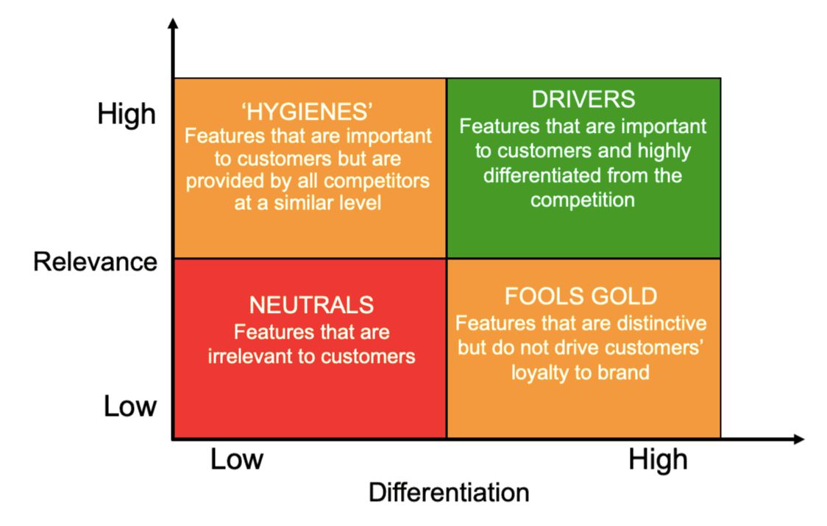
Brand Drivers?

Slide 17
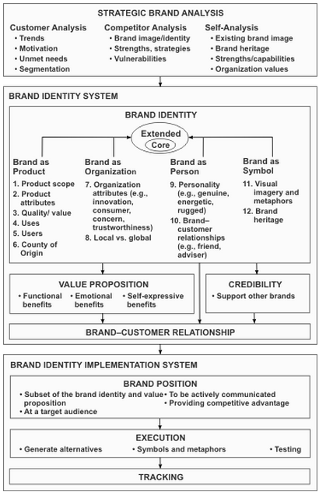
Summary: Brand Identity Source: zanthus.com

Slide 18
Flipkart & Walmart

Slide 19
Flipkart & Walmart Case
Do you think Walmart Inc. should keep investing in independent brands (Myntra and Jabong) or merge them with Flipkart?
Why?? Or Why not??

Slide 20
Flipkart & Walmart Case
What should be the post-acquisition brand identity strategy of Flipkart Group?

Slide 21
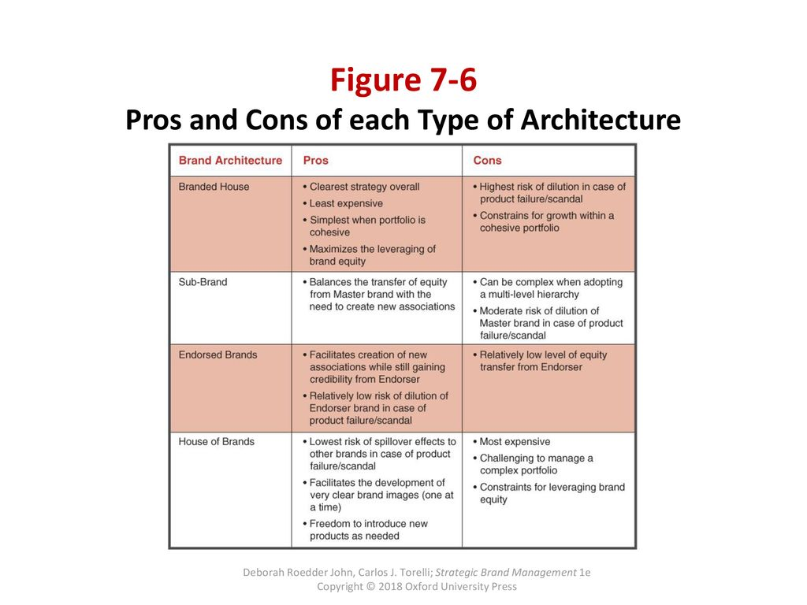
Post-acquisition Brand Identity Strategy

Slide 22
