Slide 1
Valuing Bonds

Slide 2
Valuing Bonds
Bonds, like the world suggests, binds the borrow to the lender in a contract.
An explicit IOU (I owe you): a promise to pay money in the future in return for the money borrowed.
Key Bond Characteristics
  Face Value: The face value (also known as the par value) of a bond is the price at which the bond is sold to investors when first issued; it is also the price at which the bond is redeemed at maturity.
  Coupon Rate: The periodic interest payments promised to bond holders are computed as a fixed percentage of the bond’s face value; this percentage is known as the coupon rate.
  Maturity: A bond’s maturity is the length of time until the principal is scheduled to be repaid.

Slide 3
Indian bond market
ISIN | Descriptor | Weighted Average Price (Rs.) | Weighted Average Yield (YTM) (%) | No. of Trades | Total Trade Value ( in lacs) | Last Trade Price (in ) | Last Trade Yield (Annualized) (%)
INE001A07SG6 | HOUSING DEVELOPMENT FINANCE CORPORATION LTD SR W-008 7.35 NCD 10FB25 FVRS10LAC | 100.0348 | 7.3250 | 2 | 5000.00 | 100.1350 | 7.3000
INE115A07OQ2 | LIC HOUSING FINANCE LIMITED 396 7.45 NCD 10FB23 FVRS10LAC LOAUPTO25FB20 | 100.0117 | 7.4245 | 5 | 27500.00 | 100.0728 | 7.4000
INE756I07CX7 | HDB FINANCIAL SERVICES LIMITED SR A/1/(FX)146 7.50 NCD 23DC22 FVRS10LAC | 100.0272 | 7.4600 | 2 | 13500.00 | 100.0272 | 7.4600
INE053F07728 | INDIAN RAILWAY FINANCE CORPORATION LIMITED SR-96 8.63 BD 26MR29 FVRS1000 LOA UPTO 25MR14 | 121.8673 | 5.4773 | 4 | 220.00 | 121.9223 | 5.4700
INE062A08181 | STATE BANK OF INDIA SERIES II BD 9.37 PERPETUAL FVRS10LAC | 100.7795 | 9.0793 | 3 | 1150.00 | 100.9462 | 9.0250
INE242A08445 | INDIAN OIL CORPORATION LIMITED SR XV 6.44 LOA 14AP23 FVRS10LAC | 101.1657 | 6.0000 | 1 | 2500.00 | 101.1657 | 6.0000
Notes:
https://www1.nseindia.com/products/content/debt/corp_bonds/cbm_reporting_homepage.htm

Slide 4
Indian Bond market
ISIN | INE001A07SG6
Security Description | HOUSING DEVELOPMENT FINANCE CORPORATION LTD SR W-008 7.35 NCD 10FB25 FVRS10LAC
Issue Size | 2500
Face Value | 1000000
Issue Price | 1000000
Coupon Rate | 7.35
Date of Maturity | 10-FEB-2025
ISIN Listing Status
Name of the RTA | HOUSING DEVELOPMENT FINANCE CORPORATION LIMITED
Interest Payment Date | Once A Year
First Interest Payment Date | 10-FEB-2021
Redemption Date | 10-FEB-2025
CRISIL Rating | AAA

Slide 5
Bond valuation
HDFC bank bond with coupon rate is 7.35% for 5 years maturity. The credit rating is AAA
What should be the value of the bond?
Value of bond= PV of coupon amount + PV of Principal amount
0
1
=Rs 7.35
2
=Rs 7.35
3 4 5
=Rs 7.35 =Rs. 7.35 =Rs 7.35 (coupon payment)
=Rs 100 (Redemption value
$Value of a bond=\frac{7.35}{{(1+r)}^{1}}+\frac{7.35}{{(1+r)}^{2}}$ +$\frac{7.35}{{(1+r)}^{3}}$+ $\frac{7.35}{{(1+r)}^{4}}+\frac{7.35}{{(1+r)}^{5}}+ \frac{100}{{(1+r)}^{5}}$
Expected rate of return=Expected return on default-free bond + Default spread

Slide 6
Credit rating…
Rating | Meanings
AAA | Highest degree of safety
AA | High degree of safety
A | Adequate degree of safety
BBB | Moderate degree of safety
BB | Moderate risk of default
B | High risk of default
C | Very high risk of default
D | Default or expected to be in default soon

Slide 7
Corporate bond Yield
Year | AAA | AAA | AAA | AAA | AA | AA | AA | AA
 | 1 years | 3 years | 5 years | 10 years | 1 years | 3 years | 5 years | 10 years
2008-09 |  | 8.2497 | 8.563 | 8.8307 |  |  | 9.433 | 9.3158
2009-10 | 6.7293 | 7.1959 | 8.2416 | 8.5521 | 7.0661 | 8.9651 | 8.5181 | 9.1228
2010-11 | 8.4404 | 7.3945 | 8.452 | 8.8397 | 9.1201 | 8.4423 | 9.2855 | 9.1503
2011-12 | 9.6977 | 9.176 | 9.4792 | 9.279 | 9.67 | 10.6823 | 9.9587 | 9.5408
2012-13 | 9.4336 | 9.2606 | 9.1316 | 9.0752 | 9.9744 | 9.7026 | 9.7226 | 9.3244
2013-14 | 9.6965 | 9.3603 | 9.1904 | 8.9307 | 10.1256 | 9.9663 | 9.8787 | 9.0892
2014-15 | 8.9853 | 8.872 | 8.7627 | 8.7891 | 9.4554 | 9.6298 | 9.5324 | 9.8082
2015-16 | 8.413 | 8.2777 | 8.3865 | 8.434 | 8.9895 | 8.9469 | 9.5772 | 9.5554
2016-17 | 7.5665 | 7.6169 | 7.5893 | 7.9198 | 8.0758 | 8.534 | 8.4926 | 9.0433
2017-18 | 7.3352 | 7.417 | 7.4036 | 7.6272 | 7.5839 | 8.0715 | 8.5391 | 8.6556
2018-19 | 8.3837 | 8.4213 | 8.5304 | 8.569 | 8.908 | 9.2954 | 9.3721 | 9.2421
2019-20 | 7.1788 | 7.3972 | 7.5861 | 7.8873 | 8.242 | 8.7652 | 9.3336 | 8.5986
Notes:
https://countryeconomy.com/bonds/india

Slide 8
Bond valuation
The Yield of AAA 3-year bond is 7.5861
$Value of a bond=\frac{7.35}{{(1+7.5861\%)}^{1}}+\frac{7.35}{{(1+7.5861\%)}^{2}}$ +$\frac{7.35}{{(1+7.5861\%)}^{3}}$+ $\frac{7.35}{{(1+7.5861\%)}^{4}}+\frac{7.35}{{(1+7.5861\%)}^{5}}+ \frac{100}{{(1+7.5861\%)}^{5}}$
Present value of Coupon payment= Rs 29.67
Present value of redemption value=Rs. 69.38
Bond value=Rs 99.05
When the expected return on bond is lower than coupon rate, then bond is expected to
trade at premium (more than par value).
2. When the expected return on bond is higher than coupon rate, then bond is expected to
trade at discount (less than par value).
3. When the expected return on bond is equal to coupon rate, then bond is expected to
trade at par.

Slide 9
Relationship between interest rate and bond price

Slide 10
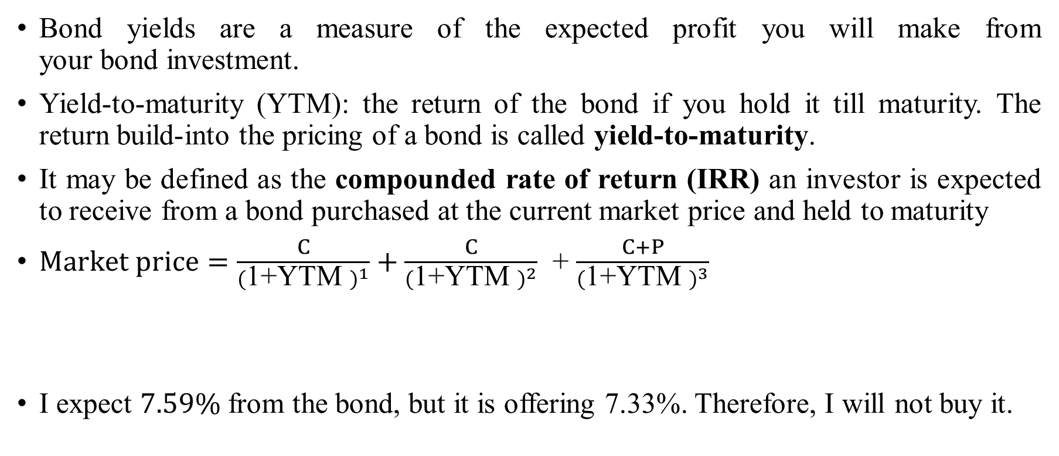
Bond yield
Bond yields are a measure of the expected profit you will make from your bond investment.
Yield-to-maturity (YTM): the return of the bond if you hold it till maturity. The return build-into the pricing of a bond is called yield-to-maturity.
It may be defined as the compounded rate of return (IRR) an investor is expected to receive from a bond purchased at the current market price and held to maturity
$Market price=\frac{C}{{(\text{1+}\text{YTM} )}^{1}}+\frac{C}{{(\text{1+}\text{YTM} )}^{2}}$ + $\frac{C+P}{{(\text{1+}\text{YTM} )}^{3}}$
I expect $7.59\%$ from the bond, but it is offering 7.33%. Therefore, I will not buy it.
$\text{1}\text{00.0348}\frac{7.35}{{(1+YTM)}^{1}}+\frac{7.35}{{(1+YTM)}^{2}}$ +$\frac{7.35}{{(1+YTM)}^{3}}$+ $\frac{7.35}{{(1+YTM)}^{4}}+\frac{7.35}{{(1+YTM)}^{5}}+ \frac{100}{{(1+YTM)}^{5}}$

Slide 11
Yield misconception
ISSUER | CURRENCY | COUPON | YIELD | MOODY'S RATING | MATURITY DATE | BID | ASK
Amazon.com Inc. | USD | 3.8750% | 29.68% |  | 8/22/2037 | 14.00 | 38.00
Argentinien, Republik | USD | 7.6250% | 21.84% |  | 4/18/2037 | 37.15 | 41.72
Argentinien, Republik | USD | 7.1250% | 21.35% |  | 6/28/2117 | 34.95 | 45.42
Bank of New York Mellon [Luxembourg] S.A., The | EUR | 3.8590% | 294.06% |  | 12/30/2099 | 3.55 | 6.55
Ecuador, Republik | USD | 10.0000% | 25.96% |  | 8/15/2030 | 44.13 | 51.68
Frontier Communications Corp. | USD | 9.0000% | 24.12% | Caa3 | 8/15/2031 | 41.88 | 45.28
Great Hall Mortgages No.1 PLC | EUR | - | 25.45% | Aa3 | 3/18/2039 | - | -
HYPO TIROL BANK AG | EUR | - | 25.37% | A2 | 3/28/2043 | - | -
J.C. Penney Co. Inc. | USD | 7.4000% | 23.75% | Caa3 | 4/1/2037 | 32.99 | 37.89
J.C. Penney Corp. Inc. | USD | 6.3750% | 21.76% | Caa3 | 10/15/2036 | 34.29 | 34.30
Mexiko, Vereinigte Staaten | EUR | 8.0000% | 162.93% | A3 | 11/7/2047 | 4.91 | 5.31
Noble Holding International Ltd. | USD | 6.2000% | 20.35% | Caa3 | 8/1/2040 | 32.08 | 35.35
Notes:
https://markets.businessinsider.com/bonds/finder?borrower=&maturity=longterm&yield=20&bondtype=&coupon=&currency=&rating=&country=

Slide 12
Yield curve
The relation between yield to maturity and the maturity of bond.
Bond A
Bond B
Which bond is riskier?
0
Year 1
=Rs 1000
Year 10
=Rs 1000
0

Slide 13
Zero coupon bond yield curve

Slide 14
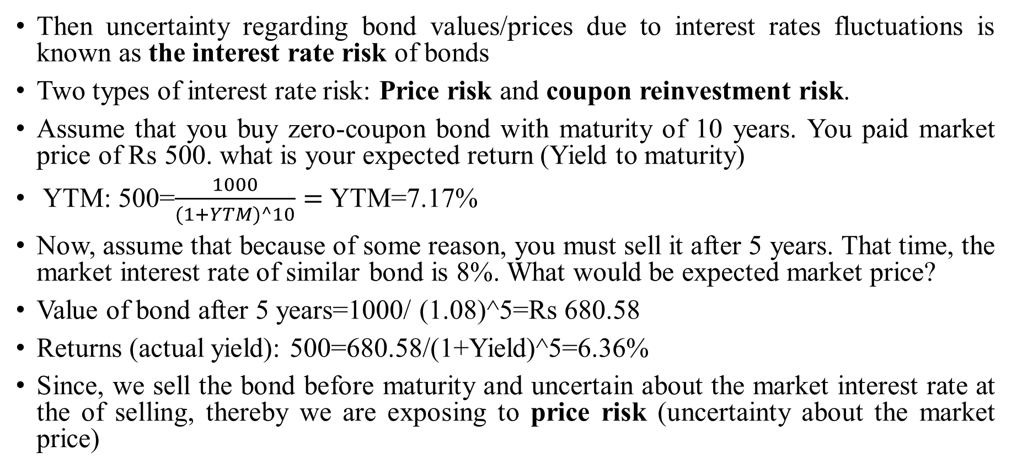
Risk of bonds: Interest-rate risk
Then uncertainty regarding bond values/prices due to interest rates fluctuations is known as the interest rate risk of bonds
Two types of interest rate risk: Price risk and coupon reinvestment risk.
Assume that you buy zero-coupon bond with maturity of 10 years. You paid market price of Rs 500. what is your expected return (Yield to maturity)
YTM: 500=$\frac{1000}{(1+YTM)^10}=$YTM=7.17%
Now, assume that because of some reason, you must sell it after 5 years. That time, the market interest rate of similar bond is 8%. What would be expected market price?
Value of bond after 5 years=1000/ (1.08)^5=Rs 680.58
Returns (actual yield): 500=680.58/(1+Yield)^5=6.36%
Since, we sell the bond before maturity and uncertain about the market interest rate at the of selling, thereby we are exposing to price risk (uncertainty about the market price)

Slide 15
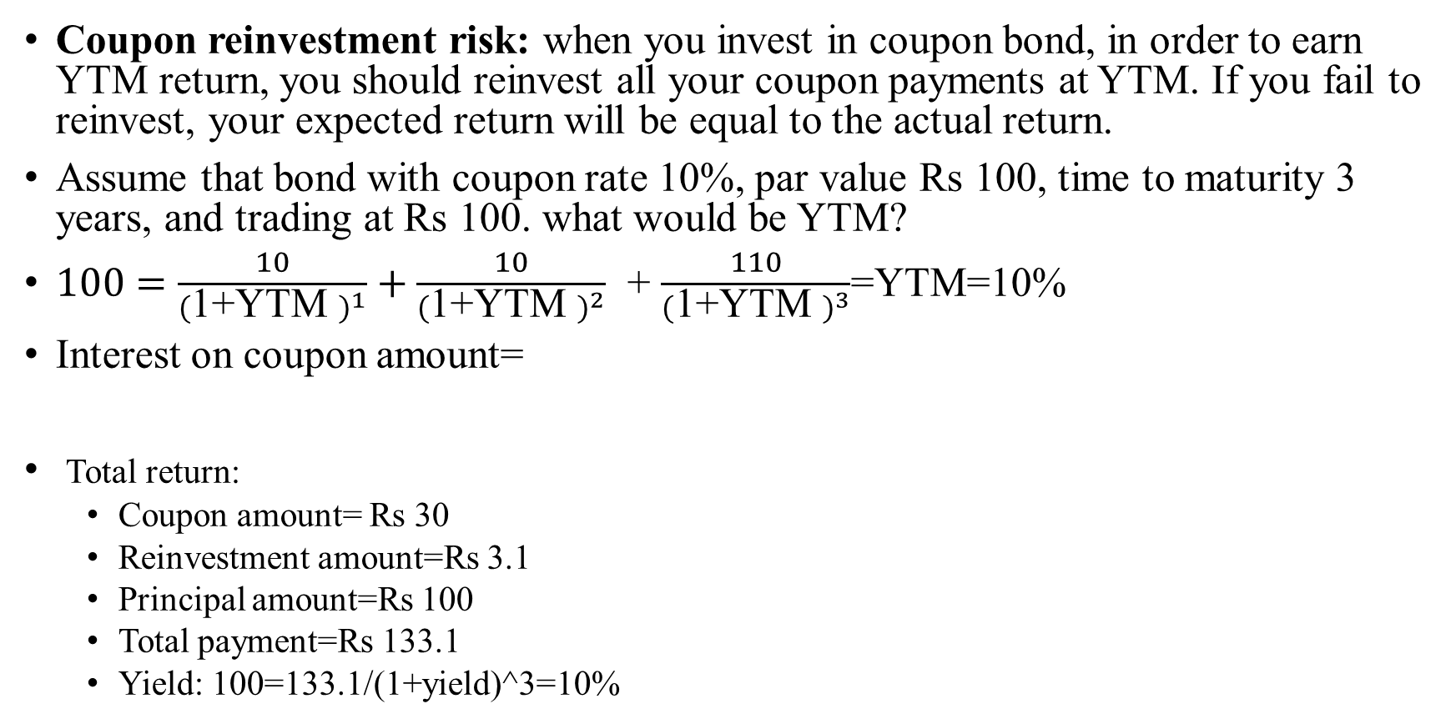
Risk of bonds: Interest rate risk
Coupon reinvestment risk: when you invest in coupon bond, in order to earn YTM return, you should reinvest all your coupon payments at YTM. If you fail to reinvest, your expected return will be equal to the actual return.
Assume that bond with coupon rate 10%, par value Rs 100, time to maturity 3 years, and trading at Rs 100. what would be YTM?
$100=\frac{10}{{(\text{1+}\text{YTM} )}^{1}}+\frac{10}{{(\text{1+}\text{YTM} )}^{2}}$ + $\frac{110}{{(\text{1+}\text{YTM} )}^{3}}$=YTM=10%
Interest on coupon amount=
Total return:
  Coupon amount= Rs 30
  Reinvestment amount=Rs 3.1
  Principal amount=Rs 100
  Total payment=Rs 133.1
  Yield: 100=133.1/(1+yield)^3=10%
0
1
Rs 10
2
Rs 10
3
Rs 10
=10*(1.1)^0-10=Rs 0
=10*(1.1)^1-10=Rs1
=10*(1.1)^2-10=Rs 2.1

Slide 16
Risk of bonds: Interest rate risk
 | Reinvestment rate
 | 5% | 10% | 15%
Reinvestment payment | Rs. 1.53 | Rs. 3.10 | Rs. 4.72
Coupon payment | Rs. 30 | Rs. 30 | Rs. 30
Principal payment | Rs. 100 | Rs. 100 | Rs. 100
Total return | Rs. 131.53 | Rs. 133.10 | Rs. 134.73
Investment (Market price) | Rs. 100 | Rs. 100 | Rs. 100
Yield(%) | 9.56% | 10.00% | 10.45%
https://beta.nseindia.com/market-data/debt-market-reporting-corporate-bonds-traded-on-exchange

Slide 17
Some intuitions
If bond market price increases (decreases), its yield must decrease (increases)
Bond Price Variability is directly related to the term to maturity.
  For the given change in the level of market interest rate, the change in bond prices are greater for long term maturity.
The percentage change in a bond’s price owing to change in its yield will be smaller if the coupon rate is higher.
The price-yield relation is convex
  A decrease in a bonds yield will rise the bonds price by an amount that is greater in size than the corresponding fall in the bonds price that would occur if there where an equal sized increase in the bonds yield.

Slide 18
Valuation of stock

Slide 19
The choice of financing
There are only two ways in which a business can raise money.
  The first is debt: The essence of debt is that a debt claim entitles the holder of the claim to a contracted set of cashflows (interest payments and repaying principle). If you fail to make those payments, you lose control of your business.
  The second is equity: With equity, you do get whatever cashflows are left over after you made debt and tax (government) payments.

Slide 20
Debt versus Equity
Fixed claim-Coupon and principal payment
Tax Deductible
High priority in financial trouble
Fixed maturity
No management control
Residual claim-Dividend and selling price
Not Tax Deductible
Low priority in financial trouble
Infinite
Management control
Debt
Bank debt
Commercial paper
Corporate Bonds
Equity
Owner’s equity
Venture capital
Common stock
Warrants
Hybrid securities
Convertible Debt
Preferred stock
Option-linked bonds

Slide 21
A snap-shot of idea/Entity
Liabilities | Assets
Equity | Real assets
Debt

Slide 22
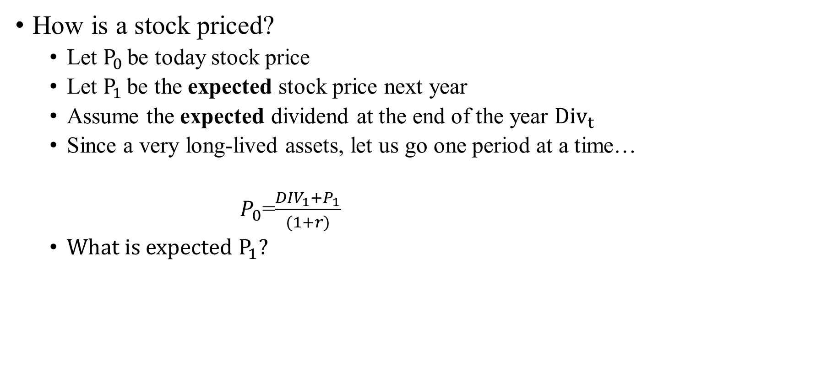
Pricing a stock
How is a stock priced?
  Let $P_{0 }$be today stock price
  Let $P_{1 }$be the expected stock price next year
  Assume the expected dividend at the end of the year ${Div}_{t }$
  Since a very long-lived assets, let us go one period at a time…
  $P_{0}$=$\frac{{DIV}_{1}+P_{1}}{(1+r)}$
  What is expected $P_{1}$?

Slide 23
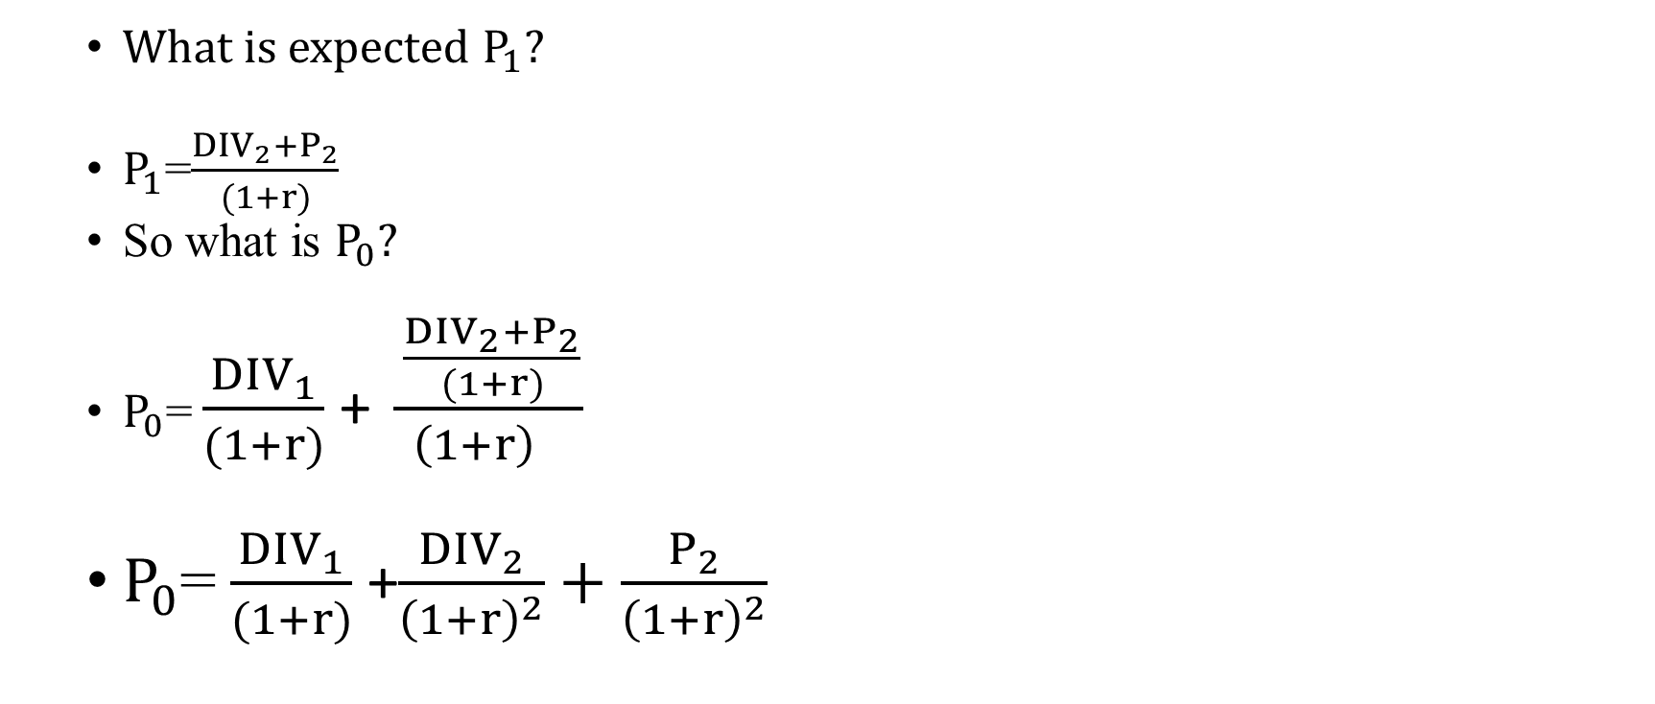
Pricing a stock
  What is expected $P_{1}$?
  $P_{1}$=$\frac{{DIV}_{2}+P_{2}}{(1+r)}$
  So what is $P_{0}?$
  $P_{0}$= $\frac{{DIV}_{1}}{(1+r)}$+ $\frac{\frac{{DIV}_{2}+P_{2}}{(1+r)}}{{\left(1+r\right)}^{}}$
  $P_{0}$= $\frac{{DIV}_{1}}{(1+r)}$+$\frac{{DIV}_{2}}{{\left(1+r\right)}^{2}}+\frac{P_{2}}{{\left(1+r\right)}^{2}}$

Slide 24
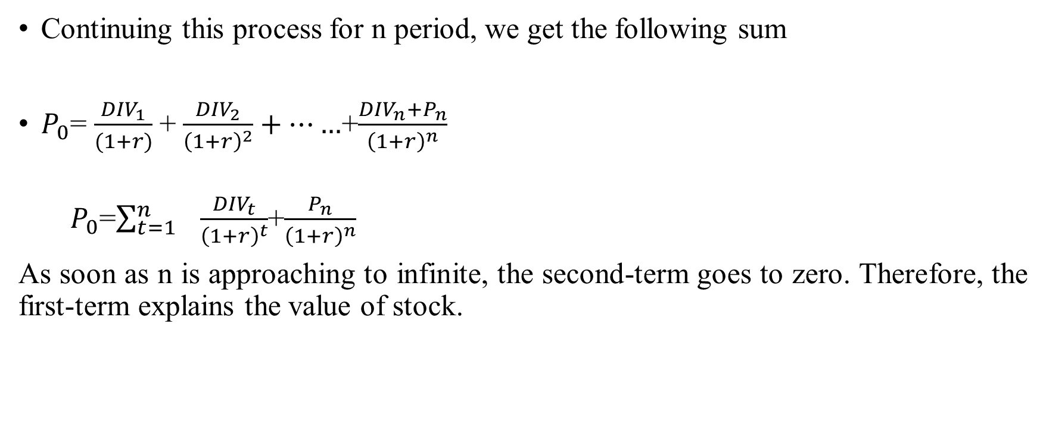
The stock price (Formula…)
Continuing this process for n period, we get the following sum
$P_{0}$= $\frac{{DIV}_{1}}{(1+r)}$+ $\frac{{DIV}_{2}}{{\left(1+r\right)}^{2}}+……$+$\frac{{DIV}_{n}+P_{n}}{{\left(1+r\right)}^{n}}$
  $P_{0}$=$\sum_{t=1}^{n}{ \frac{{DIV}_{t}}{{\left(1+r\right)}^{t}}}$+$\frac{P_{n}}{{\left(1+r\right)}^{n}}$
As soon as n is approaching to infinite, the second-term goes to zero. Therefore, the first-term explains the value of stock.

Slide 25
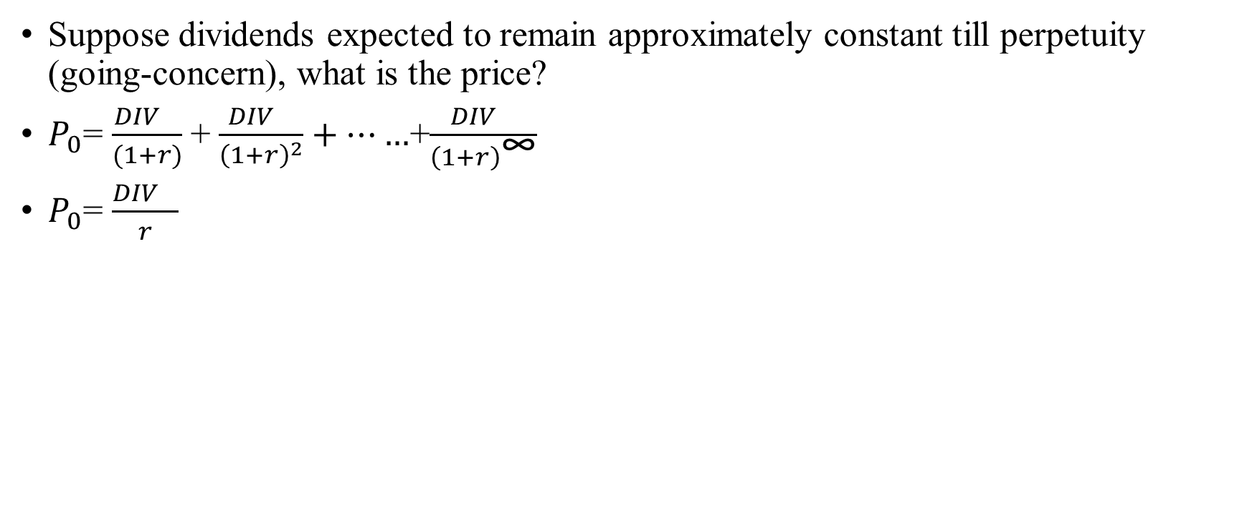
Special case I: Dividend stock
Suppose dividends expected to remain approximately constant till perpetuity (going-concern), what is the price?
$P_{0}$= $\frac{{DIV}_{}}{(1+r)}$+ $\frac{{DIV}_{}}{{\left(1+r\right)}^{2}}+……$+$\frac{{DIV}_{}}{{\left(1+r\right)}^{\text{∞}}}$
$P_{0}$= $\frac{{DIV}_{}}{r}$

Slide 26
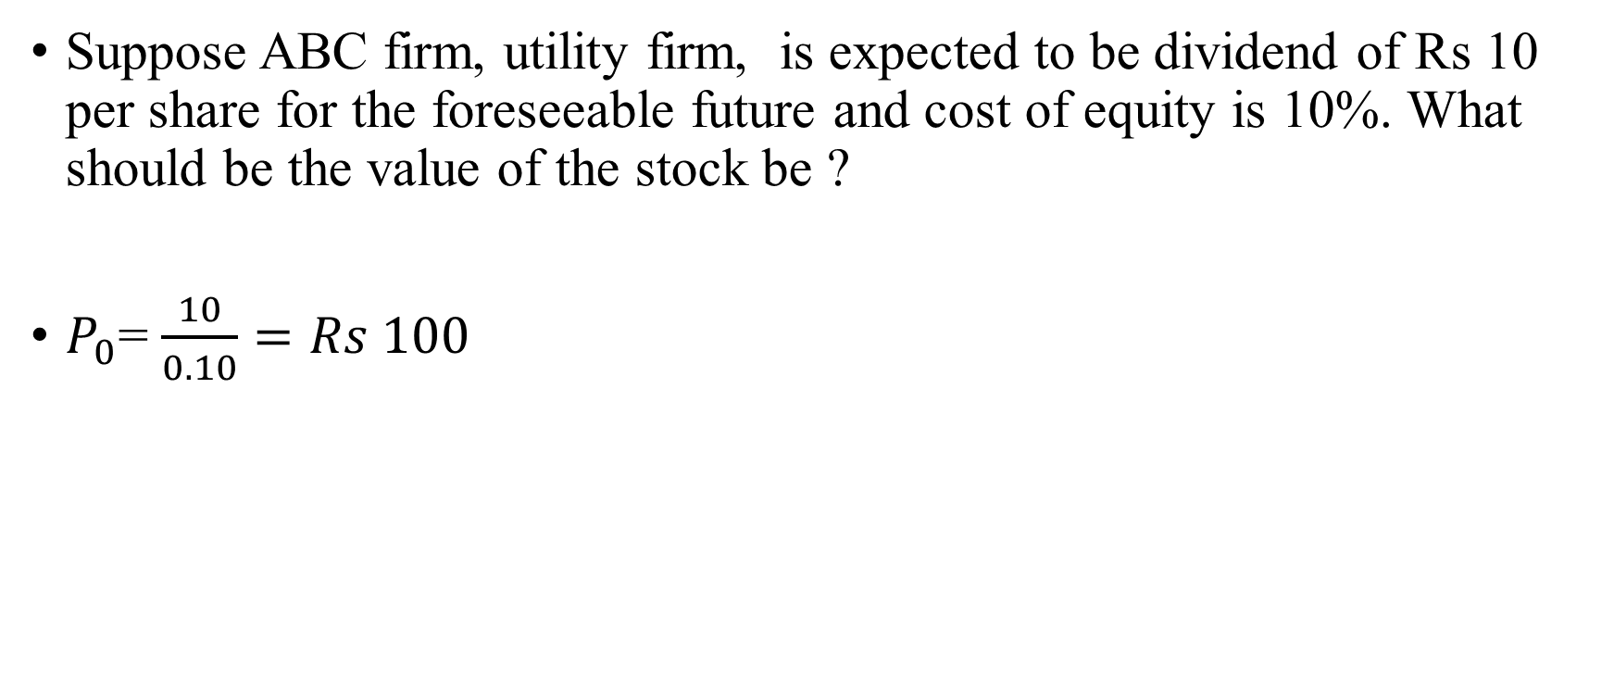
Special case I: Dividend stock (Income stock)
Suppose ABC firm, utility firm, is expected to be dividend of Rs 10 per share for the foreseeable future and cost of equity is 10%. What should be the value of the stock be ?
$P_{0}$= $\frac{10}{0.10}=Rs 100$

Slide 27
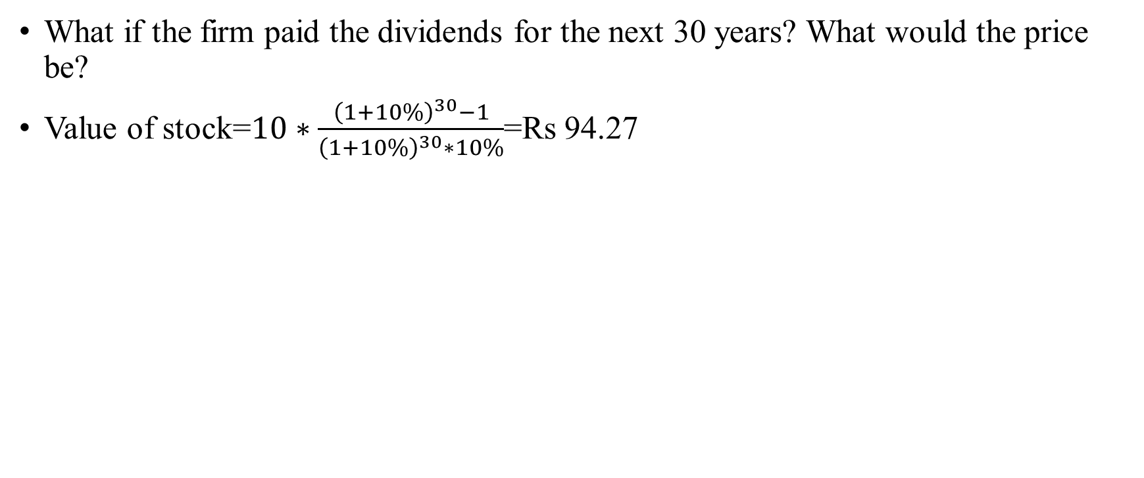
Is forever really forever?
What if the firm paid the dividends for the next 30 years? What would the price be?
Value of stock=$10∗\frac{{\left(1+10\%\right)}^{30}−1}{{\left(1+10\%\right)}^{30}∗10\%}$=Rs 94.27

Slide 28
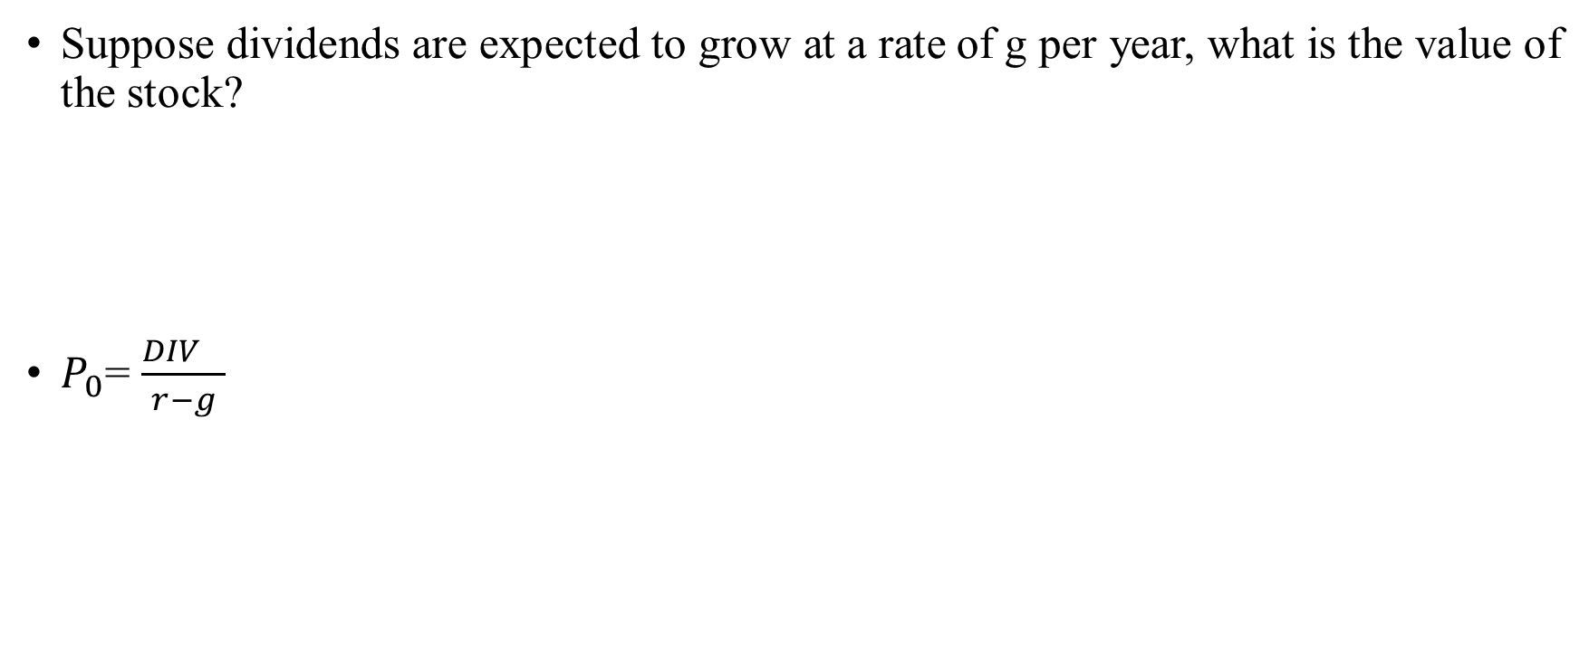
Special Case II: Growth stock
Suppose dividends are expected to grow at a rate of g per year, what is the value of the stock?
$P_{0}$= $\frac{{DIV}_{}}{r−g}$

Slide 29
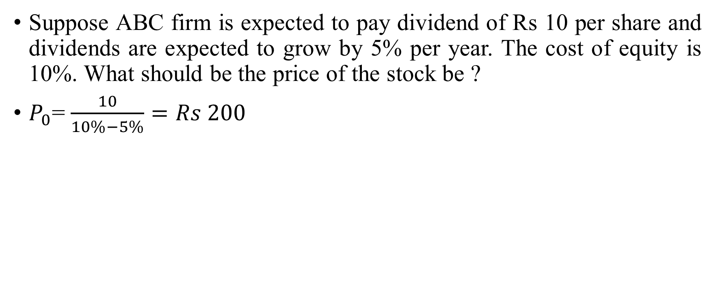
Special Case II: Growth stock
Suppose ABC firm is expected to pay dividend of Rs 10 per share and dividends are expected to grow by 5% per year. The cost of equity is 10%. What should be the price of the stock be ?
$P_{0}$= $\frac{10}{10\%−5\%}=Rs 200$

Slide 30
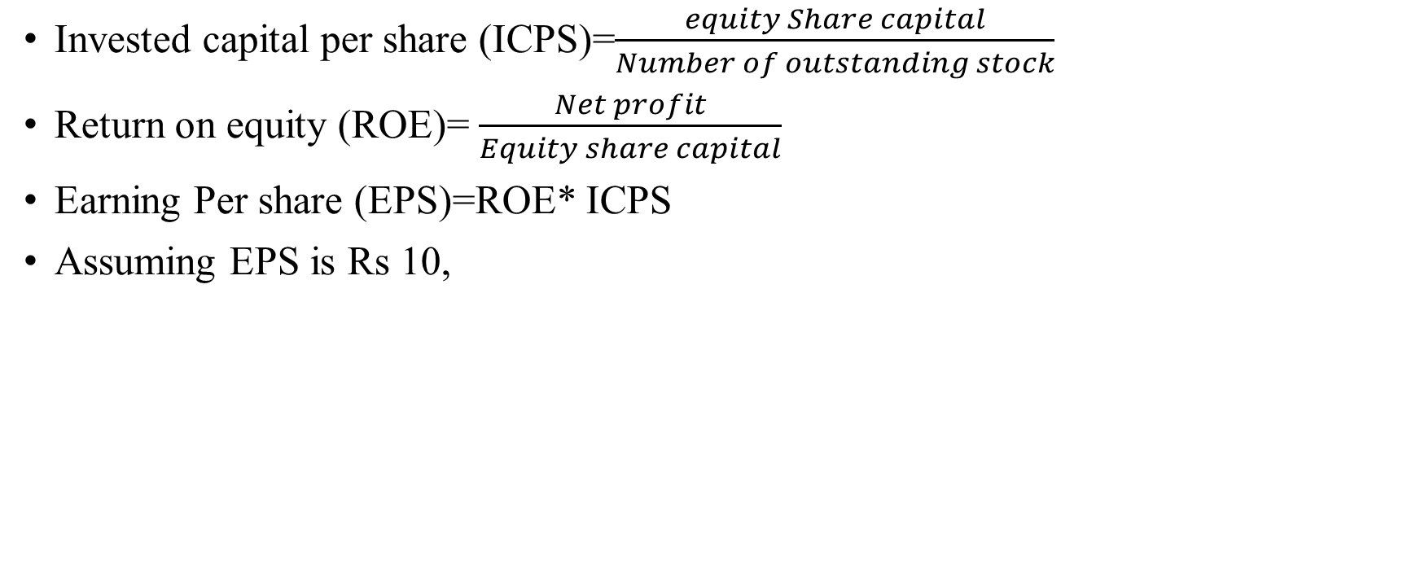
Engine of growth
Invested capital per share (ICPS)=$\frac{equity Share capital}{Number of outstanding stock}$
Return on equity (ROE)= $\frac{Net profit}{Equity share capital}$
Earning Per share (EPS)=ROE* ICPS
Assuming EPS is Rs 10,
EPS
Retained earnings per share
Dividend per share

Slide 31
Engine of growth (assume perpetuities)
A firm reports after-tax operating income Rs 75 million on invested capital of Rs 1 billion. It does not plan to reinvest in new asset but will maintain existing assets and its current return on capital. What should be the growth rate?
If this firm thinks that it can invest 50 million without improving return on capital what growth rate will you see in operating income next year?
If this firm thinks that it can improve its return on capital on existing assets from 7.5% to 10% next year by making them more efficient, what growth rate will you see in operating income next year?
If this firm thinks that it can improve its return on capital on existing assets from 7.5% to 10% next year by making them more efficient, along with 50 million new investment. What growth rate will you see in operating income next year?

Slide 32

Engine of growth
Current investment
Rs 1000
Current ROIC
7.5%
Current earnings
Rs 75
X
=
Current investment
Rs 1000
X
Current ROIC
7.5%
New investment
Rs 50
Current ROIC 7.5%
Next period earnings
Rs 78.75
+
X
=
Current investment
Rs 1000
Change in Current ROIC
0
New investment
Rs 50
Current ROIC
7.5%
Change in next period earnings
Rs 3.75
X
+
X
=
$$\frac{reinvestment amount}{Current earning}X ROE=\frac{Change in current in earnings}{Previous earnings}$$
$\frac{50}{75} X 7.5\%=\frac{3.75}{75}$=5%

Slide 33
Expected long-term growth in EPS
We use the following inputs
  Reinvestment rate (retention ratio)=retained earnings/current earnings
  Return on equity=net income/book value of equity
Growth rate=Retention ratio*ROE
The above equation suggests the growth rate cannot be more than ROE.

Slide 34
Estimating expected growth in EPS: Sun Pharma
Book value of equity (2019)=Rs. 27855.39
Net income= Rs. 9995.92
Return on equity= 9995.92/27855.39=35.885%
Retained amount=Rs. 1,239.73
Retention ratio= 1,239.73/ 9995.92=12.4%
Implied growth rate=12.4%*35.885%=4.45%

Slide 35
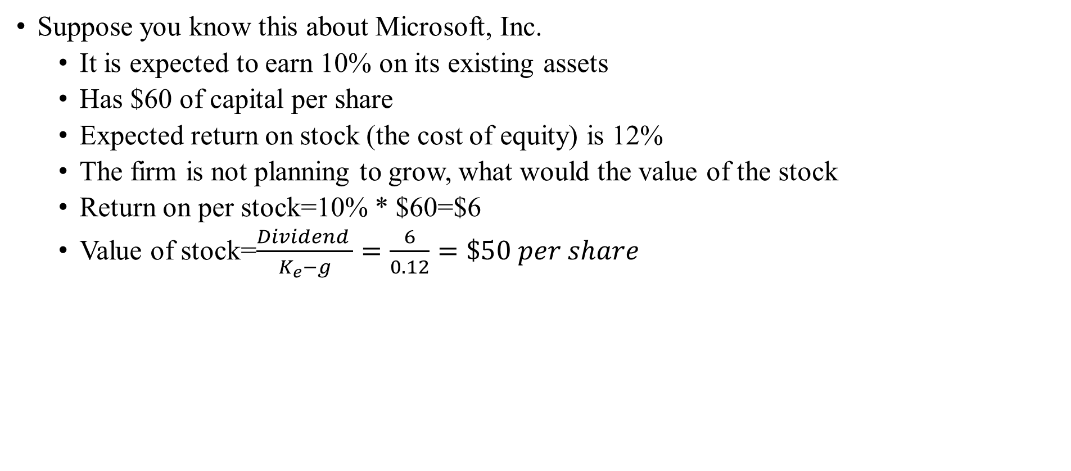
Good or Bad Growth
Suppose you know this about Microsoft, Inc.
  It is expected to earn 10% on its existing assets
  Has $60 of capital per share
  Expected return on stock (the cost of equity) is 12%
  The firm is not planning to grow, what would the value of the stock
  Return on per stock=10% * $60=$6
  Value of stock=$\frac{Dividend }{K_{e}−g}=\frac{6}{0.12}=\$50 per share$

Slide 36
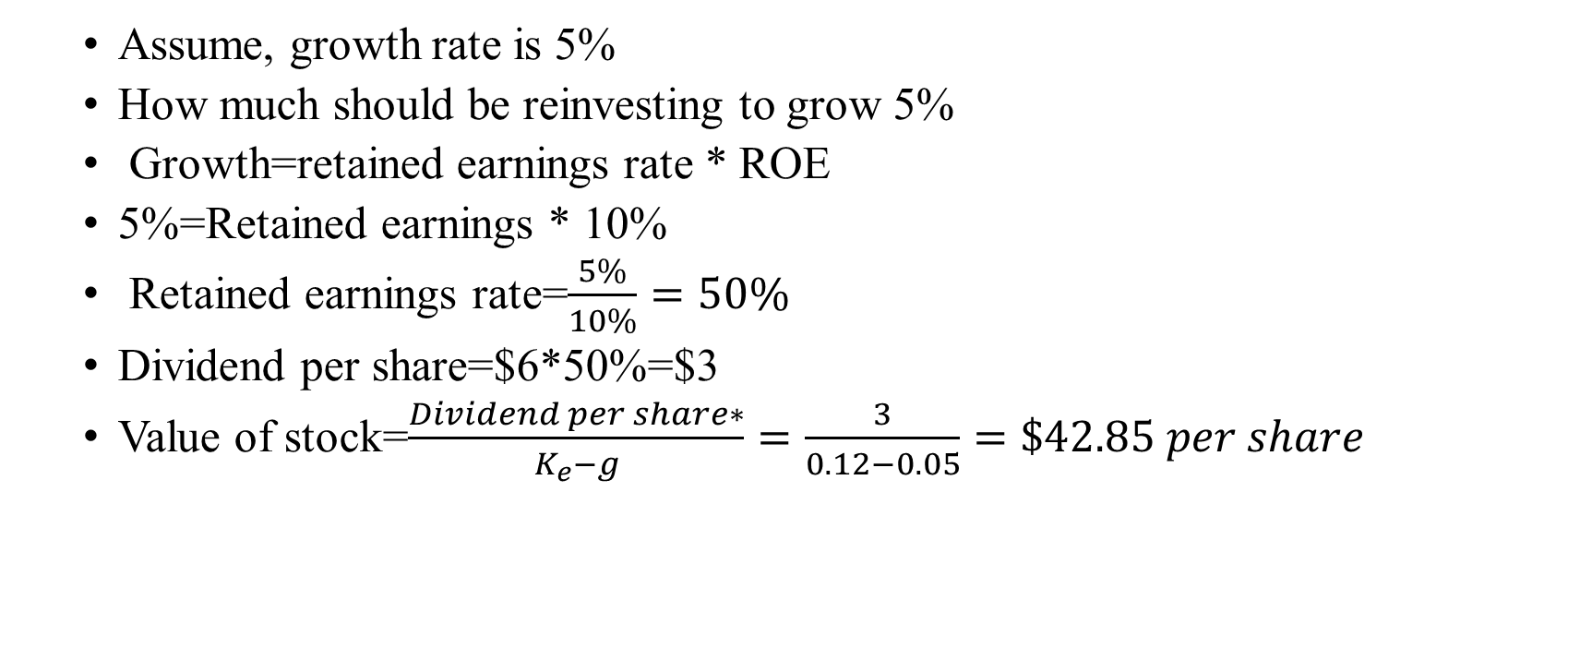
Good or Bad Growth
  Assume, growth rate is 5%
  How much should be reinvesting to grow 5%
  Growth=retained earnings rate * ROE
  5%=Retained earnings * 10%
  Retained earnings rate=$\frac{5\%}{10\%}=50\%$
  Dividend per share=$6*50%=$3
  Value of stock=$\frac{Dividend per share∗}{K_{e}−g}=\frac{3}{0.12−0.05}=\$42.85 per share$

Slide 37
Case 1: Good growth-: ROE> Cost of equity
Expected EPS | DPR | Retention ratio | Ke | ROE | Growth rate | Dividend Amount | Equity Value
100 | 10% | 90% | 10% | 11% | 9.90% | 10 | 10000.00
100 | 20% | 80% | 10% | 11% | 8.80% | 20 | 1666.67
100 | 30% | 70% | 10% | 11% | 7.70% | 30 | 1304.35
100 | 40% | 60% | 10% | 11% | 6.60% | 40 | 1176.47
100 | 50% | 50% | 10% | 11% | 5.50% | 50 | 1111.11
100 | 60% | 40% | 10% | 11% | 4.40% | 60 | 1071.43
100 | 70% | 30% | 10% | 11% | 3.30% | 70 | 1044.78
100 | 80% | 20% | 10% | 11% | 2.20% | 80 | 1025.64
100 | 90% | 10% | 10% | 11% | 1.10% | 90 | 1011.24
100 | 100% | 0% | 10% | 11% | 0.00% | 100 | 1000.00

Slide 38
Case 2: Bad growth :- Cost of equity>ROE
Expected EPS | DPR | Retention ratio | Ke | ROE | Growth rate | Dividend Amount | Equity Value
100 | 10% | 90% | 10% | 9% | 8.10% | 10 | 526.32
100 | 20% | 80% | 10% | 9% | 7.20% | 20 | 714.29
100 | 30% | 70% | 10% | 9% | 6.30% | 30 | 810.81
100 | 40% | 60% | 10% | 9% | 5.40% | 40 | 869.57
100 | 50% | 50% | 10% | 9% | 4.50% | 50 | 909.09
100 | 60% | 40% | 10% | 9% | 3.60% | 60 | 937.50
100 | 70% | 30% | 10% | 9% | 2.70% | 70 | 958.90
100 | 80% | 20% | 10% | 9% | 1.80% | 80 | 975.61
100 | 90% | 10% | 10% | 9% | 0.90% | 90 | 989.01
100 | 100% | 0% | 10% | 9% | 0.00% | 100 | 1000.00

Slide 39
Case 3: Who cares:- Cost of equity= ROE
Expected EPS | DPR | Retention ratio | Ke | ROE | Growth rate | Dividend Amount | Equity Value
100 | 10% | 90% | 10% | 10% | 9.00% | 10 | 1000.00
100 | 20% | 80% | 10% | 10% | 8.00% | 20 | 1000.00
100 | 30% | 70% | 10% | 10% | 7.00% | 30 | 1000.00
100 | 40% | 60% | 10% | 10% | 6.00% | 40 | 1000.00
100 | 50% | 50% | 10% | 10% | 5.00% | 50 | 1000.00
100 | 60% | 40% | 10% | 10% | 4.00% | 60 | 1000.00
100 | 70% | 30% | 10% | 10% | 3.00% | 70 | 1000.00
100 | 80% | 20% | 10% | 10% | 2.00% | 80 | 1000.00
100 | 90% | 10% | 10% | 10% | 1.00% | 90 | 1000.00
100 | 100% | 0% | 10% | 10% | 0.00% | 100 | 1000.00

Slide 40
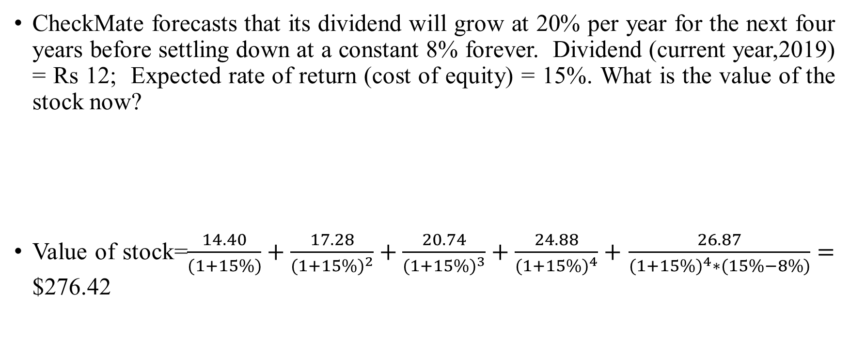
Value of high growth stocks
CheckMate forecasts that its dividend will grow at 20% per year for the next four years before settling down at a constant 8% forever. Dividend (current year,2019) = Rs 12; Expected rate of return (cost of equity) = 15%. What is the value of the stock now?
Value of stock=$\frac{14.40}{(1+15\%)}+\frac{17.28}{{(1+15\%)}^{2}}+\frac{20.74}{{(1+15\%)}^{3}}+\frac{24.88}{{(1+15\%)}^{4}}+$ $\frac{26.87}{{(1+15\%)}^{4}∗(15\%−8\%)}=$ $276.42
 | 0 | 1 | 2 | 3 | 4
Dividend amount | 12.00 | 14.40 | 17.28 | 20.74 | 24.88

