Slide 1
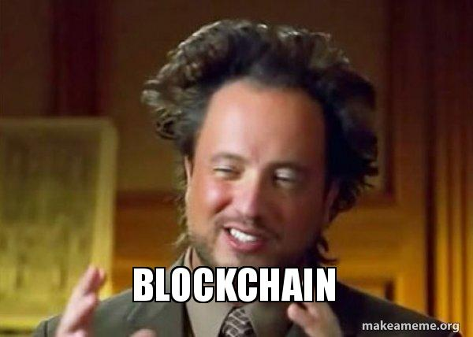

Slide 2
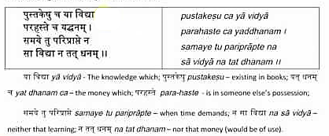

Slide 3
What is money ?

Slide 4
A generally accepted medium of exchange
Storage of value

Slide 5
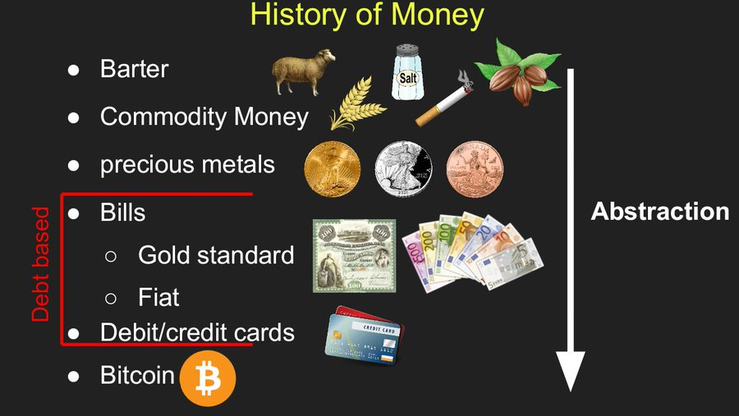

Slide 6
Role of Financial instruments in Human Civilization

Slide 7
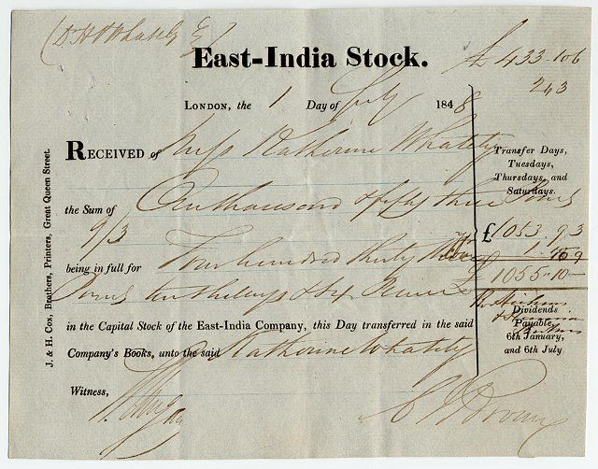

Slide 8
Double spending problem

Slide 9
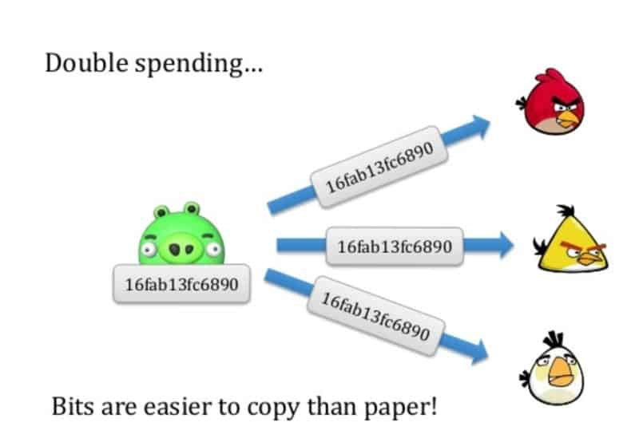

Slide 10
Distributed computing and Byzantine general problem

Slide 11
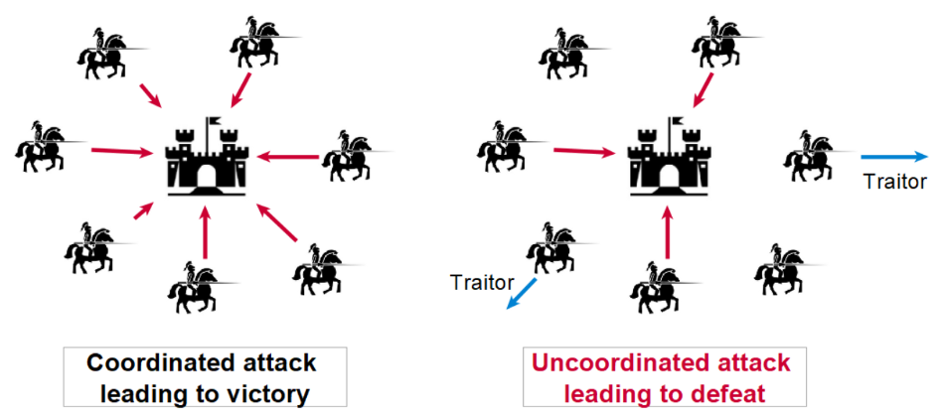

Slide 12
There is no central authority to rely on to confirm
the validity of the transactions between parties

Slide 13
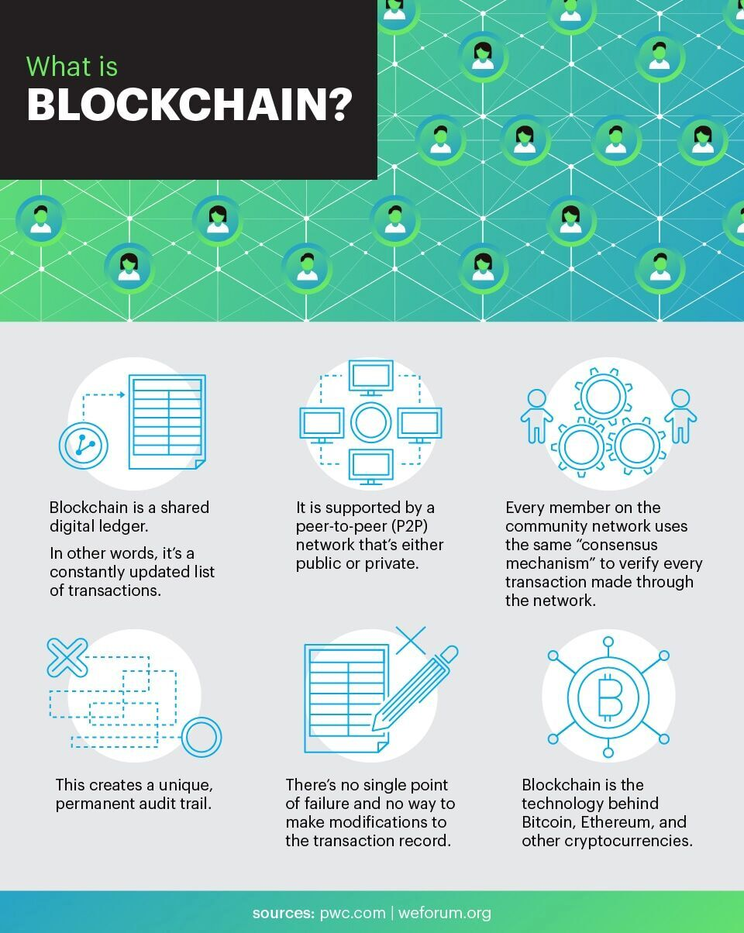

Slide 14
A blockchain can be generalized to store arbitrary data. In its simplest form, a block Bi consists of the following data:
Hash of previous block hi: A cryptographic hash of the previous block, i.e., hi:=H(Bi−1), as described above.
Payload pi: Arbitrary data that is stored in this block. In many practical applications, this data has to follow a predefined pattern (e.g., transactions in Bitcoin or operations in Ethereum).
Signature si: A digital signature of the block data, i.e., si=σsk(hi|pi), signed with the secret key sk of the creator of the block. This signature can be verified by the public key pk.

Slide 15


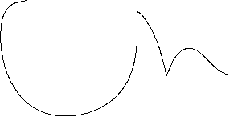
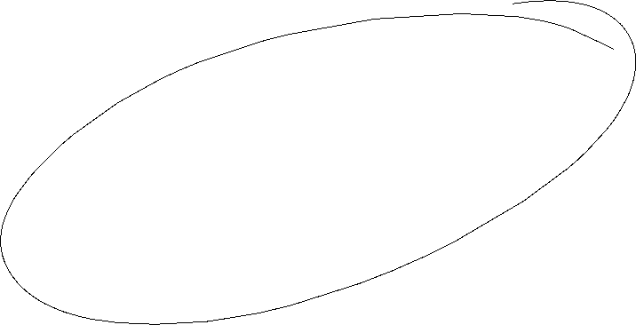


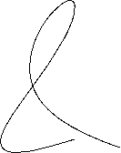
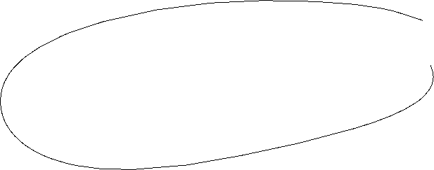

https://andersbrownworth.com/blockchain/hash

Slide 16
Blockchain Simplified

Slide 17
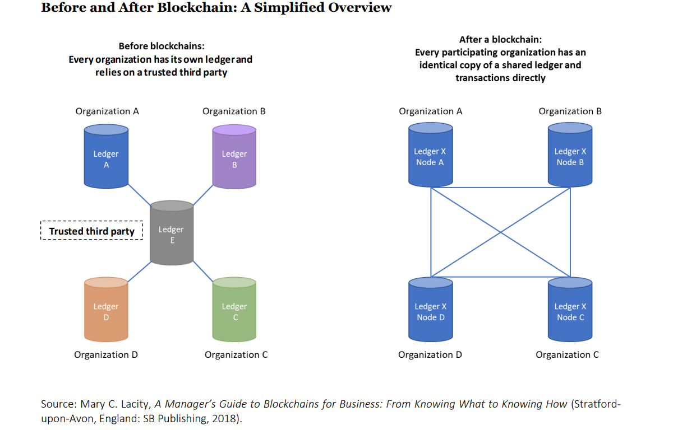

Slide 18
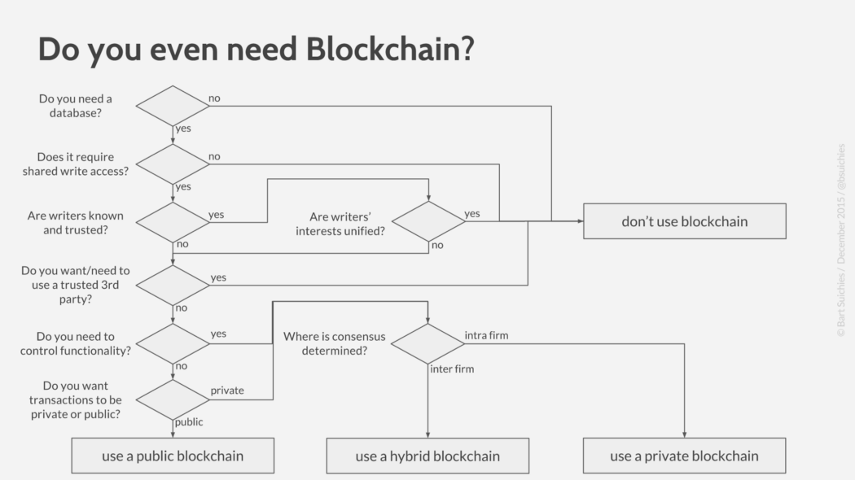

Slide 19
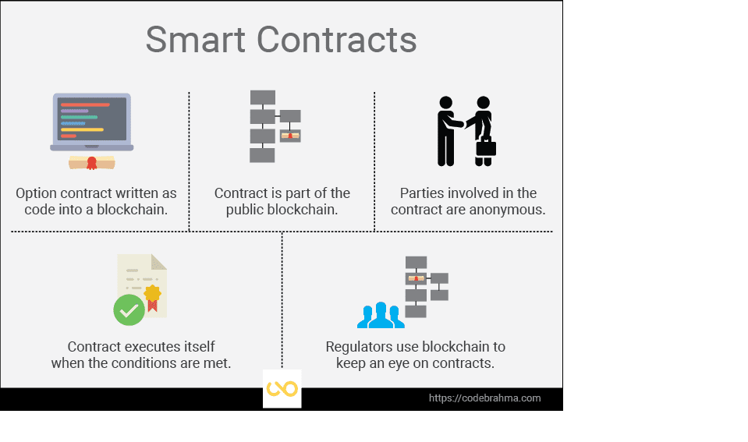

Slide 20
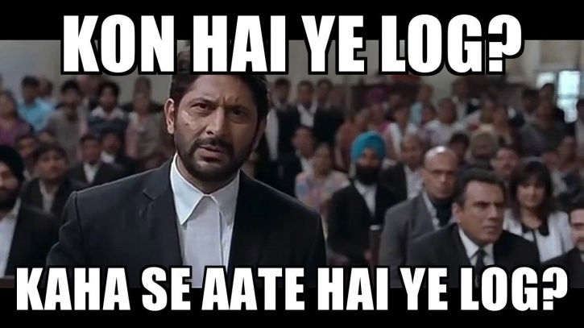
https://opensea.io/

Slide 21
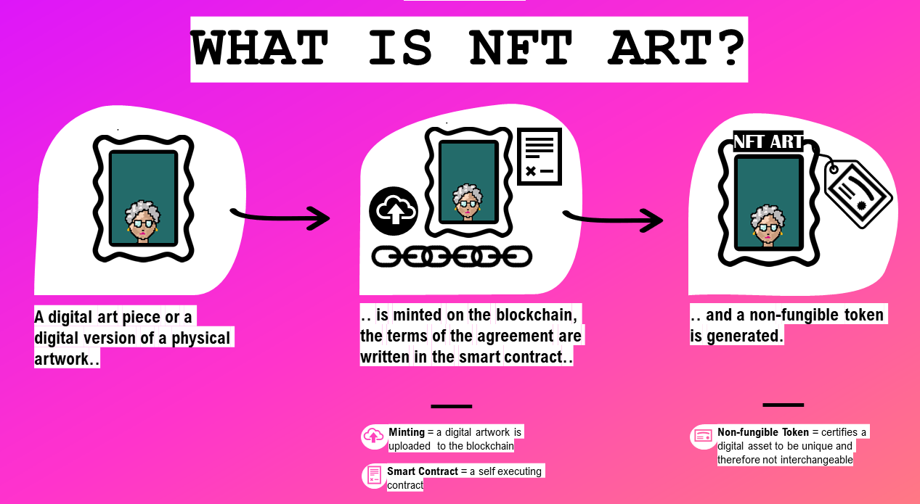
https://artynft.io/nft-granny/what-is-nft-art/

Slide 22
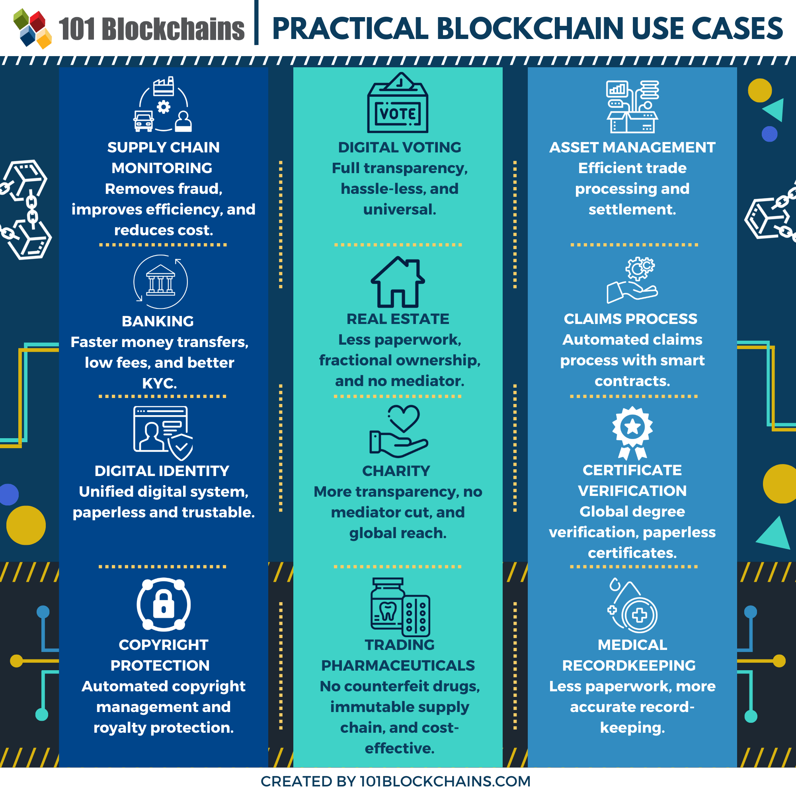

Slide 23
Legal status in India !
https://blockchain.gov.in/

