Slide 1
Balance Score Card

Slide 2
Descriptive analytics (What / why happened)
Predictive analytics (What / Why will happen)
Prescriptive analytics (What / Why should I do)

Slide 3
What is the important indicator of organization’s success?
Profit
Learning and development
Customer satisfaction
Operational efficiency

Slide 4
No single measure can provide a clear performance target or focus attention on the critical areas of the business.
Senior executives understand that their organization’s measurement system strongly affects the behavior of managers and employees.
Financial measures may give you misleading signals for continuous improvements and innovation.

Slide 5
Balance Score Card
Balance score card is strategic planning and management system that is widely employed in business, government, and non-profit organizations to align organizational values to their vision and monitor divisional organizational performance to their strategic goals.
The balance score card can serve as the focal point for the organization’s efforts, defining and communicating the priorities for managers, employees, investors and even customers.
The balance score card is not a template that can be applied to businesses in general or even industrywide. Different market situations, product strategies, and competitive environments require different scorecard.
In fact, a critical test of a scorecard’s success is its transparency

Slide 6
Balanced Scorecard
Translating the vision
Feedback and learning
Business Planning
Communicating and Linking

Slide 7
Philosophy of BSC
Four Processes
Translating the vision (clarifying the vision, gaining consensus)
Communicating and linking (communicating and educating, setting goals, linking rewards to performance measures
Business planning (setting targets, aligning strategic initiatives, allocating resources)
Feedback and learning (articulating the shared vision, supplying strategic feedback, facilitating strategy review and learning)

Slide 8
Four Perspectives
Financial perspective, How do we look to shareholders
Customer perspective, How do customers see us
Internal process perspective, What we must excel at?
Learning and growth perspective Can we continue to improve and create value
Goal Measures KRA, KPI

Slide 9
KRA & KPI
KRA | Description | KPI / Measures
Category: Customer
Employee Engagement | Implement Engagement Calendar (Festival/ Health) | 100% Adherence to calendar
Category: Finance
Recruitment | Recruitment: Adherence to TAT | 60 days from date of PR approval to Offer acceptance
Category: People
Learning & Development | Have Development Discussions with critical employees (HIPO) and building development plans for them | Once every quarter for 6 employees
Self Development | Self Development - Learn New Skill/ take up new training/ Initiative | One Self Development Training/ Learning / Initiative half yearly
Category: Process
HR Process | Drive HR processes - PMS, Recognize, Joining Process Induction, Salary Payroll, Monthly MIS & Reviews etc | 100% Adherence to timelines

Slide 10
Performance Indicators
Lead Indicator
Indicator of performance that might predict future performance
Ex:
Employee engagement
Employee Motivation
Safety measures adherence
Lag Indicator
Indicator of past performance that measures how we performed
Ex:
Customer Satisfaction
Weight
No of deaths

Slide 11
Measuring the strategic readiness of intangible assets
Human capital: the skills, talent, and knowledge that a company’s employees possess
Information capital: the company’s databases, information systems, networks and technology infrastructure
Organization capital: the company’s culture, its leadership, how aligned its people are with its strategic goals and employees’ ability to share knowledge

Slide 12
How balance score card should be prepared
Steps of Balance scorecard
Each organization is unique and so follows its own path for building a balance scorecard
Preparation
Interviews: First Round
Executive workshop: First Round
Interviews: Second Round
Executive Workshop: Second Round
Executive Workshop: Third Round
Implementation
Periodic Reviews
Departmental workshop to study the internal and external challenges
Strategic planning process to study validated strength and weakness

Slide 13
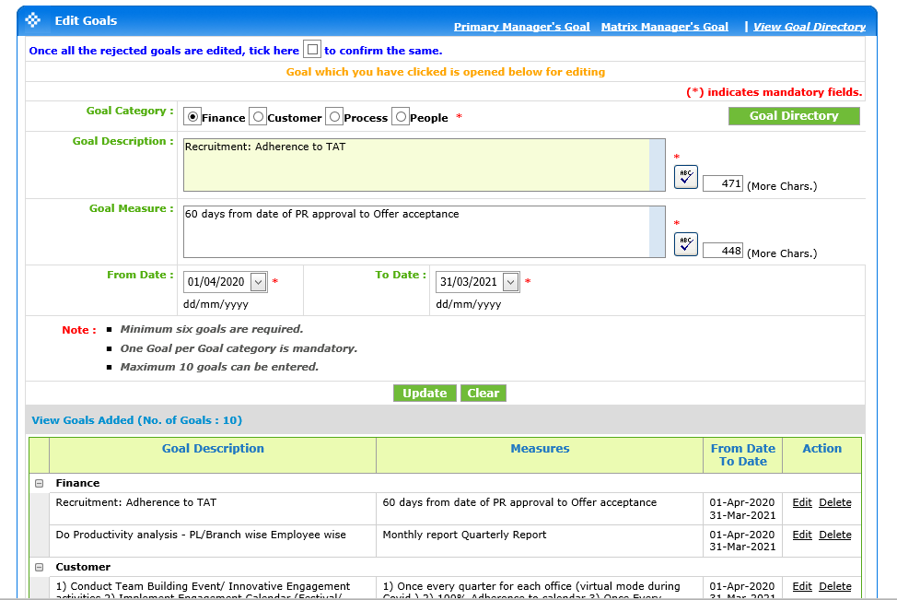

Slide 14
Case: Balance score
Tata Power Delhi Distribution Ltd: measuring beyond the metrics

Slide 15
Why there was a need of balance score card approach at Tata Power Delhi Distribution (TPDD)

Slide 16
Challenges
Join venture between Delhi government and Tata power
Employees and management were not happy with this privatization
TPDD had internal and external challenges
Internal – Demotivated employees, AT & C losses were at all time high of 53.1 percent, 48 percent streetlights were functional, 10000 no-supply complains per day, 20,000 new connection, 100000 billing complaints were pending
Incoherent results as the metrics were not aligned with the strategic objectives

Slide 17
Change
Reengineered entire revenue cycle
Upgraded IT and automation infrastructure
Established a performance management system to make the employees accountable
Engaged employees through various programs such as mentoring, motivation, training
Established a reward and recognition structure
Training for upgrading the employee’s capabilities

Slide 18
How you can measure the impact of these changes

Slide 19
What are the benefits of balance score card?

Slide 20
Reduce AT & C losses
Mitigating the regulatory uncertainty
Meet the performance standards
Improve employee competency

Slide 21
Should organization include social and environmental perspective
Or
Is there any way to include these perspectives in existing balance score card?

Slide 22
Does your organization use Balance score card?
If yes then what kind of information you will have about the organization
What are the HR problems in this case.
What type of HR information can solve your problem
Descriptive analytics
What happened, Why it happened and what is happening

Slide 23
Predictive analytics
What will happen and why it will happen
Prescriptive analytics
What should I do and Why should I Do it.
Balance score card can generate ratio, metrics

Slide 24
Employer branding
Hiring process
Workforce planning
Attraction
Acquisition
Learning and Development
Retainment
Training
PMS
Compensation
Ethical issues and organizational justice

Slide 25
Technology enablers Descriptive applications Employee related value
Organization enablers Predictive and prescriptive application - Organization related value

Slide 26
What Balance scorecard can do
Translating the vision
Communicating and linking
Business Planning
Feedback and learning
Inability to link a company’s long term strategy with its short term actions.

Slide 27
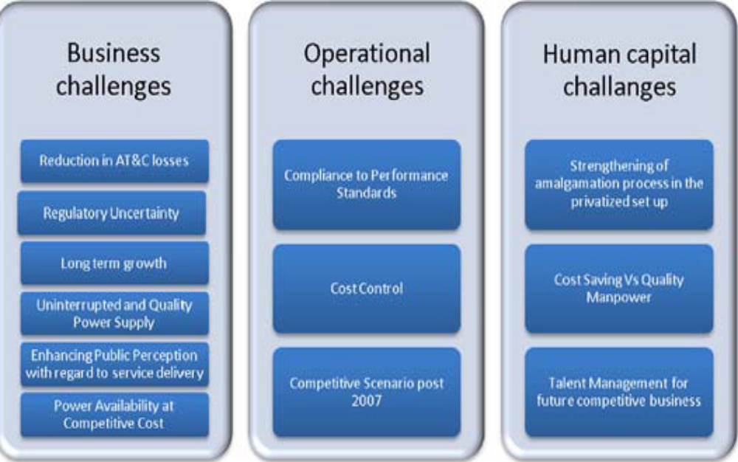

Slide 28
Thank you

