Slide 1
Integrated Marketing Communication

Slide 2
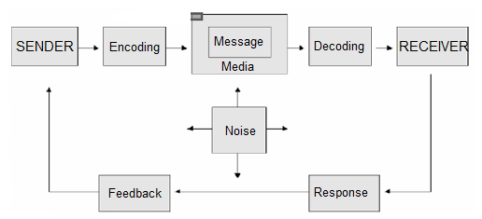
Communication Model

Slide 3
Integrated marketing communication
Integrated marketing communication (IMC) refers to integrating all the methods of brand promotion to promote a particular product or service among target customers.
The American Marketing Association defines IMC as “a planning process designed to assure that all brand contacts received by a customer or prospect for a product, service, or organization are relevant to that person and consistent over time.”

Slide 4
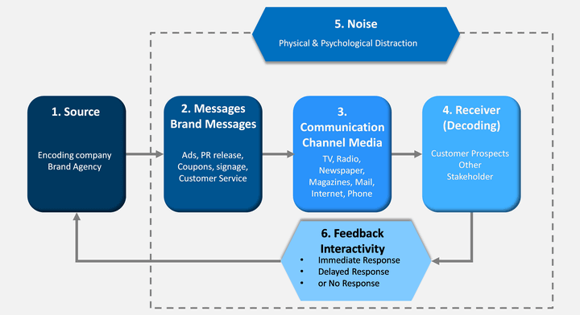
Brand Communication Model

Slide 5
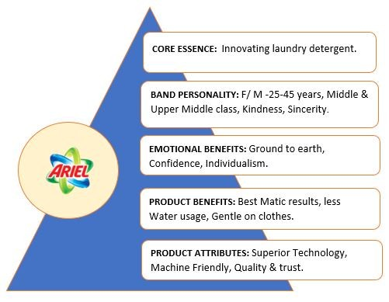

Slide 6

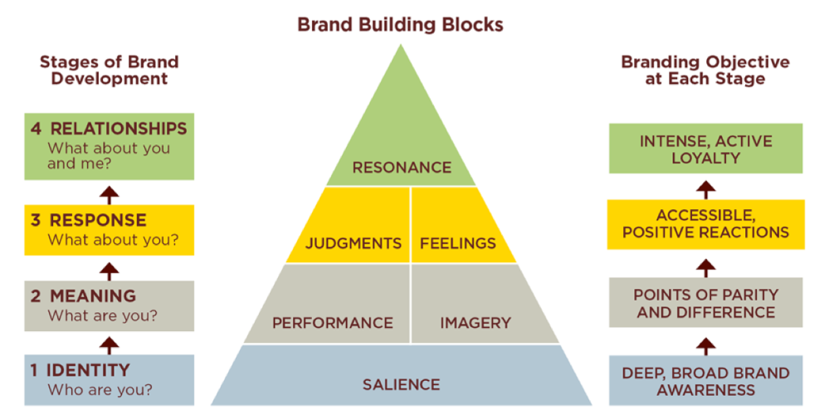

Slide 7
IMC Framework

Slide 8
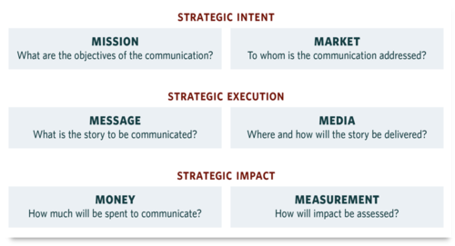
6M Framework of IMC

