Slide 1
Agile Methodology
Presented by: Rajdip Sengupta 13/04/2024

Slide 2
Agenda
01. The Agile Methodology
02. Agile vs Waterfall
03. Agile Frameworks
04. Product Managers vs Product Owners in Agile
05. Agile Tools : Product Plan, Confluence and JIRA
06. Q&A

Slide 3
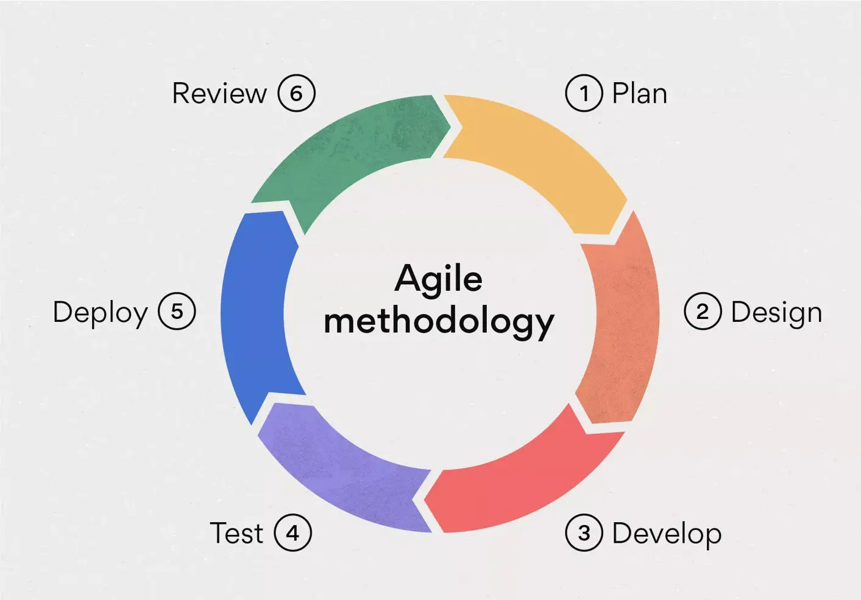
What is Agile Methodology?
Agile, as the word suggests, is a mindset emphasizing on Continuous delivery by breaking a feature into smaller usable features and delivering them within a short pre-defined timeframe following a standardized cycle of Define, Plan, Design, Develop, Review and Deliver. The Agile Manifesto was launched in 2001 and has garnered much traction post that.
(https://agilemanifesto.org/principles.html)
The three primary focus of Agile are:
Delivery as soon as possible
Transparency with Business
Continuous cross-team collaborations

Slide 4
Waterfall: The older Model
Requirements
Design
Development
Testing
Deployment
Maintenance
The Waterfall Model is a classical software development methodology that was first introduced by Winston W. Royce in 1970. It is a linear and sequential approach to software development that consists of several phases that must be completed in a specific order.
The next phase can be started only after the previous phase has been completed. Once a phase has been completed, no changes can be done to that phase. In case changes are needed, the progress has to be cancelled and the process needs to be restarted.

Slide 5
Agile vs Waterfall
An organization wants to launch an E-commerce wing in the market. The organization wants to sell books, art and gifts through its portal. They also want to allow customers to pay through both online payments as well as Cash on Delivery.
Which model should they choose?

Slide 6
Advantages and Disadvantages of Agile
Advantages
Short-term deliverables encourage productivity and efficiency
Flexible and adaptive to change
Continuous collaboration with clients and stakeholders
Transparency in timelines
Improved time to Market
Disadvantages
Cost of learning the agile methodology
Risk of incorrect prioritization
Requirements are loosely defined and may lead to rework
Potential of Scope creep
Communication between users and developers may impact project delivery negatively
Notes:
Point 3 of Agile: Faster Feedbacks

Slide 7
Advantages and Disadvantages of Waterfall
Advantages
Clearly defined requirements
Defined Timelines and Cost
Design documentation is comprehensive, no chance of scope creep
Methodical development stages leading to less deviation from initial requirement
Disadvantages
Sequential stages of work leading to more time
In case of change in requirement, effort invested goes to waste
Time to market timelines are long
Less Transparency on progress for Stakeholders
Final product may not align with Customer requirements leading to disatisfaction
Notes:
Point 3 of Agile: Faster Feedbacks

Slide 8


Agile vs Waterfall
An organization wants to launch an E-commerce wing in the market. The organization wants to sell books, art and gifts through its portal. They also want to allow customers to pay through both online payments as well as Cash on Delivery.
Which model should they choose?
Based on the assessment in the previous slides,
Criteria | Agile | Waterfall
Flexibility
Cost
Timeline
Transparency
Customer Satisfaction

Slide 9

Agile Frameworks: How to Practice Agile?

Slide 10
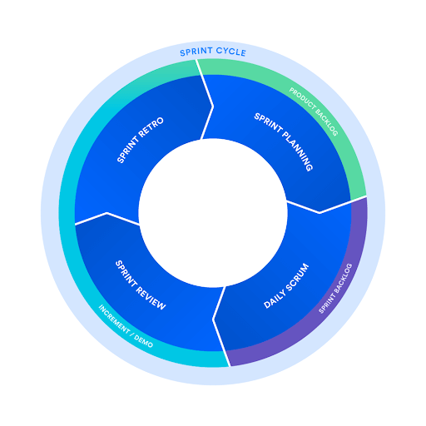
Scrum Framework
Scrum is the most used Framework for practising Agile. The word Scrum denotes a Rugby team, the ordered formation of the team with each individual player taking responsibility for the collective goal of winning.
Scrum encourages teams to learn through experiences, self-organize while working on a problem, and reflect on their wins and losses to continuously improve.
The key Players in a Scrum team are:
Product Owners – The one who manages sprint backlog, defines the priority of a sprint
Scrum Master – The bridge between the Product owner and the developers, preaching Scrum best practises and scheduling collaborations as per need.
The Scrum development team
Agile Methodology 13/04/2024

Slide 11
Scrum Ceremonies
Sprint : Time-boxed period, which iterates cyclically, where the scrum team aims to complete a defined set of work
Backlog management : At the start of a sprint, the product owner is expected to groom a particular set of features or defined set of work that the development team is expected to take in a sprint
Sprint Planning : The work to be performed (scope) during the current sprint is planned during this meeting by the entire development team. This meeting is led by the scrum master and is where the team decides on the sprint goal.
Daily Scrum or Stand up : A quick status update from each team member on the work that has already been done, the work that is to be done on that day and if there are any blockers to address
Sprint Review : Done at the end of a sprint for the developers to review the tasks completed, showcase demos, highlight spillovers
Sprint Retrospective : A look back on the previous sprint to identify what went well and what needs to improve

Slide 12
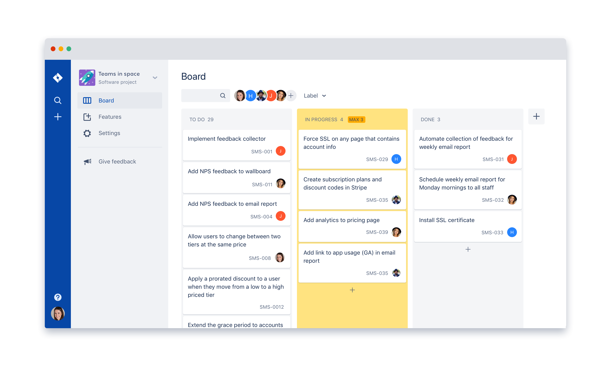
Kanban Boards
The word “Kanban” is Japanese for Visual Signal.
A Kanban board is an agile project management tool designed to help visualize work, limit work-in-progress, and maximize efficiency (or flow).
A Kanban board can be Physical or Digital in nature.
It has 5 key elements:
Visual Signals – depicting user stories or tasks
Columns – Depicting Stages in a workflow
Work in Progress Limits – Number of visual signals that are WIP
Commitment Point – Backlogs that can be taken up when the team is ready
Delivery Point – Items that are delivered or ready to be delivered to the users
Agile Methodology 13/04/2024

Slide 13
Some other Agile Frameworks
Lean Framework – Lean methodology is a systematic approach to continuous process improvement through the elimination of waste.
DSDM – Dynamic Systems development Method is a framework that focuses on in-budget, on-time delivery without compromising on quality
Extreme Programming – This framework promotes continuous development and continuous review, requiring close collaboration between developer and User to have minimum feedback once the final product is delivered
Feature driven development – This framework promotes creation of a feature set, plan by feature, build by feature and deliver by feature
Agile Methodology 13/04/2024

Slide 14
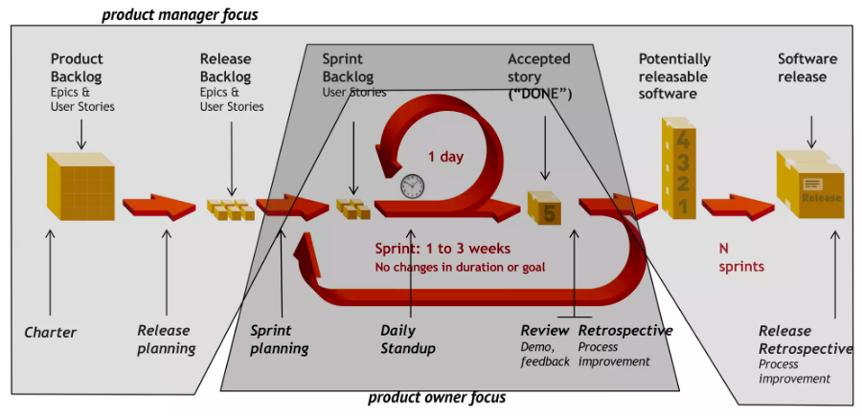
Product Managers vs Product Owners in Agile

Slide 15
Agile Tools

Slide 16
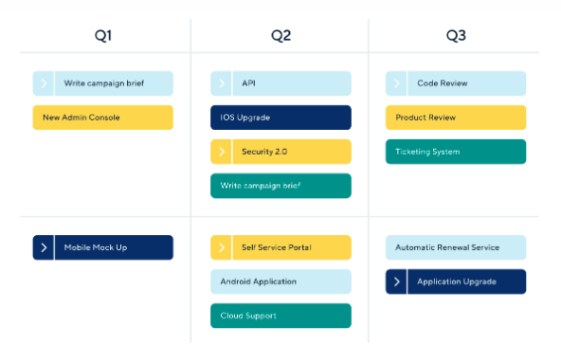
Product Plan
Product plan is a tool that makes it easy to build strategic roadmaps across Agile timelines and review progress for each Epic/ User story through a visual representation in the form of a Gantt chart.

Slide 17
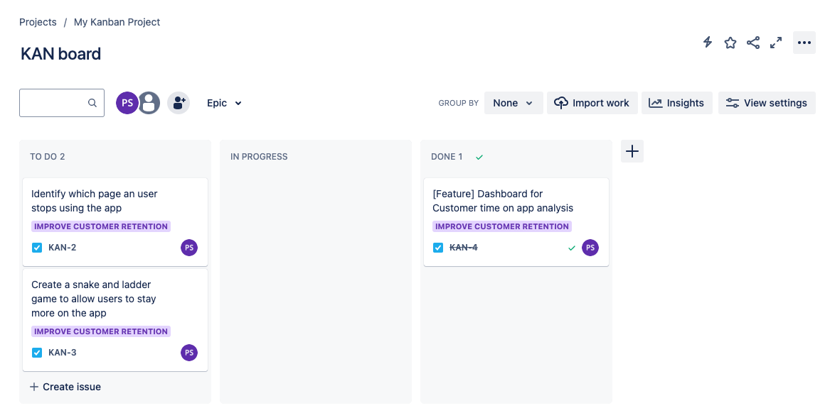
Jira
Released in 2002, Jira is a tool used extensively to create and track user stories, manage status of progress and create a Kanban board for project to track status of each task in the project as part of the Agile methodology

Slide 18
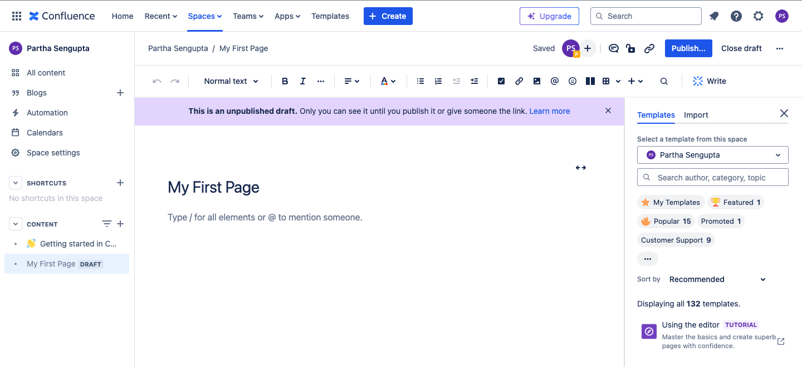
Confluence
Released in 2004, created by the same developer who created Jira, Confluence is a web-based corporate wiki. Confluence is extensively used hand in hand with Jira as a comprehensive source of information for all projects that align towards the same strategic goal.
Confluence is used a source of truth where multiple teams can collaborate and view a consolidated set of relevant information

Slide 19
Q&A

Slide 20
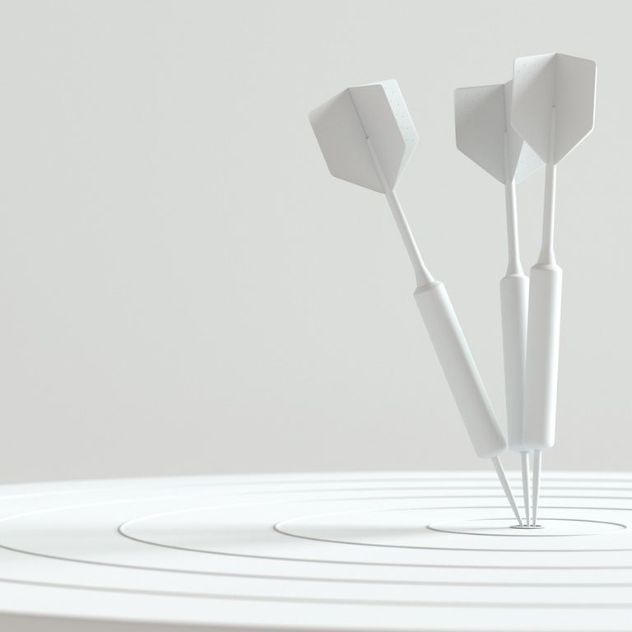
Thank you
Thanks to your commitment and participation throughout the session
For any queries feel free to write to me at:
Email ID:
Rajdip.sengupta17@iimranchi.ac.in
Agile Methodology 13/04/2024

