Slide 1







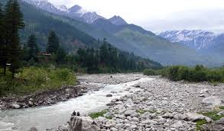

About me | Niti Beri
Experience
Must Have
EDITABLE SLIDE
Notes:
Facilitator Introduction:
MUST HAVE
Duration: 3 minutes
Note: This slide contains animations. Please review the animations prior to your session to sync it with your dialogue effectively.
Purpose: To introduce yourself as a facilitator, establish your professional credibility and share some personal interest as it may help the audiences connect with you.
Note#1: EDITABLE: This is a slide for your introduction. The graphics are suggestive only, edit as per your need.
Pre-prep this section.
Animate the slide as per the narration. Sync the dialogue to tell a picture story.
You can select a few visuals to represent the 3 aspects:
PASSION – Your interests and what energizes you (favorite sports / any volunteering activity/ interesting hobbies)
EDUCATION – Your accomplishments to establish your credentials with the audience
PROFESSION – Your past associations in various organizations. Reverse chronological order (latest organization first.)
The best part of this approach is to keep no text and still engage the audience (Hook- technique)
Note#2: If you have already done a session with this audience you can skip the introductions part. Instead, you can show this slide and ask a few questions to check if the audiences remember something about you…like a connect the images quiz.
Say: I am going to give a PEP talk (P E P – My passion, education and profession).
Do: Introduce yourself.
Do: Transition to the next slide.

Slide 2

Sponsored Search Marketing
By: Niti Beri

Slide 3
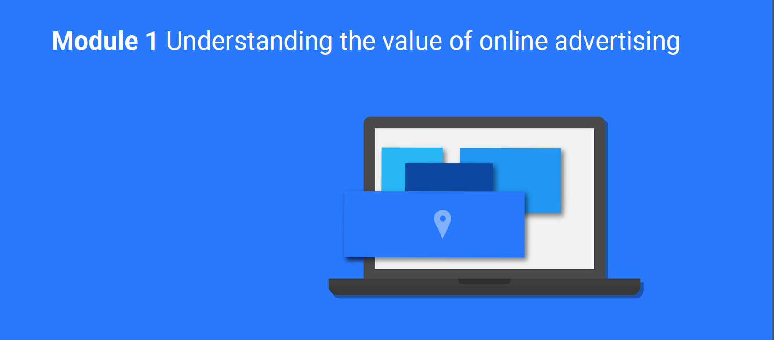

Slide 4


Slide 5
Relevance through specific targeting (Location, Time, Age, Interests, Language etc.)
Measurability of results (Real-time)
Variety of formats
(Video, Text, Banner, Calls)
Control (pay for results, make changes on the go)

Slide 6


Slide 7
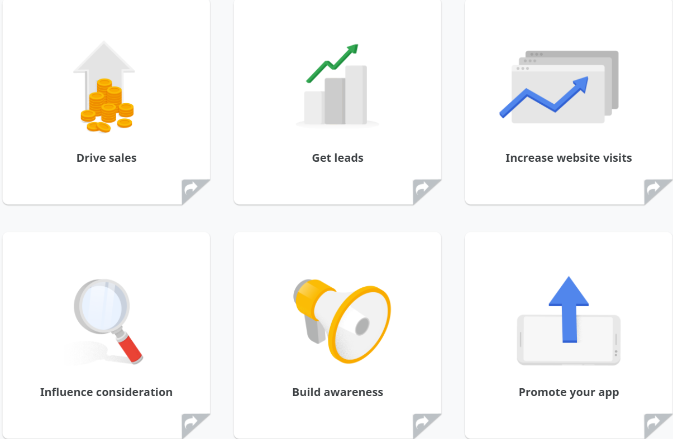

Slide 8
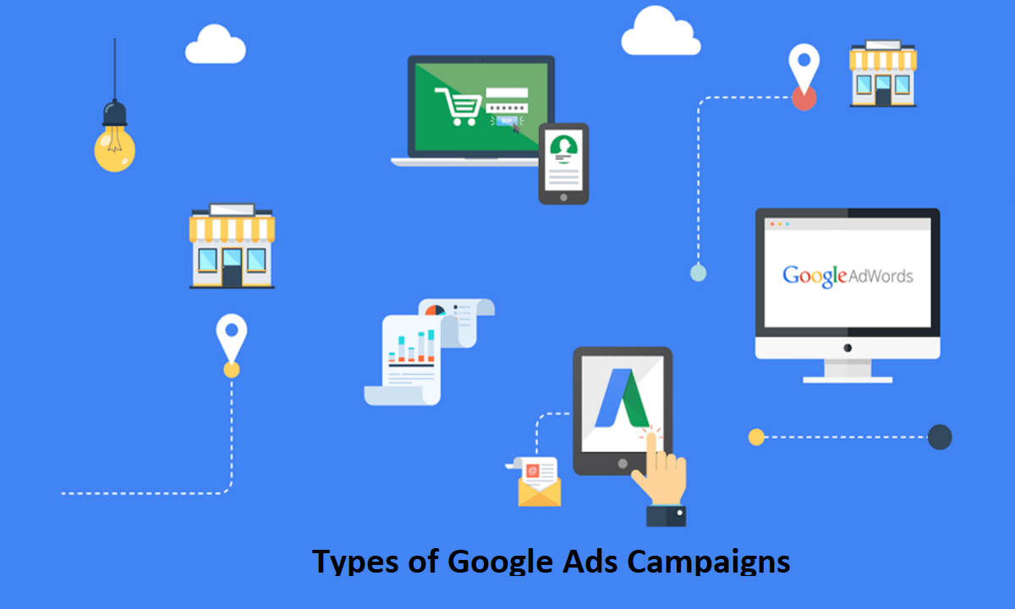

Slide 9
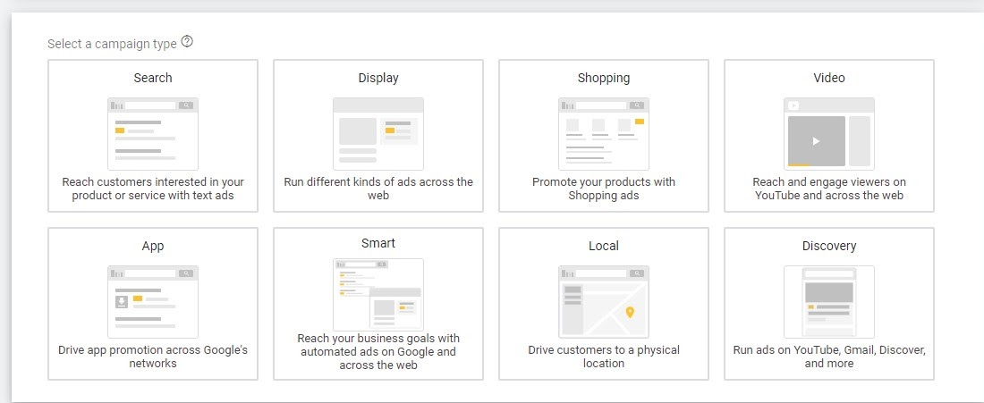

Slide 10


Slide 11
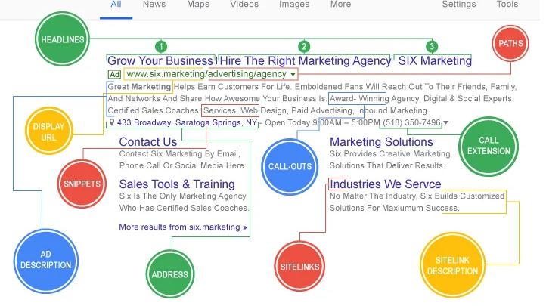

Slide 12


Slide 13
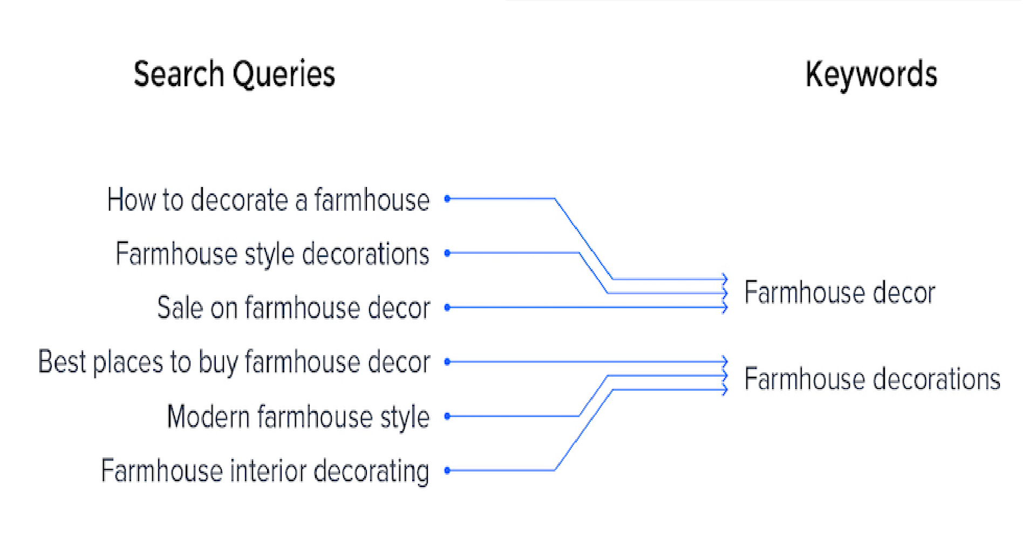

Slide 14
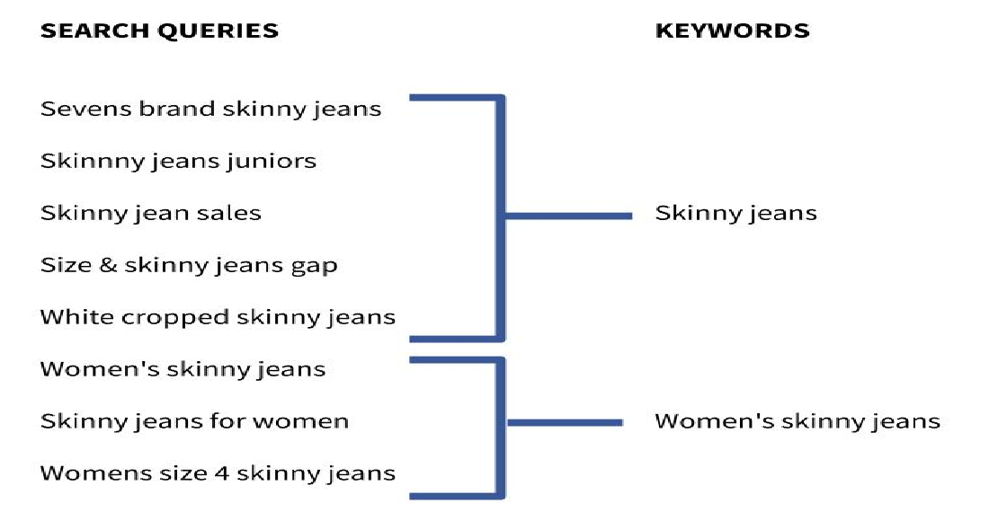

Slide 15
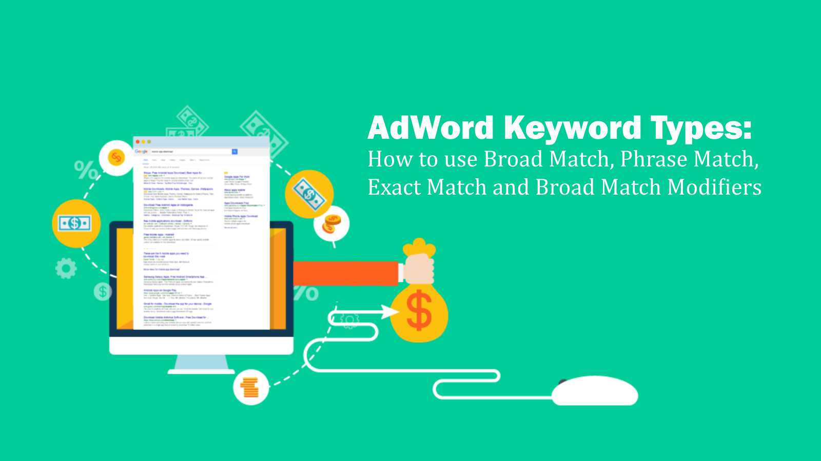

Slide 16
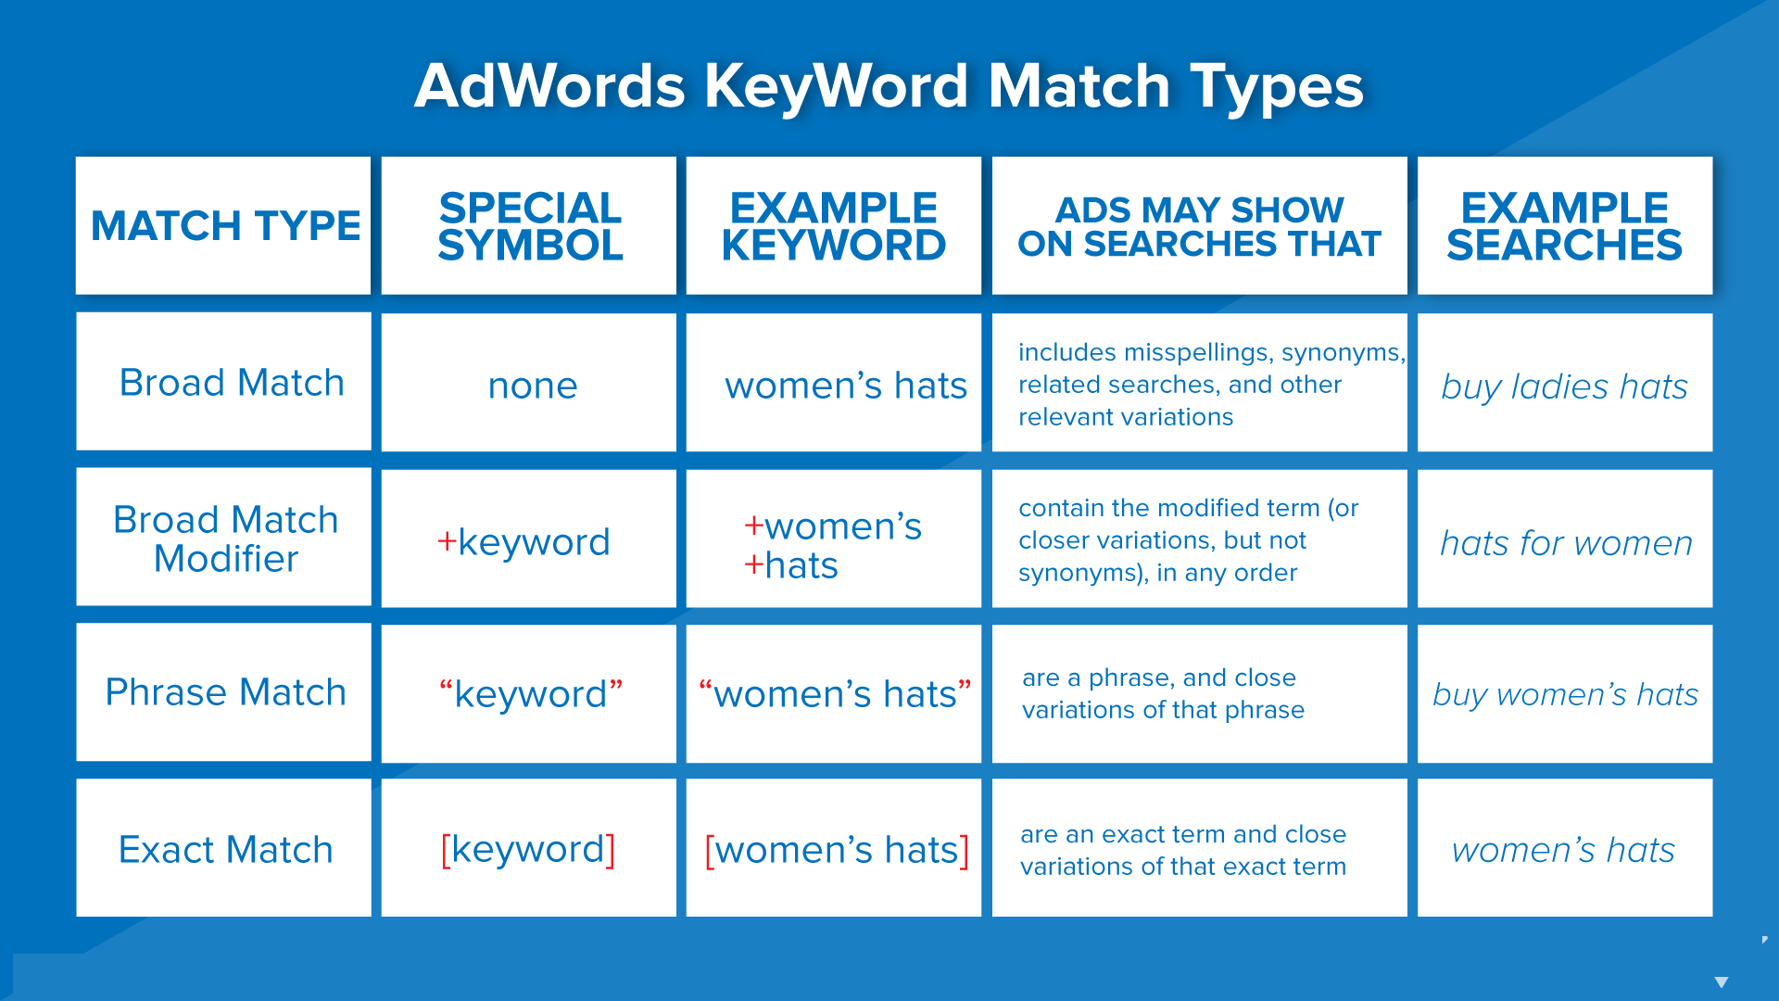

Slide 17


Slide 18
Exclusions are as important as Inclusions
The concept of negatives

Slide 19
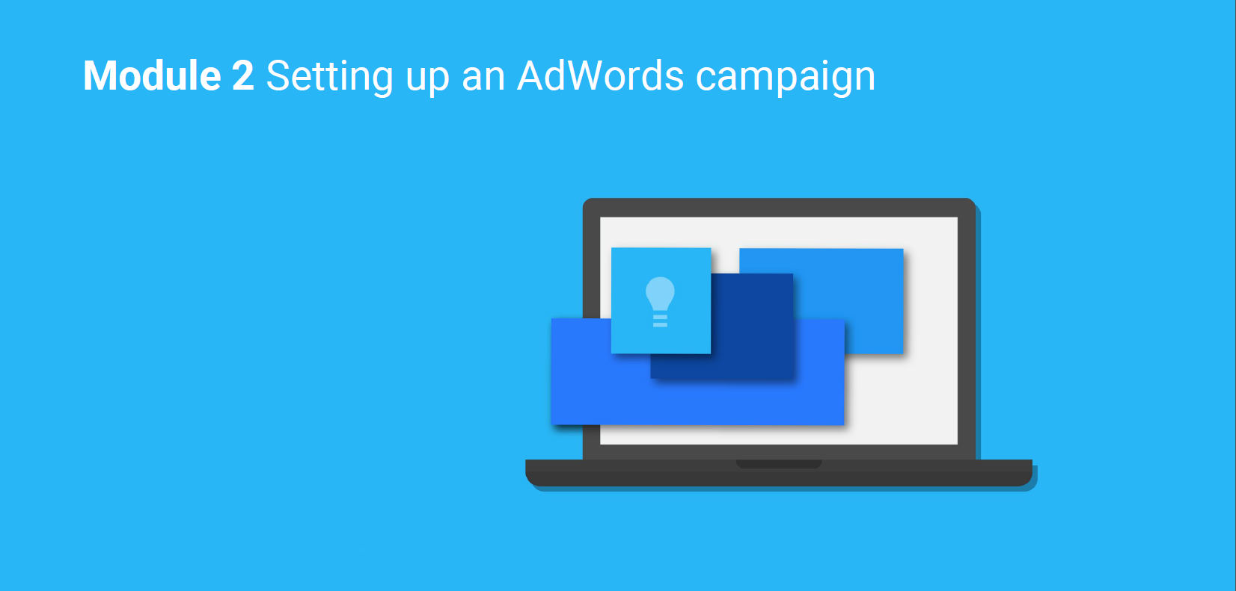

Slide 20
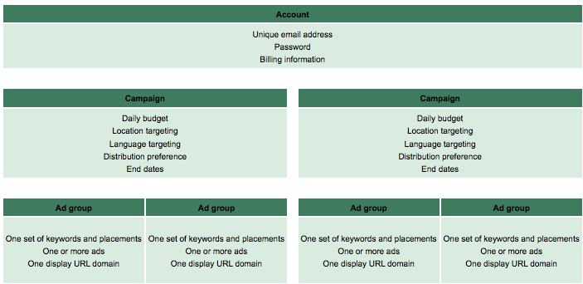

Slide 21
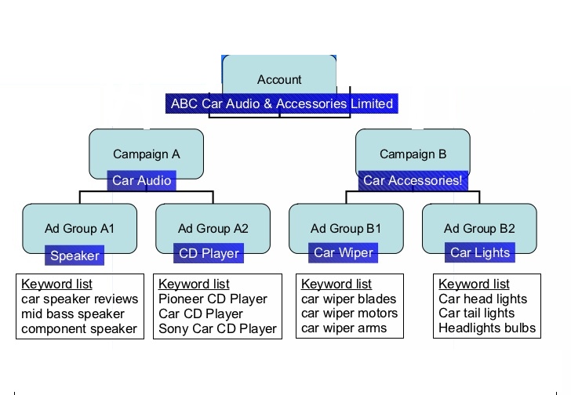

Slide 22
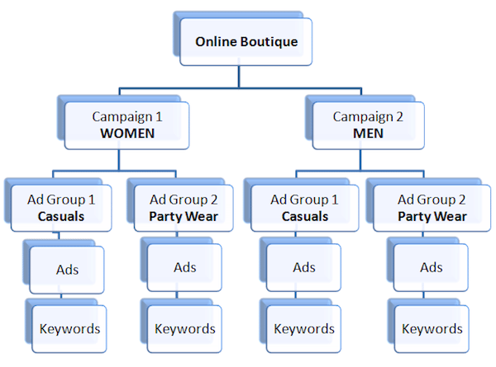

Slide 23
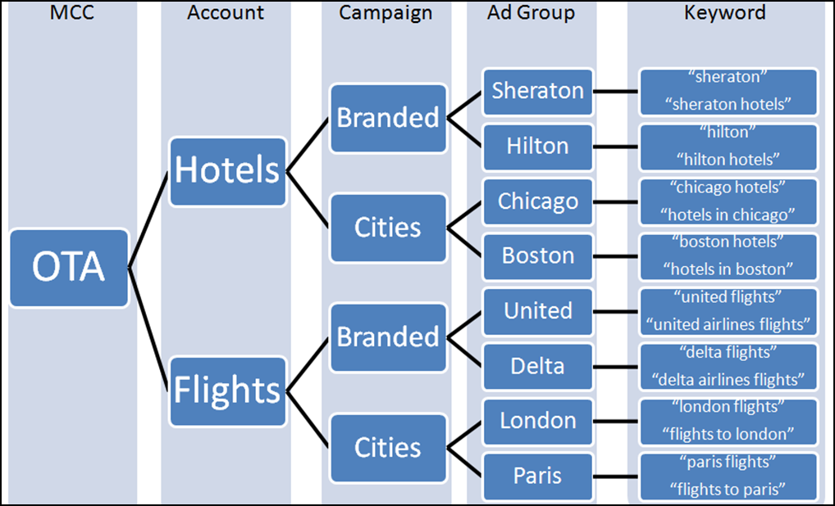

Slide 24
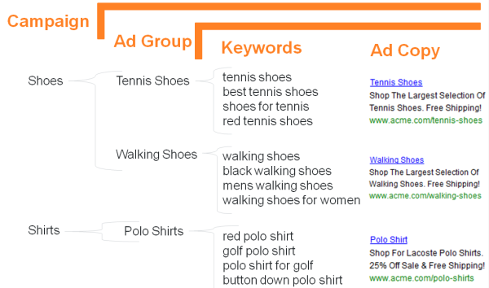

Slide 25
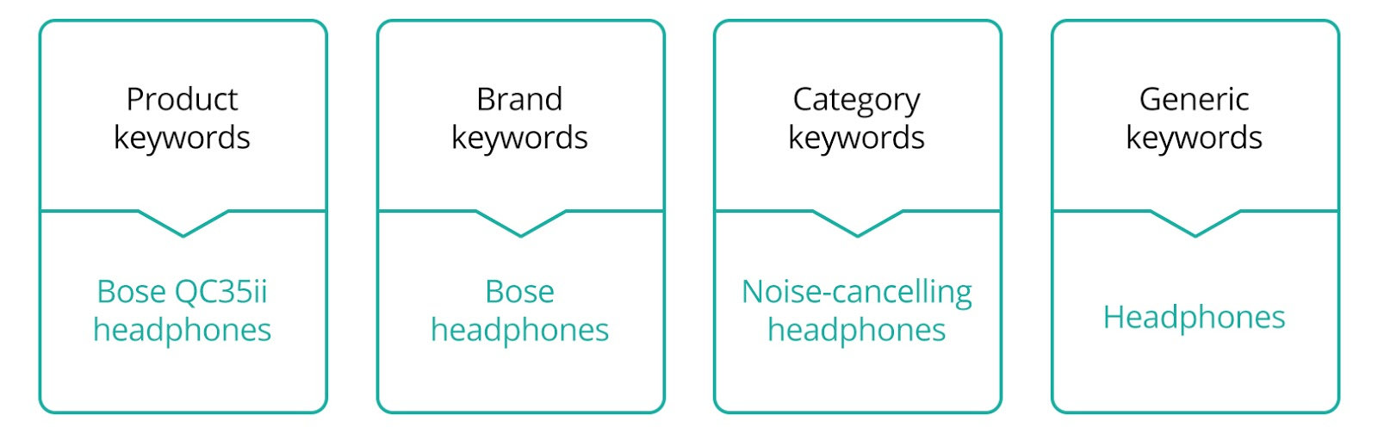

Slide 26
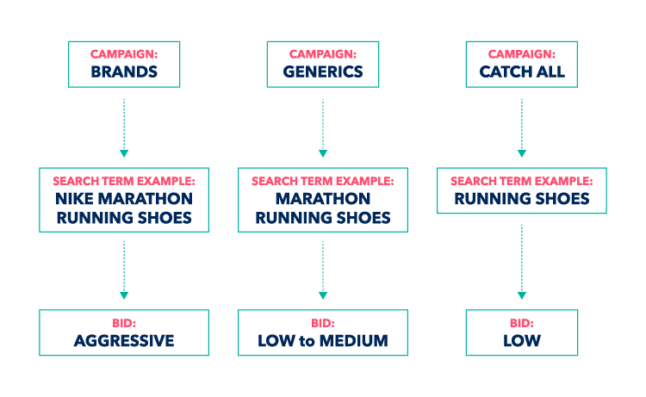

Slide 27
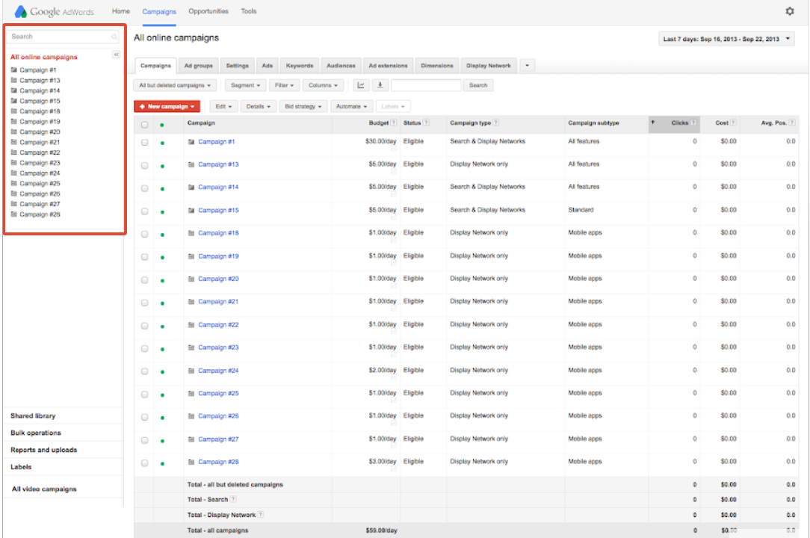

Slide 28
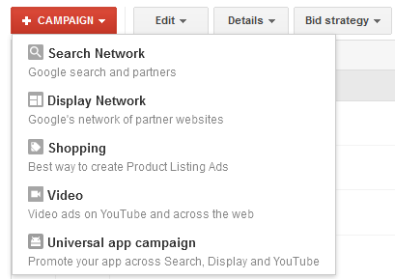

Slide 29
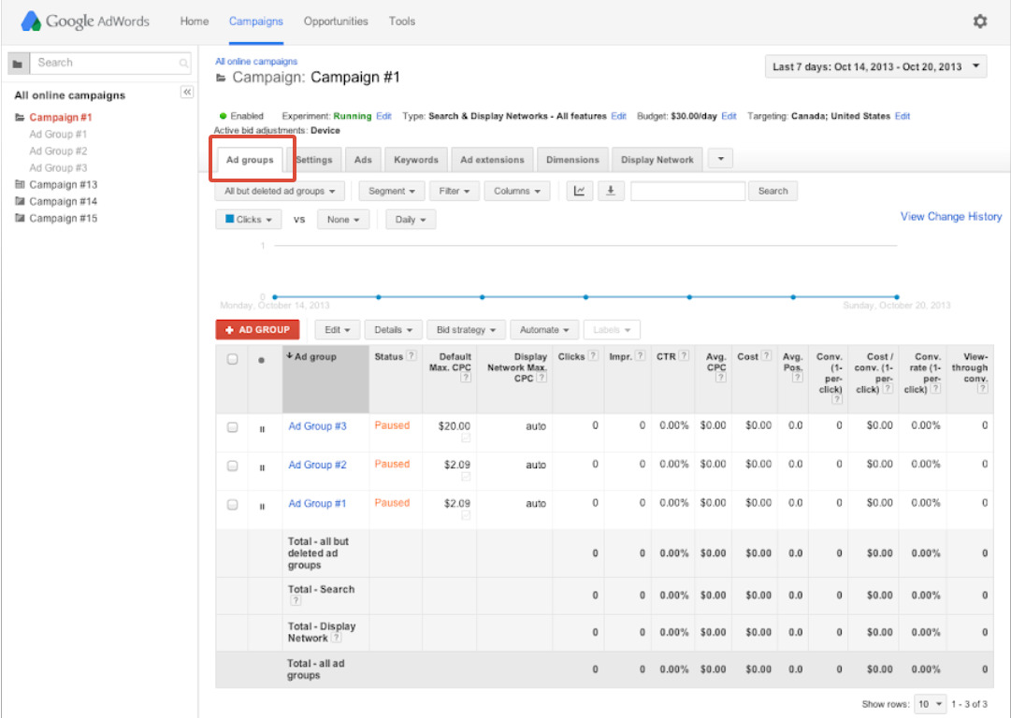

Slide 30
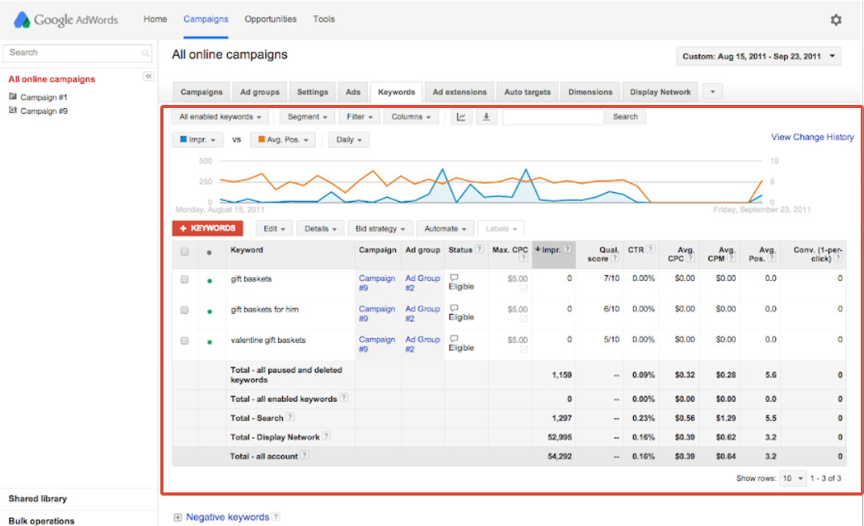

Slide 32


Slide 33
Clicks
Impressions
CTR
Conversions

Slide 34


Slide 35
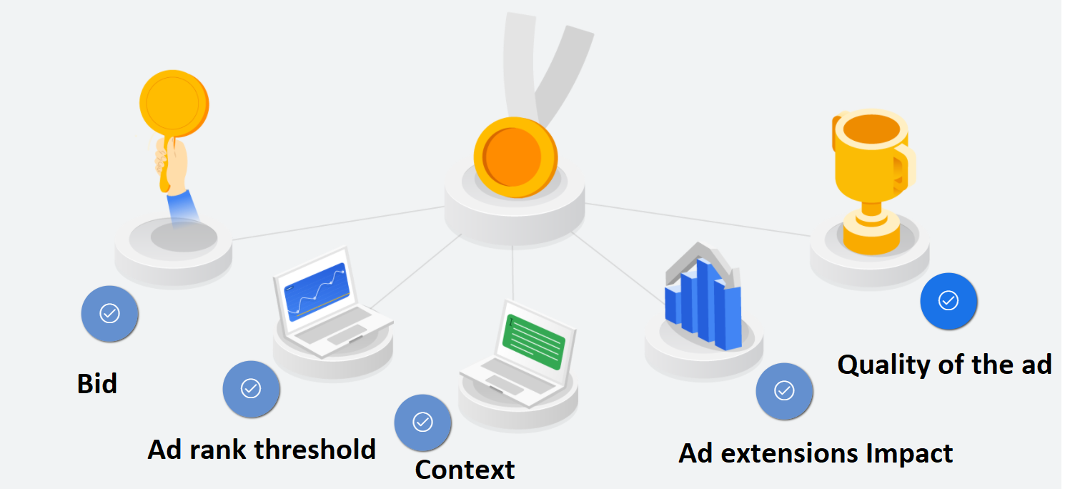
The concept of Ad rank

Slide 36
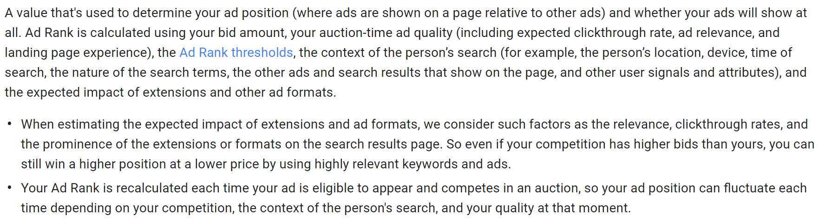

Slide 37


Slide 38
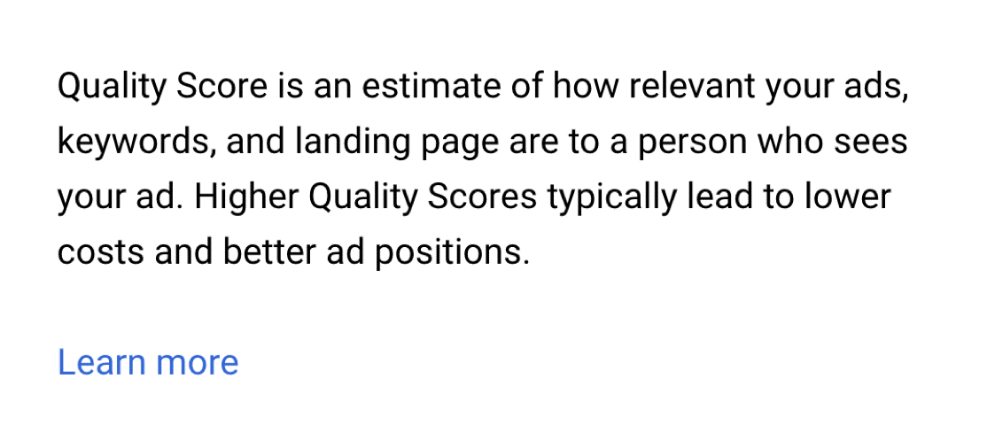

Slide 39
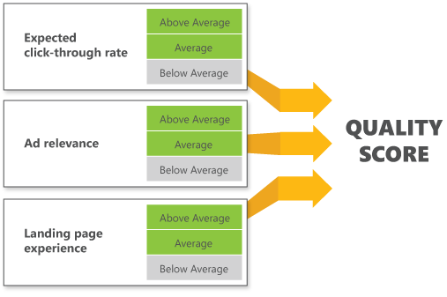

Slide 40
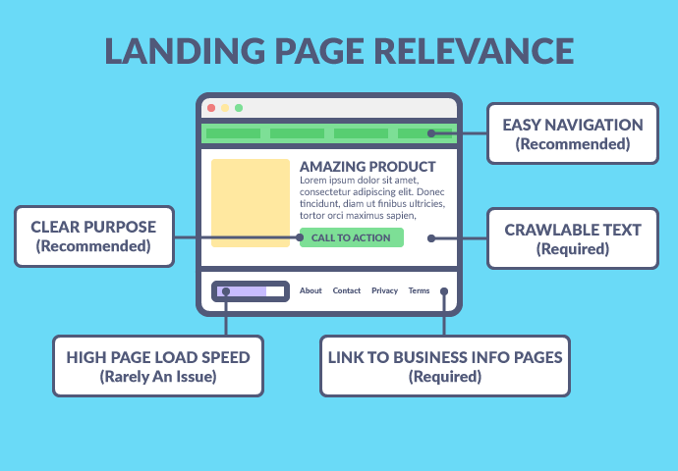

Slide 41
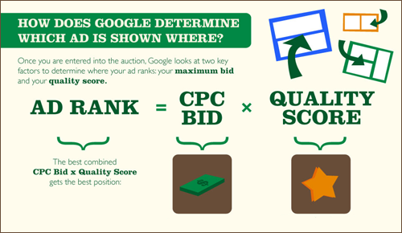

Slide 42
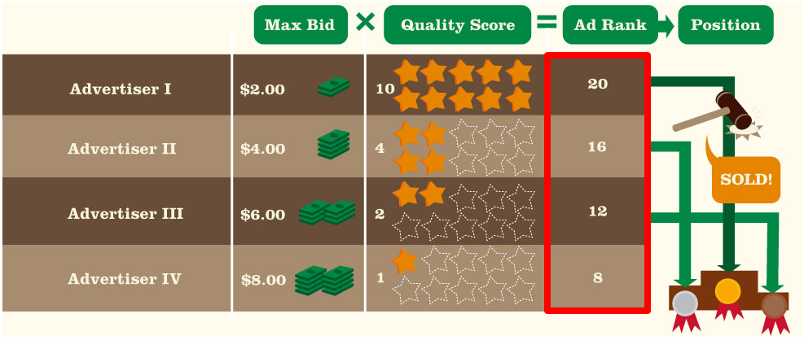

Slide 43
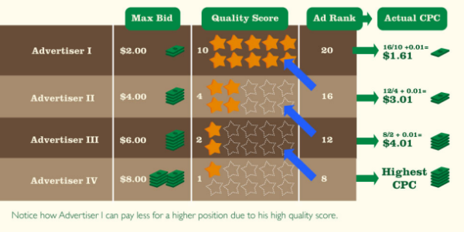

Slide 44
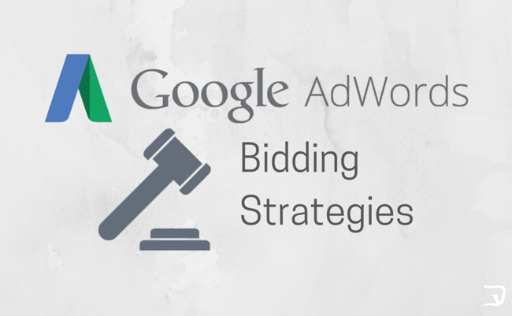

Slide 45
Cost Per Click (CPC)
Concept of Actual CPC and Max CPC
Cost Per Acquisition (CPA)

Slide 46
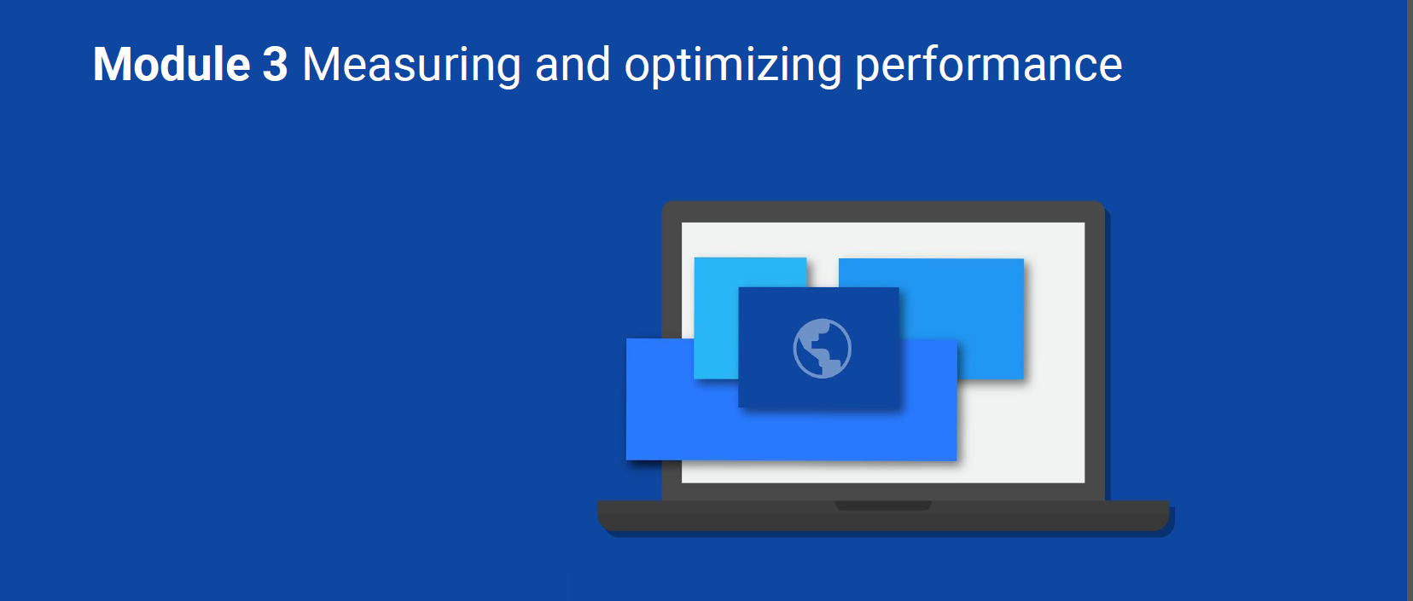

Slide 47


Slide 49
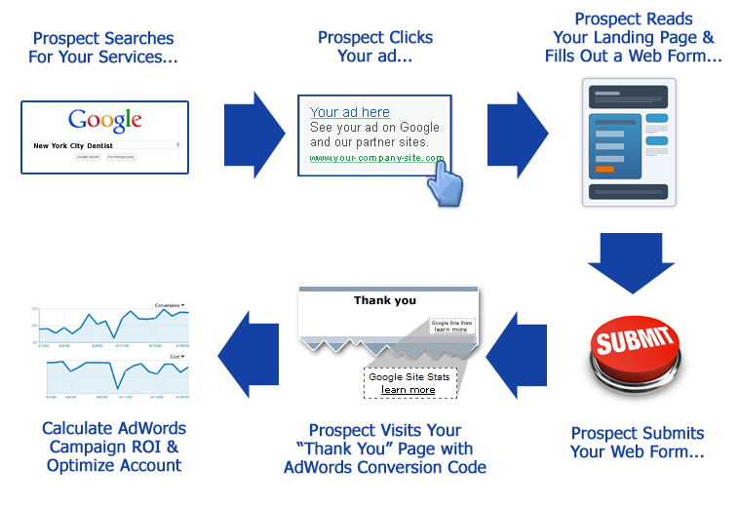

Slide 50
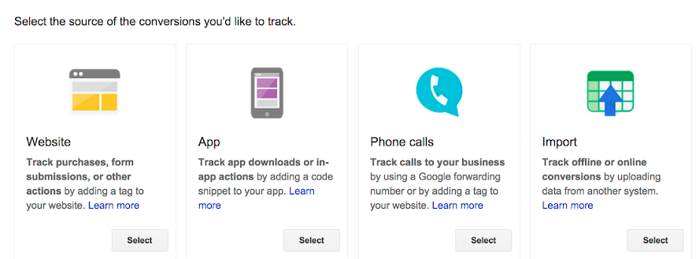

Slide 51
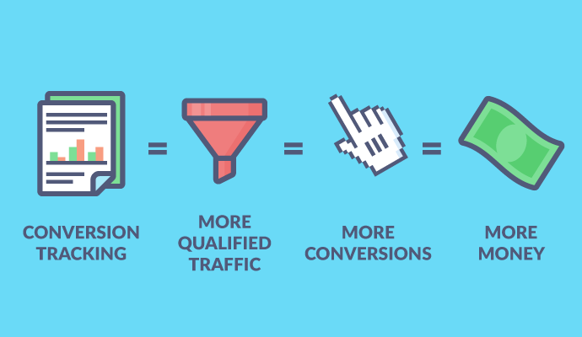

Slide 52


