Slide 1
Leadership for Enterprises in I-4.0

Slide 5
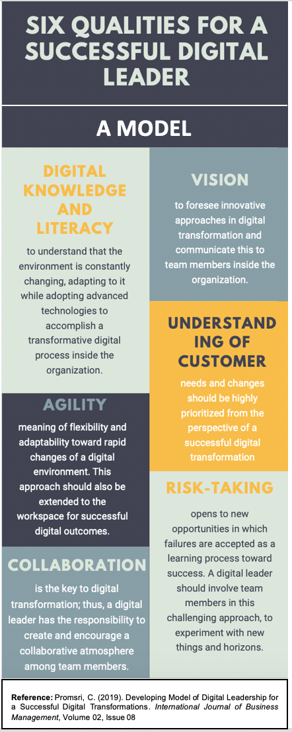
Digital Leader Quality (DLQ)

Slide 11
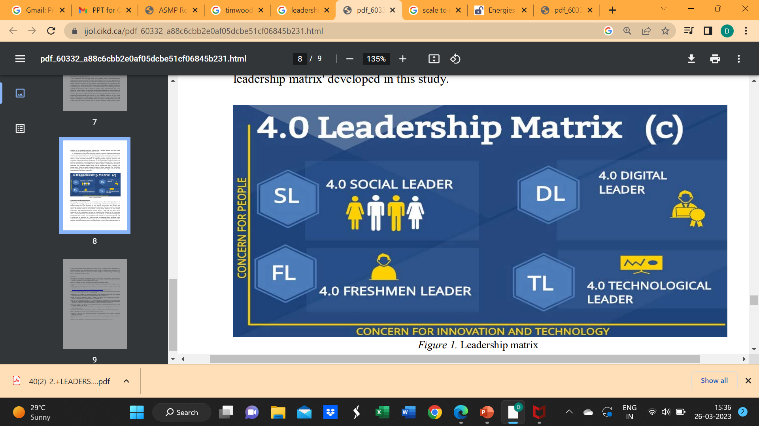
Leadership in Industry 4.0

Slide 13
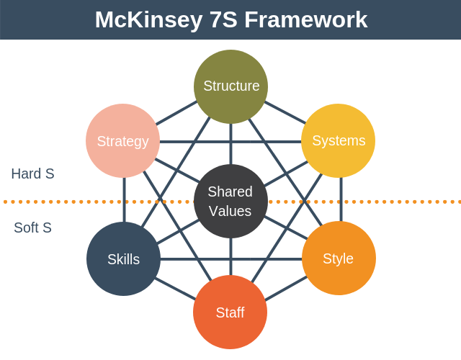

Slide 14
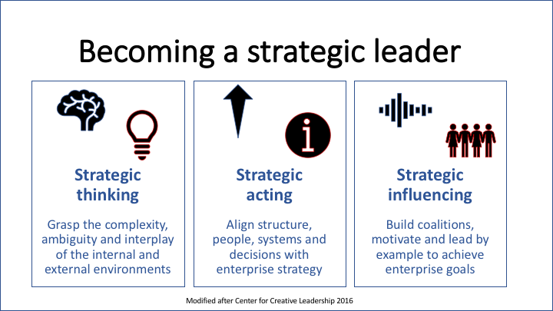

Slide 15
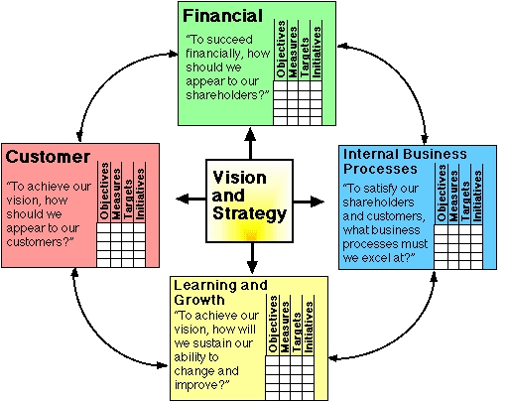
Balanced Score Card

Slide 16
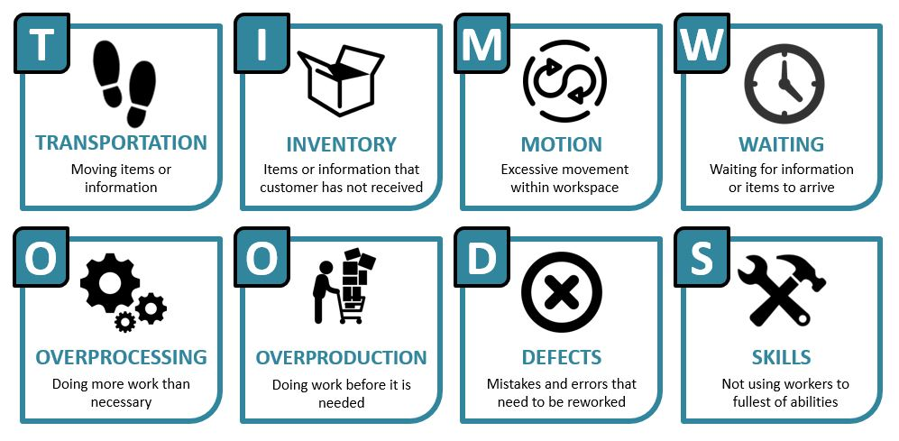
Lean Philosophy

