Slide 1
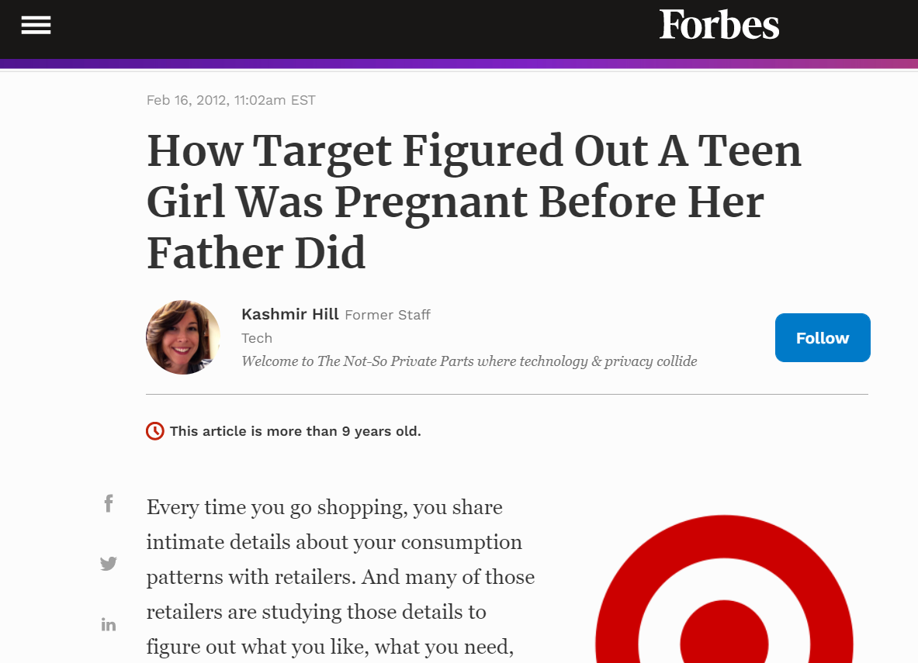

Slide 2

?

Slide 3
Association Rules

Slide 5

Study of “what goes with what”
  “Customers who bought X also bought Y”
  What symptoms go with what diagnosis
Transaction-based or event-based
Also called “market basket analysis” and “affinity analysis”
Originated with study of customer transactions databases to determine associations among items purchased

Slide 6
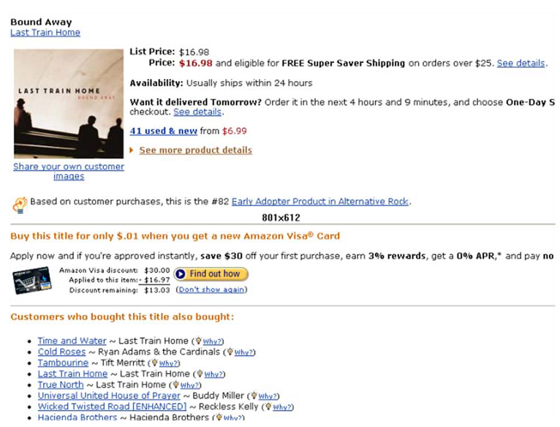
Used in many recommender systems

Slide 7
Generating Rules

Slide 8
Terms
“IF” part = antecedent
“THEN” part = consequent
“Item set” = the items (e.g., products) comprising the antecedent or consequent
Antecedent and consequent are disjoint (i.e., have no items in common)

Slide 9
Examples of Association Rules
When people buy butter, they also buy bread 70% of the time (Association)
When people buy Pepsi, they also buy Lays chips 70% of the time, on Sunday evenings (Temporal Association)
(iii) 70% of the readers who buy a DBMS book also buy a Data Mining book after a semester (Sequence Rule, a type of Temporal Association)
(iv) When people buy coke, they do not buy coffee 95% of the time (Negative Association)

Slide 10
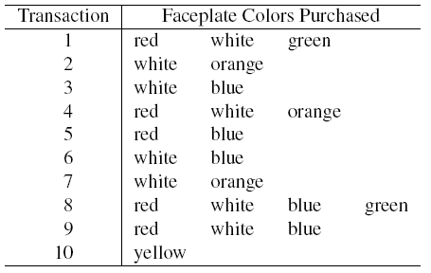
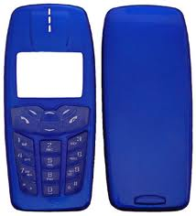
Tiny Example: Phone Faceplates

Slide 11
Many Rules are Possible
For example: Transaction 1 supports several rules, such as
  “If red, then white” (“If a red faceplate is purchased, then so is a white one”)
  “If white, then red”
  “If red and white, then green”
  + several more

Slide 12
Frequent Item Sets
Ideally, we want to create all possible combinations of items
Problem: computation time grows exponentially as # items increases
Solution: consider only “frequent item sets”
Criterion for frequent: support , confidence , lift

Slide 13
Support
Support = # (or percent) of transactions that include both the antecedent and the consequent
Example: support for the item set {red, white} is 4 out of 10 transactions, or 40%

Slide 14
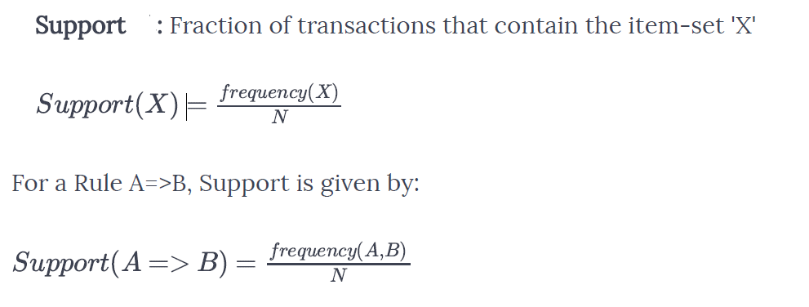
N is the total number of transaction in the systems

Slide 15
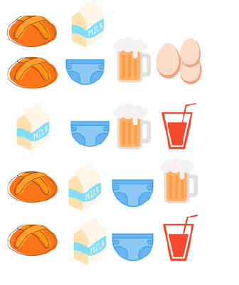
Lift (Bread =>Milk)
Support of Beer -> Diaper ?

Slide 16
‘Confidence’ of an association rule X=>Y is defined as the percentage of transactions containing X and Y both, out of all the transactions containing X.
A=>B holds with confidence c%, if c% of the transaction in the database that supports‘A’ also supports‘B’

Slide 17
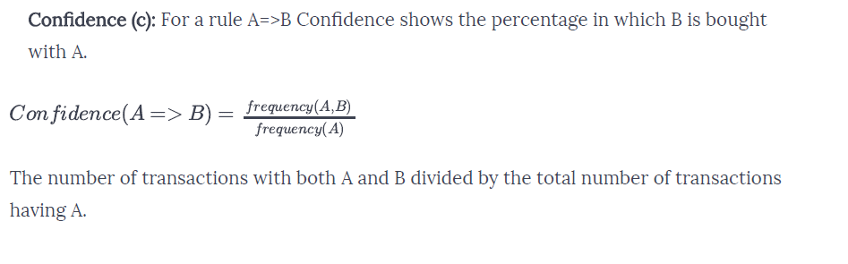

Slide 18
Confidence(Bread =>Milk)
n (Bread, Milk) = 3
n (Bread) = 4
Confidence(Bread =>Milk)
= ¾ = 0.75
Find the confidence for Beer=>Diaper.

Slide 19
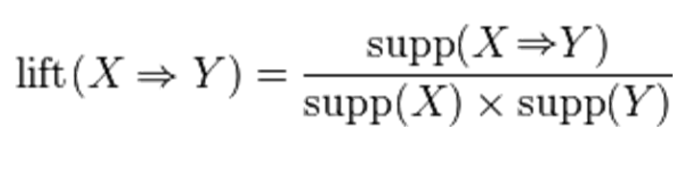
Lift is the factor by which, the co-occurence of X and Y exceeds the expected probability of X and Y co-occuring, had they been independent.
So, higher the lift, higher the chance of X and Y occurring together.

Slide 20




Slide 21
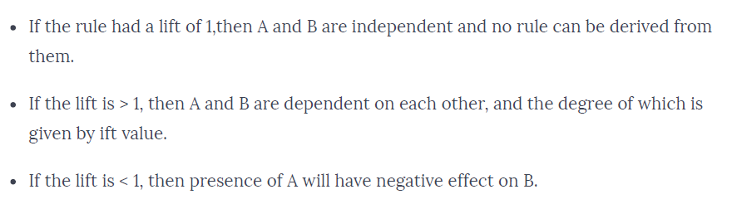

Slide 22
Summary
Association rules (or affinity analysis, or market basket analysis) produce rules on associations between items from a database of transactions
Most popular method is Apriori algorithm
To reduce computation, we consider only “frequent” item sets (=support)
Performance is measured by confidence and lift
Can produce a profusion of rules; review is required to identify useful rules and to reduce redundancy

