Slide 1

Project Team Management

Slide 2
Selecting the Project Team
At what point is the project team formed?
Who should select the project team?
What types of people should be on the team?
How do the team members get started?

Slide 10
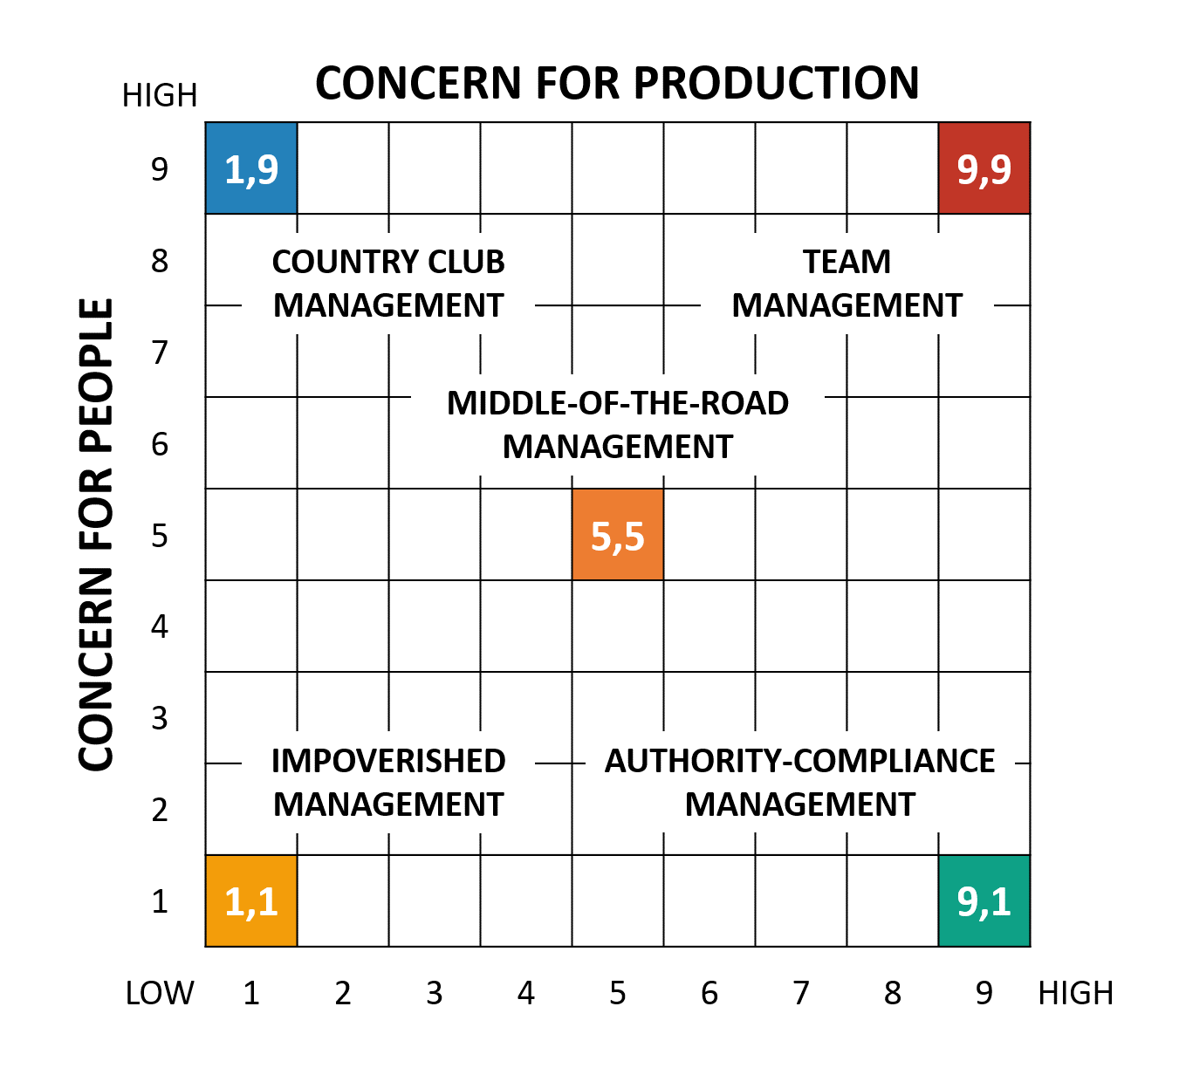
Leadership Style

Slide 16
Conflict in Project Teams
Conflict is inevitable; PM should expect conflict
PM can anticipate and avoid some conflicts; others must be managed and resolved
PM can learn different approaches for managing and resolving conflict; it’s a learned skill
Fast conflict resolution is key to project success

Slide 17
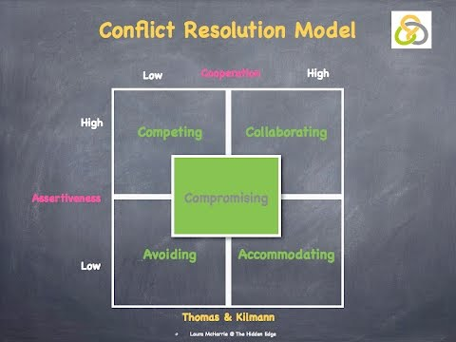

Slide 18
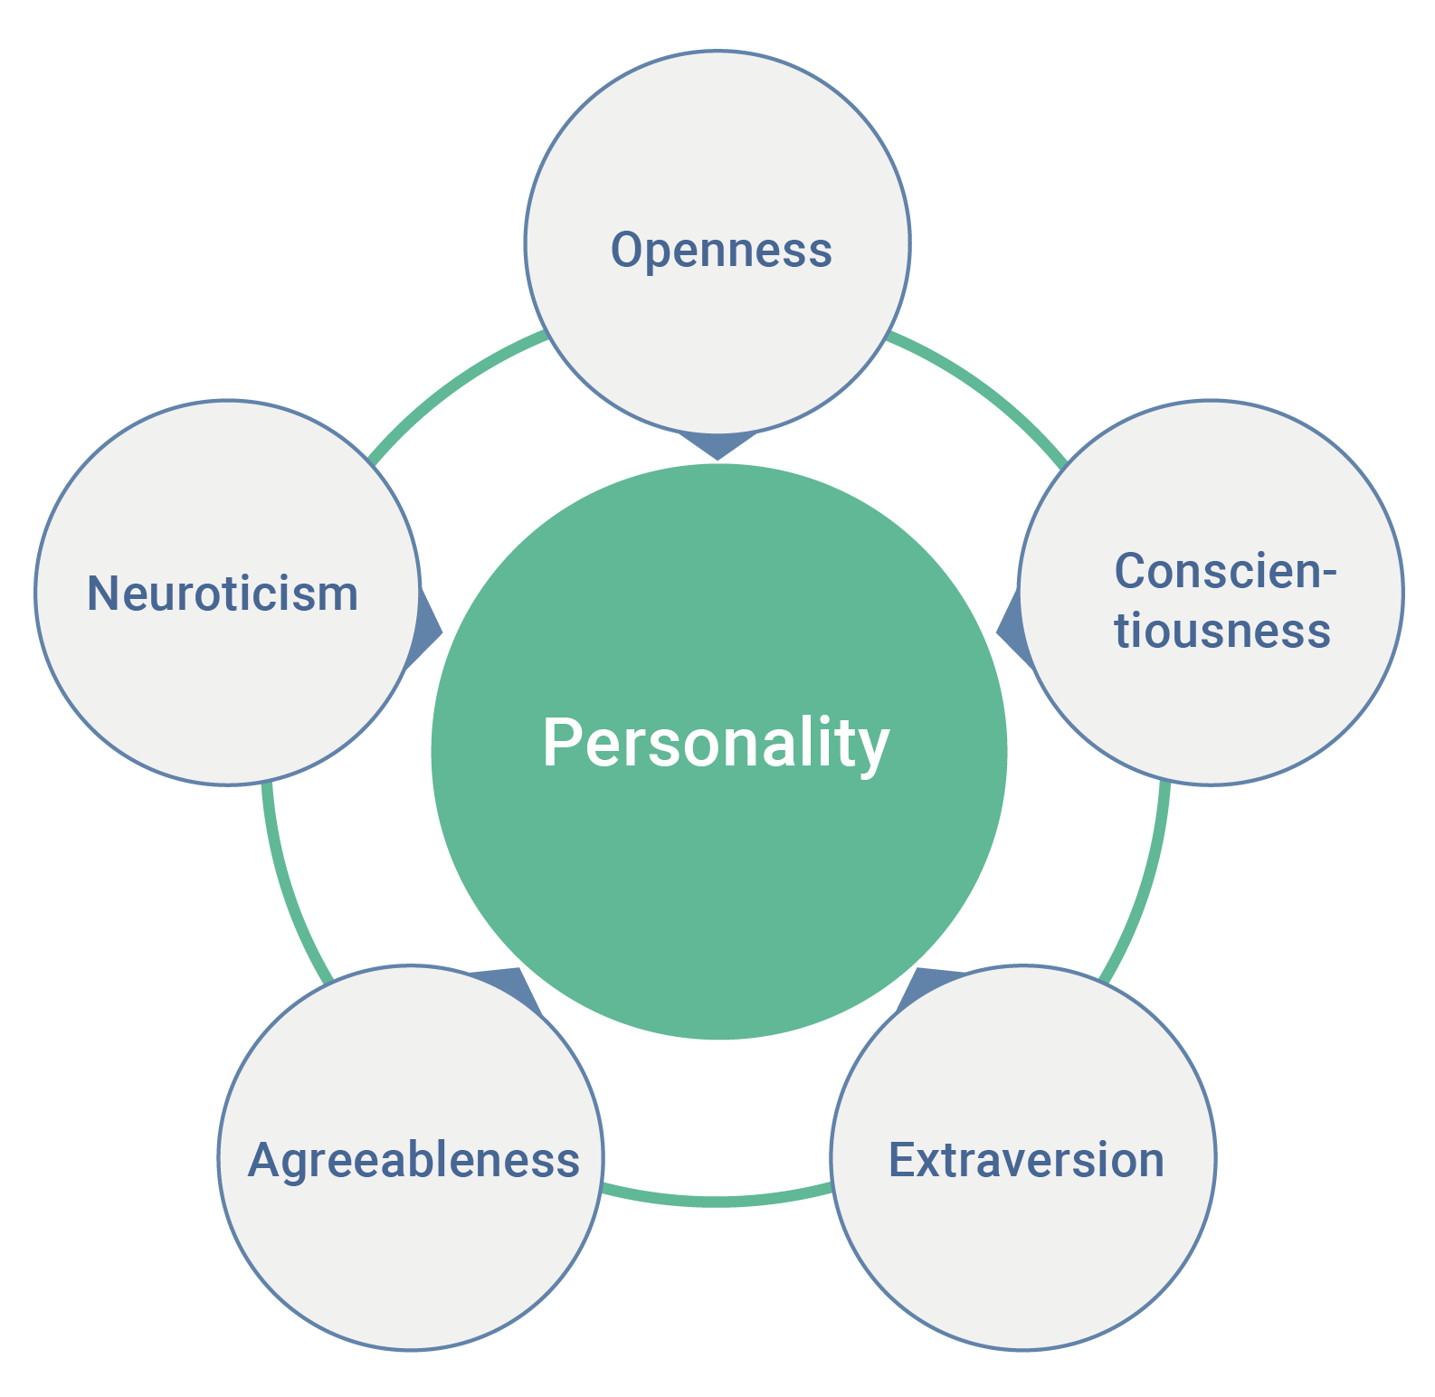
Big Five Personality

Slide 19
Root Causes of Conflict
Facts: People see the same fact from distinctly different viewpoints
Methods: People disagree on how to do something
Goals: The goals toward which people work are different
Values: People differ in their basic values

Slide 20
Managing Dysfunctional Conflict
5 Alternative Approaches to Managing Conflict:
Mediate the conflict – negotiate a solution
  emphasize urgency for the sake of project success
Arbitrate the conflict – impose a solution
  do what is best for project success
  try to allow both sides to save face
Control the conflict – reduce tensions; How?
Accept it – sometimes, learn to work around it
Eliminate people – if no longer tolerable
  remove one or both members from team

