Slide 1
Generative AI - Beyond
Stochastic Parrots

Slide 2
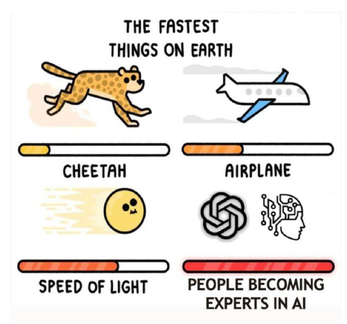

Slide 3
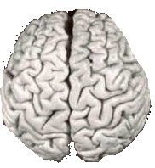
Biological Inspiration
Idea : To make the computer more robust, intelligent, and learn, …
Let’s model our computer software (and/or hardware) after the brain

Slide 4
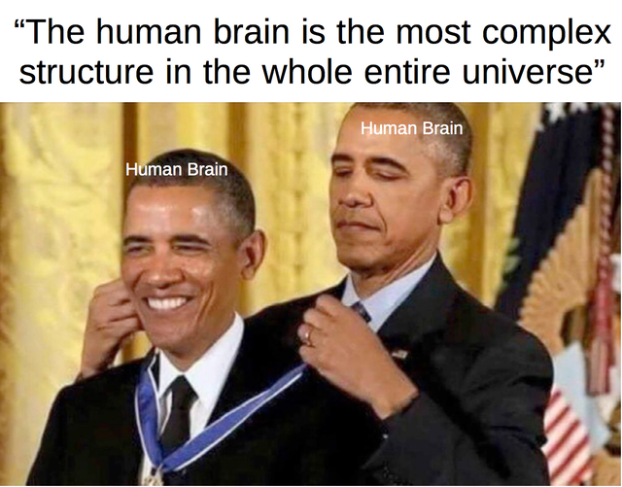

Slide 5
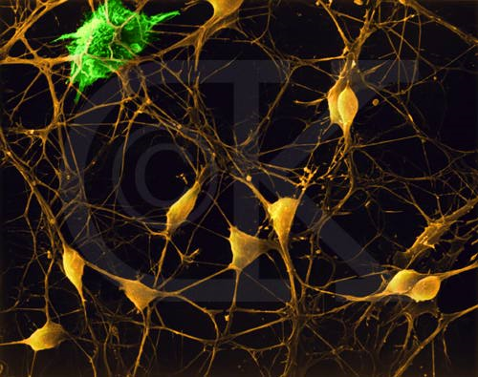
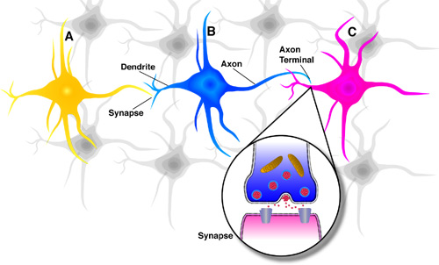
Neurons in the Brain
Although heterogeneous, at a low level the brain is composed of neurons
  A neuron receives input from other neurons (generally thousands) from its synapses
  Inputs are approximately summed
  When the input exceeds a threshold the neuron sends an electrical spike that travels that travels from the body, down the axon, to the next neuron(s)

Slide 6
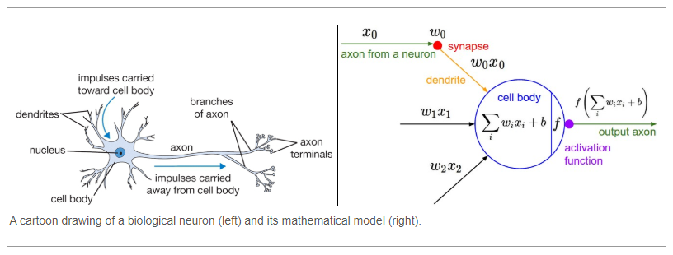

Slide 7
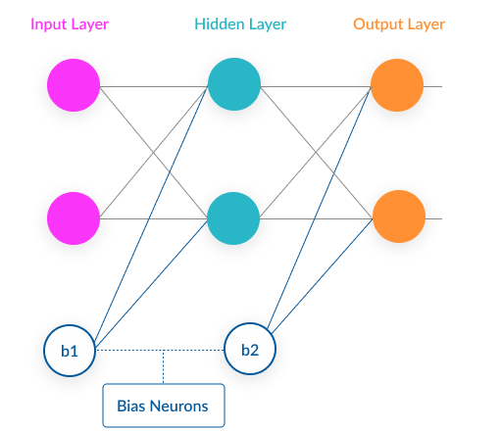

Slide 8
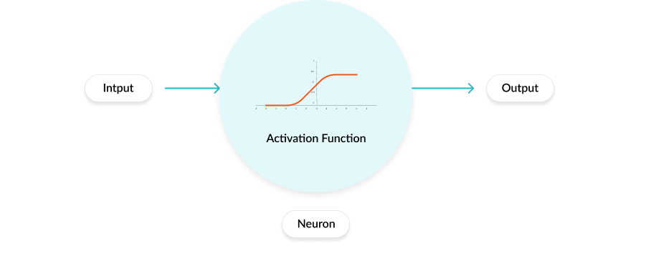
Activation functions are mathematical equations
determine the output of a neural network.
attached to each neuron in the network, and determines whether it should be activated (“fired”) or not, based on whether each neuron’s input is relevant for the model’s prediction.
also help normalize the output of each neuron to a range between 1 and 0 or between -1 and 1.

Slide 9
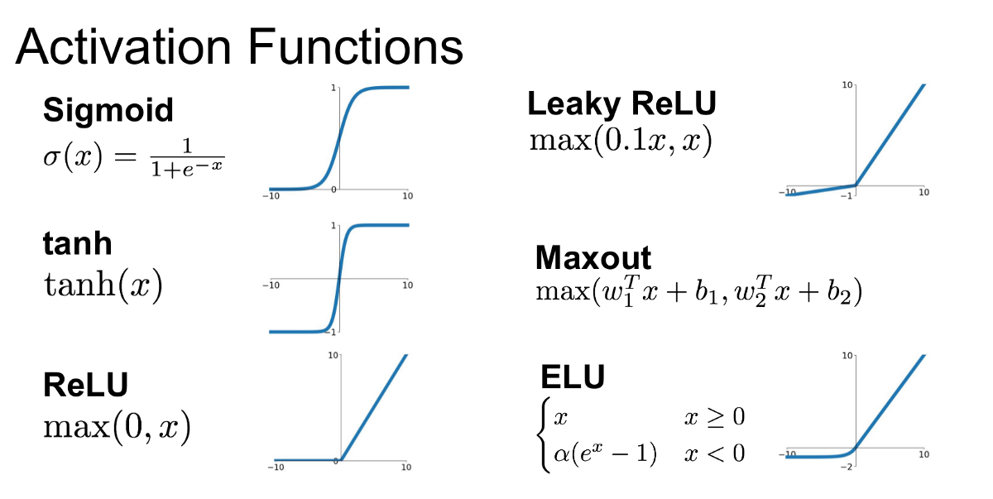

Slide 10
Loss’ in Machine learning helps us understand the difference between the predicted value & the actual value.
Loss function: Used when we refer to the error for a single training example.
Cost function: Used to refer to an average of the loss functions over an entire training dataset.

Slide 11

Cost function for regression

Slide 12
Gradient descent (GD)
iterative first-order optimization algorithm used to find a local minimum/maximum of a given function.
This method is commonly used in machine learning to minimize a cost/loss function

Slide 13
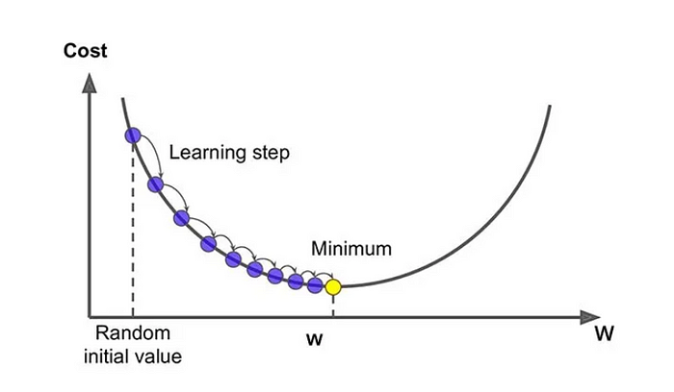

Slide 14
Back-propagation
Back-propagation is the essence of neural net training.
It is the practice of fine-tuning the weights of a neural net based on the error rate (i.e. loss) obtained in the previous epoch (i.e. iteration).
Proper tuning of the weights ensures lower error rates, making the model reliable by increasing its generalization.

Slide 15
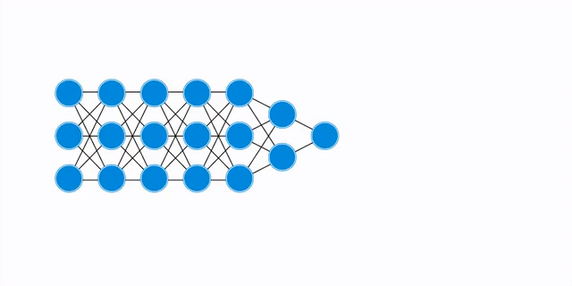

Slide 16
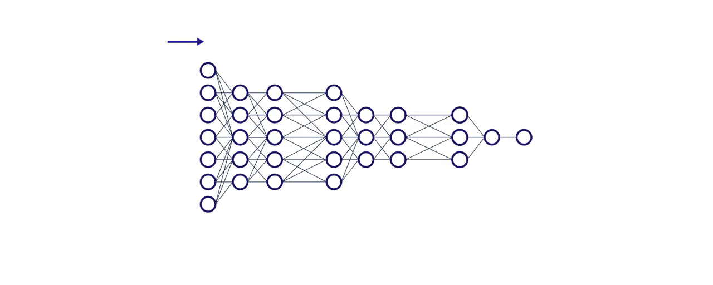

Slide 17
Learning rate
The amount that the weights are updated during training is referred to as the step size or the learning rate.
A hyperparameter that controls how much to change the model in response to the estimated error, each time the model weights are updated.

Slide 18
Epochs
The number of is a hyperparameter of gradient descent that controls the number of complete passes through the training dataset.

Slide 19
https://www.mladdict.com/neural-network-simulator
https://playground.tensorflow.org/

Slide 20
Hands on using R
Dividendinfo data set
fcfps: Free cash flow per share (in $)
earnings_growth: Earnings growth in the past year (in %)
de: Debt to Equity ratio
mcap: Market Capitalization of the stock
current_ratio: Current Ratio (or Current Assets/Current Liabilities)
Dividend class – Whether dividend given or not given (1,0)

Slide 21
What’s so special about LLMs

Slide 22


Slide 23
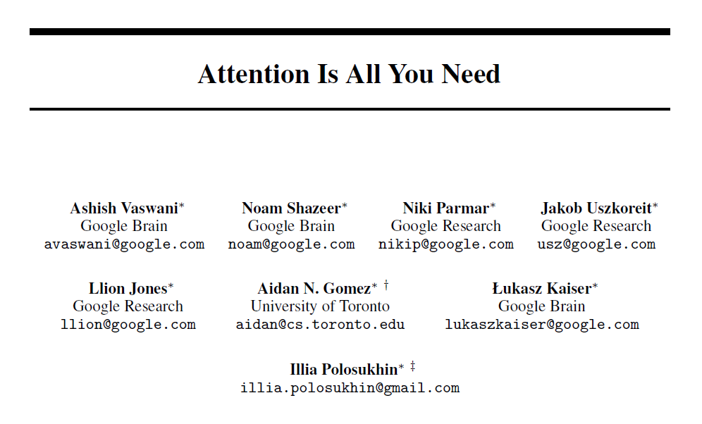

Slide 24
Before this paper was published, the state of the art in language AI was a deep learning architecture known as recurrent neural networks (RNNs).
RNNs process data sequentially—that is, one word at a time, in the order in which the words appear.
important relationships often exist between words even if they do not appear next to each other in a sequence.

Slide 25
Attention enables a model to consider the relationships between words regardless of how far apart they are and to determine which words and phrases in a passage are most important to “pay attention to.”
Transformers’ fundamental innovation, made possible by the attention mechanism, is to make language processing parallelized, meaning that all the words in a given body of text are analyzed at the same time rather than in sequence.
Chat GPT (Generative Pretrained Transformer) ()

Slide 26


Slide 27
Rather than generating strings of characters sequentially to form words and sentences (the way that humans do), the aliens in the film produce one complex symbol at a time, all at once, which conveys detailed meaning that the humans must interpret as a whole.
Transformers’ parallelization gives them a more global and thus more accurate understanding of the texts that they read and write. It also makes them more computationally efficient and more scalable than RNNs.

Slide 28
Tokens and Context in LLMs
Tokens are the building blocks of language, and context is the information provided by surrounding tokens that helps to understand and generate meaningful language

Slide 29
Foundation model
Foundation model is a pre-trained deep neural network that forms the backbone for various downstream tasks such as object classification, object detection, and image segmentation

Slide 30
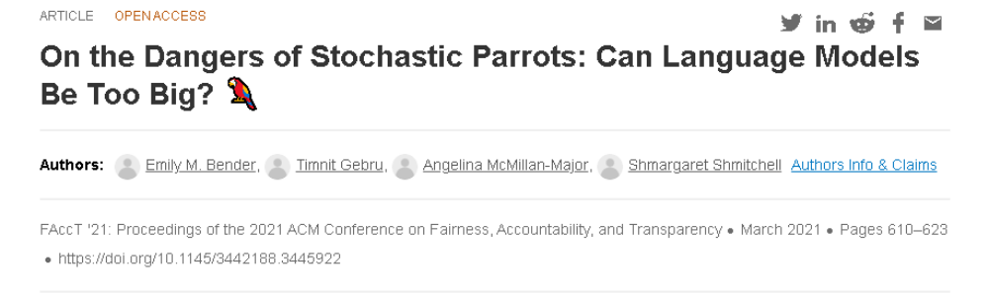

Slide 31
they simply attempt to predict the next word in a sequence by using the context and prompt provided by the user as input
“Haphazardly stitching together sequences of linguistic forms … according to probabilistic information about how they combine, but without any reference to meaning.“
Hallucinations !

