Slide 1
Artificial Intelligence in Cloud

Slide 2
Introduction
What is Cloud?
Cloud Providers: AWS,GCP, Azure
What is Cloud Computing?

Slide 3
What is the Cloud?
The cloud is a vast network of interconnected computers, accessible through the internet.
Not a physical place, but a virtual space for accessing computing resources on demand.
Eliminate the need to manage your own hardware or software.

Slide 4
What is Cloud Computing?
On-Demand Self-Service: Access resources like servers, storage, and databases instantly, without waiting for IT approval.
Broad Network Access: Use cloud resources from anywhere with an internet connection, on any device.
Resource Pooling: Shared resources are dynamically allocated and scaled based on your needs, ensuring optimal utilization.
Rapid Elasticity: Easily scale your resources up or down as your requirements change, eliminating the need to overprovision or underprovision.

Slide 5
Benefits of Cloud Computing
Cost-Effectiveness: Pay only for what you use, eliminating the burden of upfront infrastructure costs and ongoing maintenance.
Scalability: Seamlessly adjust your resource usage to meet your fluctuating needs, avoiding over provisioning or under provisioning.
Agility: Quickly deploy new applications and services without lengthy hardware procurement and configuration processes.
Accessibility: Access your data and applications from anywhere with an internet connection, fostering remote work and global collaboration.
Reliability and Security: Cloud providers offer robust infrastructure with redundant systems, ensuring high availability and data protection.

Slide 6
Key Cloud Providers: AWS
Strengths: Broadest and most mature service portfolio, global reach, focus on innovation.
Key services: EC2 (virtual servers), S3 (storage), RDS (databases), Lambda (serverless computing), Sagemaker (AI/ML)
Cost metrics: Pay-as-you-go pricing, various pricing models for different services.

Slide 7
Key Cloud Providers: GCP
Strengths: AI and machine learning capabilities, open-source friendliness, integration with Google products.
Key services: Compute Engine (virtual machines), Cloud Storage (object storage), Cloud SQL (databases), Cloud Functions (serverless computing),Vertex AI (ML/AI)
Cost metrics: Pay-as-you-go pricing, sustained use discounts, committed use discounts.

Slide 8
Key Cloud Providers: Azure
Strengths: Deep integration with Microsoft technologies, robust security features, hybrid cloud solutions.
Key services: Azure VMs (virtual machines), Azure Blob Storage (object storage), Azure SQL Database (managed databases), Azure Functions (serverless computing), Azure ML ( ML/AI)
Cost metrics: Pay-as-you-go pricing, reserved instances, Azure Hybrid Benefit for on-premises licenses.

Slide 9
Cloud deployment Models
Public Cloud: Resources are shared among multiple users, managed by the cloud provider (e.g., AWS, GCP, Azure).
Private Cloud: Dedicated infrastructure for a single organization, providing high security and control.
Community Cloud: Shared infrastructure for a specific community with similar needs, offering cost-effectiveness and collaboration.
Hybrid Cloud: Combines public and private clouds, allowing for flexibility and scalability while maintaining sensitive data on-premises.

Slide 10
Cloud Service Models
Infrastructure as a Service (IaaS): Rent virtual servers, storage, networking, and other basic infrastructure components.
Platform as a Service (PaaS): Leverage a platform with pre-configured tools and services to develop, deploy, and manage applications.
Software as a Service (SaaS): Access and use software applications directly over the internet, eliminating the need for installation or maintenance.

Slide 11
Securing Your AWS Resources with IAM
IAM (Identity and Access Management): The service for controlling access to AWS resources.
Users: Represent people or applications that need access to AWS resources.
Groups: Organize users for easier access management.
Policies: Grant specific permissions to users and groups.
Best Practices:
  Use least privilege principle: Grant only necessary permissions.
  Enable multi-factor authentication (MFA).
  Rotate access keys and credentials regularly.
  Monitor IAM activity for suspicious behavior.

Slide 12
S3 vs hard drive
Similarities:
Storage: Both S3 and hard drives store data in a digital format.
Accessibility: Both allow you to access and manage your data.
Scalability: Both offer options for scaling your storage capacity up or down as needed.

Slide 13
S3 vs hard drive
Differences:
Location: S3 is a cloud-based storage service, meaning your data is stored in multiple geographically dispersed data centers. A hard drive is a physical device located within your computer.
Accessibility: With S3, you can access your data from anywhere with an internet connection and any device. A hard drive's access is limited to the computer it's connected to.
Management: S3 is managed by Amazon, while you manage and maintain your hard drive.
Security: S3 offers robust security features and redundancy, while a hard drive's security depends on your implementation.
Cost: S3 typically has a pay-as-you-go pricing model, while a hard drive has a one-time purchase cost.
Performance: S3 might have slightly higher latency compared to a local hard drive, but the difference is often negligible for most use cases.

Slide 14
S3
AWS S3 Documentation: https://docs.aws.amazon.com/AmazonS3/latest/userguide/Welcome.html
S3 Pre-signed URLs: https://docs.aws.amazon.com/AmazonS3/latest/userguide/using-presigned-url.html

Slide 15
AWS database
Amazon Relational Database Service (RDS): Managed service for popular relational databases like MySQL, PostgreSQL, MariaDB, Oracle, SQL Server, and Aurora. Offers scalability, high availability, and automated backups.
Amazon Aurora: MySQL and PostgreSQL-compatible relational database built for the cloud. Provides high performance, scalability, and durability.
Amazon DynamoDB: NoSQL database with high performance and scalability for large datasets. Offers flexible data schemas and pay-per-request pricing.
Amazon Redshift: Petabyte-scale data warehouse for large-scale data analytics. Offers fast query performance and parallel processing.
Amazon ElastiCache: Managed in-memory caching service for popular caching engines like Redis and Memcached. Improves application performance and reduces latency.

Slide 16
AWS Compute
Lambda: A serverless compute service that lets you run code without provisioning or managing servers.
Pay-per-execution: You only pay for the time your code runs, reducing costs.
Highly scalable: Automatically scales to handle any amount of traffic.
Event-driven: Trigger your code automatically based on events from other AWS services or your own applications.
Wide range of use cases: Build web applications, microservices, data processing pipelines, and more.

Slide 17
SAM : https://docs.aws.amazon.com/serverless-application-model/latest/developerguide/what-is-sam.html

Slide 18
AWS Comprehend:
Unleash the Power of Text Analysis: Extract meaning and sentiment from your textual data, including documents, social media posts, and customer reviews.
Key Features:
  Identify key phrases and entities (people, locations, organizations).
  Analyze sentiment (positive, negative, neutral).
  Classify text into predefined categories (e.g., topic, language).
  Customize models with your own data for domain-specific insights.
Benefits:
  Gain deeper customer understanding from reviews and feedback.
  Improve content moderation and sentiment analysis.
  Drive personalized recommendations and targeted marketing.

Slide 19
AWS Rekognition:
See the World Through AI Eyes: Analyze and understand images and videos, revealing valuable information hidden within visual content.
Key Features:
  Object and scene detection (e.g., faces, cars, animals).
  Image and video analysis (e.g., celebrity recognition, inappropriate content).
  Text extraction from images (e.g., printed text, handwritten notes).
Benefits:
  Automate image and video moderation for safety and compliance.
  Enhance product search and visual discovery for customers.
  Extract valuable data from documents and receipts.

Slide 20
AWS Textract
Turn Unstructured Text into Structured Data: Extract key information from documents and forms, unlocking valuable insights previously hidden within.
Key Features:
  Extract text, tables, and forms from various document formats (e.g., PDFs, images).
  Recognize specific data types (e.g., names, dates, addresses).
  Convert extracted data into structured formats for further analysis.
Benefits:
  Automate data entry and document processing for increased efficiency.
  Streamline document review and analysis workflows.
  Integrate extracted data into your existing systems for enhanced insights.

Slide 21
AWS CLI
Aws-cli-install
Pros:
  Easy to use for quick commands and ad-hoc tasks.
  No coding required.
  Good for beginners or exploring AWS services.
Cons:
  Can be repetitive for complex tasks.
  Limited automation capabilities.
  Not ideal for integrating with applications.

Slide 22
commands
Simple AWS CLI Example Commands:
Here are some basic AWS CLI commands to get you started:
1. List S3 Buckets:
aws s3 ls
This command lists all the S3 buckets you have access to in your account.
2. Create an S3 Bucket:
aws s3 mb s3://my-bucket-name
This command creates a new S3 bucket named "my-bucket-name". Replace "my-bucket-name" with your desired name, ensuring it adheres to Amazon S3 naming conventions.

Slide 23
Upload a file to S3:
aws s3 cp my-file.txt s3://my-bucket-name/
This command uploads the file "my-file.txt" to your S3 bucket named "my-bucket-name". Replace "my-file.txt" with the actual file path and "my-bucket-name" with your bucket name.
4. Download a file from S3:
aws s3 cp s3://my-bucket-name/my-file.txt ./
This command downloads the file "my-file.txt" from your S3 bucket named "my-bucket-name" to your current working directory.

Slide 24
Boto3
Boto3 Docs
Pros:
  Python library for programmatic access to AWS services.
  Enables automation and integration with applications.
  Offers more flexibility and control than the CLI.
Cons:
  Requires knowledge of Python programming.
  Steeper learning curve compared to the CLI.

Slide 25
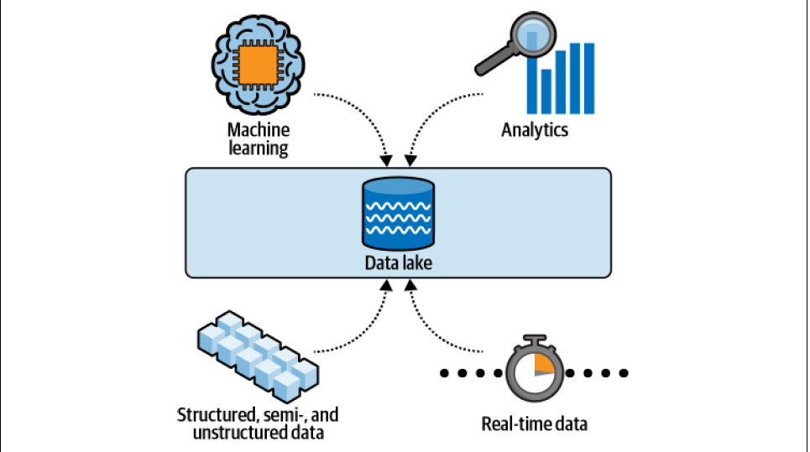
Data lake

Slide 26
Amazon Athena
Amazon Athena is an interactive query service that makes it easy to analyze data in Amazon S3 using standard SQL.
Athena separates compute from storage and lowers the overall time to insight for our business.

Slide 27
Athena vs Databases
While Athena provides database-like functionality, it's not technically considered a database itself. Here's the key difference:
Databases:
Store data in a structured format, usually with tables, rows, and columns.
Provide functionalities like data manipulation (insert, update, delete) and querying.
Manage data access control and security mechanisms.
Athena:
Doesn't store data itself, it directly accesses data stored in Amazon S3 (object storage).
Primarily focuses on querying data in S3 using standard SQL language.
Offers limited data manipulation capabilities (e.g., partition switching).
Doesn't handle data access control directly, relies on S3 bucket permissions.
Think of it this way:
Imagine a library: A database is like a well-organized bookshelf, with books categorized and easily searchable.
Imagine a warehouse: Athena is like a search engine for a warehouse full of unorganized boxes. While you can find specific items using keywords, you don't have the same level of organization and management as a library.

Slide 28
Amazon redshift
Amazon Redshift is targeted for modern data analytics on petabytes of structured data.
Need to have a predefined “schema on write.”
Amazon Redshift requires us to create a cluster (compute and storage resources),
Highly relational data with a transactional nature (data gets updated), workloads that involve complex joins, or sub second latency requirements,

Slide 29
Athena vs redshift
Athena and Amazon Redshift are optimized for read-heavy analytics workloads; they are not replacements for write-heavy, relational databases such as Amazon Relational Database Service (RDS) and Aurora.
At a high level, use Athena for exploratory analytics and operational debugging; use Amazon Redshift for business-critical reports and dashboards.

Slide 30
Redshift
redshift

Slide 31
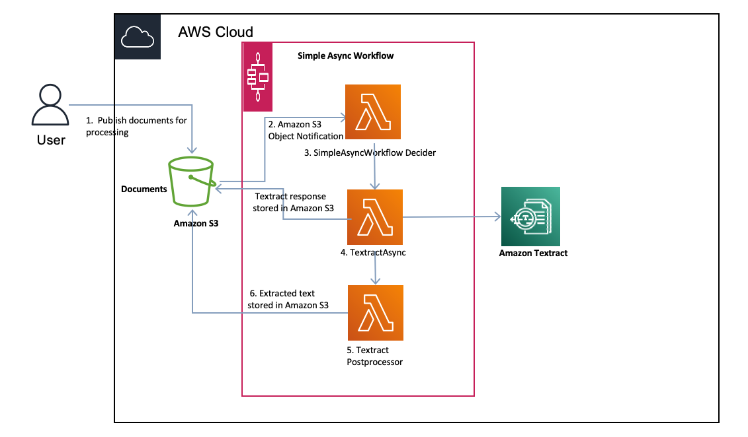
texract

Slide 32
Rekognition
texract

Slide 33
Amazon Sagemaker
A fully managed service for building, training, and deploying machine learning models
Simplifies the entire ML workflow
Offers a wide range of capabilities, including:
  Pre-built algorithms
  Notebook instances for data exploration
  Training jobs for model creation
  Model deployment for real-time inference
  Monitoring for model performance tracking

Slide 34
SageMaker Clarify
SageMaker Clarify helps identify potential bias during data preparation without writing code.
SageMaker Clarify provides a visual report with a description of the metrics and measurements of potential bias so that you can identify steps to remediate the bias.

