Slide 2
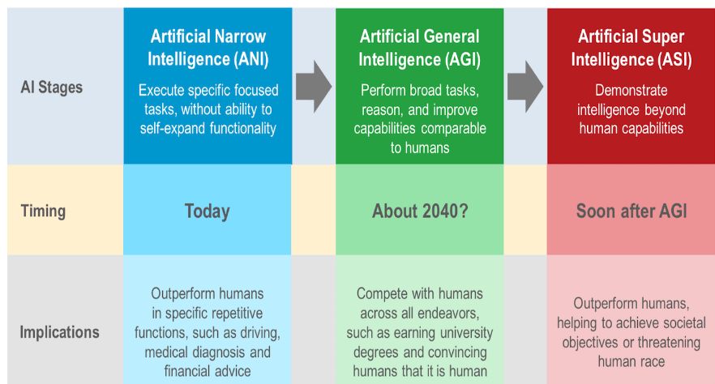

Slide 3

#AIForGood
https://aiforgood.itu.int/gateway/

Slide 4
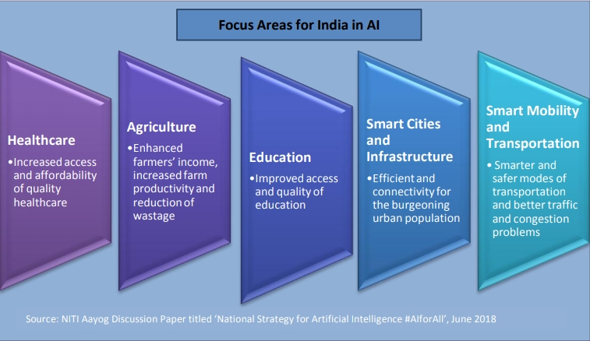
#AIforALL
#NitiAyog

Slide 5
Where to start with AI in your Organisation ?

Slide 6
Take an organization selfie
What is the current state of AI in your Organization / BU / Team
Clear and well-defined use cases ?
Right Data capturing processes ?
Tech capabilities to build AI models ?
Tech capabilities to deploy & scale AI models ?
Promised value getting realized or not ?

