Slide 1

Analytic hierarchy process (AHP)

Slide 2
Essential concepts of AHP
AHP was developed by Saaty (1977, 1980).
To use AHP the user needs to complete four steps to obtain the ranking of the alternatives
The problem first has to be structured
Scores – or priorities, as they are known in AHP – are calculated based on the pairwise comparisons provided by the user.
A consistency check
A sensitivity analysis

Slide 3
Problem structuring
Problems that require MCDA techniques are complex and, as a result, it is advantageous to break them down and solve one ‘sub-problem’ at a time.
The problem structuring (The problem is structured according to a hierarchy)
The elicitation of priorities through pairwise comparisons

Slide 4
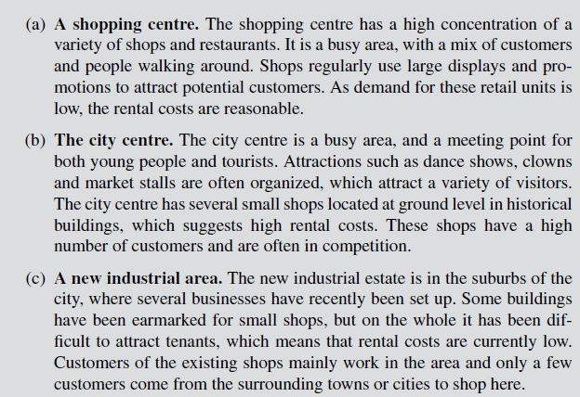

Slide 5
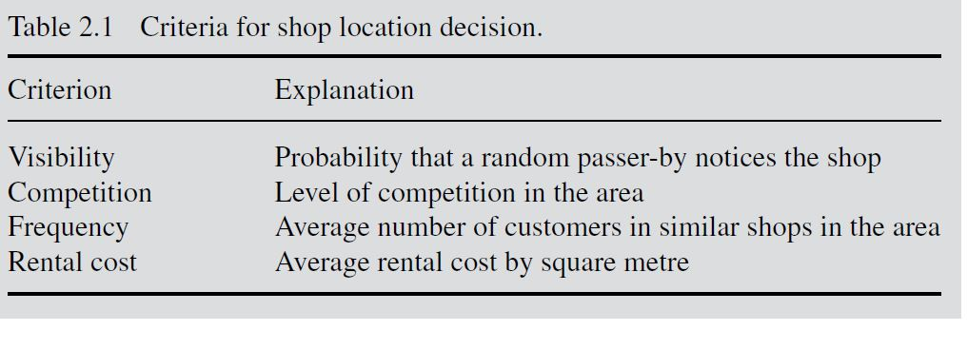

Slide 6
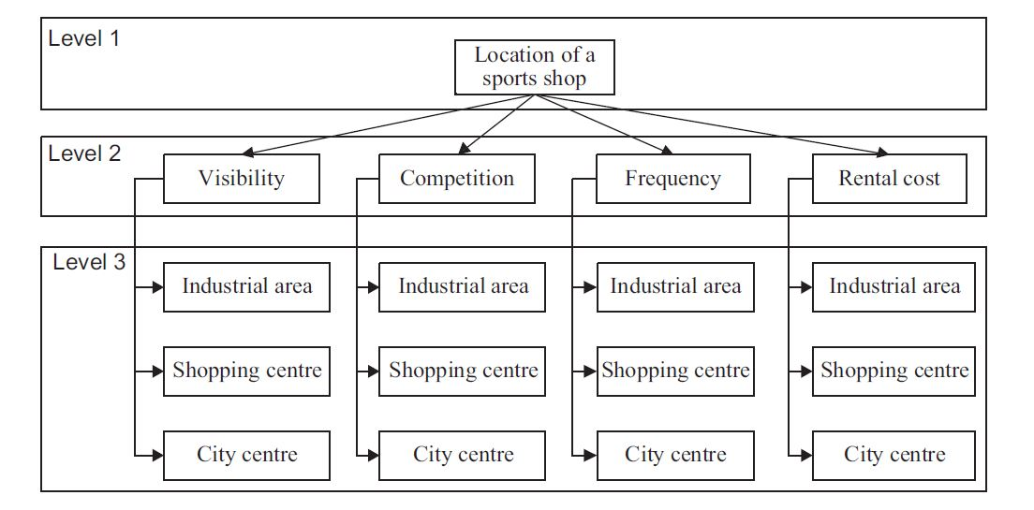

Slide 7
Each lower level is prioritized according to its immediate upper level.
For example, in order to prioritize the criteria of level 2 with regard to the goal ‘location of a sports shop’, an appropriate question would be: ‘Which criterion is most important for choosing the location of the sports shop and to what extent?’
On the other hand, the alternatives in level 3 must be prioritized with regard to each criterion in level 2.
An appropriate question would be: ‘Which alternative is preferable to fulfil the given criterion and to what extent?’

Slide 8

Priority calculation
Criteria priorities: Importance of each criterion (with respect to the top goal).
Local alternative priorities: Importance of an alternative with respect to one specific criterion.
Global alternative priorities: Priority criteria and local alternative priorities are intermediate results used to calculate the global alternative priorities. The global alternative priorities rank alternatives with respect to all criteria and consequently the overall goal.

Slide 9
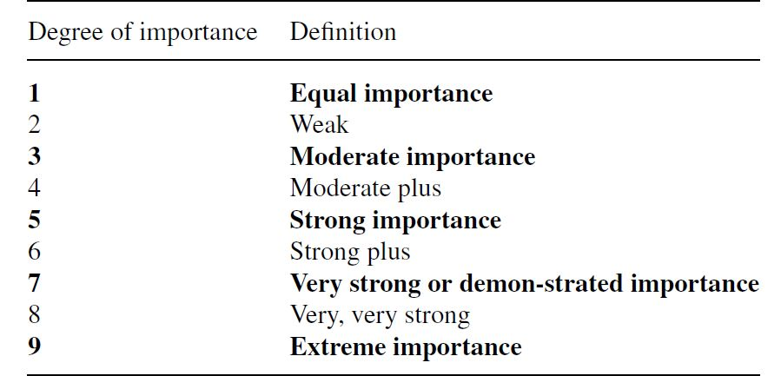

Slide 10
Consistency check
When the matrix is complete, a consistency check may be performed to detect possible contradictions in the entries.
When several successive pairwise comparisons are presented, they may contradict each other.
The shopping centre is two times more visible than the city centre.
The city centre is three times more visible than the industrial area.
The industrial area is four times more visible than the shopping centre.

Slide 11
AHP allows up to a 10% inconsistency compared to the average inconsistency

Slide 12
Sensitivity analysis
The last step of the decision process is the sensitivity analysis, where the input data is slightly modified to observe the impact on the results.
These different scenarios may result in other rankings, and further discussion may be needed to reach a consensus. If the ranking does not change, the results are said to be robust – otherwise they are sensitive.

