Slide 1
What is the phrase ‘limited liability’ mean in the corporate context?

Slide 2
What is the ‘agency problem’ in corporate finance?

Slide 3
What is the type-I and type-II ‘agency problem’ in corporate finance?

Slide 4
I will try to control the agency problem through …,……,…

Slide 5
Primary market and secondary market ?

Slide 6
What is the function of the stock market or why do stock markets exist?

Slide 7
What are the three most important functions of the financial manager?

Slide 8
Is there any assumption when the investment decision is taken?

Slide 9
What is arbitrage?

Slide 10
What is the goal of the firm: profitability or shareholder wealth maximization?Why?

Slide 11
If real interest rate is 4% and inflation is 6%, what is the approximate nominal interest rate?

Slide 12
What is NPV? What is the NPV rule?

Slide 13
What is NPV profile?
What is its use?

Slide 14
What is IRR?
What is the IRR rule?

Slide 15
What is the payback period rule?

Slide 16
What are the drawbacks of the payback period?

Slide 17
What is the difference between an opportunity cost and sunk cost w.r.t. capital budgeting?

Slide 18

Why is depreciation added back?

Slide 19
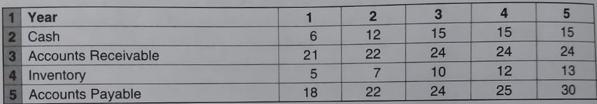
Please determine the changes in working capital

Slide 20
What is the difference between debt and equity?

Slide 21
What is the difference between public debt and private debt?

