Slide 1
Importance of accounting for business
Understanding the accounting system of the business organization
Deepika Gupta
IIM Visakhapatnam

Slide 2
Introduction of Accounting
Largely confined to record keeping
Change in role of accountant – from recorder of transactions to decision maker
Today accounting is not just preparation of financial reports but also includes
  Financial accounting, cost accounting and management accounting
  Forensic accounting
  E commerce accounting
  Environmental accounting
  Financial planning

Slide 3
History of Accounting
Records show transactions recorded around 4000 BC in Babylonia and Egypt
In Greece, accounting used to maintain government records
In Rome, day-book were maintained (700 BC – 400 AD)
China shows use of accounting as early as 2000 BC
In India, accounting traced back to 23 centuries ago when Kautilya wrote Arthashastra (describing accounting records) during Chandragupta’s regime
The current double entry book keeping based on Luca Pacioli’s book
  Review of Arithmetic and Geometric Proportions (Summa de Arithmetica, Geometria, Proportion at Proportionality)

Slide 4
Meaning of Accounting
It is the art of recording, classifying and summarizing in a significant manner and in terms of money, transactions and events which are, in part atleast, of financial character and interpreting the results thereof (AICPA, 1941)
Also defined as “The process of identifying, measuring and communicating economic information to permit informed judgements and decisions by users of information (AAA, 1966)

Slide 5
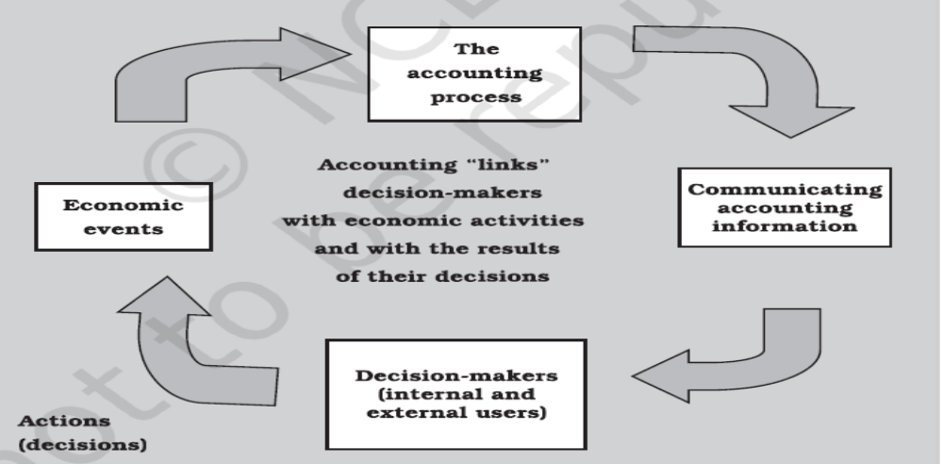
Process of Accounting

Slide 6
Economic event
It is known as happening of consequence to a business organization which consists of transactions and which is measurable in monetary terms
External event - An event involving transactions between an outsider and an organization.
  Sale of merchandise to the customers.
  Rendering services to the customers by ABC Limited.
  Purchase of materials from suppliers.
  Payment of monthly rent to the landlord.
Internal event - An event involving transactions entirely between internal wings of the enterprise.
  Supply of raw material from stores department to manufacturing department
  Salary payment to employees

Slide 7
Users of Accounting
Owners/shareholders
Directors
Managers
Creditors
Bankers
Government
Others

Slide 8
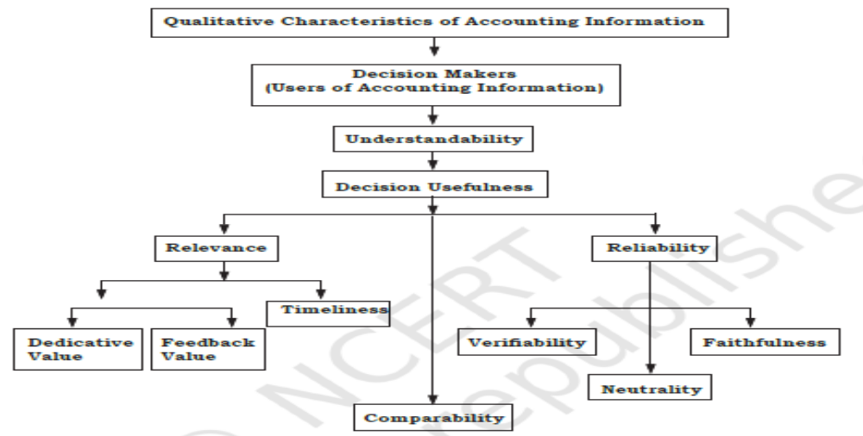
Characteristics of Accounting

Slide 9
Terms used in Accounting
Entity
Transactions
Assets
Liabilities
Capital
Sales
Revenues (Income)
Expenses/expenditure
Profit/gain
Loss
Discount
Drawings
Purchases
Stock
Debtors
Creditors

Slide 10
Exercise 1
Mr. PQR started a business for buying and selling of stationery with Rs.5,00,000 as an initial investment. Of which he paid R. 1,00,000 for furniture, Rs.2,00,000 for buying stationery items. He employed a sales person and clerk. At the end of the month, he paid Rs.5,000 as their salaries. Out of the stationery bought he sold some stationery for Rs.1,50,000 for cash and some other stationery for Rs. 1,00,000 on credit basis to Mr. LMN. Subsequently, he bought stationery items of Rs.1,50,000 from Mr. XYZ. In the first week of next month there was a fire accident and he lost Rs.30,000 worth of stationery. A part of the machinery, which cost Rs.40,000, was sold for Rs.45,000.
From the above, answer the following :
1. What is the amount of capital with which Mr. PQR started business.
2. What are the fixed assets he bought?
3. What is the value of the goods purchased?
4. Who is the creditor and state the amount payable to him?
5. What are the expenses?
6. What is the gain he earned on fixed asset?
7. What is the loss he incurred due to fire?
8. Who is the debtor? What is the amount receivable from him?
9. What is the total amount of expenses and losses incurred?
10. Determine if the following are assets, liabilities, revenues, expenses or none of the these:
- sales, debtors, creditors, salary to manager, discount to debtors, drawings by the owner.

Slide 11
Basic Accounting Concepts
Business entity concepts – distinct and separate from owners
Money measurement concept
Going concern concept
Accounting period concept
Cost concept
Dual aspect – double entry
  Duality principle : Assets = Liabilities + Capital
Revenue recognition concept
Matching concept
Full disclosure concept
Consistency concept
Conservatism concept – prudence
Materiality concept
Objectivity concept

Slide 12
Exercise 2
Ruchica’s father is the sole proprietor of ‘Friends Gifts’, a firm engaged in the sale of gift items.
In the process of preparing financial statements, the accountant of the firm Mr. Goyal fell ill and had to proceed on leave.
Ruchica’s father was urgently in need of the statements as these had to be submitted to the bank, in pursuance of a loan of Rs.5 lakh applied for the expansion of the business of the firm.
Ruchica who is studying Accounting in her school, volunteered to complete the work.
On scrutinising the accounts, the banker found that the value of building bought a few years back for Rs. 7 lakh has been shown in the books at Rs.20 lakh, which is its present market value.
Similarly, as compared to the last year, the method of valuation of stock was changed, resulting in value of goods to be about 15 per cent higher.
Also, the whole amount of Rs. 70,000 spent on purchase of personal computer (expected life 5 years) during the year had been charged to the profits of the current year.
The banker did not rely on the financial data provided by Ruchica.
Advise Ruchica for the mistakes committed by her in the preparation of financial statements in the context of basic concepts in accounting.

Slide 13
Exercise 3
It is known that the court judgment will be in favour of the customer and the trader will be required to pay the damages.
However, the amount of legal damages is not known with certainty.
The accounting year has already been ended and the books are now finalised to ascertain true profit or loss.
The accountant of the trader has advised him not to consider the expected loss on account of payment of legal damages because the amount is not certain and the final judgment of the court is not yet out.
Do you think the accountant is right in his approach? Justify.

Slide 14
Systems of Accounting
Two types
  Double entry – dual aspect
  Single entry
Approaches to accounting
  Cash basis
  Accrual basis
Accounting Standards

Slide 15
Accounting equations
Assets = Liabilities + Capital
Liabilities = Assets – Capital
Capital = Assets – Liabilities

Slide 16
Golden rules of Accounting
Debit the receiver , credit the giver
Debit what comes in, credit what goes out
Debit expenses/losses, credit profits/gains

Slide 17
Books of Original Entry
Journal
Cashbook
Other books like purchases, sales, returns, etc
The entries to be posted into ledgers
Leading to trial balance preparation
Profit and loss account and balance sheet

Slide 18
Journal and ledger
Most important books of the double entry mechanism of accounting and are indispensable for an accounting system
Journal is the book of first entry (original entry); the ledger is the book of second entry.
The Journal is the book for chronological record; the ledger is the book for analytical record.
The Journal, as a book of source entry, gets greater importance as legal evidence than the ledger.
Transaction is the basis of classification of data within the Journal; Account is the basis of classification of data within the ledger.
Process of recording in the Journal is called Journalising; the process of recording in the ledger is known as Posting.

Slide 19
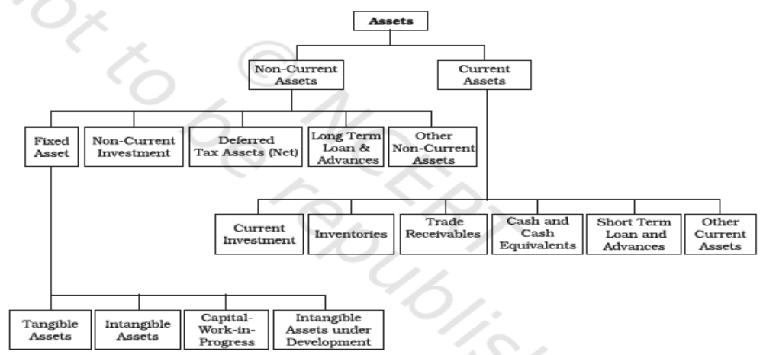
Classification of assets

Slide 20
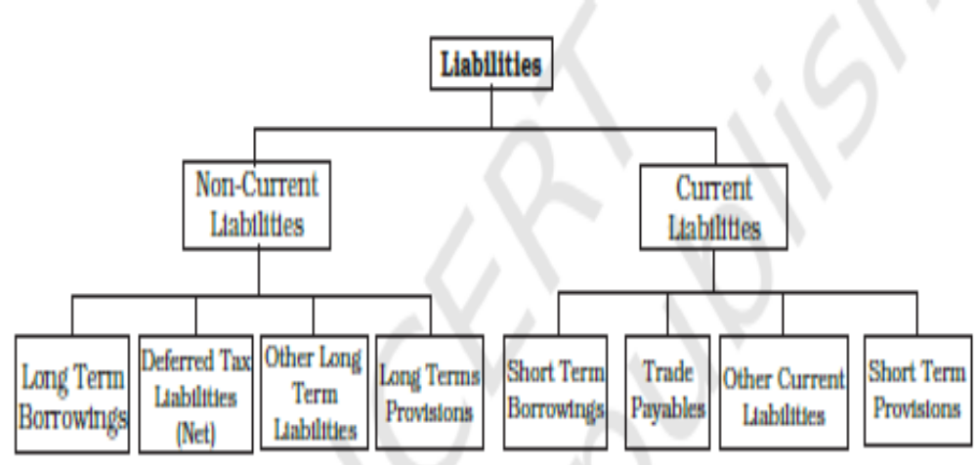
Classification of liabilities

Slide 21
Exercise 4
Items | Current Assets | Non-current asests | Current liabilities | Non-current liablities
Machinery
Sundry creditors
Cash at bank
Goodwill
Bills payable
Land & Building
Loose tools
Computer systems
Inventory
Investments
Loan from bank
Sundry debtors
Patents

Slide 22
More books and accounts!!
Cash book – single column and double column
Petty cash book
Purchase book
Purchase return (Return outwards) book
Sales book
Sales return (Return inwards) book
Bank reconciliation statements (BRS)
Depreciation, provision and reserves – major issue and concern !!!

Slide 23
Debit note and credit note
A Debit note is a document evidencing a debit to be raised against a party for reasons other than sale on credit.
  On finding that goods supplied are not as per the terms of the order placed, the defective goods are returned to the supplier of the goods and a note is prepared to debit the supplier; or when an additional sum is recoverable from a customer such a note is prepared to debit the customer with the additional dues. In these two situations the note is called a debit note.
A Credit note is prepared, when a party is to be given a credit for reasons other than credit purchase. It is a common practice to make it in red ink.
  When goods are received back from a customer, a credit note should be sent to him.

Slide 24
Journal Proper
A book maintained to record transactions, which do not find place in special journals, is known as Journal Proper or Journal Residual.
  Opening entry – for opening balances
  Adjustment entry – outstanding, prepaid, depreciation etc
  Rectification entry – to rectify errors
  Transfer entry – also called closing entries
  Other entry – any other entry not recorded in any books

Slide 25
Trial balance
It is a statement showing the balances, or total of debits and credits, of all the accounts in the ledger with a view to verify the arithematical accuracy of posting into the ledger accounts.
It is an important statement in the accounting process as it shows the final position of all accounts and helps in preparing the final statements.
A tallied trial balance only proves, to a certain extent, that the posting to the ledger is arithmetically correct but there can be errors such as
  Errors of commission – say wrong posting of transactions, wrong totals etc
  Errors of omission – at the time of recording transaction or posting in ledger
  Errors of principle
  Compensating errors
Create suspense account but then sort out the errors.

Slide 26
Depreciation
It implies that fixed assets are subject to decline in value and this decline is technically referred to as depreciation.
As an accounting term, depreciation is that part of the cost of a fixed asset which has expired on account of its usage and/or lapse of time. Hence, depreciation is an expired cost or expense, charged against the revenue of a given accounting period.
Depreciation may be described as a permanent, continuing and gradual shrinkage in the book value of fixed assets.
It is based on the cost of assets consumed in a business and not on its market value.
Terms like depletion (in case of mines etc), amortization (for patents, goodwill etc) as also used.
AS – 6 on Depreciation.
Methods – straight line method, written down value method.

Slide 27
Provision and reserve
Provisions: There are certain expenses/losses which are related to the current accounting period but amount of which is not known with certainty because they are not yet incurred. It is necessary to make provision for such items for ascertaining true net profit.
  Provision for depreciation;
  Provision for bad and doubtful debts;
  Provision for taxation;
  Provision for discount on debtors; and
  Provision for repairs and renewals.
Reserve: A part of the profit may be set aside and retained in the business to provide for certain future needs like growth and expansion or to meet future contingencies. It is not a charge against profit as it is not meant to cover any known liability or expected loss in future.
  General reserve;
  Workmen compensation fund;
  Investment fluctuation fund;
  Capital reserve;
  Dividend equalisation reserve;
  Reserve for redemption of debenture.

Slide 28
NOW …… COMPANY ACCOUNTS !!! ☺

Slide 29
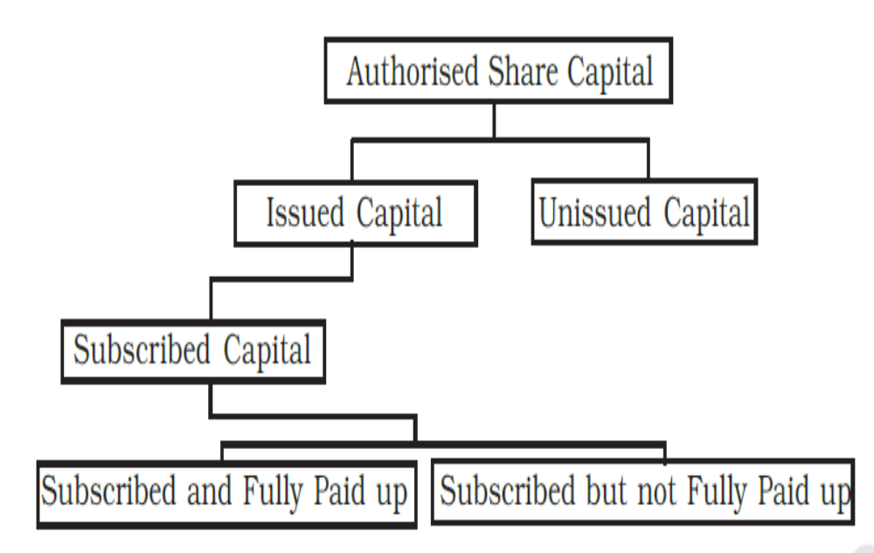
Share capital

Slide 30
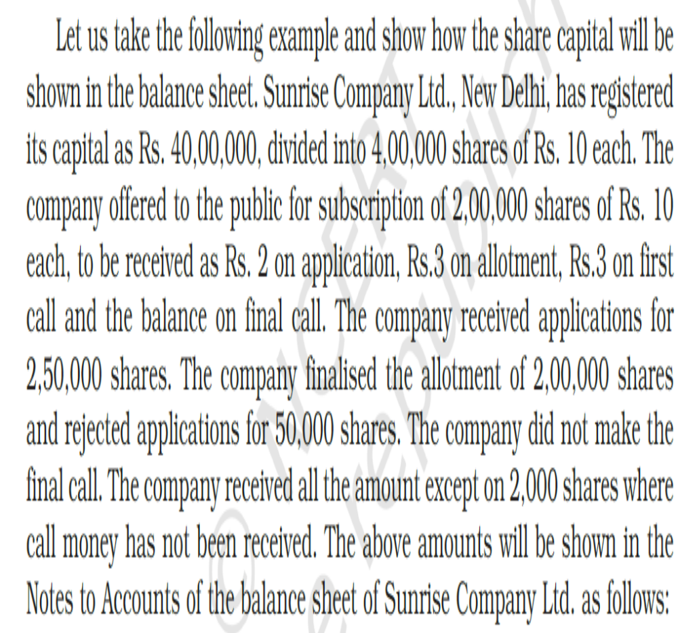
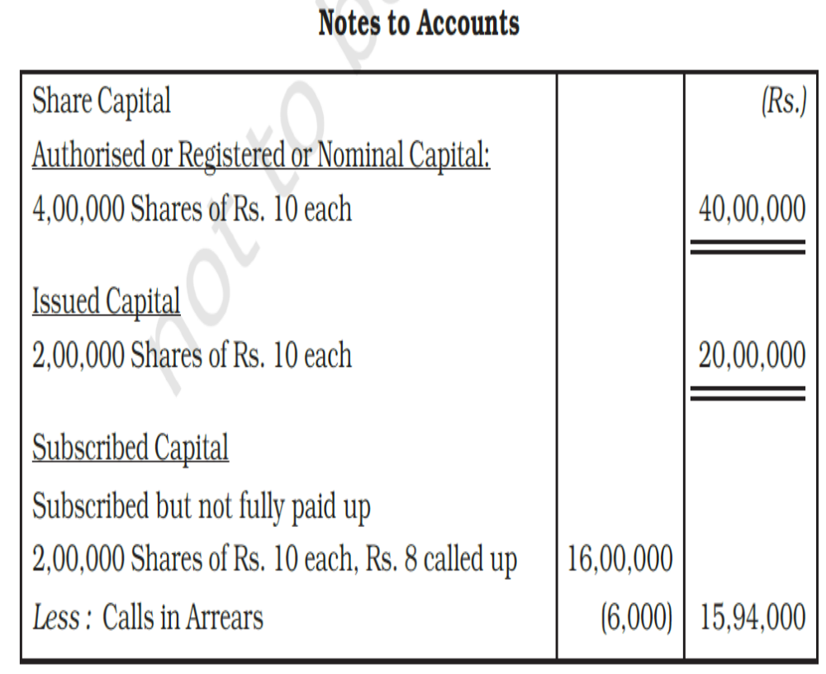
Example

Slide 31
Classes of shares
MoA – Amount of authorised share capital with all details like number of shares in which it is divided
AoA – classes of shares, their rights and obligations
Can be issued at premium or discount
2 types of shares
  Equity shares (ordinary shares)
  Preference shares
    Cumulative
    Non-cumulative
    Redeemable
    Non-redeemable

Slide 32
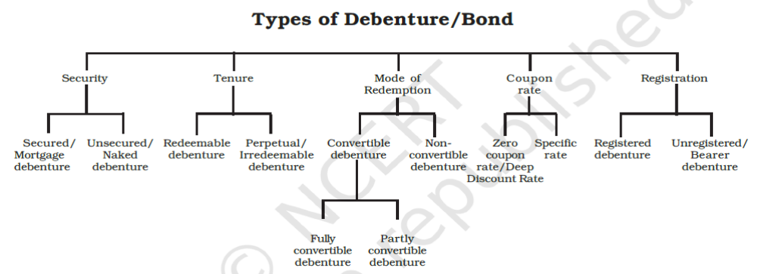
Debentures
Latin word – debere – means to borrow
To meet long term financial needs of the company
Can be through private placement or to public
Known as long term debt
Can be issued at
  Par
  Premium
  Discount
  Can be for other
  than cash also

Slide 33
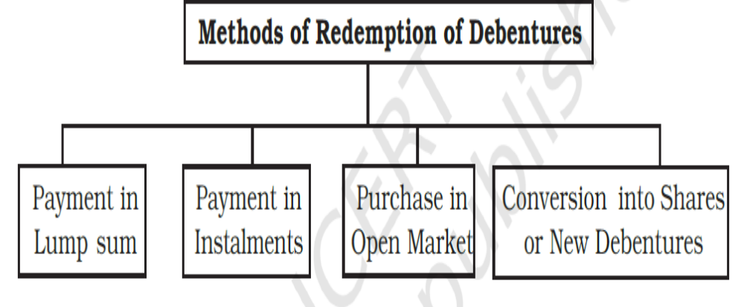
Redemption of debentures

Slide 34
Financial statements of company
Balance sheet – Schedule III of Companies Act 2013
Profit and loss account – as per Companies Act 2013
Statement of retained earnings
Statement of cash and fund flows
Financial statement analysis
  Trend analysis,
  Comparative statements,
  Common size statements,
  Ratio analysis

Slide 35
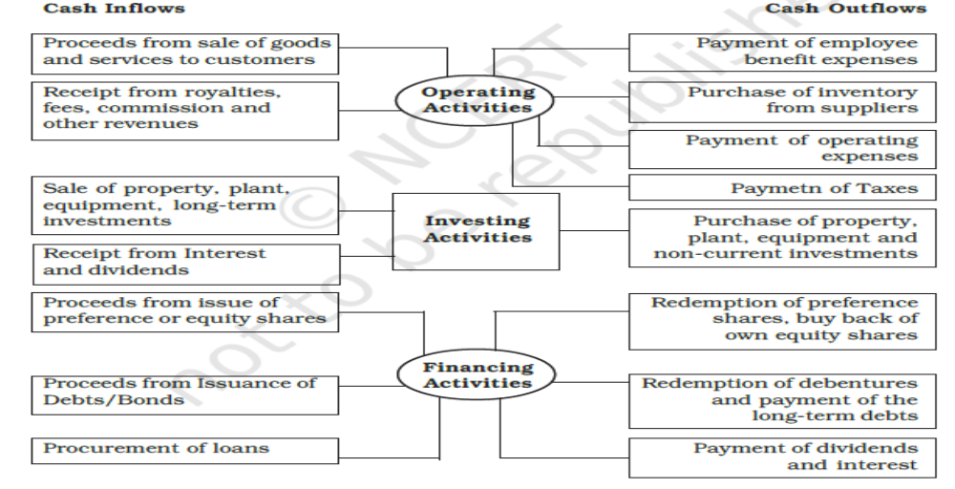
Cash flow statements

Slide 36
Different activities … some difference !!
Manufacturing/production companies
Trading companies
Service companies
What is different ?
  Cost of goods sold concept
  Inventory consideration
  Purchase/sales- goods or services
  Sometimes – formats etc as per law

Slide 37
So much more !!!! ☹
Calculation of goodwill
Calculation of market value of shares, bonds and debentures
Consignment accounts
Departmental accounts
Joint venture accounts
Hire purchase and instalment purchase system
Leasing and royalty account
Insurance company accounts
Banking sector accounts
Investment accounts
Government accounts
Holding and subsidiary company accounts – consolidation
Impacts of Absorption, mergers and acquisitions, internal and external reconstructions (including liquidations)
And many more !!!!!!

