Slide 1
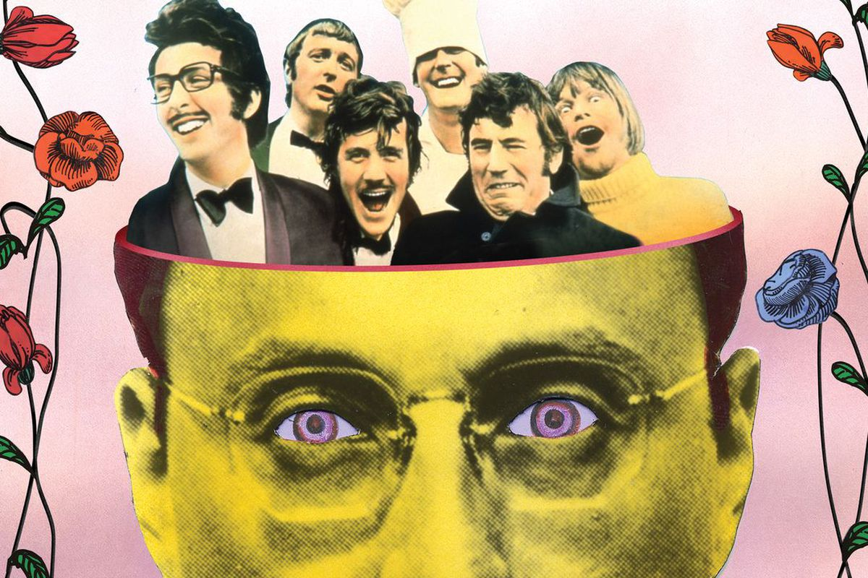

Python

Slide 2
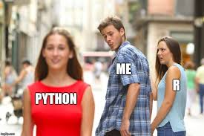

Slide 3
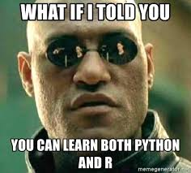

Slide 4

Reticulate
Notes:
Why is Python called Python !

Slide 5
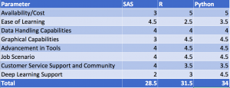
©Analyticsvidhya

Slide 6
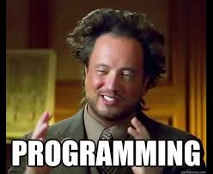
WHY SHOULD I CARE ABOUT CODING !

Slide 7
https://www.youtube.com/watch?v=Dv7gLpW91DM

Slide 8
INPUT
PROCESS
OUTPUT

Slide 9
Input
Read different kind of data from different types of files, locations, devices, other programs.
Take Input from user

Slide 10
Process
Use various expressions for calculations.
Write your own function which can be called whenever required
Use third party libraries/packages for readily available functions.
Use loops for iterating some task.
Use Control statements for taking decisions

Slide 11
Output
Save the calculated results in different types of files, locations, send to other programs.
Show the results on screen
Send it to printer or any other devices.

Slide 12
Python

Slide 13
Interpreted
Multiple programming paradigms
In AI/ML/DS , it’s useful for all the phases including production environment.

Slide 15
Environment
Anaconda
Jupyter Notebook
Spyder

Slide 16
Hello World
In Jupyter Notebook
print("Hello, World!")

Slide 17
What is Kernel ?

Slide 18
“computational engine” that executes the code contained in a Notebook document.

Slide 19
In Spyder
Jupyter Notebook

Slide 20
Comment
# This is a comment
print("Hello, World!")

Slide 22
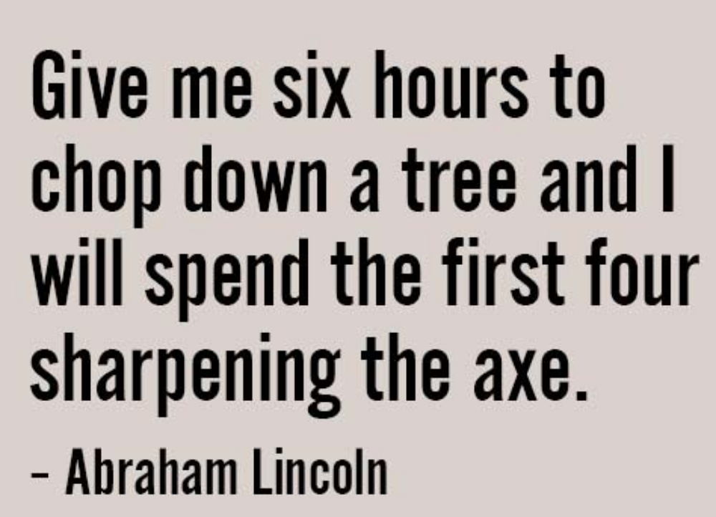

Slide 23


Slide 24
Variables
No Explicit Declaration
a = 43
c=“43”
b = "abhi"
print(a)
print(b)
print(type(a))
print(type(b))

Slide 25
More on strings
str1 = "This course is"
str2 = "Python 101 module"
print(str1[1])
print(str2[3:7])
str3 = str1 + str2
print(str3)

Slide 26
Multi variables in 1 line
x,y,z = "IIM","IIT","AIIMS“
print(x)
print(y)
print(z)

Slide 27
Escape Characters
\n new line
\t tab
print("abhi \n \n \n \n sri")

Slide 28
print
a = 6546
b = 32
c = "abhi"
print("Output is ", a,b,c )

Slide 29
Taking input
name = input("Enter your name")

Slide 30
num1 = int(input("Enter a integer number:"))
num2 =float(input("Enter a floating number "))

Slide 31
WAP , enter two numbers from user and print their sum.

Slide 32
Python Control
a = 563
b = 433
if b > a:
print("b is greater than a")
print("outside loop")

Slide 33
Indentation
whitespace at the beginning of a line
Used to define scope
Instead of brackets

Slide 34
a=344
b=45
if b > a:
print("b is greater than a")
elif a > b:
print("a is greater than b")
print("one more line in second block")
else:
print("a is equal to b")
print("now outside the overall if block")

Slide 35
While
i=1
while i<50:
print(i)
i=i+1

Slide 36
Break
i=1
while i<25:
print(i)
if i==30 :
break
i=i+1

Slide 37
For
for x in range(2, 30, 3):
print(x)

Slide 38
In reverse order
for x in range(50,1,-2):
print(x)

Slide 39
WAP for multiplication table .
Take input from user and print it’s multiplication table till 10 times.

Slide 40
num1 = int(input("Enter a integer number:"))
for x in range(1,11,1):
print(num1*x)

Slide 41
Python documentation
https://docs.python.org/3.9/
https://docs.python.org/3.9/tutorial/index.html

