Slide 1
Interpretive Structural Modeling

Slide 2
Agility is business-wide capability that embraces organizational structures, information systems and in particular, mindsets (Christopher, 2000)
Agility means using market knowledge and virtual corporation to exploit profitable opportunities in a volatile marketplace (Mason-Jones & Towill, 1999)

Slide 3
Identification of supply chain agility variables
Market sensitiveness (MS)
Delivery speed (DS)
Data accuracy (DA)
New product introduction (NPI)
Centralized and collaborative planning (CCP)
Process integration (PI)
Use of IT tools (UIT)
Lead time reduction (LTR)
Service level improvement (SLI)
Cost minimization (COM)
Customer satisfaction (CUS)
Quality improvement (QI)
Minimizing uncertainty (MU)
Trust development (TD)
Minimizing resistance to change (MRTC)

Slide 4
Interpretive structural modelling (ISM) is an interactive learning process in which a set of different and directly related elements is structured into a comprehensive systemic model (Warfield, 1974; Sage, 1977)
The model so formed portrays the structure of a complex issue or problem in a carefully designed pattern implying graphics as well as words
ISM methodology helps to impose order and direction on the complexity of relationships among elements of a system

Slide 5
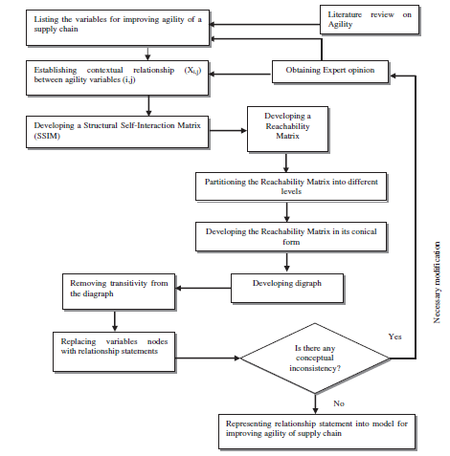
Source: Agarwal, A., Shankar, R., & Tiwari, M. K. (2007). Modeling agility of supply chain. Industrial marketing management, 36(4), 443-457.
Flow diagram for preparing ISM

Slide 6
Methodology
Structural self-interaction matrix (SSIM)
Reachability matrix
Partitioning the reachability matrix
Developing conical matrix
Conical form of reachability matrix
Diagraph
MICMAC analysis (to identify and analyse the variables according to their driving power and dependence)

Slide 7
Stepwise processes involved in the development of ISM model
Step 1: Identify different enablers based on literature review, questionnaire-based survey, and expert’s opinion.
Step 2: establishing the contextual relationship between the enablers.
Step 3: development of structural self-interaction matrix (SSIM) for variables show the pair-wise interactions among the enablers. In each “x-y” link, the interpretation is used to develop the “knowledge base”.
Step 3.1: SSIM is developed with the following variables:
V: variable x will help to achieve variable y;
A: variable y will be achieved by variable x;
X: variables x and y will help achieve each other; and
O: variables x and y are unrelated.
Source: Mohanty, M. (2018). Assessing sustainable supply chain enablers using total interpretive structural modeling approach and fuzzy-MICMAC analysis. Management of Environmental Quality: An International Journal.

Slide 8
Step 3.2: initial reachability matrix is developed.
Step 3.2.1: if (x, y) entry in the SSIM is V, then (x, y) entry in the reachability matrix becomes 1 and the (y, x) entry becomes 0.
Step 3.2.2: if (x, y) entry in the SSIM is A, then (x, y) entry in the reachability matrix becomes 0 and the (y, x) entry becomes 1.
Step 3.2.3: if (x, y) entry in the SSIM is X, then (x, y) entry in the reachability matrix becomes 1 and the (y, x) entry becomes 1.
Step 3.2.4: if (x, y) entry in the SSIM is O, then (x, y) entry in the reachability matrix becomes 0 and the (y, x) entry becomes 0.
Step 3.3: matrix is checked for the presence of transitive relation and is converted into a final reachability matrix.
Step 3.3.1: entries with 1* is filled for showing the transitivity relationship to fill the gap.
Step 4: level partitioning is done in reachability matrix.
Step 5: development of reachability matrix in its conical form.
Step 6: development of diagraph.
Step 7: interaction matrix represents the connectivity between the nodes denoted by 1 and where there is no connectivity it is denoted as 0.
Step 8: development of TISM.
Step 9: driving power and dependence are derived from a conical form of reachability matrix.
Step 10: MICMAC analysis is done for clustering various enablers, and the driving power and dependence of the variables is identified.
Source: Mohanty, M. (2018). Assessing sustainable supply chain enablers using total interpretive structural modeling approach and fuzzy-MICMAC analysis. Management of Environmental Quality: An International Journal.

Slide 9
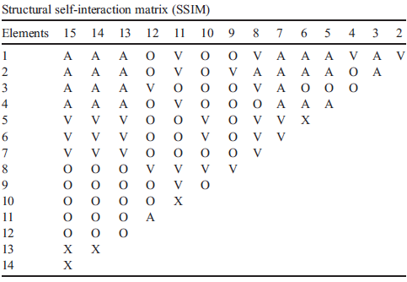
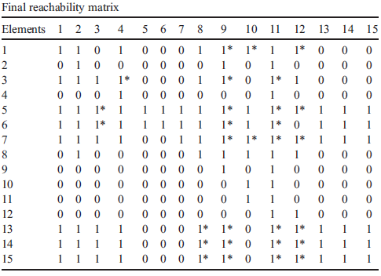
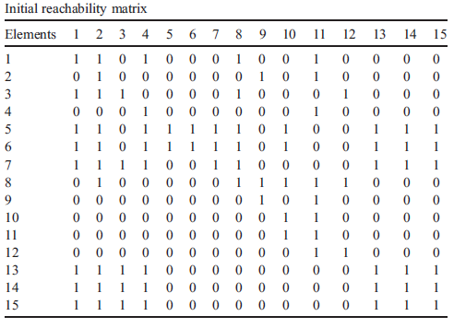
Source: Agarwal, A., Shankar, R., & Tiwari, M. K. (2007). Modeling agility of supply chain. Industrial marketing management, 36(4), 443-457.

Slide 10
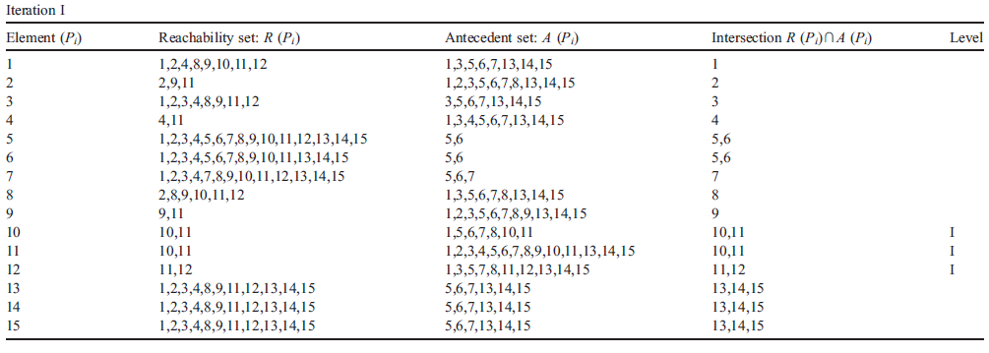
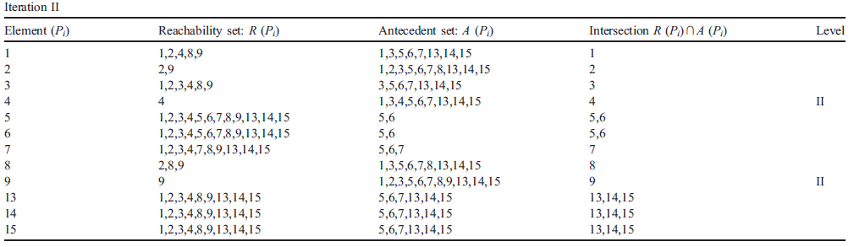
Source: Agarwal, A., Shankar, R., & Tiwari, M. K. (2007). Modeling agility of supply chain. Industrial marketing management, 36(4), 443-457.

Slide 11
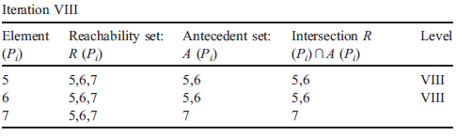
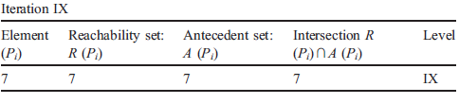
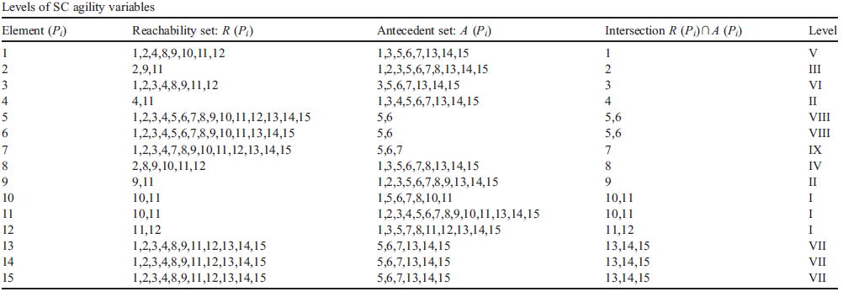
Source: Agarwal, A., Shankar, R., & Tiwari, M. K. (2007). Modeling agility of supply chain. Industrial marketing management, 36(4), 443-457.

Slide 12
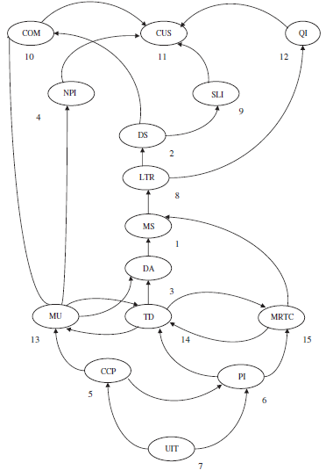
Digraph-ISM based model of the variables for improving supply chain agility
Source: Agarwal, A., Shankar, R., & Tiwari, M. K. (2007). Modeling agility of supply chain. Industrial marketing management, 36(4), 443-457.

Slide 13
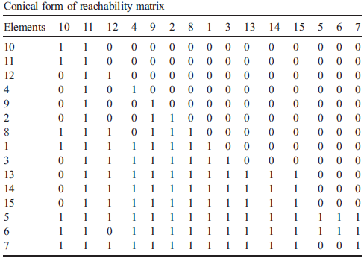
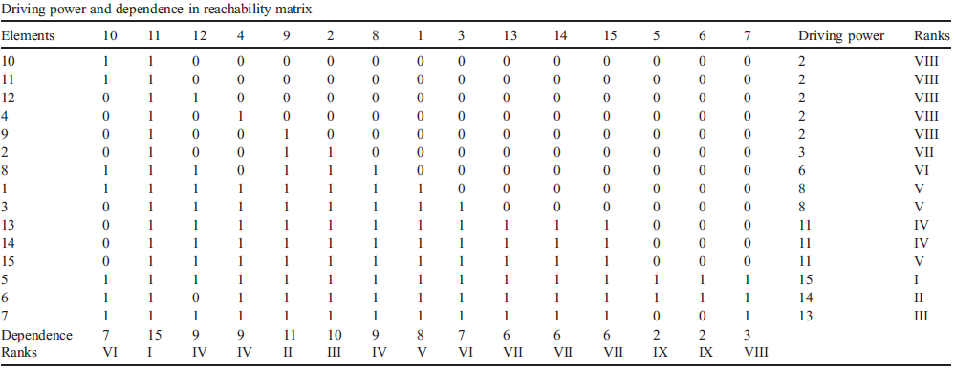
Source: Agarwal, A., Shankar, R., & Tiwari, M. K. (2007). Modeling agility of supply chain. Industrial marketing management, 36(4), 443-457.

Slide 14
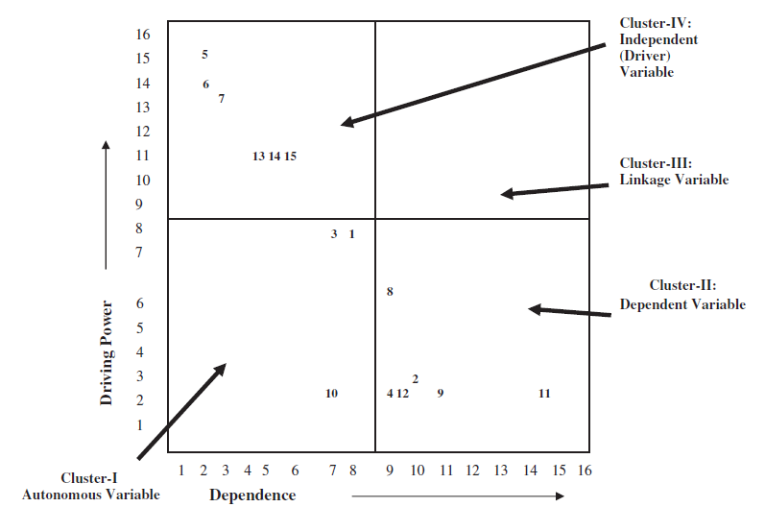
Source: Agarwal, A., Shankar, R., & Tiwari, M. K. (2007). Modeling agility of supply chain. Industrial marketing management, 36(4), 443-457.

Slide 15
Cluster I consists of autonomous variables. These factors have weak driving power and weak dependence
Cluster II consists of dependent variables that have weak driving power, but strong dependence
Cluster III consists of linkage variables that have strong driving power and also have strong dependence. These enablers are unstable in the fact that any action on these enablers will have an effect on others and also a feedback on themselves
Cluster IV includes the independent enablers having strong driving power and weak dependence

Slide 16
ISM developed acts as a tool for top management to understand the variables of an agile project
Though ISM is developed on the basis of perception of the experts of management, the results are quite generic
It is helpful for the top management to drive the efforts towards the roots of the problem
ISM approach leads us to the variables where fruitful results in terms of market share improvement can be achieved
Source: Agarwal, A., Shankar, R., & Tiwari, M. K. (2007). Modeling agility of supply chain. Industrial marketing management, 36(4), 443-457.

