Slide 1

Curve Trades

Slide 2

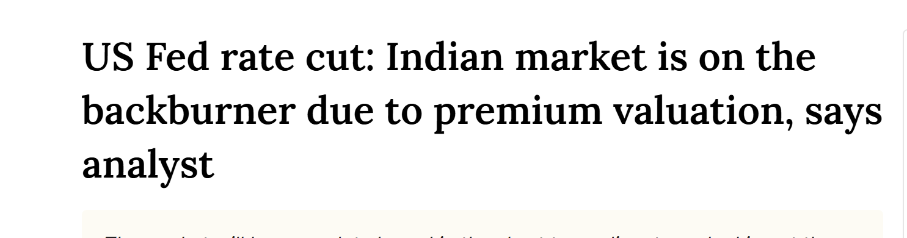
Thought for the day
Let’s start class with a good news
US Fed rate cut: Indian market is on the backburner due to premium valuation, says analyst | Stock Market News (livemint.com)

Slide 3
Price Convention…
Clean Price: it is the price of the Bond excluding Accrued interest.
  The trading in the Wholesale Debt market takes place at this price.
Dirty Price: it is the price of the bond including Accrued interest.
  The trading in the Retail Debt Segment takes place at this price and it keeps on fluctuating during the day.

Slide 4
RELATION BETWEEN
BOND PRICES AND YTM
For a given maturity period, we observe the following relation between bond price and YTM:
  HIGHER THE YTM, LOWER THE BOND PRICE and vice-versa.
  And, this relation is CONVEX.

Slide 5
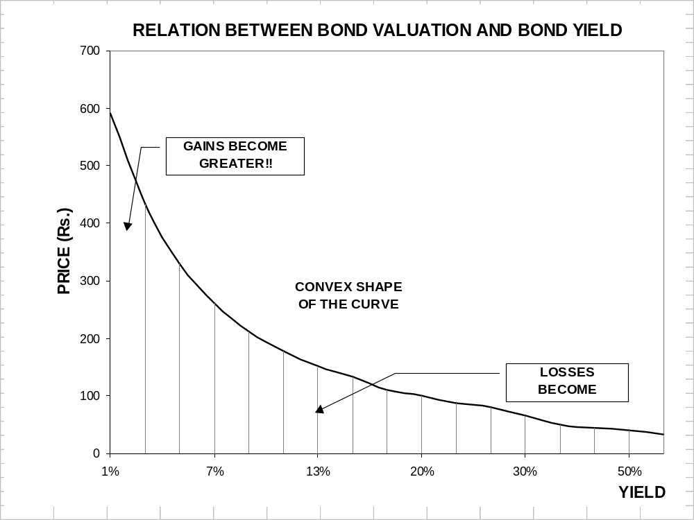
LOSSES BECOME SMALLER!!

Slide 6
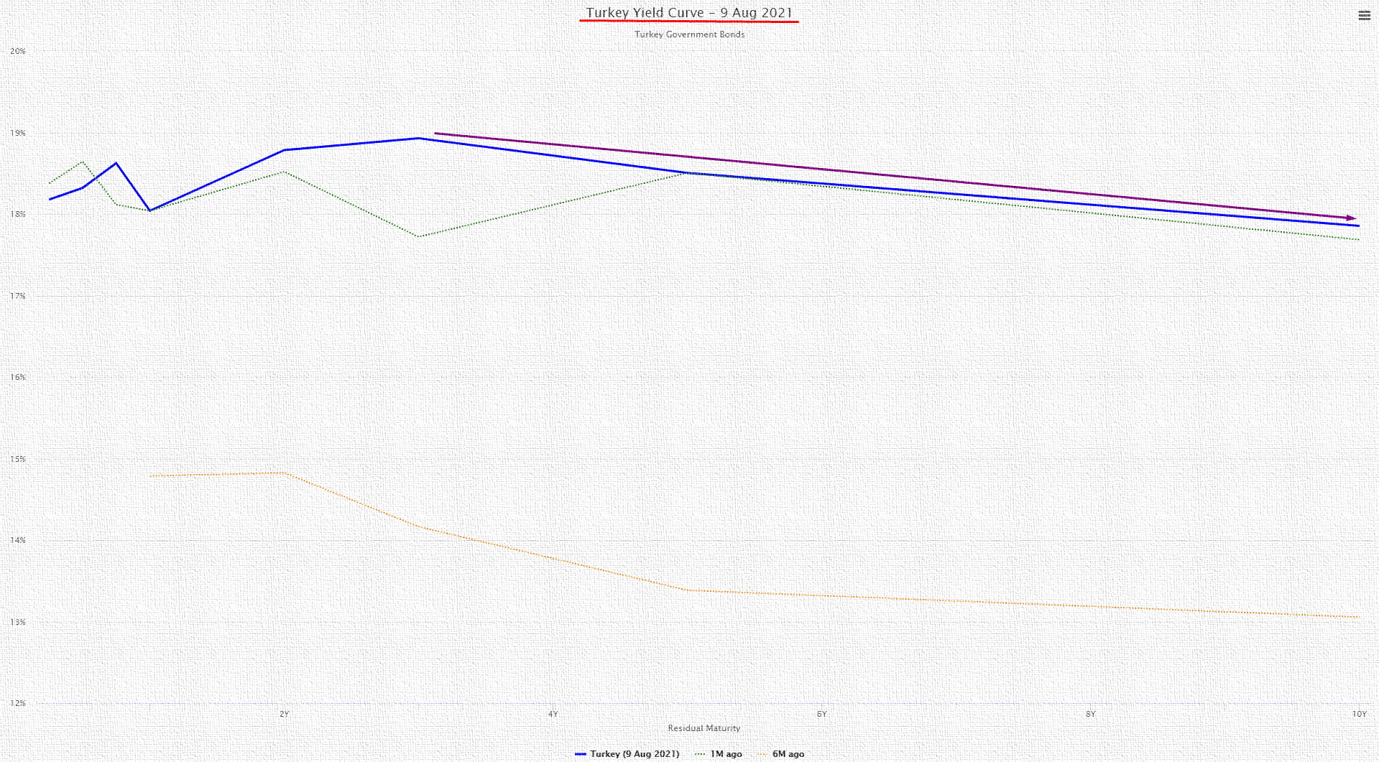
What is interesting in the following yield curve?

Slide 7
RELATION BETWEEN BOND PRICES
AND TIME TO MATURITY
Price of a bond changes with time!!!
In this regard, we observe the following:
  As a bond approaches to its maturity, its price approaches to its terminal value.
  It means that if a bond is being sold at premium at present, its price will decrease over time; and if it is being sold at a discount, then its price will increase over a period of time.

Slide 8
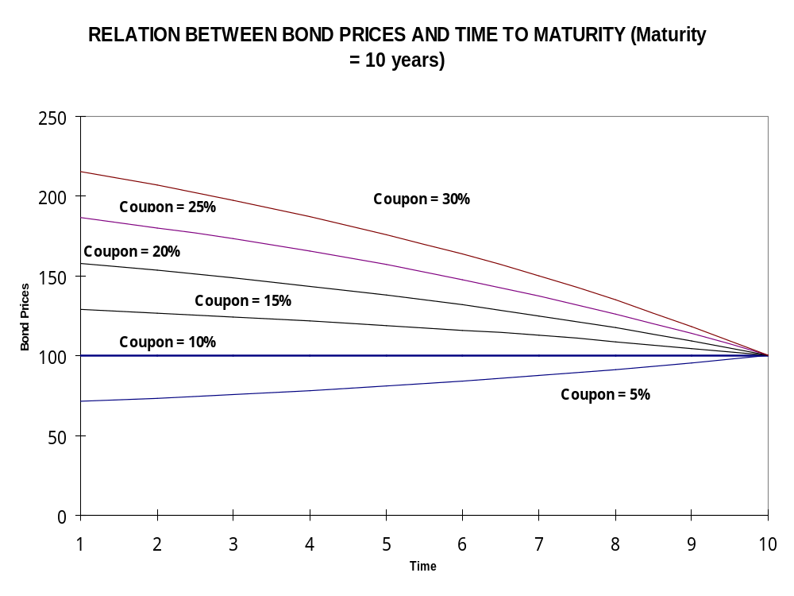

Slide 9
RELATION BETWEEN BOND PRICES
AND DIFFERENT MATURITY PERIODS(continued…)
For a given coupon rate and a given YTM, the different maturity periods bonds have mixed impact on the prices of bonds.
  If the coupon is more than the YTM, then the bond with higher maturity periods will have HIGHER PRICES.
  If the coupon is less than the YTM, then the bond with higher maturity periods will have LOWER PRICES.
  If the coupon is equal to the YTM, then the bond prices remain same AT PAR irrespective of maturity period.

Slide 10
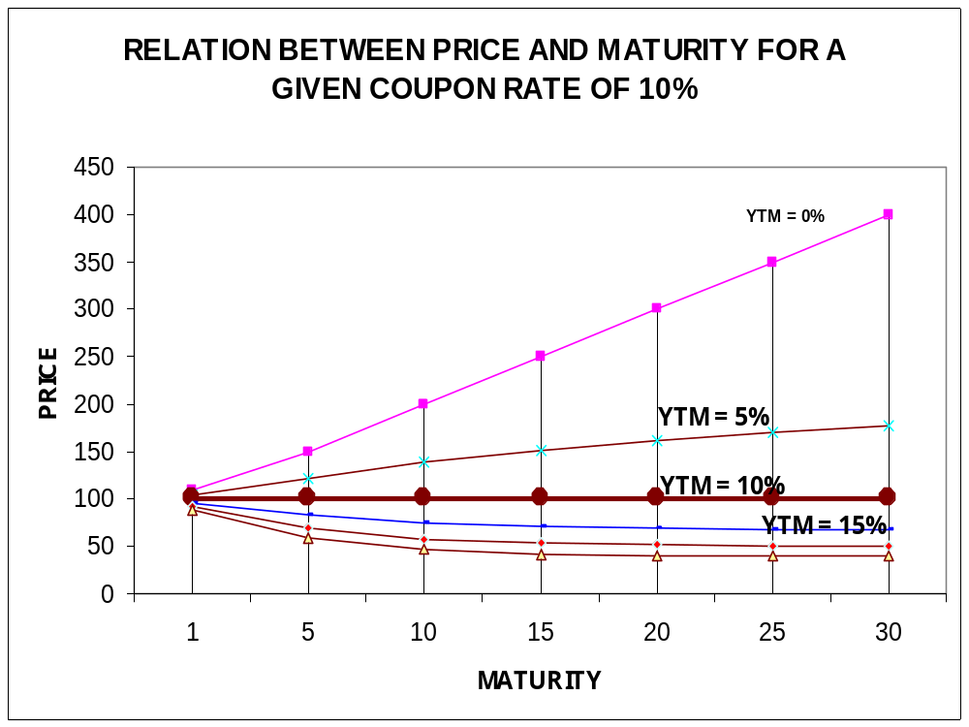

Slide 11
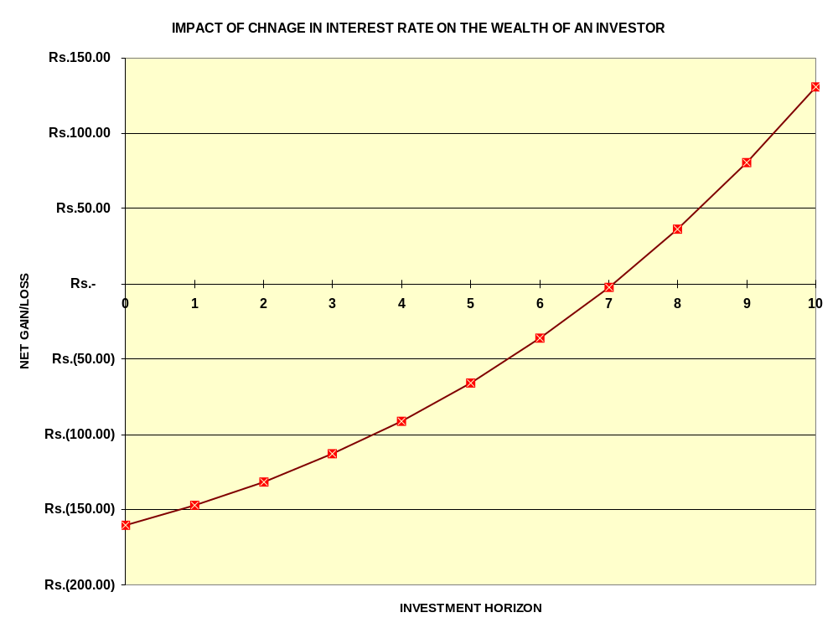

Slide 12
FUNDAMENTAL THEOREMS OF BOND PRICES
[MALKIEL’BOND THEOREMS]
Theorem#1: Bonds prices move inversely to bonds YTM.
Theorem #2: If all other factors are held constant, a bond’s interest rate risk increases with the length of time remaining until it matures.
Theorem #3: A bond’s interest rate risk increases at a diminishing rate as the time remaining until it’s maturity increases.

Slide 13
FUNDAMENTAL THEOREMS OF BOND PRICES
[MALKIEL’S BOND THEOREMS] (continued)
Theorem #4: The price change that results from an equal-sized increase or decrease in a bond’s YTM is asymmetrical. More specifically, for any given maturity, a decrease in yields causes a price rise that is larger than the price loss that results from an equal increase in yields.
Theorem #5: A bond’s interest risk varies inversely with its coupon rate.

Slide 14
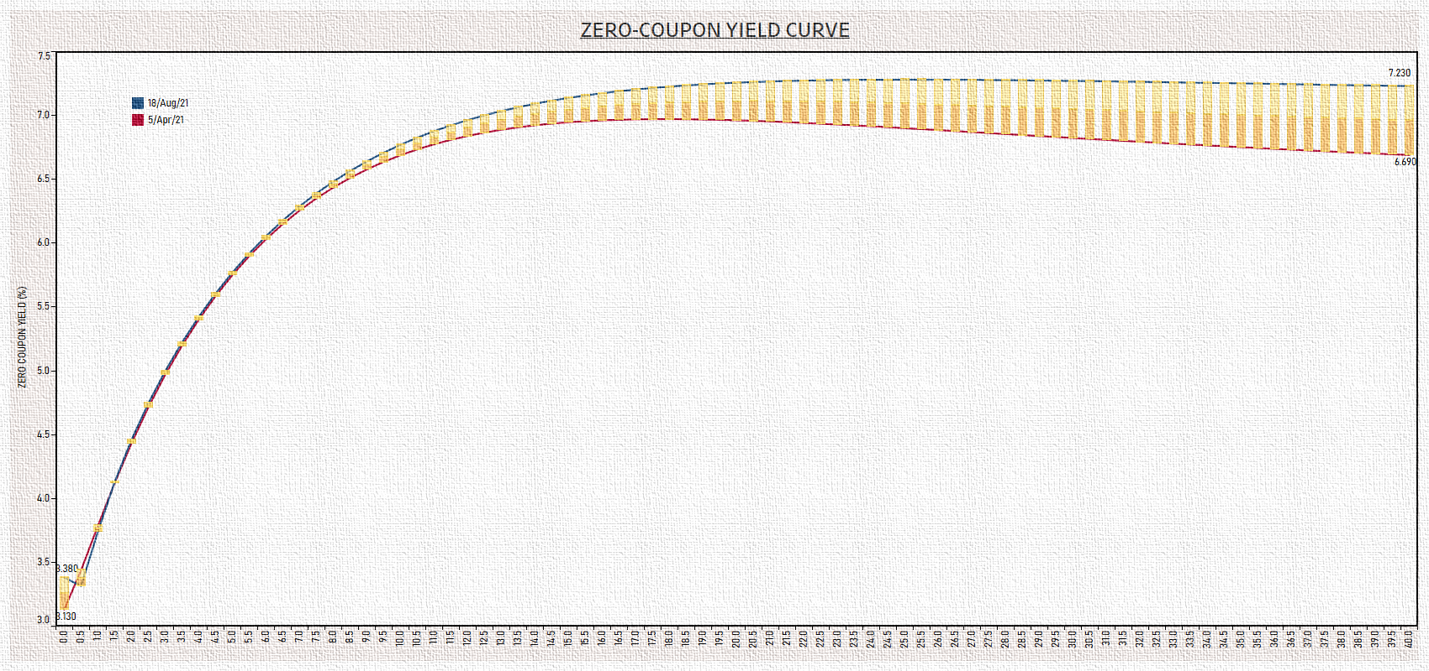

Slide 15
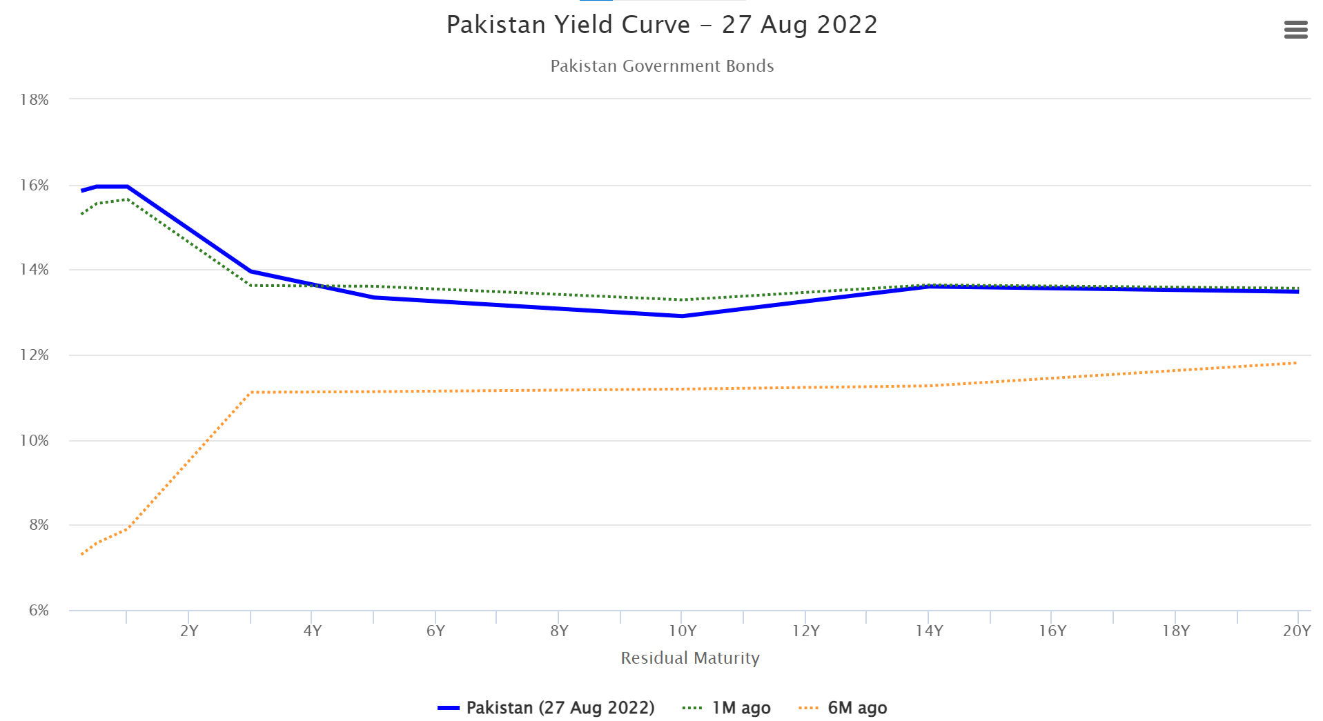
What is interesting in the following yield curve?

Slide 16

An interesting quote about investment.
ET Wealth – Aug 13, 2018

Slide 17
There are various ways to calculate the DOLLAR VALUE OF A ONE BASIS POINT DECREASE [DV01]...
DV01 is Price at a Yield One Basis Point below Existing Yield Less Price at Existing Yield.
METHOD#2: DV01 is calculated using the Derivative of the Price-Yield Relationship directly; that is to say-
DV01 = -0.0001× ^{dP}/_{dy}
METHOD#3: According to this method, DV01 is Price at a Yield ½ Basis Point below Existing Yield Less Price at ½ Basis Point above Existing Yield.
Ultimately I am interested in DP/ Dy , change in price I get from DV01 and change in yield from yield changes.

Slide 18
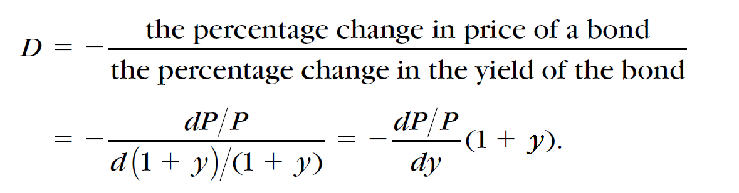
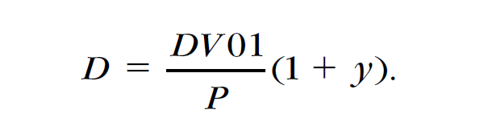
MACAULAY’S DURATION
MACULAY’S DURATION of a bond means:
  It is percentage change in price with respect to percentage change in yield.
  A measure which is based on the first derivative of the price function of a bond.

Slide 19
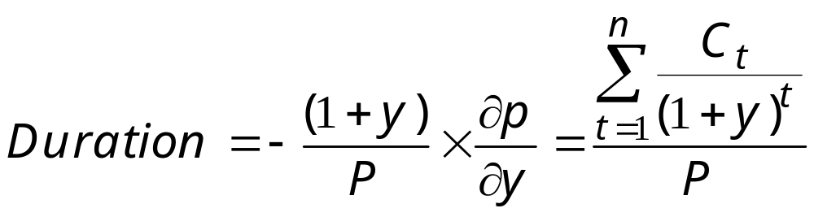
MACAULAY’S DURATION…continued
MACULAY’S DURATION of a bond is calculated as thus:

Slide 20
MACAULAY’S DURATION (RHS Meaning)
MACAULAY'S DURATION of a bond means:
  The weighted average of the times of payment of all the cash flows generated by the bond, the weights being the shares of the bond’s cash flows in a period in the bond’s total present value.
  The weighted average of the waiting times (measured in years) for receiving its promised future cashflows.
  A measure of the weighted average time where weights are the present value of future cash flows and total value of future cash flows is nothing but the price of a bond.

Slide 21
Duration
Duration is interpreted as the approximate percentage change in price for a 100 basis point change in rates. Consequently, a duration of 10.66 means that the approximate change in price for this bond is 10.66% for a 100 basis point change in rates.
For example, suppose that we want to know the approximate percentage change in price for a 50 basis point change in yield for our hypothetical 9% coupon 20-year bond selling for 134.6722. Since the duration is 10.66, a 100 basis point change in yield would change the price by about 10.66%. For a 50 basis point change in yield, the price will change by approximately 5.33% (= 10.66%/2). Thus, if the yield changes by 50 basis points, the price will change by 5.33% from 134.6722 to 127.4942.(Page 241 Frank Fabbozi )

Slide 22
MACAULAY’S DURATION…(LHS Meaning)
MACULAY’S DURATION of a bond means:
  a measure of sensitivity/elasticity of bond price with respect to yield of the bond.
  a measure which is based on the first derivative of the price function of a bond.

Slide 23

Remember …
Modified Duration is RELATIVE CHANGE IN PRICES (in terms of percentage) with respect to changes in interest rate.
It is not ABSOLUTE CHANGE IN PRICES.

Slide 24
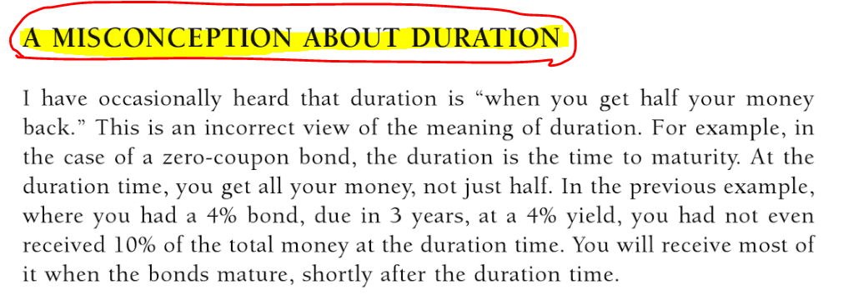
Do not misunderstand duration …

Slide 25
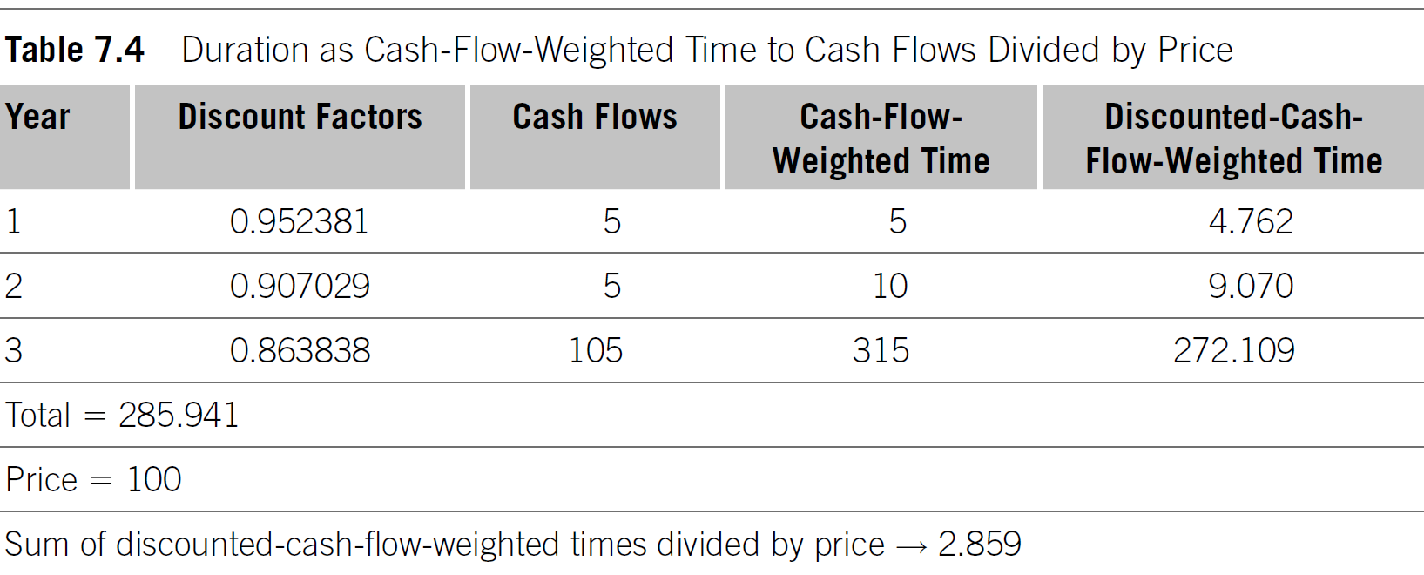

Slide 26
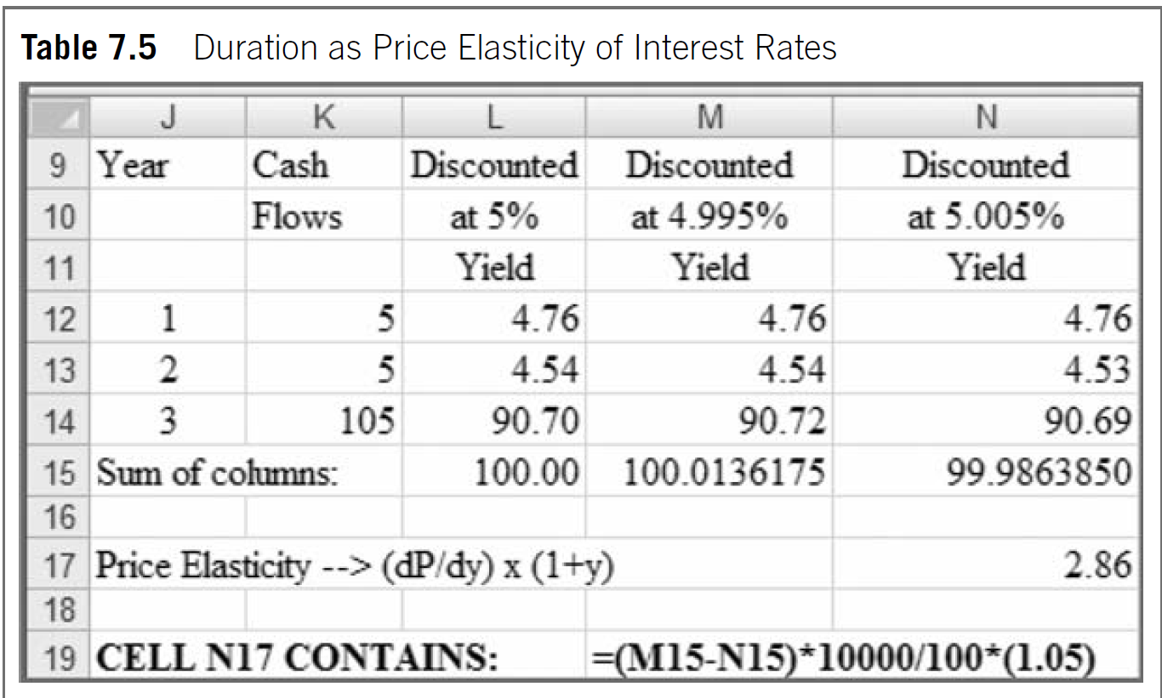

Slide 27
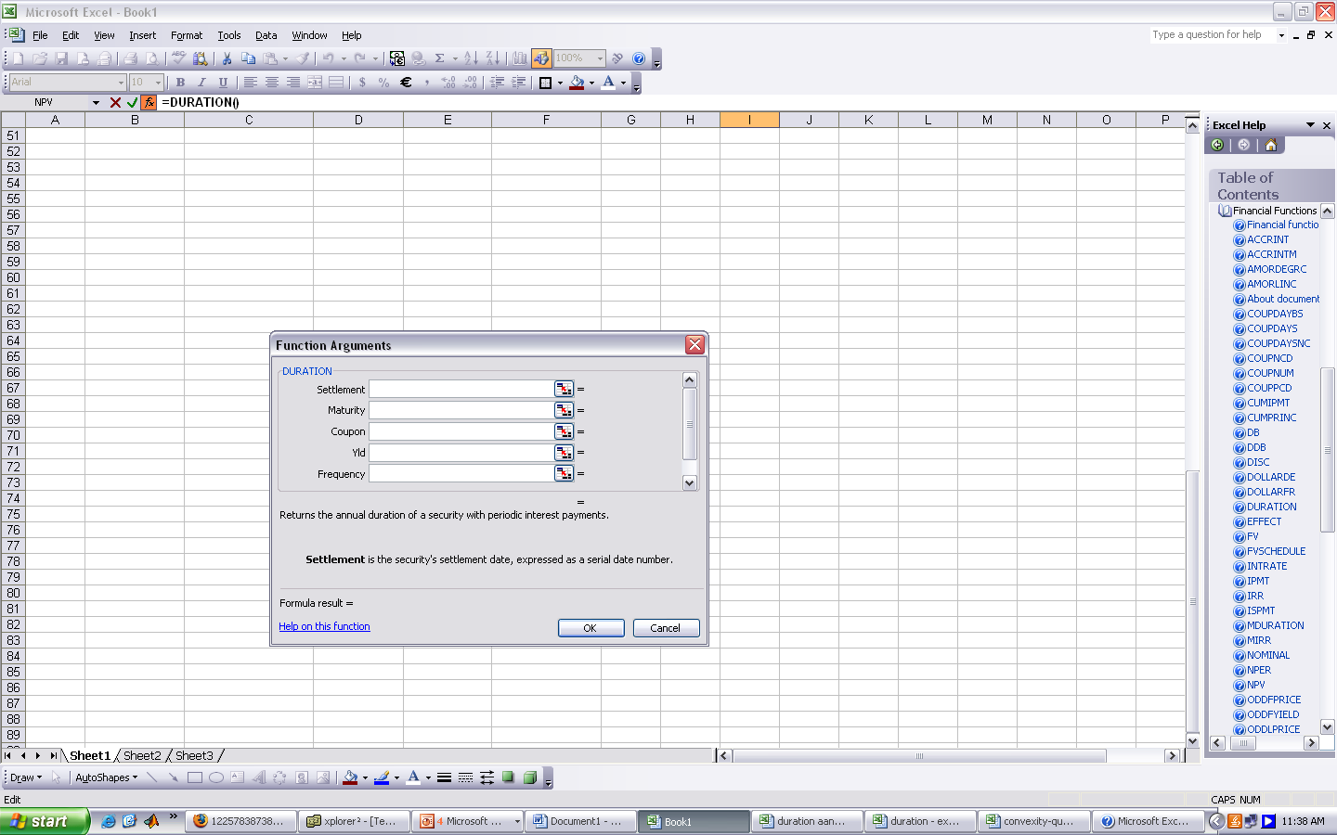
EXCEL INBUILT FUNCTION OF DURATION
Date of Start/Purchase of a Bond
Date of Maturity
Coupon Rate
Yield-to-Maturity
Frequency of Payment of Coupon

Slide 28
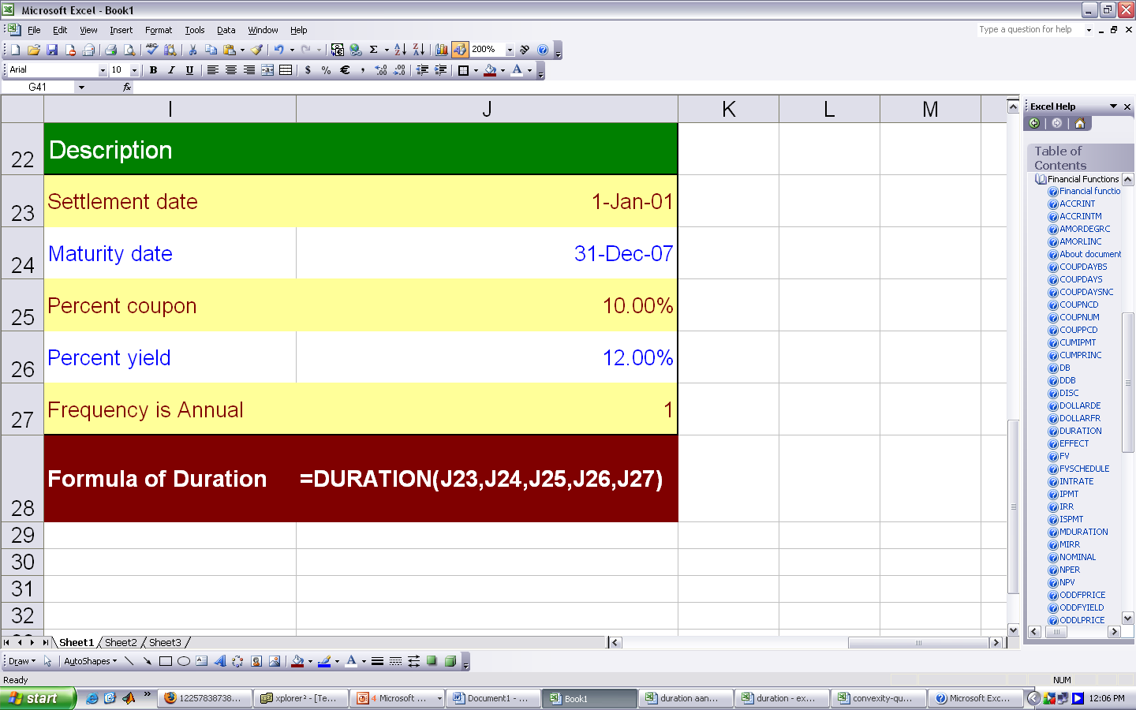
DURATION FUNCTION …

Slide 29
Duration of a Zero – Coupon Bond…
It has no relation with the coupon rates as the zero coupon bond has no coupon.

Slide 30
Duration of a Zero – Coupon Bond…
Since the Duration of a zero – coupon bond is always equal to its maturity, there is no impact of changes in yield on the duration of a zero coupon bond.

Slide 31
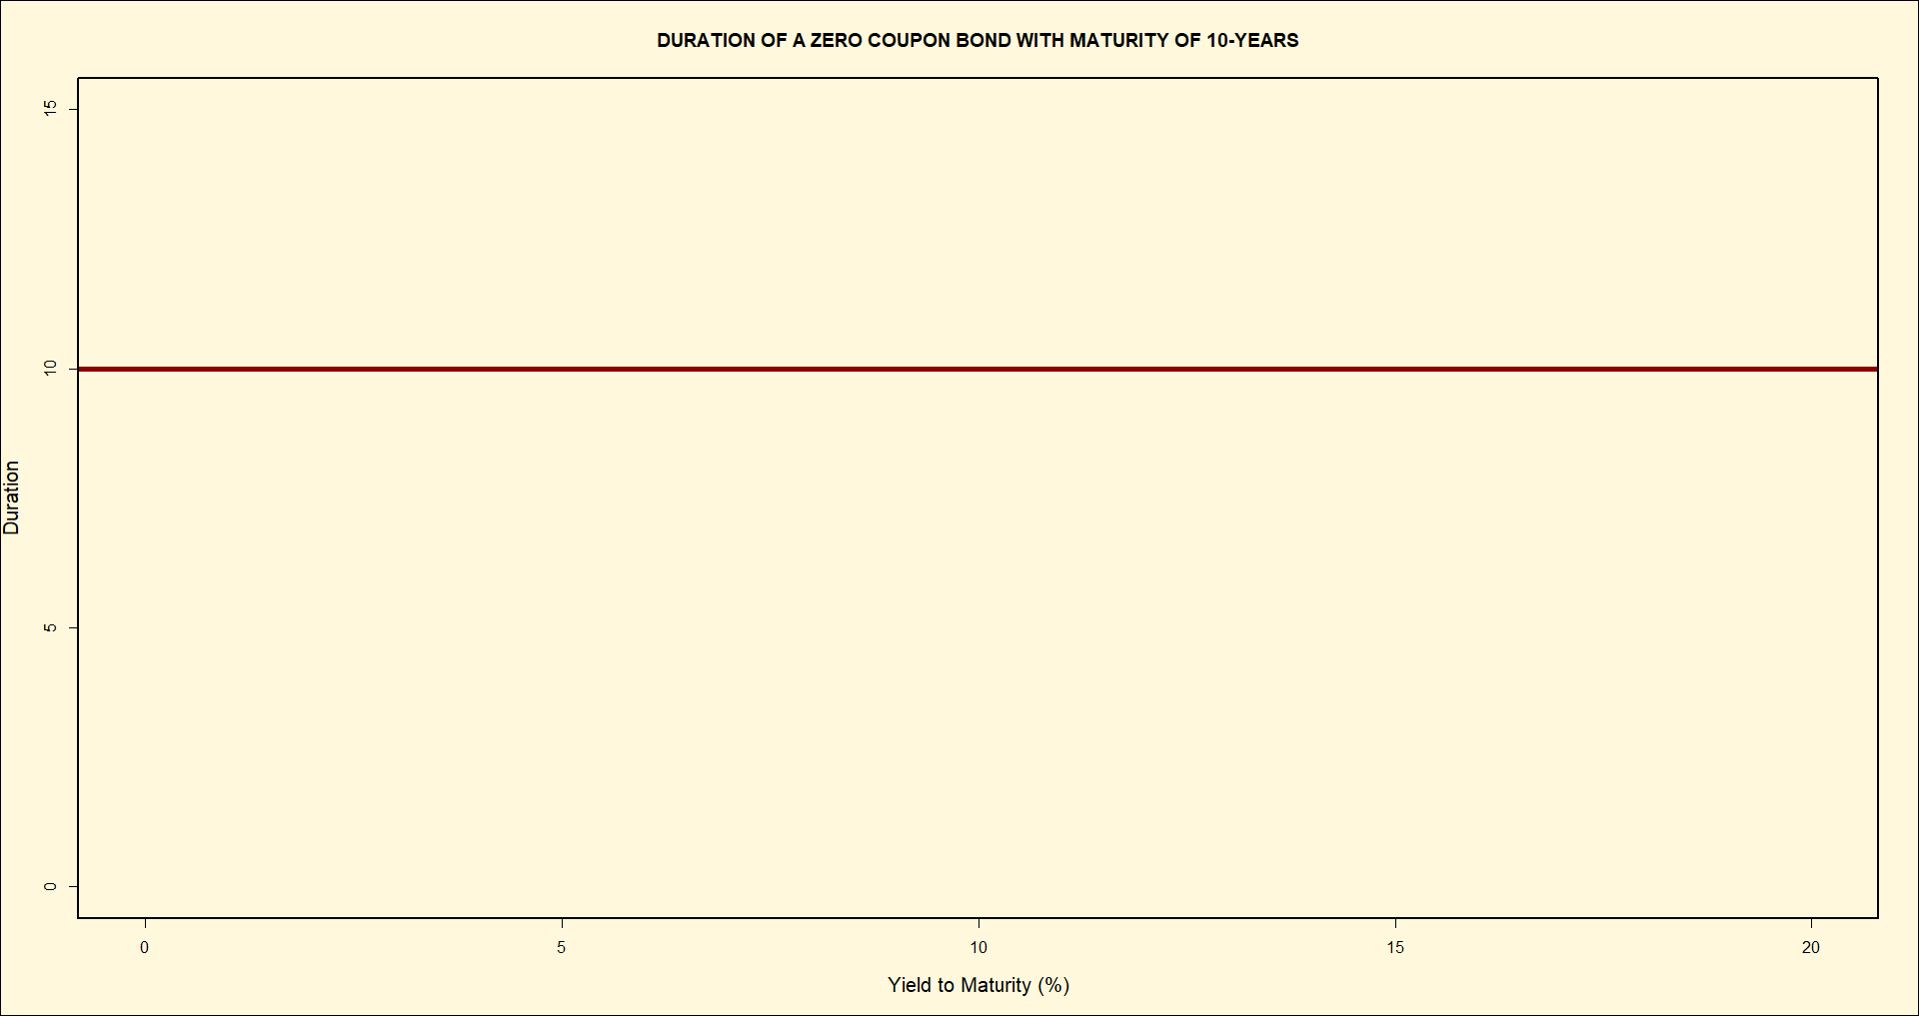

Slide 32
Second…
…We take relation between Dur(without embedded options) and its determinants…

Slide 33
MACAULAY’S DURATION (Some Implications ...)
RELATION BETWEEN COUPON RATE AND DURATION:
  RULE #1: An increase in coupon rate, other things being equal, shortens duration and hence, reduces interest rate risk.
COUPON
DURATION

Slide 34
Duration of a Zero – Coupon Bond…
Since the Duration of a zero – coupon bond is always equal to its maturity, there is one-to-one positive relation between duration of a zero coupon bond and its maturity.

Slide 35

MACAULAY’S DURATION (Some Implications ...)
RELATION BETWEEN COUPON AND DURATION:
Earlier receipts of money through
coupons reduces sensitivity towards
prices and hence INTEREST RATE RISK!!!

Slide 36
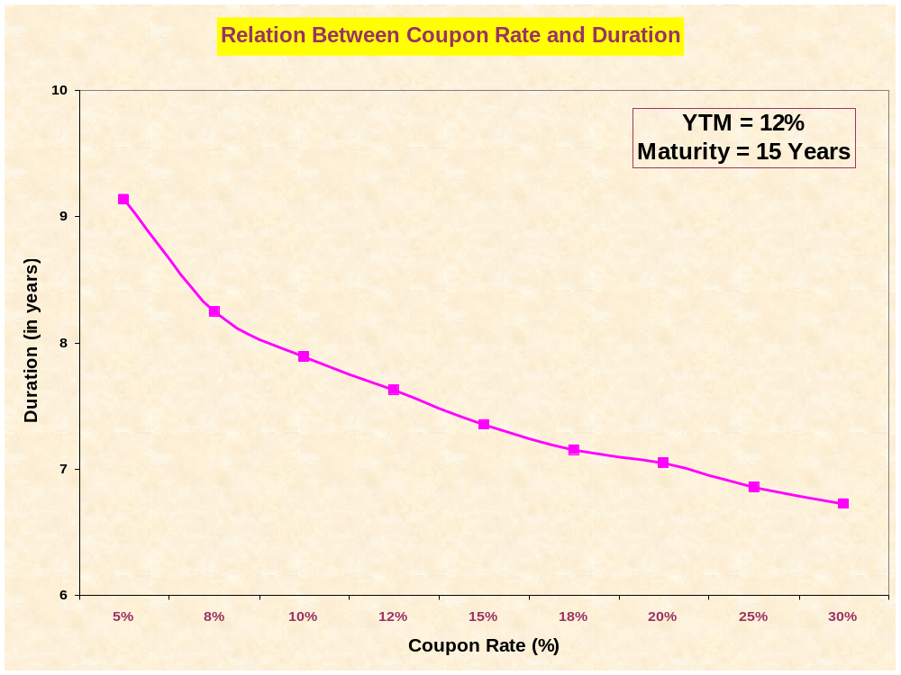
GO TO EXCEL

Slide 37
MACAULAY’S DURATION (Some Implications ...)
RELATION BETWEEN YTM AND DURATION:
  RULE #2: Increase in yield reduces duration and hence, interest rate risk.
YTM
DURATION

Slide 38

MACAULAY’S DURATION (Some Implications ...)
RELATION BETWEEN YTM AND DURATION:
Reduction in YTM increases prices
which implies more exposure to interest rate
fluctuations and hence,
MORE INTEREST RATE RISK!!!

Slide 39
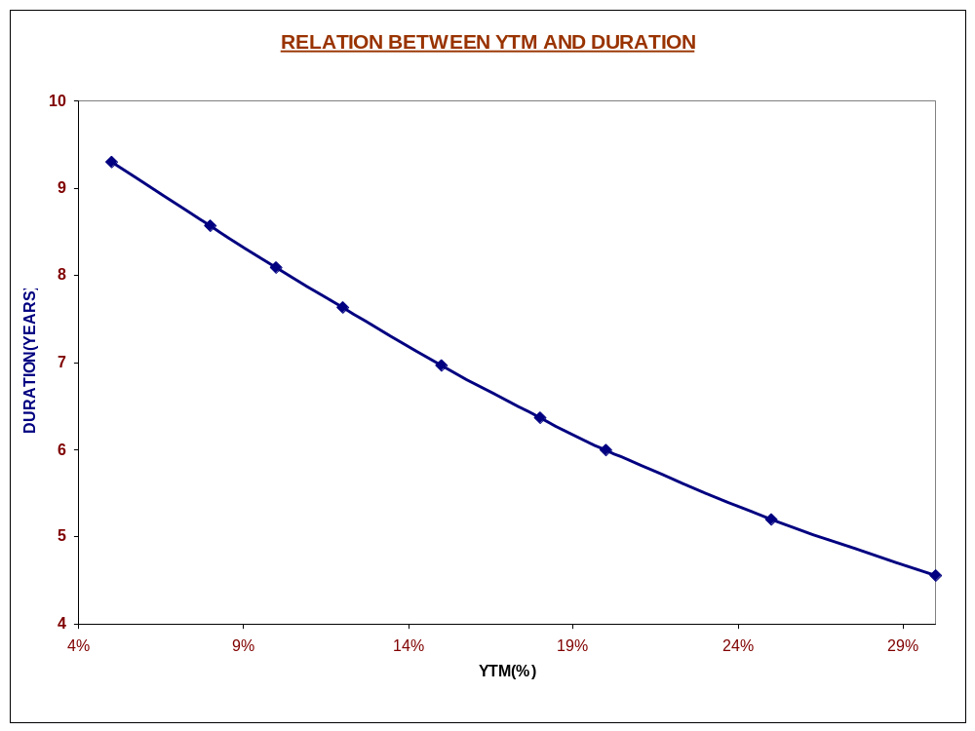
GO TO EXCEL

Slide 40
MACAULAY’S DURATION (Some Implications ...)
RELATION BETWEEN MATURITY AND DURATION:
  RULE #5: Maturity has a mixed impact on the duration. However, it is noticed that if a bond is selling at a premium or at par, maturity and duration are positively related and if a bond is selling at a discount, then maturity and duration are positively as well as negatively related.

Slide 41
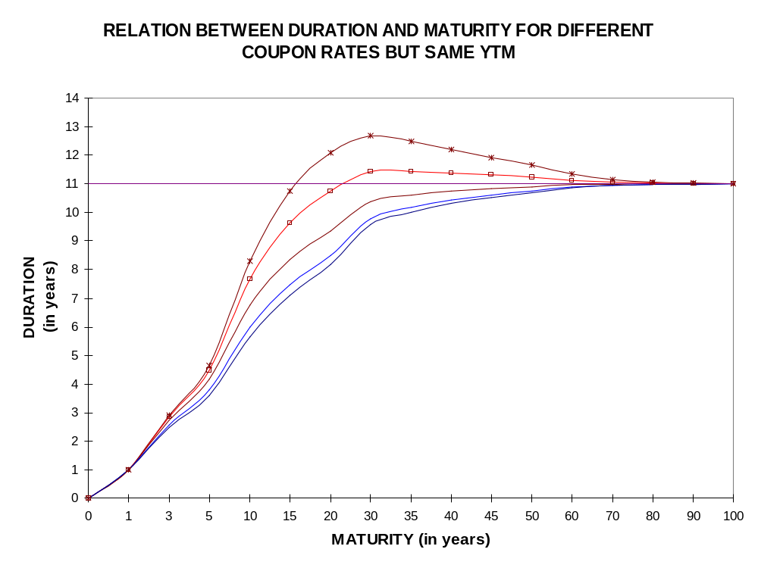
GO TO EXCEL

Slide 42
2s/5s/10s butterfly
The terminology means trading the 5-year treasury versus the 2-year and 10-year Treasuries.
The 5-year Treasury is referred to as the body or belly of the butterfly.
2-year and 10-year Treasury legs are referred to as the wings.
“Selling the belly” of the butterfly or “belly-cheapening trade. We sell the 5-year Treasury and buy the 2-year and 10-year Treasuries.
If we sell the 5-year and buy the 2-year and 10-year Treasuries, the aim is for a more “humped” shape of the yield curve.

Slide 43
How Balance Sheet Trade is set up
The trader will borrow and sell a million par amount of the 10-year T-note and post the cash proceeds as collateral.
Buy the 2year T note.

Slide 44
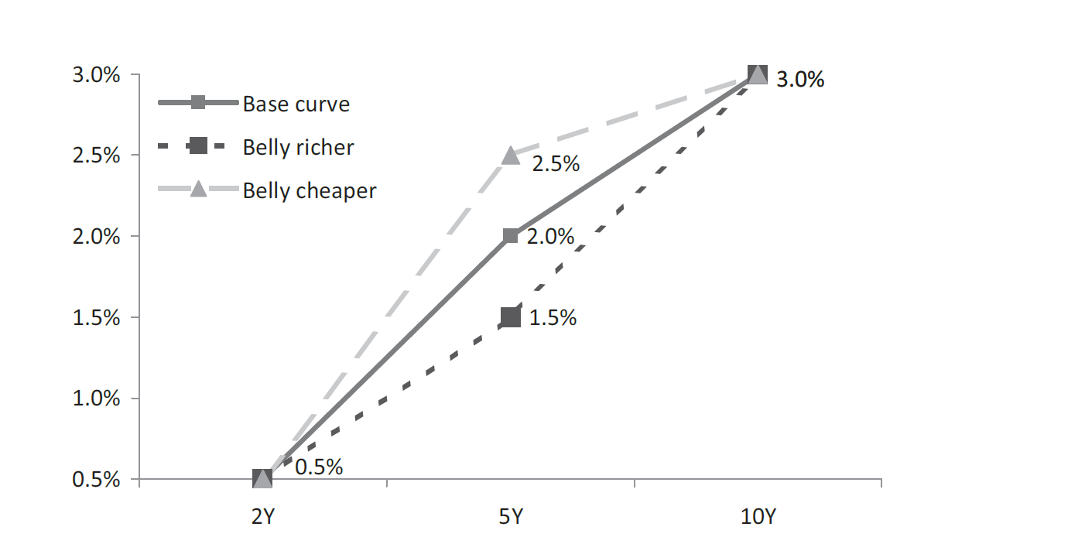
Identify the trade

Slide 45
Amount to Buy
Bearish market (when all rates are expected to go up), the 2-year yields must increase by much less than the 10-year yields.
This calls for a long position in the 2-year T-note and a short position in the 10-year T-note.
Second, the trader must determine the amount of the 2-year T-note to buy and the amount of the 10-year T-note to short

Slide 46
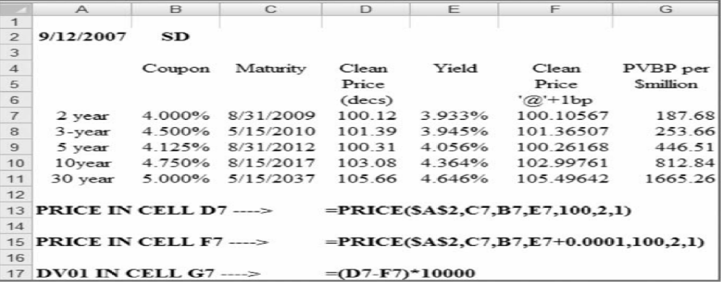
DV01(One basis point change

Slide 47
Meaning
Note that the 2-year T-note changes by $187.68 per million-dollar par when its yield changes by one basis point. On the other hand, a 30-year bond changes by $1,665.26 for a basis point change in its yield. This implies the following: If the 2-year yield and 30-year bond yield were to move down by exactly one basis point, the 30-year bond will appreciate by $1,666.26, whereas the 2-year bond will appreciate by only 187.68. We can therefore say that the 30-year bond is 1,666.26/187.68 8.87 times more risky than a 2-year T-note under these hypothesized assumptions.

Slide 48
PVBP
 | Coupon | Maturity | Clean Price | Yield | Clean price + 0.5 bp | Clean price - 0.5 bp | PVBP per million
2 | 0.04 | 31 August 2009 | 100.1059 | 0.0399 | 100.0033585 | 100.0198836 | 165.2510533
3 | 0.045 | 15 May 2010 | 101.2736 | 0.03945 | 101.2616363 | 101.2848104 | 231.7411579
5 | 0.04125 | 31 August 2012 | 100.2889 | 0.04056 | 100.2675224 | 100.3102156 | 426.9325951
10 | 0.0475 | 15 August 2017 | 103.0164 | 0.04364 | 102.9762259 | 103.055937 | 797.1111258
30 | 0.05 | 15 May 2037 | 105.6446 | 0.04646 | 105.5615237 | 105.7275579 | 1660.342428

Slide 49
Amount to Buy
The trader will want to set up the trade such that the total PVBP is zero.
The fact that PVBP 0 ensures that the price risk of 2-year notes is offset by the price risk of 10-year T-notes for small interest rate changes.
PVBPp = n2 *165.25 + n10 * 797.11.
n2 is the number of 2-year T-notes
n10 is the number of 10- year T-notes

Slide 50
Amount to Buy
N2 = 1.26 so buy(long) 1.20 million worth of T bond and sell .26 million of 5 year note.

Slide 51
First we shall see what’s happening to ‘YIELDS’ in India…

Slide 52
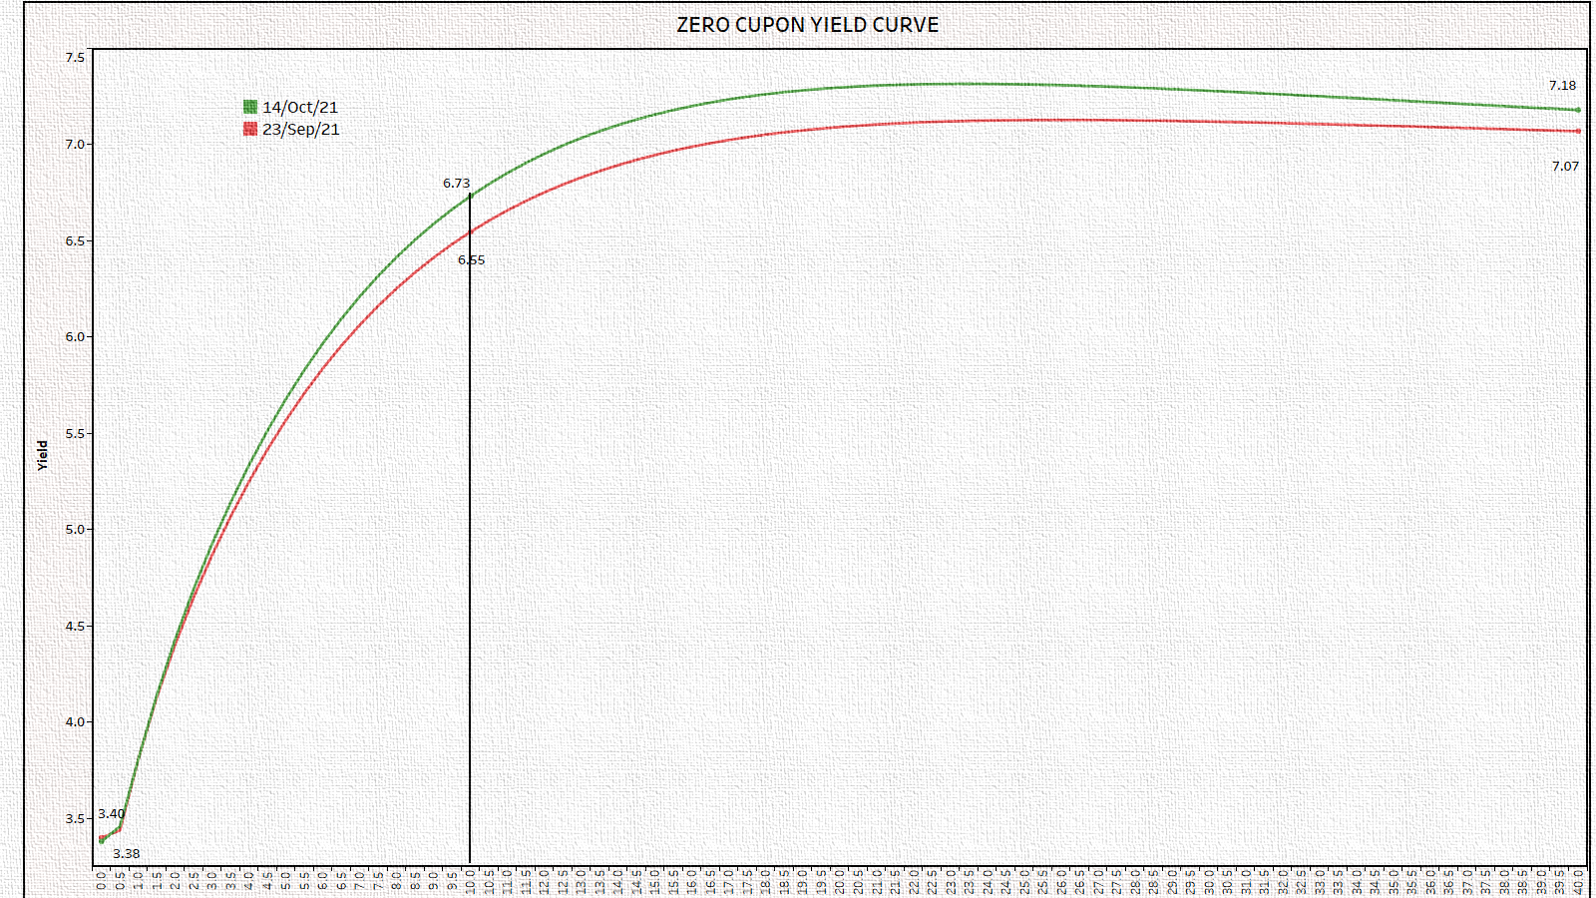
Look at the following:
Issues:
  What is happening to Yields in India?
  What will happen to the bond prices?
  Will the bond trader be happy with it?
  Does it mean MORE interest rate risk?

Slide 53
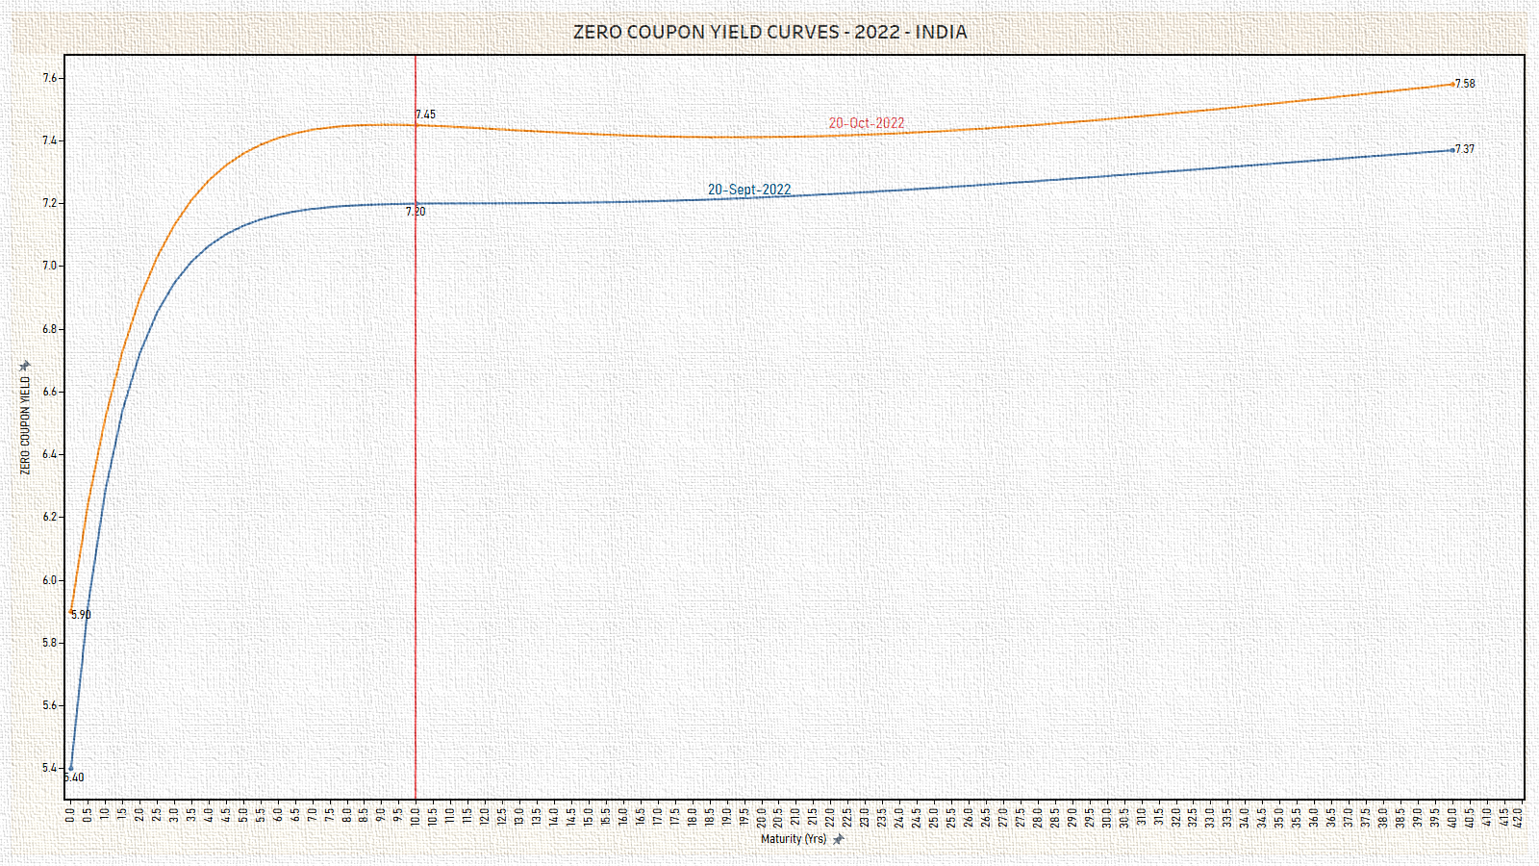
Look at the following – after one year:
Issues:
  What is happening to Yields in India?
  What will happen to the bond prices?
  Will the bond trader be happy with it?
  Does it mean MORE interest rate risk?

Slide 54
Second…

Slide 55
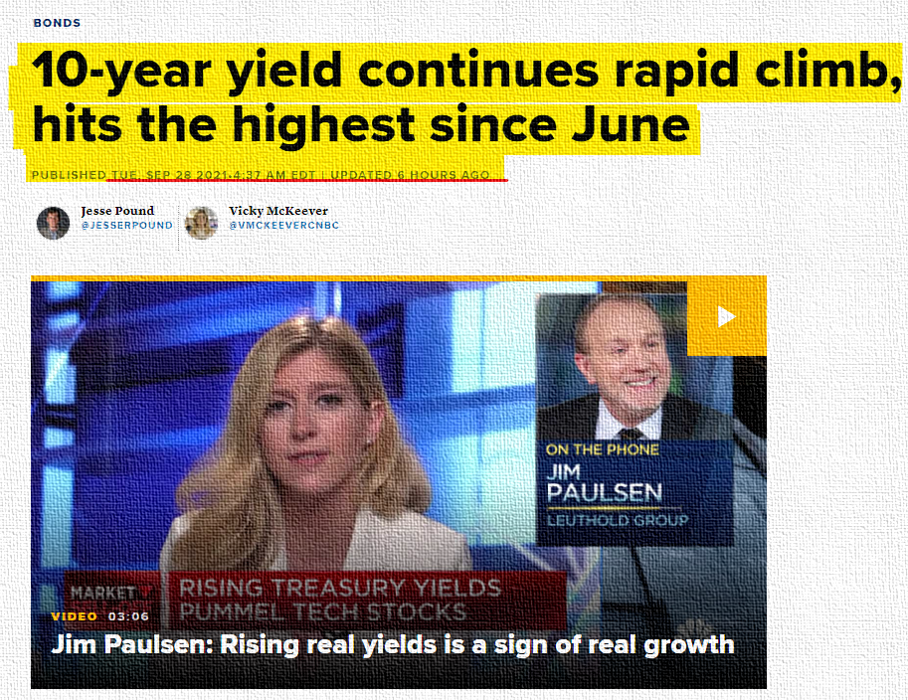
How will you react when you hear the following news?

Slide 56
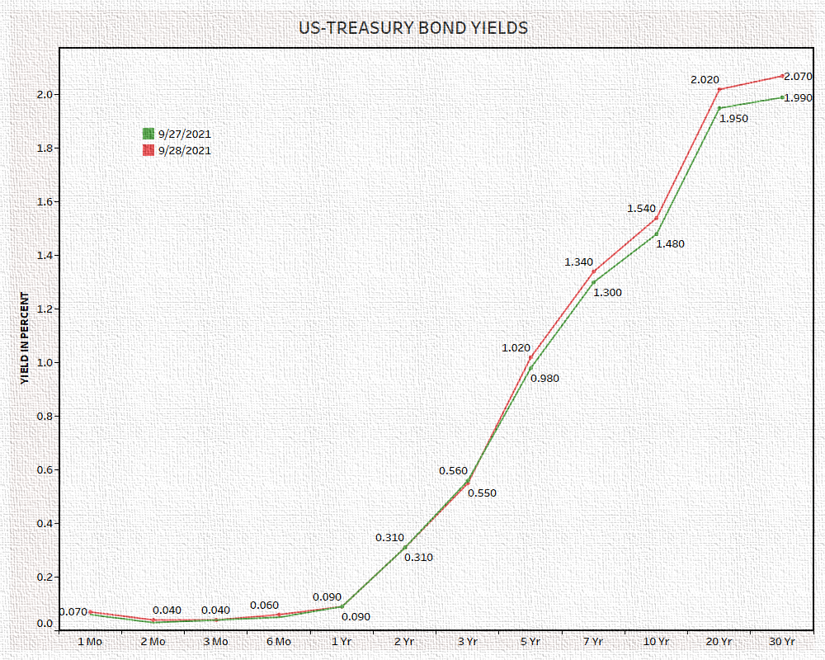

Slide 57
What happened in India?

Slide 58
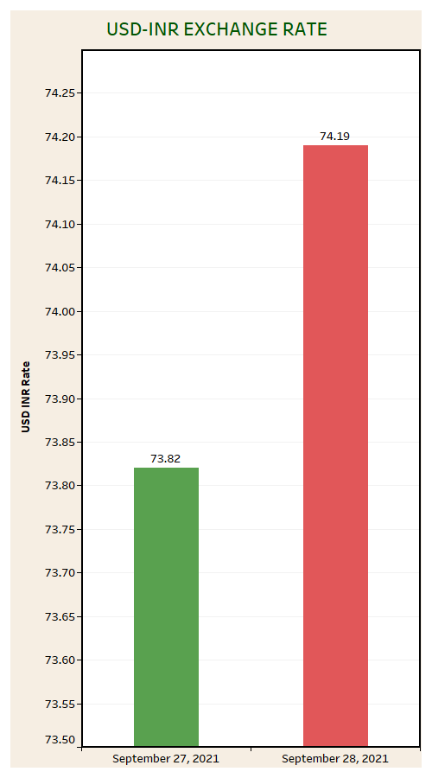
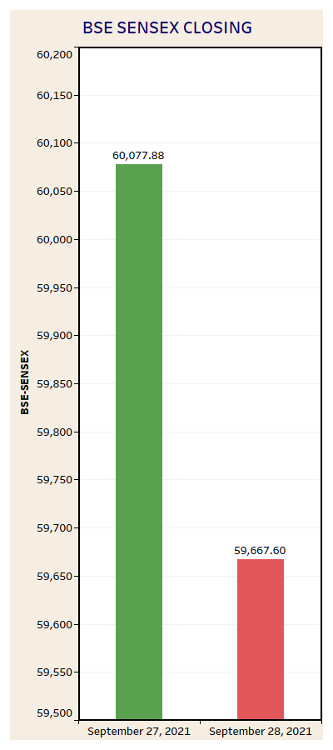
Reaction of markets in India

Slide 59
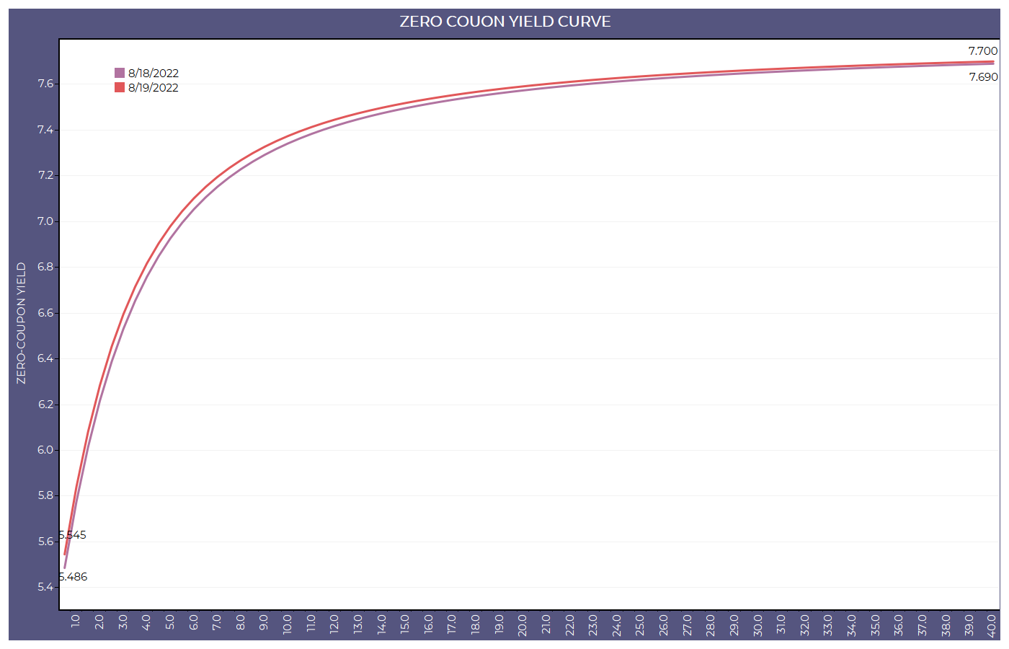
Why there was a Increase in the Yields on August 19,2022?

Slide 60
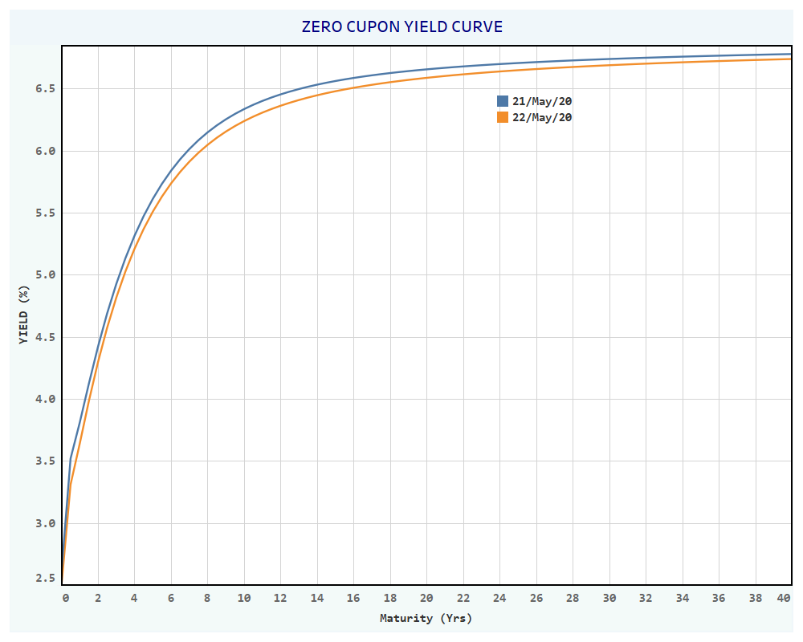
Why there was a decline in the Yields on May 22, 2020?

Slide 61
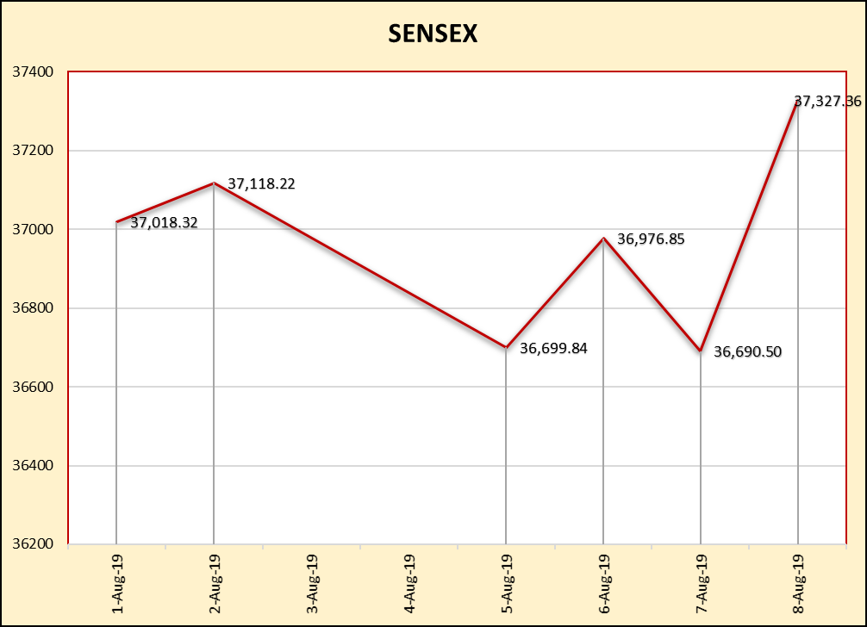
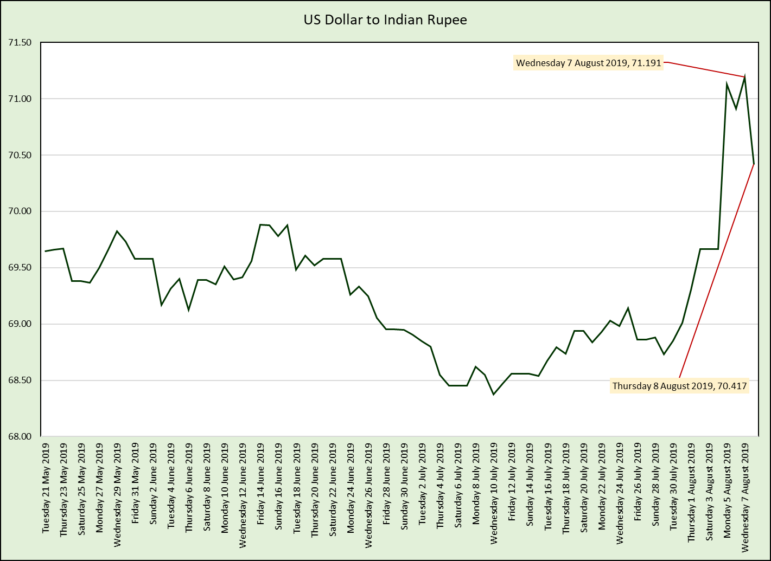
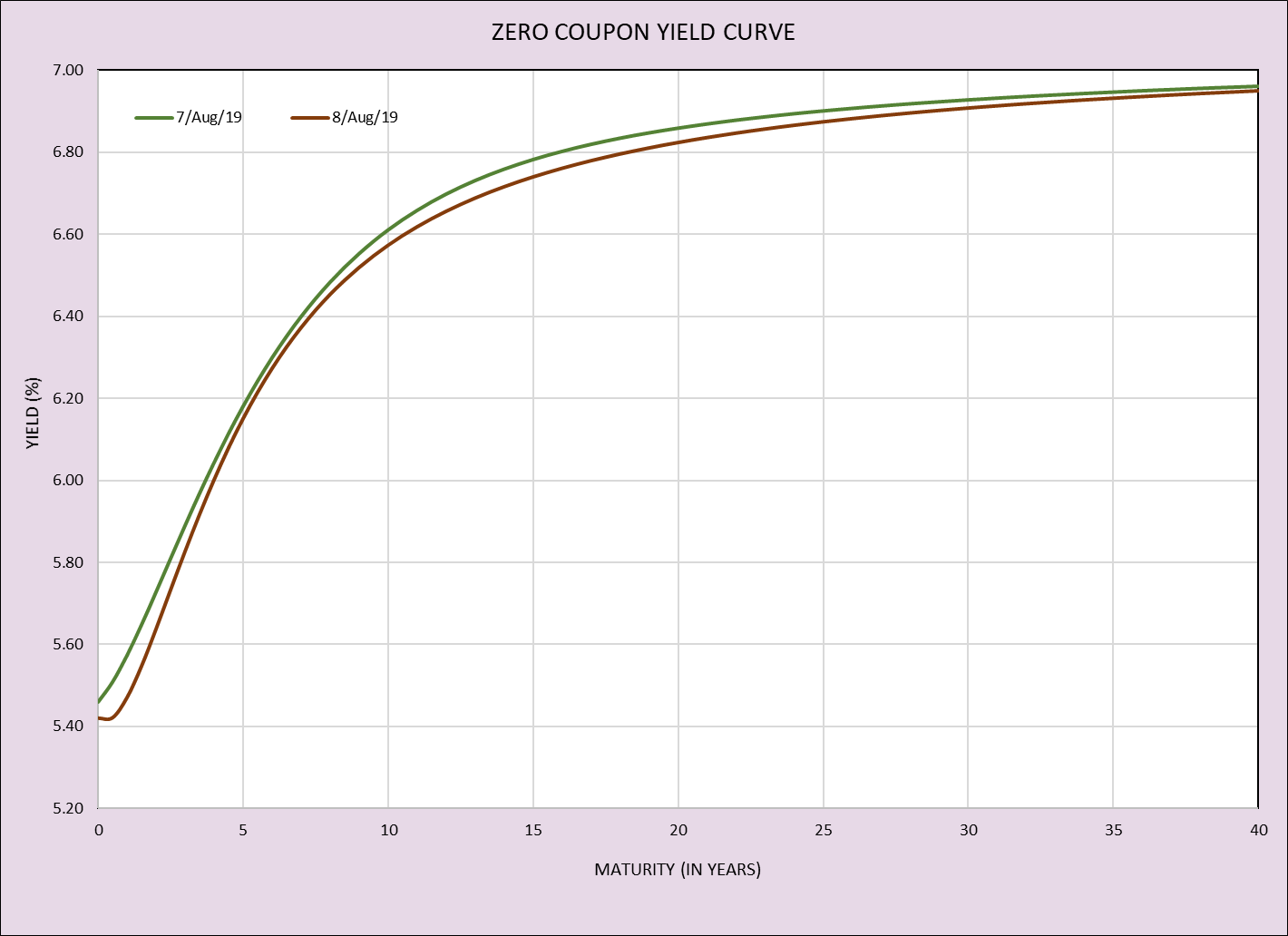
Same story in the markets on August 8, 2019?

Slide 62
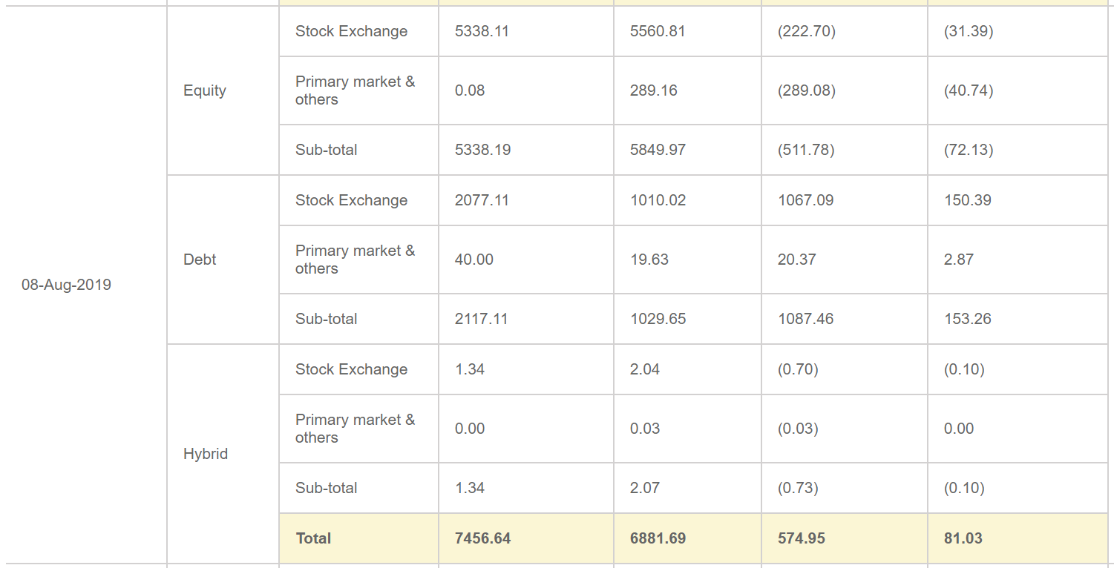

Slide 63

One of the most important challenge for a bank is –
  “How to have a proper balance between the assets and liabilities?”

Slide 64
One of the tool is Duration Gap Analysis.

Slide 65
Duration Analysis …
Before the use of Duration Analysis, banks used to calculate MATURITY GAP .
Since Duration is a better measurement of interest rate sensitivity as compared to maturity and hence, the Gap between Rate Sensitive Assets (RSA) and Rate Sensitive Liabilities (RSL) should be calculated using their durations.

Slide 66
Duration Analysis … (continued)
When the average duration of assets exceeds the average duration of liabilities, the Duration Gap is positive. This implies that the market value of The bank’s assets is more sensitive to interest rate movements than the value of its liabilities. So if interest rates rise, banks with positive duration gaps will be adversely affected. Conversely, if interest rates decline, then banks with positive duration gaps will benefit.
Similarly, if the Duration Gap is negative, and interest rates increase it will benefit the bank, and if the interest rates decrease, the bank will be adversely affected.
Please note that the larger the Duration Gap, the more sensitive the bank should be to interest rate movements.

Slide 67
Duration Gap Analysis
We illustrate duration gap using a simple example involving ‘‘one’’ discount rate for all assets and a financial institution with a single asset, which is financed partly by equity and partly by liabilities. The balance sheet identity requires.
A = E + L
where A denotes assets, E denotes equity, and L denotes liabilities.

Slide 68
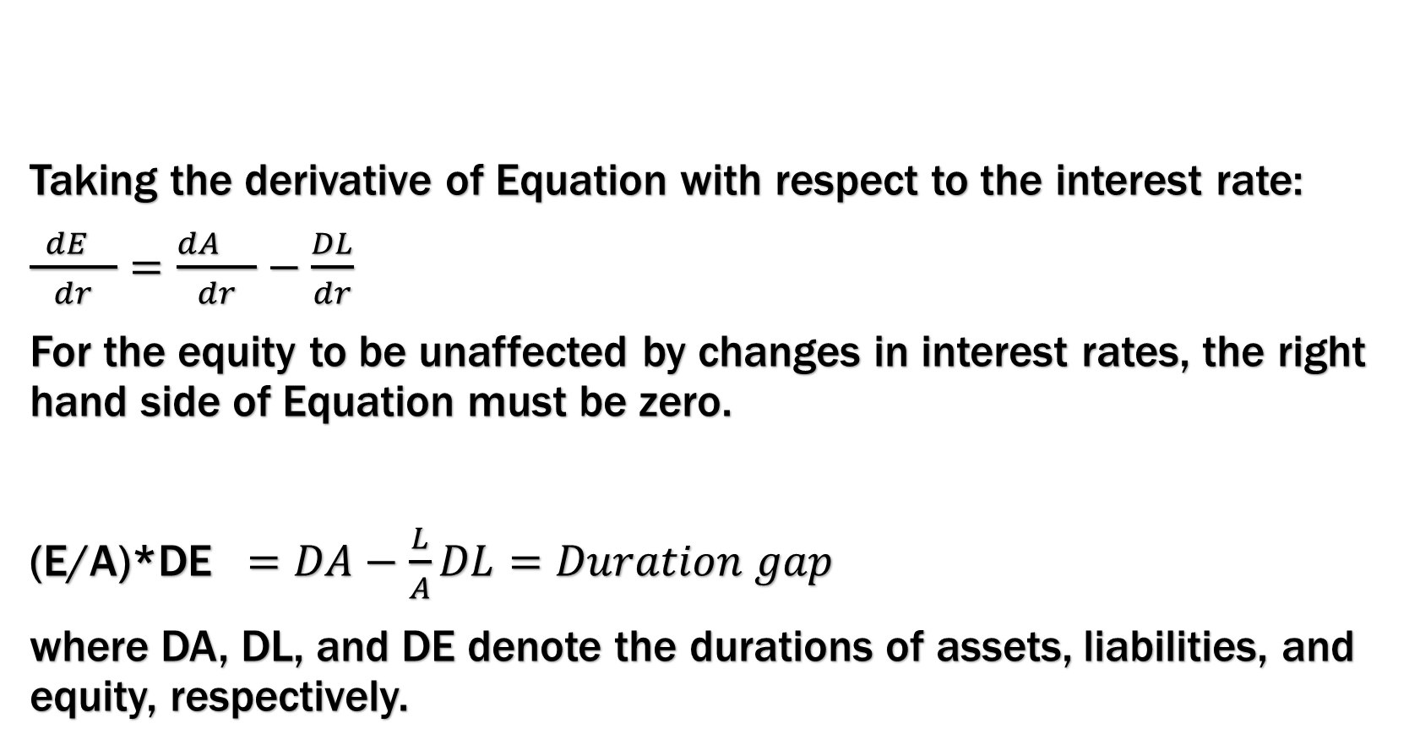
Duration GaP analysis…
Taking the derivative of Equation with respect to the interest rate:
$\frac{ dE }{dr}$ $=\frac{dA }{dr}−\frac{DL}{dr}$
For the equity to be unaffected by changes in interest rates, the right hand side of Equation must be zero.
(E/A)*DE $=DA−\frac{L}{A}DL=Duration gap$
where DA, DL, and DE denote the durations of assets, liabilities, and equity, respectively.

Slide 69
Duration GAP
When duration gap is zero, the shares of the FI will not be affected by interest rate shocks; the FI’s shares will behave like floating rate bonds with zero duration.
The shares of an FI with a positive duration gap will rise when rates fall analogously to a long position in a bond.
If an FI has a negative duration gap, its shares will increase in value when rates rise. Holding the shares of such an FI is like taking a short position in a bond.

Slide 70
Scenarios in DURATION GAP
Suppose that the management of an FI regards future interest rate movements as highly uncertain. In this case, the FI should immunize by setting the duration gap to zero.
If senior executives predict that rates will fall, the FI Should expand its portfolio of longer term loans financed by short term deposits increasing Dgap.

Slide 71
Basic Theory
Central to this strategy is the implied assumption that the difference between convexity of assets and convexity of liabilities (adjusted for capital structure and the ratio of return on assets over return on liabilities) is non-negative.
Fooladi and Roberts (2004) show that if this difference which they call ‘‘convexity gap’’ is not nonnegative, satisfying duration condition is not sufficient for hedging against interest rate risk.

Slide 72
Hedging
To reduce adjustment time, and to save on transactions costs, FIs adjust duration gaps using off-balance-sheet positions in derivative securities such as interest rate futures, interest rate options and swaps.

Slide 73
Other Applications of Duration Gaps
Life insurance companies were the first class of financial institutions to implement duration matching.
The typical life insurance company invests the bulk of its assets in bonds and mortgages. This leads to a constitutionally negative duration gap as future policy liabilities generally have a longer duration than bonds and mortgages.

Slide 74
Application of Duration Gap
Analysis
Pension plans come in two types: defined benefit and defined contribution.
Given that an average employee may retire 20 years from today, and then live for another 20 years, the duration of the pension liability is generally longer than the duration of the asset portfolio invested in equities and bonds.

Slide 75
Duration gaps can also be used to hedge the equity of nonfinancial corporations and governments against interest rate fluctuations.

Slide 76

One of the basic issue behind Investment Strategy in bonds is
How to ensure a balance between risk and return while making a suitable portfolio of bonds so as to satisfy the risk-return appetite of an investor?”

Slide 77
PASSIVE STRATEGY
A buy-and-hold strategy is one whereby an investor buys and holds bonds till the maturity or redemption.
In it, the objective of the investor is to maximise the income over a period through coupon and its reinvestment.
This strategy ignores the risk of capital gains/losses arising due to changes in interest rate.
A passive strategy requires no economic forecasting or on going asset allocation decisions. In it, once a portfolio is established, one simply waits until the term of bond expires.
If bonds’ market is efficient, then such a strategy would be very useful strategy.
The investor does not actively seek out trading possibilities in an attempt to outperform the market

Slide 78
PASSIVE STRATEGY…???
Some of the passive strategies may be
  Bond Ladder Strategy
  Bond Barbell Strategy
  Bond Bullet Strategy
  Investment in Index Fund
  Riding the Yield Curve

Slide 79
BOND LADDER STRATEGY
Bond value changes daily and an investor can avoid losses arising due to these fluctuations by acquiring short-term bonds. They usually have higher transaction cost and lower yields.
On the other side, the opposite strategy is to buy long term bond but they are having high interest rate risk.
But, if a portfolio of bonds is constructed with maturities distributed over a period of time, then it can have the advantages of short-term bonds as well as long term bonds.
A bond portfolio construction strategy that invests approximately equal amounts in every maturity within a given range.
Such a strategy is inflexible and if an investor seeks to take advantage of anticipated changes in interest rates then the whole portfolio is to be revised.

Slide 80
LADDER STRATEGY
“INVEST EQUALLY IN ALL MATURITY”
Amount Invested
Time

Slide 81
BOND BARBELL STRATEGY
In this strategy, an investor acquires portfolio consisting of very long and very short term maturity bonds.
A fixed income strategy in which the maturity`s of the securities included in the Portfolio are concentrated at two extremes.
The advantage of this is - an investor needs to revise only half of his/her portfolio depending upon the expectation of changes in interest rates. If interest rates are expected to rise, then he/she should sell the long-term bonds and invest in short term and do the opposite if the interest rates are expected to fall.
This strategy as compared to LADDERED ONE is more risky if the anticipation about future interest rates go wrong

Slide 82
BARBELL STRATEGY
“INVESTMENT CONCENTRATED AT TWO EXTREMES OF MATURITY”
Amount Invested
Time

Slide 83
BOND BULLET STRATEGY
A single maturity is at the heart of the bullet strategy. However, the essence is that the maturities of the bonds in the portfolio are concentrating towards one maturity time.
One of the advantages of the Bullet Strategy is to focus cash flows to meet expected future expenditures such as buying a business in future. Zero-coupon bonds could be appropriate in these situations because they eliminate reinvestment risk and provide a known amount of cash at maturity.
Another reason to have such a strategy could be to position a portfolio in response to strong anticipated change in interest rates in one direction.

Slide 84
BULLET STRATEGY
“INVESTMENT CONCENTRATING TOWARDS ONE MATURITY”
Amount Invested
Time

Slide 85
Which one has higher Duration – Bullet Strategy or Ladder?

Slide 86
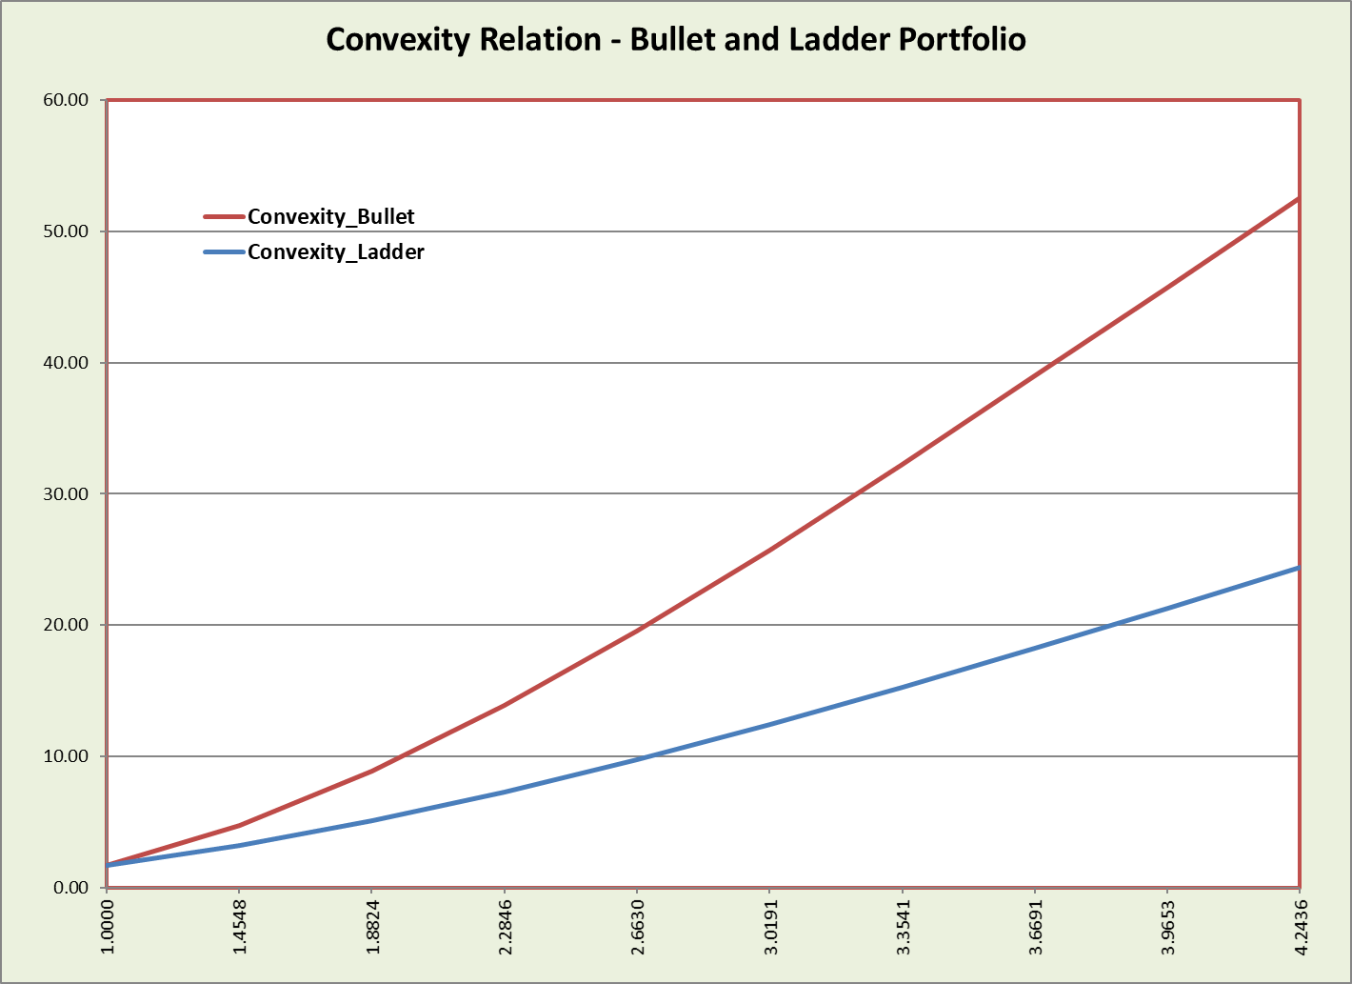
Which one has higher CONVEXITY – Bullet Strategy or Ladder?

Slide 87
Example…
A bank is having 10,000 8% GOI dated security going to be matured in the next 5 years with a face value of Rs. 1,000.
Assume that it is not listed and coupon is paid half-yearly.
We want to determine its price as on March 31, 2024 for the purpose of Balance Sheet.

Slide 88
Relevant part of the ZCYC as on March 31, 2022 is given below:

Slide 89
Case#3: When bond is unlisted/not actively traded and on the valuation date we do not get the spot rates for the required period
In such, we use – Matrix Pricing

Slide 90
Matrix Pricing
Matrix Pricing is an estimation procedure that involves –
  Use of the market discount rate and price based on the quoted prices of more frequently traded comparable bonds.
  These comparable bonds have similar times-to-maturity, coupon rates, and credit quality.

Slide 91
Example…
An insurance company needs to value a 3-year, 8% annual coupon paid half-yearly with a face value of Rs. 1,000.
Assume that the bond is not actively traded and that there are no recent transactions reported for this particular security.
However, there are quoted prices for four bonds that have very similar credit quality:
  Bond A: two-year, 6% semiannual coupon payment bond trading at a price of Rs. 98.50
  Bond B: two-year, 10% semiannual coupon payment bond trading at a price of Rs. 102.25
  Bond C: five-year, 5% semiannual coupon payment bond trading at a price of Rs. 90.25
  Bond D: five-year, 7% semiannual coupon payment bond trading at a price of Rs. 99.125

Slide 92
Matrix Pricing…(continued)
If the market prices/yields of the comparable bonds are available for all time period, then we can use them as it is.
But, if they are not available then…
  We fill the gap by taking some linear or average estimate of the available rates.

Notes:


