Slide 1





Operations Management with Six Sigma
Dr. Gopal Kumar
gopalkumar@iimraipur.ac.in
IIM Raipur
19 January 2020

Slide 2
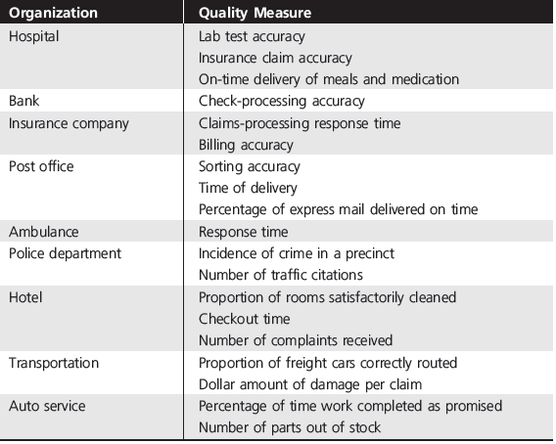
Measurement for Quality Control

Slide 3
Cost of Quality (COQ)
Traditionally, the reporting of quality-related costs had been limited to inspection and testing;
Other costs were accumulated in overhead accounts.
Findings in investigation
Quality-related costs were much larger than previously reported, generally in the range of 20 to 40 percent of sales.
Most of the costs resulted from poor quality and were avoidable.

Slide 4
Cost of Quality (COQ)
Managing quality is strategic decision as it supports differentiation, customer loyalty and commitment
.
Organization boundary
Prevention costs
Process 1
Process 2
Finished goods
Market
Appraisal costs
Appraisal costs
Internal Failure costs
External Failure costs
The correct cost for a well-run quality management program should be under 2.5%.
-Philip Crosby
Notes:
Prevention costs:costs associated with reducing the potential for defective parts or services (e.g., training, quality improvement programs).
Appraisal costs:costs related to evaluating products, processes, parts, and services (e.g., testing, labs, inspectors).

Slide 5
Quality and Cost
Managing quality is strategic decision as it supports differentiation and customer loyalty and commitment
.
Total Cost
Total Cost
For every dollar invested in prevention, you can save $10 in failure and appraisal cost.
External Failure
Internal Failure
Prevention
Appraisal
Quality Improvement

Slide 6
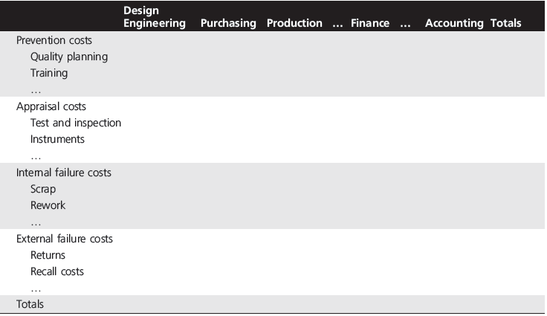
COQ Reporting Matrix
.
Notes:
For instance, if we rank internal failure costs from largest to smallest, chances are that 70 or 80 percent of all internal failure costs are due to only one or two manufacturing problems.
Identifying these “vital few,” as they are called, leads to corrective action that has a high return for a low dollar input.
Experts estimate that 60 to 90 percent of total quality costs are the result of internal and external failure and are the responsibility of management.
Managers typically react to high failure costs by increasing inspection.

Slide 7
Quality and Cost
Managing quality is strategic decision as it supports differentiation, low cost, and customer loyalty and commitment
.
Sales Gains via
Improved response
Improved reputation
Improved Quality
Increased Profits
Reduced Costs via
Lower rework and scrap costs
Increased productivity
Lower warranty costs

Slide 8
Quality and Profitability
.
Improved quality of design
Improved quality of conformance
Higher perceived value
Higher prices
Lower manufacturing and service costs
Increased market share
Increased revenues
Higher profitability

Slide 9
Total Quality Management (TQM)
In 1970s, GE studied consumer perceptions of the quality of many GE product lines. They found:
Product with poor reputations for quality
Deemphasized customer view points
regard quality as
Tight tolerance and conformance to the specification
tie quality objectives to
Manufacturing flow
express quality objectives as
Number of defects per unit
used
Formal quality control system only in manufacturing
Notes:
TQM expands the traditional view of quality—looking only at the quality of the final product or services—to looking at the quality of every aspect of the process that produces the product or service.

Slide 10
Total Quality Management (TQM)
In 1970s, GE studied consumer perceptions of the quality of many GE product lines. They found:
Product that received customer praise
Emphasized satisfying customer expectations
determine
Customer needs through market research
use
Customer based quality performance measures
formalized
Quality control system for all business functions, not just
manufacturing
Notes:
TQM expands the traditional view of quality—looking only at the quality of the final product or services—to looking at the quality of every aspect of the process that produces the product or service.

Slide 11
Total Quality Management (TQM)
In 1970s, GE studied consumer perceptions of the quality of many GE product lines. They found:
They concluded that their focus should be on
Design
Supplier relation
Marketing
Manufacturing
Financial management
Human resource management
Notes:
TQM expands the traditional view of quality—looking only at the quality of the final product or services—to looking at the quality of every aspect of the process that produces the product or service.

Slide 12
Total Quality Management (TQM)
In 1970s, GE studied consumer perceptions of the quality of many GE product lines. They found:
They concluded that
Quality of Management
is as important as
Management of Quality
Quality Assurance
gave way to
Quality Management
Notes:
TQM expands the traditional view of quality—looking only at the quality of the final product or services—to looking at the quality of every aspect of the process that produces the product or service.

Slide 13
Total Quality Management (TQM)
In 1970s, GE studied consumer perceptions of the quality of many GE product lines. They found:
They concluded that
Focusing on manufacturing quality (Little q)
Focusing on all organizational process (Big Q)
Total Quality Management (TQM) or Total Quality (TQ)
Notes:
TQM expands the traditional view of quality—looking only at the quality of the final product or services—to looking at the quality of every aspect of the process that produces the product or service.

Slide 14
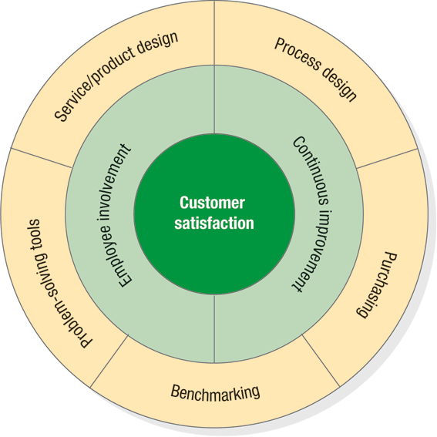
Total Quality Management (TQM)
Encompasses entire organization from supplier to customer
Stresses a commitment by management to have a continuing company wide drive toward excellence in all aspects of products and services that are important to the customer.
1970s and 1980s
Notes:
TQM expands the traditional view of quality—looking only at the quality of the final product or services—to looking at the quality of every aspect of the process that produces the product or service.

Slide 15
Seven Concept of TQM
Continuous improvement
Six Sigma
Employee empowerment
Benchmarking
Just-in-time (JIT)
Taguchi concepts
Knowledge of TQM tools
(From 14 points of
WE Deming)

Slide 16
Continuous improvement
Perfection is never achieved but always sought
Never-ending process of continuous improvement
Covers people, equipment, suppliers, materials, procedures
Every operation can be improved
Walter-Shewhart: PDCA
For example:
Reduce cycle time
Improve customer satisfaction
Reduce defects, waste, emission
Improve product and services
Improve productivity
Reduce customer complain
Deming
Japan (Kaizen)
TQM
US
Zero defect

Slide 17
Continuous improvement
Perfection is never achieved but always sought
Kaizen focuses on small, gradual, and frequent improvements over long-term.
Planning
Execution of plans
Assessment of progress
Revision of plans based upon assessment findings
4. Act
Implement the plan, document
Plan
Identify the pattern and make a plan
3. Check
Is the plan working?
2. Do
Test the plan

Slide 18
Continuous improvement
Example
The co-owner of a diner decided to do something about the long lines that occurred everyday in their place of business. After discussion with employees, several facts came to light:
Customer waited in line for up to 15 minutes
Usually, tables were available
Many of their customers were regulars
People taking orders and preparing food were getting in each other’s way
They collected data on number of customers in line

Slide 19
Continuous improvement
Example
Plan: The owner wanted to a few changes. They decided the following change:
Provide a way for customer to fax their orders in ahead of the time
Do: Fax machine was installed. Length of line, number of empty table, and time until last person in the line was served were measured.
Check: They detected several improvement. Length of line came down (peak avg of 12 people), number of available table decreased, time in line wend down from 15 minutes to 5 minutes
Act: They held a meeting, and incorporated the changes

Slide 20


Six Sigma
6σ
Lower limits
Upper limits
3.4 defects/million
2,700 defects/million
Mean
±3σ
±6σ
$$Process width=μ±3σ$$
$$Specification width=μ±3σ$$
Notes:
There is no harm in going from 6 to 7 og 8. In fact airline industry operate at 10 or more for flight take off & landing, but for all practical purposses in an industry where human life is not at risk six sigma is a good enough improvement benchmark.
More than that may not be worth the Time, money$$ and effort.

Slide 21
Six Sigma
  A process that is 99.9997% capable, 3.4 defects per million opportunities (DPMO)
  A program designed to reduce defects, lower costs, save time, and improve customer satisfaction
6σ
Developed by Motorola and enhanced by Honeywell and GE
Highly structured way to process improvement
  A discipline – DMAIC
  A set of 7 tools
Notes:
There is no harm in going from 6 to 7 og 8. In fact airline industry operate at 10 or more for flight take off & landing, but for all practical purposses in an industry where human life is not at risk six sigma is a good enough improvement benchmark.
More than that may not be worth the Time, money$$ and effort.

Slide 22
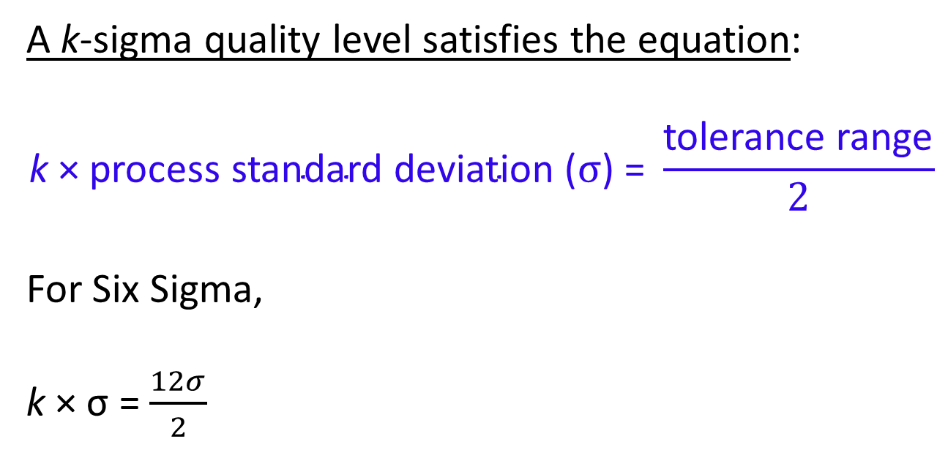
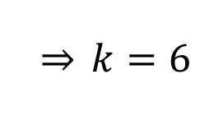
Six Sigma
A k-sigma quality level satisfies the equation:
$$\text{k}\text{ × }\text{process} \text{standard} \text{deviation}\text{ (}σ\text{)}\text{ = }\frac{\text{tolerance} \text{range}}{2}$$
For Six Sigma,
k × σ = $\frac{12σ}{2}$
$$\overset{⇒}{} k=6$$
Notes:
There is no harm in going from 6 to 7 og 8. In fact airline industry operate at 10 or more for flight take off & landing, but for all practical purposses in an industry where human life is not at risk six sigma is a good enough improvement benchmark.
More than that may not be worth the Time, money$$ and effort.

Slide 23
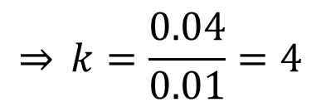
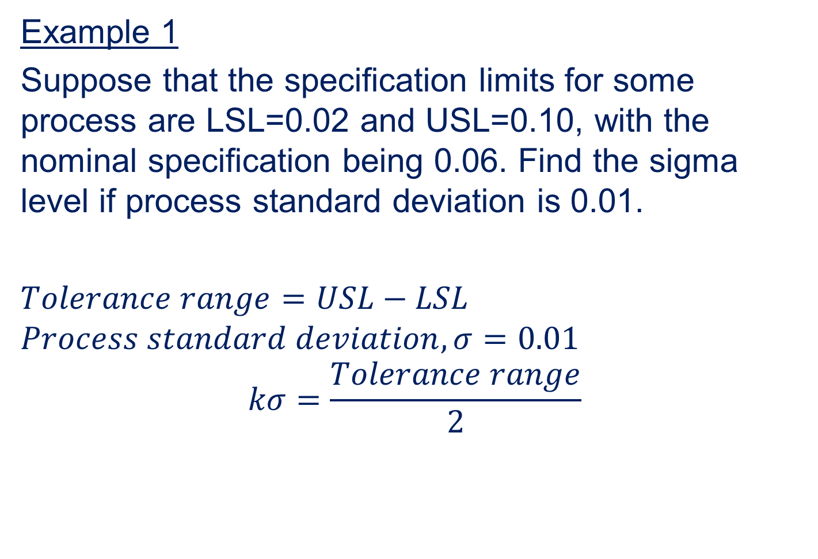
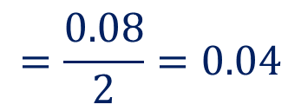


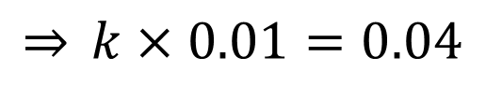
Six Sigma
Example 1
Suppose that the specification limits for some process are LSL=0.02 and USL=0.10, with the nominal specification being 0.06. Find the sigma level if process standard deviation is 0.01.
$Tolerance range=USL−LSL$
$$Process standard deviation, σ=0.01$$
$$kσ=\frac{Tolerance range}{2}$$
$$=0.10−0.02$$
$$=0.08$$
$$=\frac{0.08}{2}=0.04$$
$$\overset{⇒}{} k=\frac{0.04}{0.01}=4$$
$$\overset{⇒}{} k×0.01=0.04$$
Notes:
There is no harm in going from 6 to 7 og 8. In fact airline industry operate at 10 or more for flight take off & landing, but for all practical purposses in an industry where human life is not at risk six sigma is a good enough improvement benchmark.
More than that may not be worth the Time, money$$ and effort.

Slide 24

Quality Measurements
TQM
  A unit of work
  Nonconformance
  Nonconforming unit of work
  Error
  Measures
  Attributes measurement (presence, absence, counts, proportions)
  Variable measurement (weight, length, time, etc.)
$$50±0.05 cm$$

Slide 25
Quality Measurements
TQM
  .

Slide 26
Quality Measurements
TQM
  Inspecting smartphone
  10 quality characteristics (Camera, GPS, fingerprint, visuals, sound system, recording etc.)
  One day 500 smartphones were inspected
  18 of them were found nonconforming
$$Proportion nonconforming=\frac{Number of nonconforming units found}{Number of units inspected}$$
$$Nonconformances per unit (NPU)=\frac{Total number of nonconformances}{Number of units inspected}$$

Slide 27
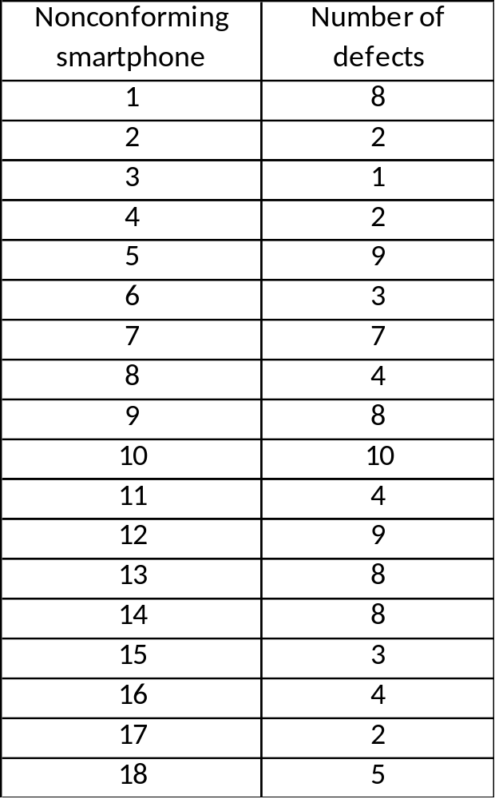
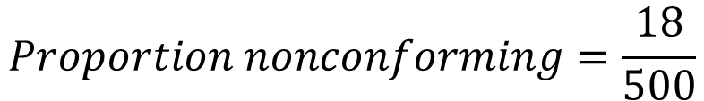
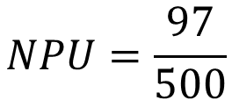
Quality Measurements
TQM
$$Proportion nonconforming=\frac{18}{500}$$
= 0.036
$$NPU=\frac{97}{500}$$
= 0.194
Total = 97

Slide 28

Quality Measurements
TQM
  Defects
  Critical defects
  Major defects
  Minor defects
 | Error Type | Weight
1 | Complaints reopened
2 | Damaged package
3 | Invoice adjustments
4 | Late pickup stops
5 | Lost packages
6 | Missed proof of delivery
7 | Right date late
8 | Traces
9 | Wrong day late
3
10
1
3
10
1
1
3
5

Slide 29
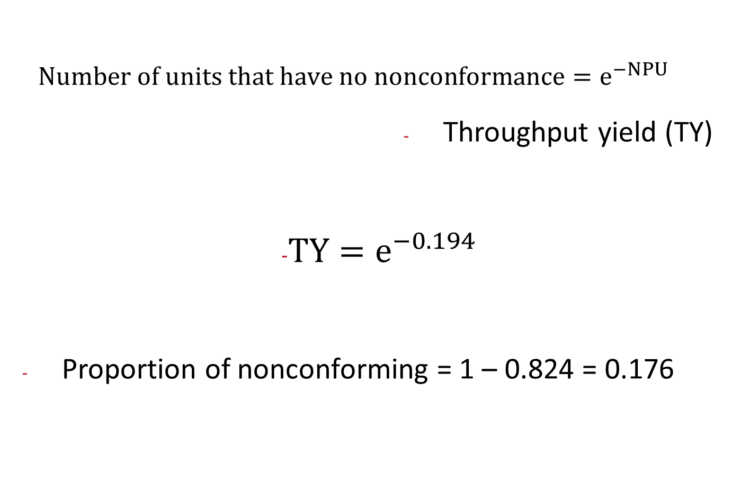
Quality Measurements
TQM
  $$Number of units that have no nonconformance=e^{−NPU}$$
  Throughput yield (TY)
                $TY=e^{−0.194}$
  Proportion of nonconforming = 1 – 0.824 = 0.176
= 0.824

Slide 30


Quality Measurements
Customer Focus
Rolled throughput yield (RTY)
y₁
y₂
y₃
Process 1
Process 2
Process 3
0.98
0.95
0.97
$$RTY=y_{1}×y_{2}×y_{3}$$
$$RTY=0.98×0.95×0.97$$
= 0.903
Proportion nonconforming = 1 – 0.903 = 0.097
Notes:
Essentially, they are the “hows” by which the company will respond to the “whats”—the customer requirements that will determine customer satisfaction or delight, often called critical to quality characteristics (CTQs).

Slide 31
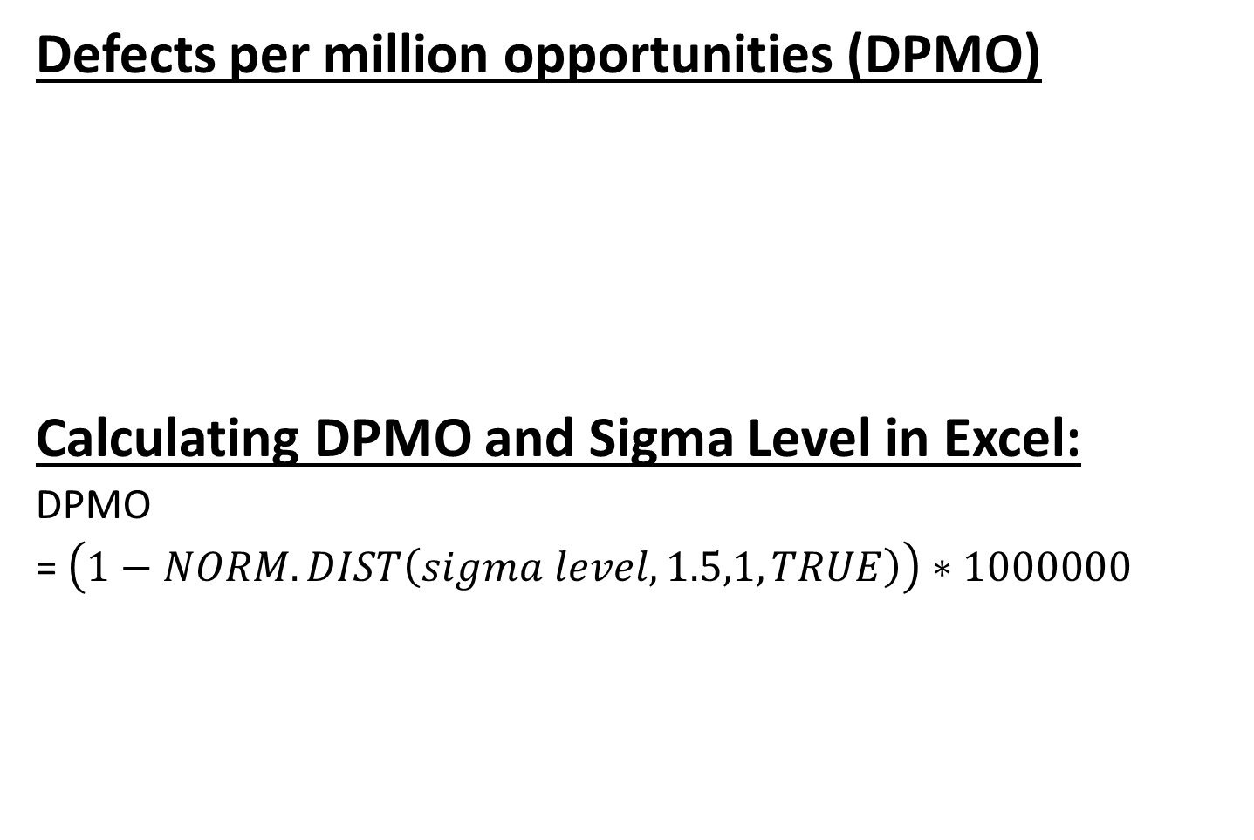
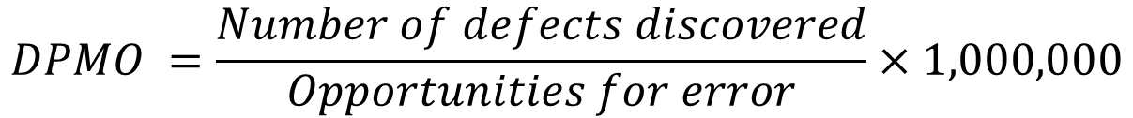
Quality Measurements
Customer Focus
Defects per million opportunities (DPMO)
Calculating DPMO and Sigma Level in Excel:
DPMO
= $\left(1−NORM.DIST\left(sigma level,1.5,1,TRUE\right)\right)∗1000000$
$$DPMO =\frac{Number of defects discovered}{Opportunities for error}×1,000,000$$
Sigma Level =$NORM.S.INV\left(1−\frac{DPMO}{1000000}\right)+1.5$
Notes:
Essentially, they are the “hows” by which the company will respond to the “whats”—the customer requirements that will determine customer satisfaction or delight, often called critical to quality characteristics (CTQs).

Slide 32
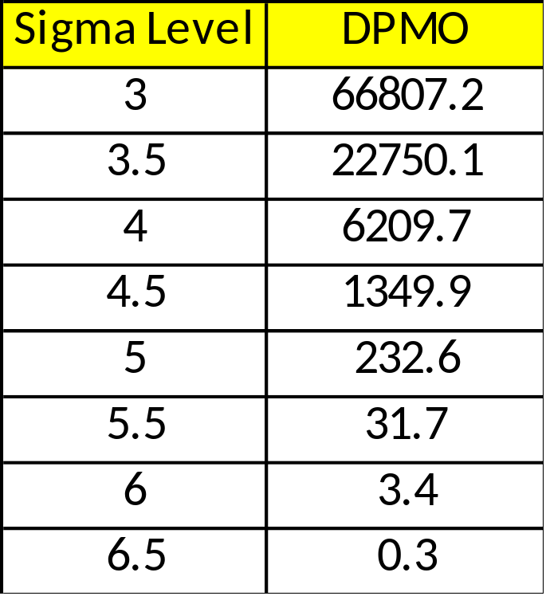
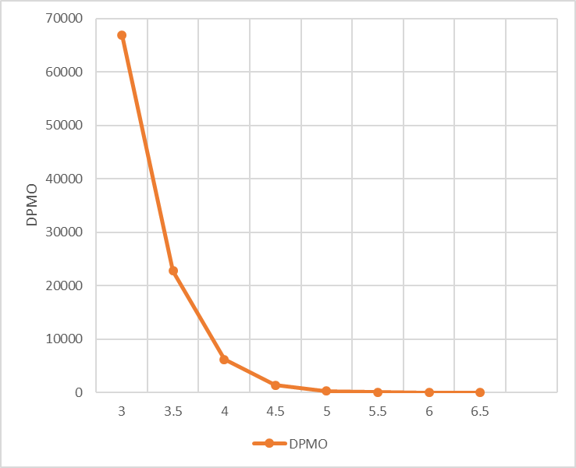
Quality Measurements
Customer Focus
Defects per million opportunities (DPMO)
Notes:
Essentially, they are the “hows” by which the company will respond to the “whats”—the customer requirements that will determine customer satisfaction or delight, often called critical to quality characteristics (CTQs).

Slide 33




Quality Measurements
Customer Focus
Defects per million opportunities (DPMO)
$$≈10 fold improvement$$
$$≈28 fold improvement$$
$$≈70 fold improvement$$
It is generally easy to move from 2 or 3 sigma level
to 4 sigma level, but moving beyond that requires
much more effort
Notes:
Essentially, they are the “hows” by which the company will respond to the “whats”—the customer requirements that will determine customer satisfaction or delight, often called critical to quality characteristics (CTQs).

Slide 34
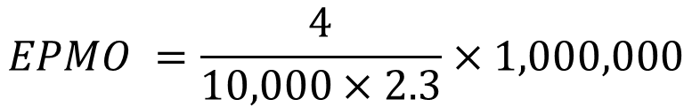
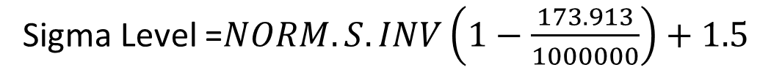

Quality Measurements
Customer Focus
Defects per million opportunities (DPMO)
Lost baggage on airport
Average bag per customer = 2.3
4 lost bags for 10,000 passengers over one month
In manufacturing fault is called defect, i.e., DPMO
In service fault is called error, i.e., EPMO
$$EPMO =\frac{4}{10,000×2.3}×1,000,000$$
$$=173.913$$
Sigma Level =$NORM.S.INV\left(1−\frac{173.913}{1000000}\right)+1.5$
= 5.0768
Baggage handling system on the airport is operating at
more than 5 sigma level
Notes:
Essentially, they are the “hows” by which the company will respond to the “whats”—the customer requirements that will determine customer satisfaction or delight, often called critical to quality characteristics (CTQs).

Slide 35
Six Sigma Implementation
6σ
Think in terms of key business processes and customer requirements with a clear focus on overall strategic objectives.
Focus on corporate sponsors responsible for championing projects, support team activities, help to overcome resistance to change, and obtain resources.
Emphasize such quantifiable measures as DPMO that can be applied to all parts of an organization: manufacturing, engineering, administrative, software, and so on.
Notes:
There is no harm in going from 6 to 7 og 8. In fact airline industry operate at 10 or more for flight take off & landing, but for all practical purposses in an industry where human life is not at risk six sigma is a good enough improvement benchmark.
More than that may not be worth the Time, money$$ and effort.

Slide 36
Six Sigma Implementation
Ensure that appropriate metrics are identified early in the process and that they focus on business results, thereby providing incentives and accountability.
Provide extensive training followed by project team deployment to improve profitability, reduce non-value-added activities, and achieve cycle time reduction.
Create highly qualified process improvement experts (“Green Belts,” “Black Belts,” and “Master Black Belts”) who can apply improvement tools and lead teams.
Set stretch objectives for improvement.
6σ
Notes:
There is no harm in going from 6 to 7 og 8. In fact airline industry operate at 10 or more for flight take off & landing, but for all practical purposses in an industry where human life is not at risk six sigma is a good enough improvement benchmark.
More than that may not be worth the Time, money$$ and effort.

Slide 37














Six Sigma Companies
Six Sigma

Slide 38
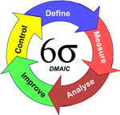
Six Sigma Methodology
Six Sigma
DMAIC
DMAIC: Dumb Managers Always Ignore Customers
Defines the project’s purpose, scope, and outputs, then identifies the required process information keeping in mind the customer’s definition of quality
Measures the process and collects data
Analyzes the data ensuring
repeatability and reproducibility
Improves by modifying or
redesigning existing
processes and procedures
Controls the new process
to make sure performance
levels are maintained
Create qualified process improvement experts (Black Belts, Green Belts, etc.)
Notes:
Cummins India Ltd., Tata Consultancy Services is one such name. TATA Motors, John Deere, Mahindra & Mahindra, KPMG, GenPact, Gabriel Motors, Lear Corporation are few other industry giants that are using Six Sigma methodologies.

Slide 39

DMAIC Tools and Techniques
Six Sigma
.
Notes:
Cummins India Ltd., Tata Consultancy Services is one such name. TATA Motors, John Deere, Mahindra & Mahindra, KPMG, GenPact, Gabriel Motors, Lear Corporation are few other industry giants that are using Six Sigma methodologies.

Slide 40
References.
Managing for Quality and Performance Excellence, Evans, J.R. and William M. Lindsay, W.M., Cengage Learning, India
The Six Sigma Handbook, Tomas Pyzdek and Paul Keller, Fourth edition, McGraw Hill India.
Total Quality Management, Besterfield et al., Revised third edition, Pearson India
The Management and Control of Quality, J. Evans, and W. Lindsay, Third edition, Cengage Learning

Slide 41
.
Thanks!

