Slide 1
Supply chain Networks Design

Slide 2
Role of network in the Supply Chain
Distribution – steps taken to move and store a product from the supplier stage to the customer stage in a supply chain
Supplier
Manufacturer
Distributor
Retailer
Customer

Slide 3
Case 1: Solution Plus: Solution Plus is an industrial manufacturing company that manufactures computer components like CPU, monitor, keyboards etc. The company has several manufacturing units of producing these components. Solution plus has three manufacturing units for manufacturing central processing units (CPUs). The CPUs are manufactured in Seattle, Columbus and New York. The solution plus has five warehouses located at Pittsburgh, Mobile, Denver, Los Angeles, and Washington, D C, where these CPUs are stored for further distribution. Each manufacturing unit is working with varied production capacity, the capacity of each manufacturing unit is shown in the following table. As per the customer requirements, the demand of each warehouse is also varied and shown in the following table. The distances between the manufacturing units and warehouses are also varied and hence different transportation cost is incurred to ship the CPU from a manufacturing unit to a warehouse. The shipping cost from manufacturing unit to warehouse is given in the following table.
Warehouse
Plant | Pittsburgh | Mobile | Denver | Los Angeles | Washington | CPU’s Available
Seattle | 10 | 20 | 5 | 9 | 10 | 9000
Columbus | 2 | 10 | 8 | 30 | 6 | 4000
New York | 1 | 20 | 7 | 10 | 4 | 8000
CPU’s required | 3000 | 5000 | 4000 | 6000 | 3000 | 21000
Requirements : 1. Develop the network representation of the problem, 2. Determine the amount that should be shipped from each plant to each warehouse to minimize the total shipping cost. 3. The Pittsburgh warehouse just increased it order by 1000 units, and Solution Plus authorized the Columbus plant to increase its production by 1000 units. Will this production increase lead to an increase or decrease the total shipping cost?

Slide 8
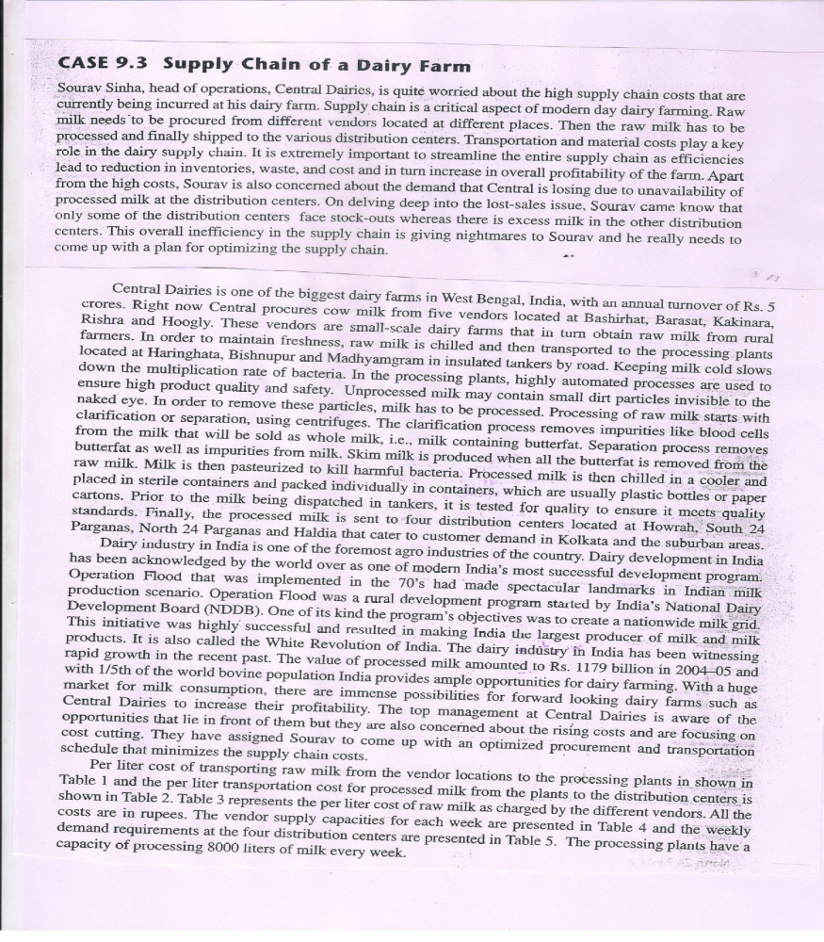
Case 2

Slide 9
