Slide 1





Operations Management with Six Sigma
Dr. Gopal Kumar
gopalkumar@iimraipur.ac.in
IIM Raipur
12 January 2020

Slide 2
Prof. Dr. Gopal Kumar (IIM Raipur)
Education:
  M.Tech and Ph.D: Indian Institute of Technology Kharagpur (IIT Kharagpur), WB, India
Post-Doctoral Research Scientist:
  Dublin City University, Dublin, Ireland
  University of Edunburgh, UK
  Ceramicx, Ireland
  Vistacon, CMR, Ireland
Assistant Professor:
  Indian Institute of Management Raipur, Raipur
  Institute for Financial Management and Research (IFMR), Chennai
  Institute of Management Studies (IMS Ghaziabad), Ghaziabad
  FORE School of Management, New Delhi
Editororial Board Members/Global Advisor:
  International Journal of Research in IT and Management (ISSN: 2231–4334)
  International Journal of Research in Finance & Marketing (ISSN: 2231–5985)
  Buenmafe™ Research & Review-The Business Journal (ISSN 2320-5296)
Publications:
  Published several papers in top-notch International Journals and Conferences of Operations and Supply Chain Management area
  Reviewer in more than a dozen International Journals

Slide 3




Quality
.

Slide 4
Quality
Perfection
Fast delivery
.
Providing a good, usable product
Consistency
Eliminating waste
Doing it right the first time
Delighting or pleasing customers
Total customer service and satisfaction
Compliance with policies and procedures

Slide 5
Quality
.
Pursue Quality
Satisfy Customer

Slide 6
Quality and its Perspectives
  An operations manager’s objective is to build a total quality management system that identifies and satisfies customer needs.
  Quality: The totality of features and characteristics of a product or service that bears on its ability to satisfy given needs (ASQ).
  Quality: Meeting and exceeding customer expectations.
Fitness for use

Slide 7
Quality and its Perspectives
  Focus should not be only on products and services that organization produces
Management practices

Slide 8
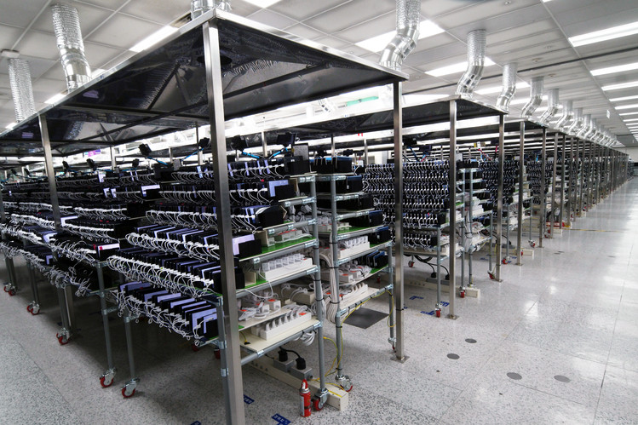



Importance of Quality
Note 7s (August 2016)
Battery A
Battery B
.

Slide 9
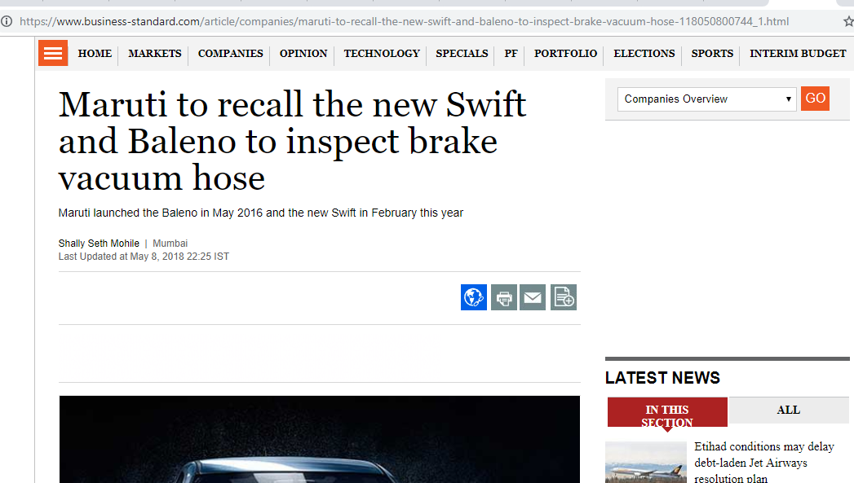
Importance of Quality
  Maruti’s vehicle recall
.

Slide 10


Importance of Quality
  Delayed delivery of Apple’s watch
.
The problem lies in the Apple Watch's taptic engine
Taptic engines from one of two suppliers, the Shenzhen, China-based AAC Technologies Holdings, were found to quickly wear down after mass production began in February 2015.
Rather than ship potentially bad units, Apple decided to throw away some Apple Watches with the AAC taptic engines.
Continuous improvement

Slide 11





Importance of Quality
.
50 million defective
vehicle air bags in the U.S.
Notes:
Kobe Steel, Mitsubishi Materials, and Subaru have all just admitted to manipulating quality inspections.
Takata declared bankruptcy last year after supplying 50 million defective vehicle air bags in the U.S.
Mitsubishi Motors has admitted covering up vehicle faults and falsifying fuel-economy data.
It also places enormous responsibility on the line workers (called genba) at the factory-floor level to manage daily operations and generate innovation.
The genba have traditionally been guaranteed jobs for life in return for dedication. But many Japanese companies can no longer afford the luxury of lifetime employment for factory craftsmen.

Slide 12
Importance of Quality
THE buzzword among business in the 1980s and 1990s
Quality problems still abound in many industries, such as automotive
Consumer expectations are high and they are intelligent enough to recognize quality issues.
“We’ve made dependence on the quality of our technology a part of life” – Joseph Juran
Notes:
20th century – era of productivity
21st century – era of quality --Joseph Juran

Slide 13



.
Notes:
Motorola built its culture on two key beliefs: respect for people and uncompromising integrity.
Motorola was a pioneer in continual reduction of defects and cycle times in all the company’s processes, from design, order entry, manufacturing, and marketing, to administrative functions.
Employees in every function of the business measure defects and use statistical techniques to analyze the results.
Products that once took weeks to make are now completed in less than an hour. Even the time needed for closing the financial books has been reduced; what used to take a month was shortened to only four days by applying quality principles.
Apple created new position –Senior VP of Operations dedicated to product quality

Slide 14
OMSS
Session | Topics | Readings and Cases*
1-3 | Understanding Quality, Dimensions of Quality, Costs of Quality, Basic QC Tools, Seven Management and Planning Tools | Chapter 2 Handouts and classroom discussion
4-5 | Voice of Customer, Quality Function Deployment (QFD), House of Quality | Chapter 2 and 3 Handouts and classroom discussion
6-7 | Specification Limits, Process Management, Total Quality Management, Customer Relationship, Process Performance | Chapter 2 and 3 Case: The Ritz-Carlton Hotel Company: The Quest for Service Excellence [Product#: CU09-PDF-ENG] Handouts and classroom discussion
8-9 | Understanding Six Sigma Concept, Measurement of Six Sigma, Throughput Yield, PPM, Six Sigma Improvement Models, DMAIC Methodology, Six Sigma Teams | Chapter 1, 5, 7, and 8 Case: Era of Quality at the Akshaya Patra Foundation [Product#: IMB493-PDF-ENG] Classroom discussion

Slide 15
OMSS
Session | Topics | Readings and Cases*
10-11 12-14 | Understanding Measurement Phase, Reliability and Validity, Accuracy, Bias, Stability, Repeatability and Reproducibility | Chapter 9, 10 Handouts and class room discussion
 | Understanding Analyze Phase, Data Analysis, Process Control Chart, Process Capability, Process Yield, Regression, Logistic Regression | Chapter 11, 12, and 14 Case: Process Control at Polaroid (A) [Product#: 693047-PDF-ENG] Handouts and classroom discussion
15-17 | Understanding Improve Phase, Failure Mode and Effect Analysis (FMEA), Tolerance Intervals, Design of Experiments, Factorial Experiments | Chapter 16 and 17 Handouts and classroom discussion
18 | Control Planning, Short and Small Runs Control Plan | Chapter 18 Handouts and classroom discussion
19-20 | Applying Six Sigma Concepts and Methods, Concluding the Course | Case: Six Sigma at Academic Medical Hospital (A) [Product#: UV0339-PDF-ENG]

Slide 16
Expectations
Midterm exam – 30%
Endterm exam – 35%
Quiz – 15% (Objective, multiple choice)
Assignment – 10% (Numerical/analytics problems)
Class exercise – 10%
Exam pattern (tentative)
  Conceptual questions (20%)
  Small case (40%)
  Numerical/analytics problems (40%)

Slide 17
Quality Dimensions
Garvin’s eight dimensions of quality:
Performance
  Example: Acceleration, handling, cruising speed, comfort, etc., in a car
Features
  Example: GPS, camera, fingerprint, etc., in smartphone
Reliability
Probability of a product’s failing within a specified period of time (mean time between failures).
A car’s ability to start on cold days
Conformance
Degree to which a product’s design and operating characteristics match preestablished standards.

Slide 18
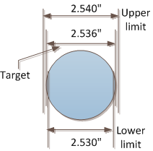
Quality Dimensions (Variance/Defects/Variability)
Conformance
Conformance
  Requirement: 2.536 inches
  Upper limit: 2.540 inches, and
  Lower diameter limit of 2.530 inches.
  In such judgments diameter within the upper and lower limit will be acceptable and would be close to the target.

Slide 19

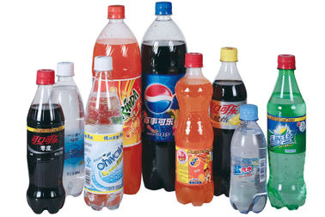
Quality Dimensions (What a giveaway)
Conformance
Conformance
Technology used to fill packages is not always totally consistent
They must build in a margin of safety into filling levels
This margin of safety is known as ‘giveaway’ or ‘over-fill’.
Notes:
There is always some degree of variation in the amount ‘dispensed’.
So, if packers or fillers want to conform to legal weights and measures stipulations on minimum fill levels, they must build in a margin of safety into filling levels in order to overcome the variation of the filling technology.

Slide 20

Quality Dimensions
Garvin’s eight dimensions of quality:
Durability
  Useful life (it has economic and technical dimension)
Serviceability
  Ease of repair, availability of authorized repair center
  Tesla
Notes:
Part of the problem is that Tesla, unlike other auto makers, doesn’t have a network of hundreds of franchise dealerships to sell and service its vehicles.
It has long touted this as an advantage, giving it more control over the customer experience.

Slide 21
Quality Dimensions
Garvin’s eight dimensions of quality:
Aesthetics
  Look and feel
Perceived quality
  Brand name recognition, general perception, past performance
One should not follow all eight criteria to be successful

Slide 22
Quality and its Perspectives
User based: better performance, more features
Manufacturing based: conformance to standards, making it right the first time
Product based: specific and measurable attributes of the product
Fitness for intended use
Quality “lies in the eyes of the beholder.”
“Making it right the first time.”
Quantities of product attributes

Slide 23
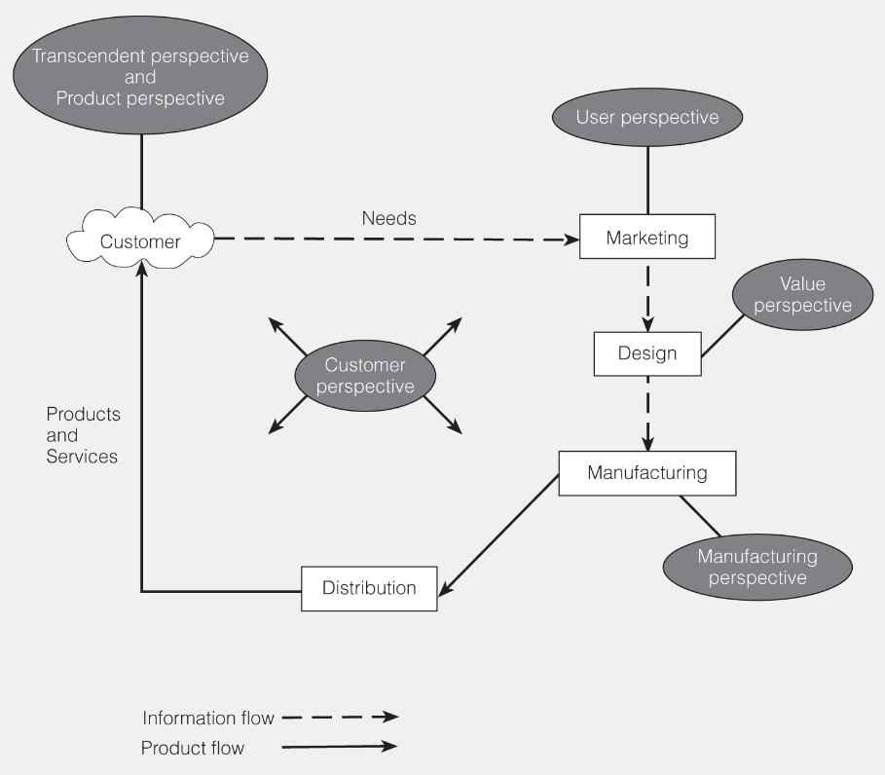
Quality and its Perspectives

Slide 24
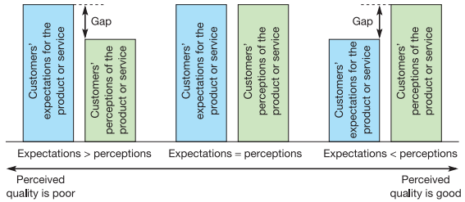
Variance/Defects

Slide 25

Tea and Sympathy
  Be pleasant to the waitresses – remember Tea and Sympathy girls are always right.
  You will have to wait outside the restaurant until your entire party is present: no exceptions.
  Occasionally, you may be asked to change tables so that we can accommodate all of you.
  If we don’t need the table you may stay all day, but if people are waiting it’s time to naff off.
  These rules are strictly enforced. Any argument will incur Nicky’s wrath. You have been warned.

Slide 26
Kano Model of Customer Requirements
Customer Focus
Dissatisfiers (“must haves”): expected requirements that cause dissatisfaction if not present
Satisfiers (“wants”): expressed requirements
Exciters/delighters (“never thought of”): unexpected features
Notes:
Navigation system in a car was originally exciter is probably viewed as satisfier will become dissatisfier.

Slide 27
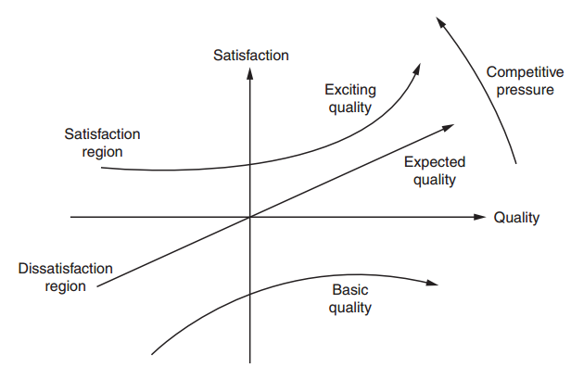
Kano Model of Customer Requirements
Customer Focus
.
Notes:
Navigation system in a car was originally exciter is probably viewed as satisfier will become dissatisfier.

Slide 28
Kano Model of Customer Requirements
Customer Focus
.
Six Sigma Region
Notes:
Some people, including your author, believe that even Six Sigma doesn’t go far enough.
In fact, even “zero defects” falls short

Slide 29
Measurement for Quality Control
Measurement
Measures and indicators
Good measures should be SMART
  S – Simple
  M – Measurable
  A – Actionable
  R – Related
  T – Timely

Slide 30
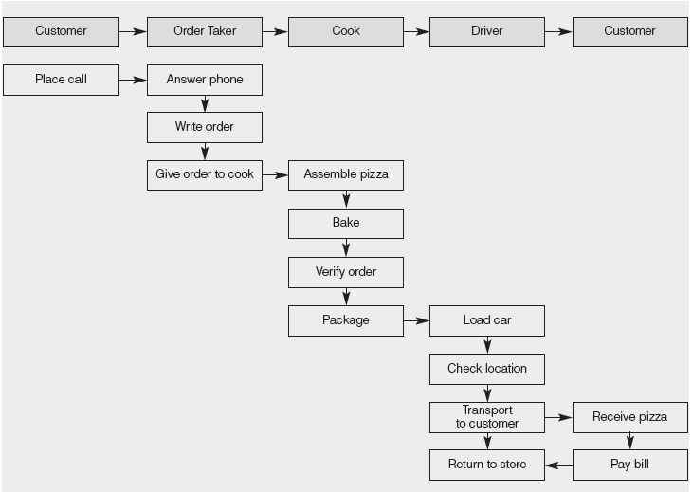
Measurement for Quality Control
Quality Measurements for Pizza Delivery

Slide 31
Measurement for Quality Control
Number of pizzas, by type per hour.
Order accuracy (as transmitted to the kitchen).
Number of pizzas rejected per number prepared.
Time to delivery.
Number of errors in collections.
Raw materials (dough, etc.) or finished pizzas inventory.

Slide 32
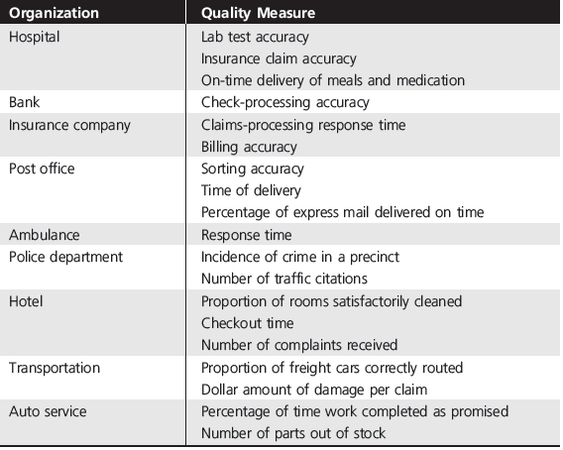
Measurement for Quality Control

Slide 33
Cost of Quality (COQ)
Traditionally, the reporting of quality-related costs had been limited to inspection and testing;
Other costs were accumulated in overhead accounts.
Findings in investigation
Quality-related costs were much larger than previously reported, generally in the range of 20 to 40 percent of sales.
Most of the costs resulted from poor quality and were avoidable.

Slide 34
Cost of Quality (COQ)
Managing quality is strategic decision as it supports differentiation, customer loyalty and commitment
.
Organization boundary
Prevention costs
Process 1
Process 2
Finished goods
Market
Appraisal costs
Appraisal costs
Internal Failure costs
External Failure costs
The correct cost for a well-run quality management program should be under 2.5%.
-Philip Crosby
Notes:
Prevention costs:costs associated with reducing the potential for defective parts or services (e.g., training, quality improvement programs).
Appraisal costs:costs related to evaluating products, processes, parts, and services (e.g., testing, labs, inspectors).

Slide 35
Quality and Cost
Managing quality is strategic decision as it supports differentiation and customer loyalty and commitment
.
Total Cost
Total Cost
For every dollar invested in prevention, you can save $10 in failure and appraisal cost.
External Failure
Internal Failure
Prevention
Appraisal
Quality Improvement

Slide 36
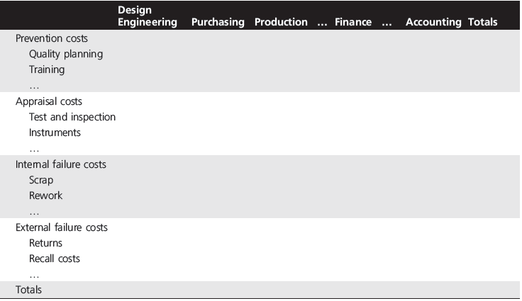
COQ Reporting Matrix
.
Notes:
For instance, if we rank internal failure costs from largest to smallest, chances are that 70 or 80 percent of all internal failure costs are due to only one or two manufacturing problems.
Identifying these “vital few,” as they are called, leads to corrective action that has a high return for a low dollar input.
Experts estimate that 60 to 90 percent of total quality costs are the result of internal and external failure and are the responsibility of management.
Managers typically react to high failure costs by increasing inspection.

Slide 37
Quality and Cost
Managing quality is strategic decision as it supports differentiation, low cost, and customer loyalty and commitment
.
Sales Gains via
Improved response
Improved reputation
Improved Quality
Increased Profits
Reduced Costs via
Lower rework and scrap costs
Increased productivity
Lower warranty costs

Slide 38
Quality and Profitability
.
Improved quality of design
Improved quality of conformance
Higher perceived value
Higher prices
Lower manufacturing and service costs
Increased market share
Increased revenues
Higher profitability

Slide 39
References.
Managing for Quality and Performance Excellence, Evans, J.R. and William M. Lindsay, W.M., Cengage Learning, India
The Six Sigma Handbook, Tomas Pyzdek and Paul Keller, Fourth edition, McGraw Hill India.
Total Quality Management, Besterfield et al., Revised third edition, Pearson India
The Management and Control of Quality, J. Evans, and W. Lindsay, Third edition, Cengage Learning

Slide 40
.
Thanks!

