Slide 1

Cost of Capital and Capital Structure : Theories and Practice
Dr. Akanksha Saxena

Slide 2

Topics
Fundamentals
Cost of capital
Theories of Capital Structure
Recapitalisation and Target Capital Structure
Capital Structure Decisions

Slide 3
Case : Boeing: surviving business turbulence after black swan cataclysms

Slide 4

Capital Structure
Capital
Debt
Preferred Stock
Common Equity
Retained Earnings
New Common Stock
Notes
Payable
Long-Term Debt

Slide 5
Components of cost of capital
Cost of Debt
Cost of Preference Capital
Cost of Equity Capital
Cost of Capital
Cost of Retained earnings and external equity
Cost of debentures
Cost of term loans

Slide 6
Cost of Capital
Rate of return that the suppliers of capital require as compensation for their contribution of capital
The rate of return the firm expects to earn from its investments in order to increase the value of the firm in the market place
Minimum required rate of return

Slide 7
Calculating the Weighted Average Cost of Capital
WACC = w_{d}r_{d}(1 – T) + w_{p}r_{p} + w_{c}r_{s}
The w’s refer to the firm’s capital structure weights.
The r’s refer to the cost of each component.

Slide 8
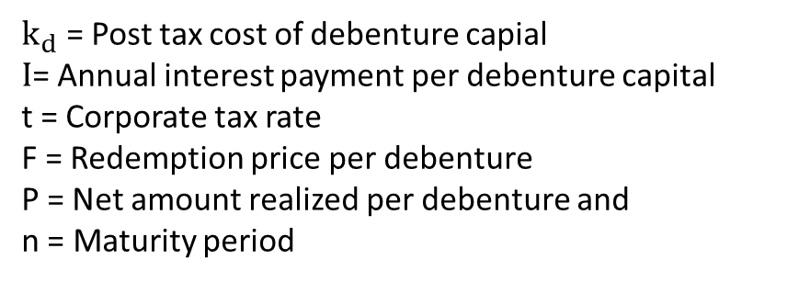
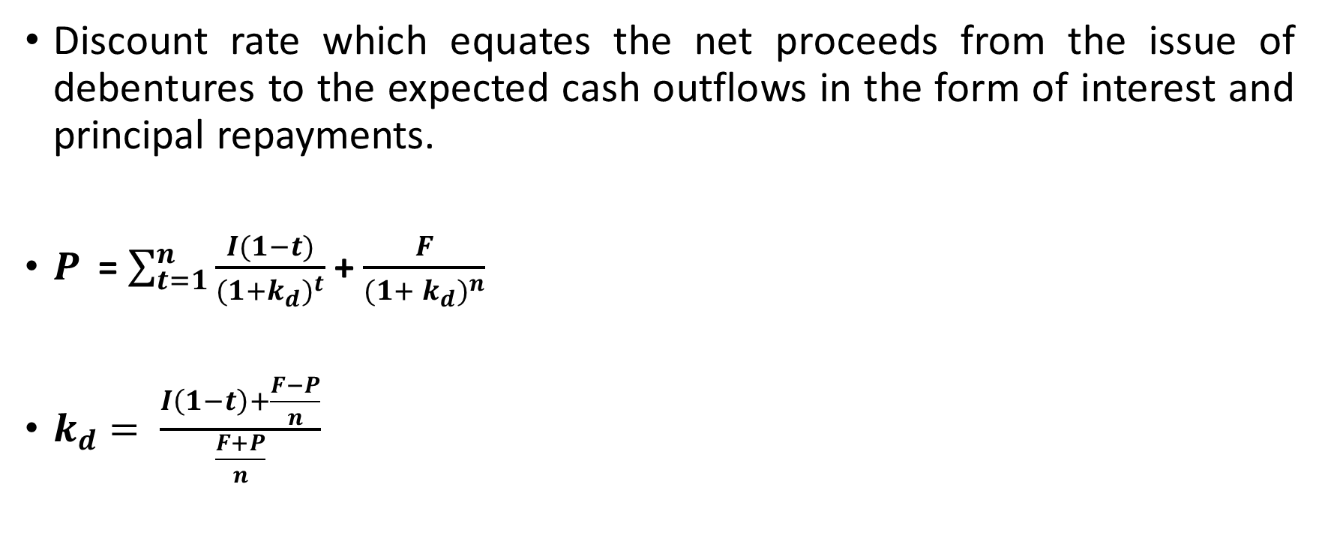
Cost of Debentures
Discount rate which equates the net proceeds from the issue of debentures to the expected cash outflows in the form of interest and principal repayments.
$P_{ }$ = $\sum_{t=1}^{n}{\frac{I(1−t)}{{(1+k_{d})}^{t}}}$ + $\frac{F}{{(1+ k_{d})}^{n}}$
$k_{d}= \frac{I\left(1−t\right)+\frac{F−P}{n}}{\frac{F+P}{n}}$
$k_{d}$ = Post tax cost of debenture capial
$I$= Annual interest payment per debenture capital
t = Corporate tax rate
F = Redemption price per debenture
P = Net amount realized per debenture and
n = Maturity period

Slide 9
Question
Ajax Ltd. has recently made an issue of non-convertible debentures for Rs. 400 lakh. The terms of the issue are as follows: each debenture has a face value of Rs. 100 and carries a rate of interest of 14 %. The interest is payable annually and the debenture is redeemable at a premium of 5 percent after 10 years.
If Ajay Ltd. realises Rs. 97 per debentures and the corporate tax rate is 50 percent, what is the cost of debentures to the company?

Slide 10

Given,
I = Rs. 14
T= 0.50
P= Rs. 97
n=10 years
F=Rs. 105
Find out $k_{d}$!

Slide 11
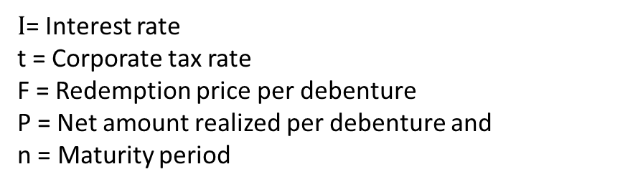

Cost of Term Loans
Interest rate
$$k_{t}= I\left(1−t\right)$$
$I$= Interest rate
t = Corporate tax rate
F = Redemption price per debenture
P = Net amount realized per debenture and
n = Maturity period

Slide 12
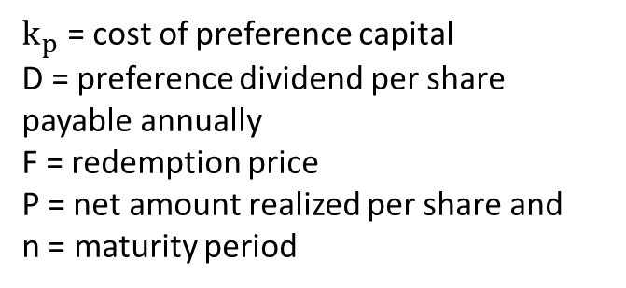
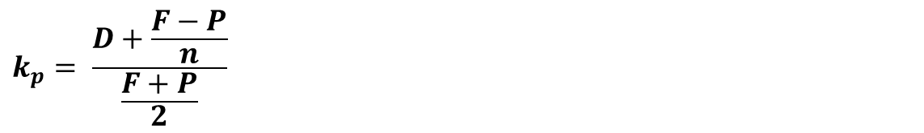
Cost of Preference Capital
Discount rate which equates the proceeds from preference capital issue to the payments associated with the same i.e. dividend payment and principal payments
  Can also use - k_{p} = D_{p}/P_{p}
  = $10/$111.10
  = 9%
$$k_{p}= \frac{D+\frac{F−P}{n}}{\frac{F+P}{2}}$$
$k_{p}$ = cost of preference capital
D = preference dividend per share payable annually
F = redemption price
P = net amount realized per share and
n = maturity period

Slide 13
Question
The terms of the preference share issue made by Color-Dye-Chem are as follows: Each preference share has a face value of Rs. 100 and carries a dividend rate of 14 percent payable annually. The share is redeemable after 12 years at par. If the net amount realized per share is Rs. 95, what is the cost of the preference capital?
D= 14, F= 100, P = 95, and n=12

Slide 14
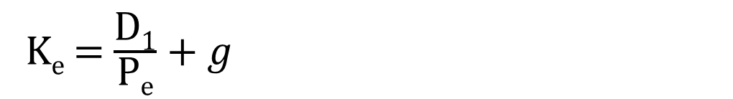
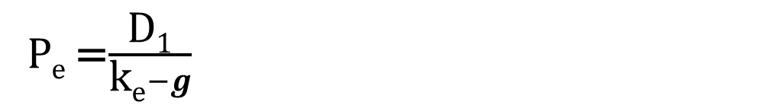
Cost of Equity Capital
According to dividend forecast approach, the intrinsic value of an equity stock is equal to the sum of the present values of the dividends associated with it. i.e.,
P_{e} =$\frac{\text{D}\text{1}}{\text{k}\text{e}−g}$
K_{e} = $\frac{\text{D}\text{1}}{\text{P}\text{e}}+g$

Slide 15
Three Ways to Determine the Cost of Common Equity, r_{s}
CAPM: r_{s} = r_{RF} + (r_{M} – r_{RF})b
DCF: r_{s} = (D₁/P₀) + g
Bond-Yield-Plus-Risk-Premium:
r_{s} = r_{d} + RP

Slide 16
Find the Cost of Common Equity Using the CAPM Approach
The r_{RF} = 7%, RP_{M} = 6%, and the firm’s beta is 1.2.
r_{s} = r_{RF} + (r_{M} – r_{RF})b
= 7.0% + (6.0%)1.2 = 14.2%

Slide 17
Find the Cost of Common Equity Using the
DCF Approach
D₀ = $4.19, P₀ = $50, and g = 5%.
D₁ = D₀(1 + g)
  = $4.19(1 + 0.05)
  = $4.3995
r_{s} = (D₁/P₀) + g
= ($4.3995/$50) + 0.05
= 13.8%

Slide 18
Can DCF methodology be applied if growth is not constant?
Yes, nonconstant growth stocks are expected to attain constant growth at some point, generally in 5 to 10 years.
May be complicated to calculate.

Slide 19
Bond-Yield-Plus-Risk-Premium Approach
r_{d} = 10% and RP = 4%.
This RP is not the same as the CAPM RP_{M}.
This method produces a ballpark estimate of r_{s}, and can serve as a useful check.
r_{s} = r_{d} + RP
r_{s} = 10.0% + 4.0% = 14.0%

Slide 20
What is a reasonable final estimate of r_{s}?
Method | Estimate
CAPM | 14.2%
DCF | 13.8
r_{d} + RP | 14.0
Range = 13.8%-14.2%, might use midpoint of range, 14%.

Slide 21
Why is the cost of retained earnings cheaper than the cost of issuing new common stock?
When a company issues new common stock they also have to pay flotation costs to the underwriter.
Issuing new common stock may send a negative signal to the capital markets, which may depress the stock price.

Slide 22
Question
The market price per share of Mobile Glycols Ltd. is Rs. 125. The dividend expected per share a year hence is Rs. 12 and the DPS is expected to grow at a constant rate of 8 percent per annum. What Is the cost of equity capital to the company?

Slide 23
Cost of retained earnings and cost of external equity
Earnings of a firm can be reinvested or paid as dividend
If firm retained part of earnings for future growth of the firm, the shareholder will demand compensation from the firm for using that money
Thus, cost of retained earnings is expected return from the firm’s common stock
Thus, K_{r} = K_{e}

Slide 24
Why is there a cost for retained earnings?
Earnings can be reinvested or paid out as dividends.
Investors could buy other securities, earn a return.
If earnings are retained, there is an opportunity cost (the return that stockholders could earn on alternative investments of equal risk).
  Investors could buy similar stocks and earn r_{s}.
  Firm could repurchase its own stock and earn r_{s}.

Slide 25
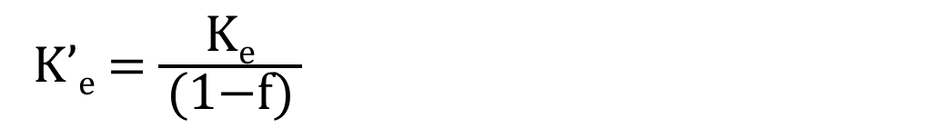
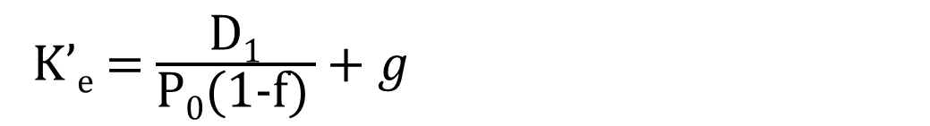
Under dividend capitalization model, the following formula can be used for calculating the cost of external equity :
For all other approaches,
K’_{e} = $\frac{\text{D}\text{1}}{\text{P}\text{0}\text{(1−}\text{f}\text{)} }+g$
K’_{e} = Cost of external equity
D₁ = Dividend expected at the end of year 1
P₀ = Current market price per share
g = Constant growth rate applicable to dividends
f = Floatation costs as a percentage of the current market price
K_{e} = rate of return required by the equity investors
K’_{e} = cost of external equity
f = Floatation costs as a percentage of the current market price
K’_{e} = $\frac{\text{K}\text{e}}{ \text{(1−}\text{f}\text{)} }$

Slide 26
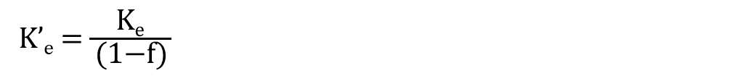
Question
Gamma Asbestos Ltd. has got Rs. 100 lakh of retained earnings and Rs. 100 lakh of external equity through a fresh issue, in its capital structure. The equity investors expect a rate of return of 18%. The cost of issuing external equity is 5%. The cost of retained earnings and the cost of external equity can be determined as follows:
Cost of retained earnings:
$$\text{K}\text{r}\text{=}\text{K}\text{e}$$
K’_{e} = $\frac{\text{K}\text{e}}{ \text{(1−}\text{f}\text{)} }$

Slide 27
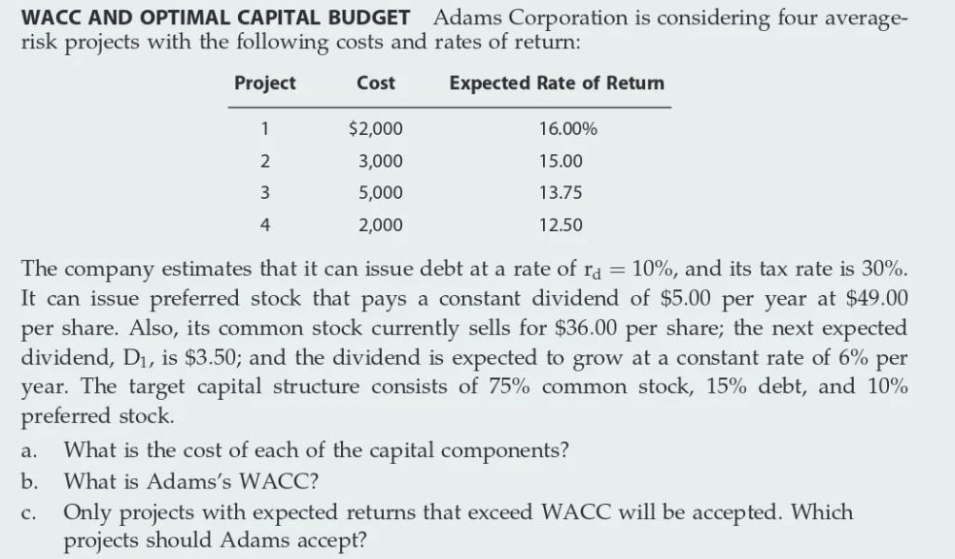

Slide 29
a. r_{d}(1 – T) = 0.10(1 – 0.3) = 7%.
r_{p} = $5/$49 = 10.2%.
r_{s} = $3.50/$36 + 6% = 15.72%.
b. WACC: After-Tax Weighted
Component Weight × Cost = Cost
Debt 0.15 7.00% 1.05%
Preferred stock 0.10 10.20 1.02
Common stock 0.75 15.72 11.79
WACC = 13.86%
c. Projects 1 and 2 will be accepted since their rates of return exceed the WACC.

Slide 30
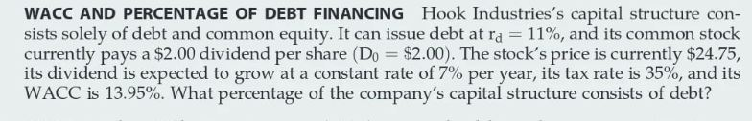

Slide 31
r_{s} = D₁/P₀ + g
= $2(1.07)/$24.75 + 7%
= 8.65% + 7% = 15.65%.
WACC = w_{d}(r_{d})(1 – T) + w_{c}(r_{s}); w_{c} = 1 – w_{d}.
13.95% = w_{d}(11%)(1 – 0.35) + (1 – w_{d})(15.65%)
0.1395 = 0.0715w_{d} + 0.1565 – 0.1565w_{d}
-0.017 = -0.085w_{d}
w_{d} = 0.20 = 20%.

Slide 32
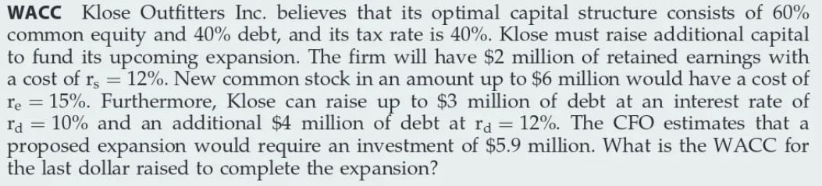

Slide 33
If the investment requires $5.9 million, that means it requires $3.54 million (60%) of common equity and $2.36 million (40%) of debt. In this scenario, the firm would exhaust its $2 million of retained earnings and be forced to raise new stock at a cost of 15%. Needing $2.36 million in debt, the firm could get by raising debt at only 10%. Therefore, its weighted average cost of capital is: WACC = 0.4(10%)(1 – 0.4) + 0.6(15%) = 11.4%.

Slide 34
Debt Finance –Pros and Cons
Pros
Less Costly
Tax benefits
Flexibility
Cons
Financial Risk
Effects of profit
Penal rate of interest with high financial leverage

Slide 35

Capital Structure
The choice of the firm regarding the amount of debt to hold relative to equity
Financial Leverage high when debt is high
Puzzling question for managers and researchers
“Whether the changes in capital structure impacts the cost of capital and value of the firm?”

Slide 36
Leverage Analysis
Leverage arises from the existence of fixed costs.
There are two kinds of leverage, viz, operating leverage and financial leverage.
Operating leverage arises from the firm's fixed operating costs such as salaries, rent, depreciation, insurance, property taxes, and advertising outlays.
Financial leverage arises from the firm's fixed financing costs such as interest on debt.

Slide 37

Financial vs Operating leverage
Financial leverage –choice of the amount of debt in capital structure
Operating Leverage- choice of the amount of Fixed cost in the cost structure
$$Operating leverage=\frac{Contribution Margin}{Net Operating Income}$$
The company with high operating leverage would be in distress if sales is not enough to cover the fixed costs
other things held constant, the higher a firm’s operating leverage, the higher its business risk.

Slide 38
Example-Operating Leverage
the Alaskan Barrel Company (ABC) has the following financial results:
Revenues $100,000
Variable expenses 30,000
Fixed expenses 60,000
Net operating income $10,000
ABC has a contribution margin of 70% and net operating income of $10,000, which gives it a degree of operating leverage of 7. ABC’s sales then increase by 20%, resulting in the following financial results:
Revenues $120,000
Variable expense 36,000
Fixed expenses 60,000
Net operating income $24,000
The contribution margin of 70% has stayed the same, and fixed costs have not changed. Because of ABC’s high degree of operating leverage, the 20% increase in sales translates into a greater than doubling of its net operating income.

Slide 39

Capital Structure -Schools of Thought
Capital structure is relevant
Debt is cheaper –reduces cost of capital- enhance value of firm
Optimum capital structure exists
Capital Structure Irrelevant
Increasing financial leverage increases the cost of equity- benefits of low cost of debt is offset
Value of firm depends on the operating earnings

Slide 40

Assumptions of Capital structure theories
D/E ratio can be changed instantly
Company’s operating earnings is constant till perpetuity
Entire earnings is distributed as dividend
No transaction cost or bankruptcy cost
Business risk is stable and the company earns constant operating profits each year
All investors are rational and have the same subjective probability distribution for the operating earnings
There are no income taxes

Slide 41

Capital Structure theories
Net Income Approach
Net Operating Income Approach
Traditional Theory of Capital structure
The Modigliani-Miller Approach
The Pecking order Theory
The Trade of theory
Signalling Theory

Slide 42
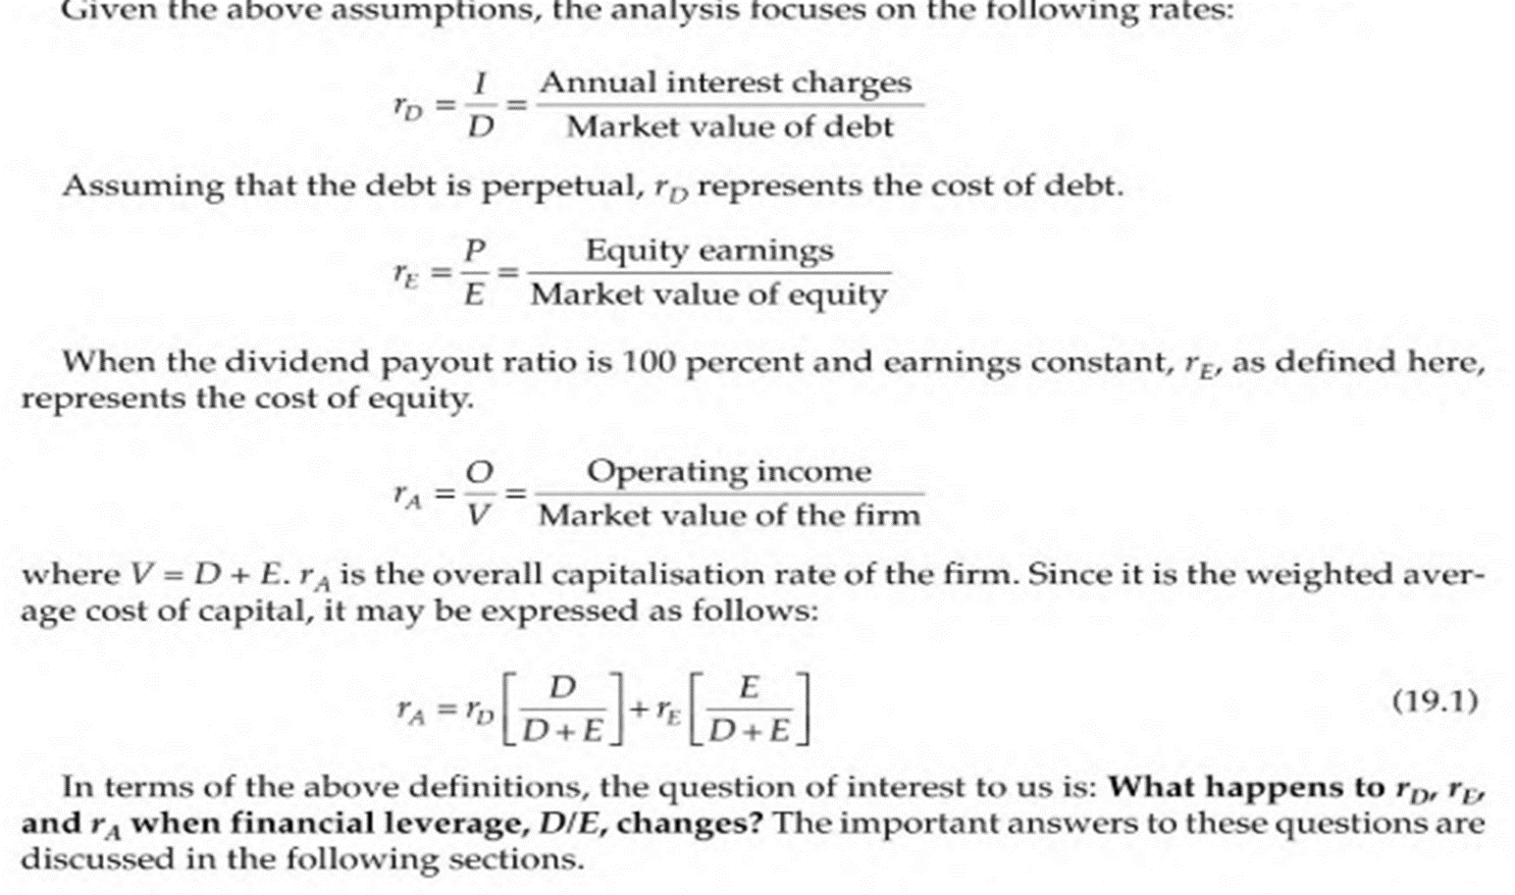
Important measures

Slide 43
Net income theory
The approach was given by David Durand
According to this approach, capital structure decision is relevant to the valuation of the firm
In other words, a change in the capital structure will lead to a corresponding change in the overall cost of capital as well as the total value of the firm
If D then, Cost of capital If D then, Cost of capital
Market value of share Market value of share
Value of the firm Value of the firm

Slide 44
Net income theory
According to the NI Approach, the financial leverage is, an important variable to the capital structure of a firm. With a judicious mixture of debt and equity, a firm can evolve an optimum capital structure which will be the one at which value of the firm is the highest and the overall cost of capital is the lowest. At that structure, the market price per share would be maximum

Slide 45
Net income theory
Assumptions:
There are no corporate taxes
Cost of debt is less than cost of equity
Use of debt, does not change the risk perception of the investors. That, the financial risk perception of the investors does not change with the introduction of debt or change in leverage. Thus, due to change in leverage, there is no change in either the cost of debt or the cost of equity

Slide 46
Example
A company’s expected annual net operating income (EBIT) is Rs 50,000. The company has Rs 2,00,000, 10% debentures. The equity capitalisation rate (ke) of the company is 12.5 per cent.

Slide 48
Base case
EBIT – Rs. 50000
B – Rs. 200000
I or Kd – 10%
Ke= 12.5%
Calculate NI = EBIT – Interest
Calculate S – MV of Shares = NI/Ke
Calculate V = S + B
Ko = EBIT/V
Increase in Debt
EBIT – Rs. 50000
B – Rs. 300000
I or Kd – 10%
Ke= 12.5%
Calculate NI = EBIT – Interest
Calculate S – MV of Shares = NI/Ke
Calculate V = S + B
Ko = EBIT/V
Decrease in Debt
EBIT – Rs. 50000
B – Rs. 100000
I or Kd– 10%
Ke= 12.5%
Calculate NI = EBIT – Interest
Calculate S – MV of Shares = NI/Ke
Calculate V = S + B
Ko = EBIT/V

Slide 49
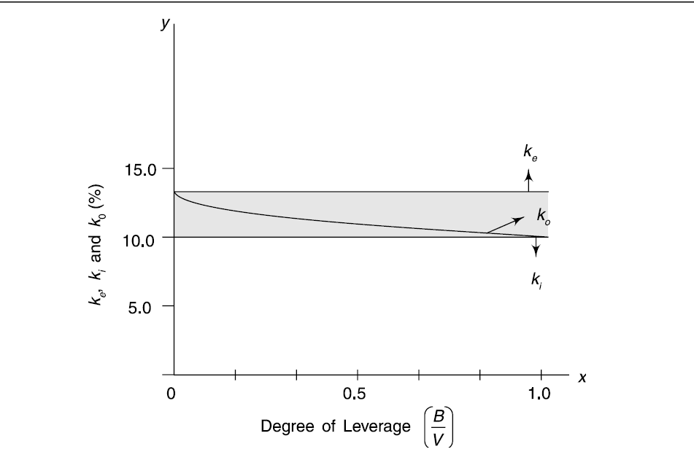
Net Income Approach (NI)
We can graph the relationship between the various factors (ke, ki, k0) with the degree of leverage

Slide 50
Net Operating Income Theory
As per this approach, the WACC and the total value of a company are independent of the capital structure decision or financial leverage of a company
Benefits that a firm derives by infusion of debt is negated by the simultaneous increase in the required rate of return by the equity shareholders
As per this approach, the market value is dependent on the operating income and the associated business risk of the firm.
Both these factors cannot be impacted by the financial leverage.
Financial leverage can only impact the share of income earned by debt holders and equity holders but cannot impact the operating incomes of the firm.
Therefore, change in debt to equity ratio cannot make any change in the value of the firm.

Slide 51
Net operating income theory
Assumptions:
There are only two sources of financing – debt and equity
Value of equity is calculated by deducting the value of debt from total value of the firm
Value of firm is EBIT/Ko
WACC remains constant and with an increase in debt, the cost of equity increases
Dividend payout ratio is 1
There are no taxes and no retained earnings

Slide 52
Example
Operating income Rs 50,000; cost of debt, 10 per cent; and outstanding debt, Rs 2,00,000. If the overall capitalisation rate (overall cost of capital) is 12.5 per cent, what would be the total value of the firm and the equity-capitalisation rate?

Slide 54
Base case
EBIT – Rs. 50000
B – Rs. 200000
I or Kd– 10%
Ko = 12.5%
Ke, V= ?
Assuming WACC (Ko) remains constant
V = EBIT/Ko
S = V – B
Ke = (EBIT – Interest)/S
Increase in Debt
EBIT – Rs. 50000
B – Rs. 300000
I or Kd – 10%
Ko = 12.5%
Ke, V = ?
Assuming WACC (Ko) remains constant
V = EBIT/Ko
S = V – B
Ke = (EBIT – Interest)/S
Decrease in Debt
EBIT – Rs. 50000
B – Rs. 100000
I or Kd – 10%
Ko = 12.5%
Ke, V = ?
Assuming WACC (Ko) remains constant
V = EBIT/Ko
S = V – B
Ke = (EBIT – Interest)/S

Slide 55
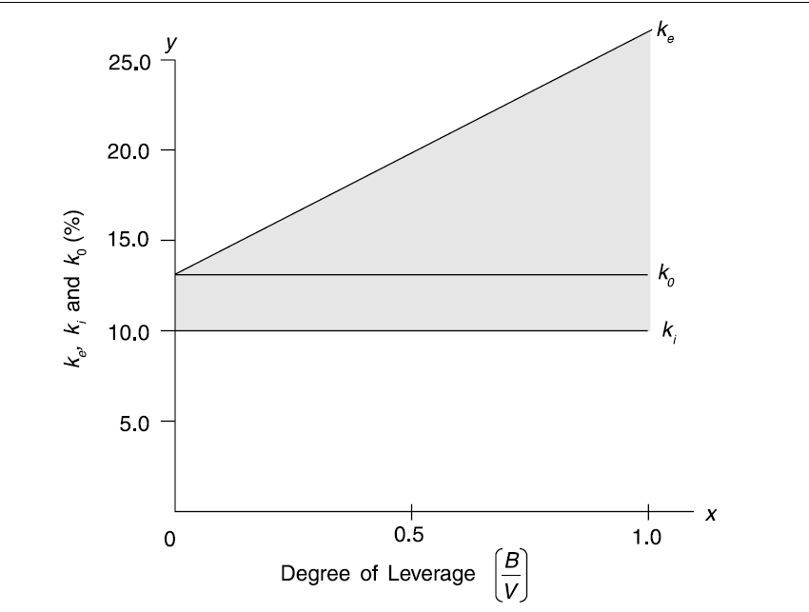
Net Operating Income Approach (NOI)
We can graph the relationship between the various factors (ke, ki, k0) with the degree of leverage

Slide 56
Traditional/ Intermediate Approach
Traditional approach has emerged as a compromise to the extreme proposition taken by NI and NOI approach.
The main propositions of the traditional approach are:
The cost of equity capital, Ke, remains more or less constant or rises only gradually up to a certain degree of leverage and rises sharply thereafter.
The cost of debt capital, Ki, remains more or less constant up to a certain degree of leverage but rises thereafter at an increasing rate.
The average cost of capital, Ko, as a consequence of the above behavior of Ke and Ki,
    (i) decreases up to a certain point;
    (ii) remains more or less unchanged for moderate increases in leverage thereafter; and
    (iii) rises beyond a certain point.
Thus there is a optimal capital structure when weighted average cost of capital is minimum and the value of the firm is maximum.

Slide 57
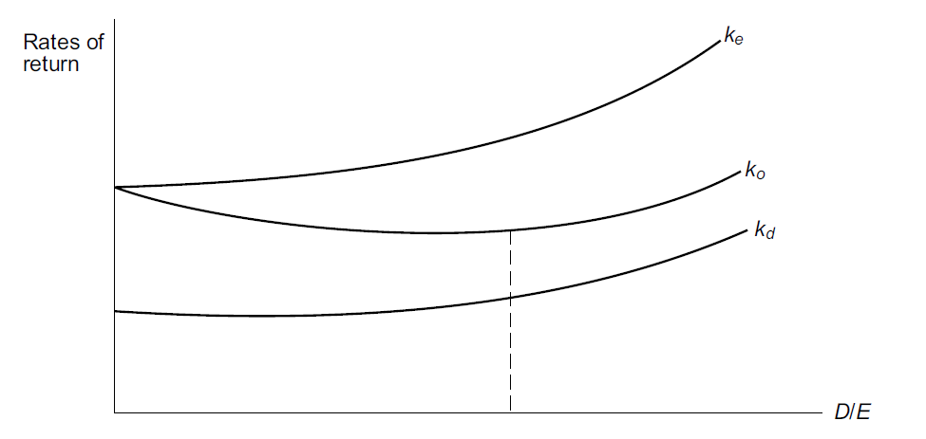
Traditional Approach
We can graph the relationship between the various factors (ke, ki, k0) with the degree of leverage

Slide 58
Readings
Modigliani, F., & Miller, M. H. (1958). The cost of capital, corporation finance and the theory of investment. The American economic review, 48(3), 261-297
Jensen, M. C., & Meckling, W. H. (1976). Theory of the firm: Managerial behavior, agency costs and ownership structure. Journal of financial economics, 3(4), 305-360.
Myers, S. C., & Majluf, N. S. (1984). Corporate financing and investment decisions when firms have information that investors do not have. Journal of financial economics, 13(2), 187-221.
Rajan, R. G., & Zingales, L. (1995). What do we know about capital structure? Some evidence from international data. The journal of Finance, 50(5), 1421-1460.
Denis, D. J., & Osobov, I. (2008). Why do firms pay dividends? International evidence on the determinants of dividend policy. Journal of Financial economics, 89(1), 62-82.

Slide 59
Modigliani and Miller (1958, 1963)
Modigliani and Miller developed two approaches of Capital Structure:
Modigliani and Miller : Without taxes (1958)
Modigliani and Miller : With taxes (1963)
Modigliani and Miller (1958) :
Similar to NOI Approach
Capital Structure Irrelevant Approach

Slide 60
Modigliani and Miller
In their celebrated 1958 paper, Modigliani and Miller (MM, hereafter) have restated and amplified the net operating income position in terms of three basic propositions.
Assumption of the Approach
Capital markets are perfect. Information is freely available and transactions are costless;
Investors are rational. Investors are well-informed and choose a combination of risk and return that is most advantageous to them.
Investors have homogeneous expectations.
Firms can be grouped into ‘equivalent risk classes’ on the basis of their business risk.
There is no corporate income tax.

Slide 61
Modigliani and Miller
Basic Propositions
Based on the above assumptions, MM derived the following three propositions.
Proposition I : The total market value of a firm is equal to its expected operating income divided by the discount rate appropriate to its risk class. It is independent of the degree of leverage.
In other words, the total value of a firm must be constant irrespective of the degree of leverage (debt-equity ratio). Similarly, the cost of capital as well as the market price of shares must be the same regardless of the financing-mix.
Vj = Sj + Bj = Oj/ko
where Vj = total market value of firm j
Sj = market value of the equity of firm j
Bj = market value of the debt of firm j
Oj = expected operating income of firm j
ko = discount rate applicable to the risk class to which the fi rm j belongs.
Example: Two companies X & Y have identical assets, Operating in same industry, same segment, and have equal market share.

Slide 62
Modigliani and Miller
Proposition II: The expected yield on equity, ke, is equal to ko plus a premium. This premium is equal to the debt–equity ratio times the difference between ko and the yield on debt, ki. In symbols
ke = ko + (ko – ki) B/S
For a zero-debt company, the second component of the above equation is zero. As the company starts using debt, the ke increases and the equity-investor is to be compensated for it. The higher the employment of debt in financing company’s assets, the higher is the financial risk as well as the financial risk premium.
Proposition III: The cutoff rate for investment decision making for a firm in a given risk class is not affected by the manner in which the investment is financed. (This proposition states the implication of the earlier propositions for investment decision-making. It emphasizes the point that investment and financing decisions are independent because the average cost of capital is not affected by the financing decision.)

Slide 63
Modigliani and Miller
Arbitrage Mechanism and Home Made leverage
According to MM, if two firms, say X and Y, are in the same risk class and have the same expected operating income, they will have the same value in the market place, irrespective of differences in their capital structure. If their values diverge, investors will resort to arbitraging.
The term ‘arbitrage’ refers to an act of buying an asset/security in one market (at lower prices) and selling it in another (at higher price). As a result, equilibrium is restored in the market price of a security in different markets.
The MM Approach illustrates the arbitrage process with reference to valuation in terms of two firms which are exactly similar in all respects except leverage so that one of them has debt in its capital structure while the other does not.
Such homogeneous firms are, according to Modigliani and Miller, perfect substitutes.

Slide 64
Limitation of MM Approach (Tax Advantage)
The most crucial element in the MM Approach is the arbitrage process which forms the behavioural foundation of, and provides operational justification to, the MM hypothesis.
The arbitrage process, in turn, is based on the crucial assumption of perfect substitutability of personal/home-made leverage with corporate leverage.
In practice how personal leverage may differ from the corporate leverage?
  Risk perception
  Convenience
  Cost
  Taxes
The leverage irrelevance theorem of MM is valid if the perfect market assumptions underlying their analysis are satisfied. However, in the face of imperfections characterizing the real world capital markets, the capital structure of a firm may affect its valuation. Presence of taxes is a major imperfection in the real world.
When taxes are applicable to corporate income, debt financing is advantageous. Why? While dividends and retained earnings are not deductible for tax purposes, interest on debt is a tax-deductible expense. As a result, the total income available for both stockholders and debtholders is greater when debt capital is used.

Slide 65
Limitation of MM Approach (Distress/ Bankruptcy cost )
MM agree that the value of the firm will increase and cost of capital will decline with leverage, if corporate taxes are introduced in the exercise. Since interest on debt is tax-deductible, the effective cost of borrowing is less than the contractual rate of interest. Debt, thus, provides a benefit to the firm because of the tax-deductibility of interest payments. Therefore, a levered firm would have greater market value than an unlevered firm. Hence, it implies that the value of a levered firm will be
Value of levered firm = Value of unlevered firm + Gain from leverage
VL = VU + tcB
In addition to taxation, which is the most important imperfection, there are several other imperfections which have a bearing on the optimal capital structure. One of the most important such cost is bankruptcy or financial distress cost
In a perfect capital market, there are no costs associated with bankruptcy. If a firm becomes bankrupt its assets can be sold at their economic values and there are no legal and administrative expenses. In the real world, however, there are considerable costs associated with bankruptcy.

Slide 66
Limitation of MM Approach
Assets, when disposed under distress conditions, generally sell at a significant discount below their economic values. Further, the legal and administrative costs associated with bankruptcy proceedings are quite high. Finally, an impending bankruptcy entails significant costs in the form of sharply impaired operational efficiency.
Other things being equal, the probability of bankruptcy is higher for a levered firm than for an unlevered firm. It seems that the probability of bankruptcy increases at an increasing rate as the debt-equity ratio increases beyond a certain threshold level. Thus investors of levered firm expect a higher rate of return for firms with higher bankruptcy rate.

Slide 67
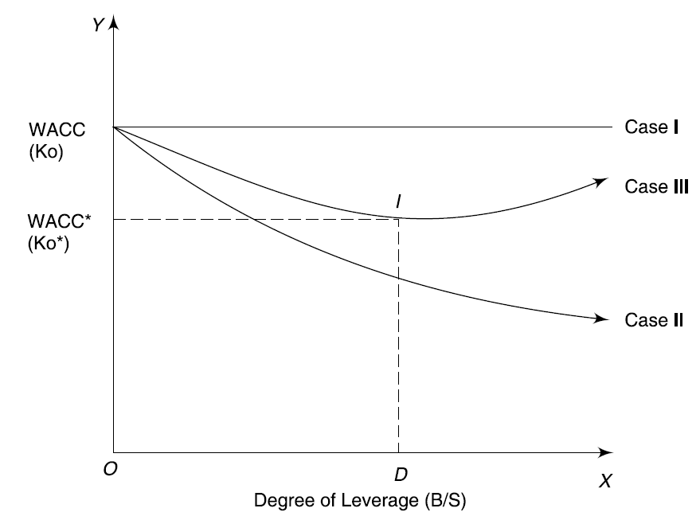
Real world Corporate Financing Behaviour
Trade off Theory
Use of debt as a means of corporate finance have led to the genesis of the trade-off theory on capital structure.
It trades off the advantage of debt financing (interest tax shields) against the costs of financial distress (consisting of higher interest rates and bankruptcy costs).
In Case I, Ko remains constant under perfect market conditions. Advantage of cheaper debt source is nullified by the higher equity capitalization rate
In case II, recognises the tax benefit of debt sources and hence, in this case Ko is decreasing with increasing leverage ratio
In case III, the presence of bankruptcy cost due to excessive debt is recognised. As a result beyond point D the tax advantage is negated by the higher bankruptcy cost.
At the point of ‘D’ the company has an optimal structure.
Its conclusion that debt should be used within safe limits converges with the trade-off theory.

Slide 68
Real world Corporate Financing Behaviour
Pecking Order Theory
There is an alternative theory which explains why profitable firms (example: SBI Life Insurance, HUL, ICICI Pru Life Insurance, ITC, Ambuja Cements) use little debt. According to this theory, there is a pecking order of financing which goes as follows:
  Retained Earnings (internal finance) (What is RE?)
  Debt Finance
  Equity Funding (External Finance)
A firm first taps retained earnings. Its primary attraction is that it comes out of profits and not much effort is required to get it. Further, the capital market ordinarily does not view the use of retained earnings negatively.
When the financing needs of the firm exceed its retained earnings, it seeks debt finance. As there is very little scope for debt to be mispriced, a debt issue does not ordinarily cause concern to investors. Also, a debt issue prevents dilution of control.
External equity appears to be the last choice. A great deal of effort may be required in obtaining external equity. More important, while retained earnings is not regarded by the capital market as a negative signal, external equity is often perceived as ‘bad news’. Investors generally believe that a firm issues external equity when it considers its stock overpriced in relation to its future prospects.

Slide 69
Real world Corporate Financing Behaviour
Signalling theory
Debt signaling is a financial theory that correlates a stock's future performance with any current announcements made regarding its debt.
Announcements made about a company taking debt are typically seen as positive news as it can signal the company is creditworthy and is raising capital for the purposes of growth.

Slide 70
Practice problems
You work for the CEO of a new company that plans to manufacture and sell a new type of laptop computer. The issue now is how to finance the company, with only equity or with a mix of debt and equity. Expected operating income is $600,000. Other data for the firm are shown below. How much higher or lower will the firm's expected EPS be if it uses some debt rather than only equity, i.e., what is EPS_{L} − EPS_{U}?
 | 0% Debt, U | 60% Debt, L
Oper. income (EBIT) | $600,000 | $600,000
Required investment | $2,500,000 | $2,500,000
% Debt | 0.0% | 60.0%
$ of Debt | $0.00 | $1,500,000
$ of Common equity | $2,500,000 | $1,000,000
Shares issued, $10/share | 250,000 | 100,000
Interest rate | NA | 10.00%
Tax rate | 35% | 35%

Slide 71
Solution
 | 0% Debt, U | 60% Debt, L
Required investment | $2,500,000 | $2,500,000
% Debt | 0.00% | 60.00%
$ of Debt | $0 | $1,500,000
$ of Common equity | $2,500,000 | $1,000,000
Shares issued at $10/share | 250,000 | 100,000
Interest rate | NA | 10.00%
Tax rate | 35.00% | 35.00%
Operating income (EBIT) | $600,000 | $600,000
Interest | 0 | 150,000
Taxable income | $600,000 | $450,000
Taxes | 210,000 | 157,500
Net income | $390,000 | $292,500
Earnings per share (EPS) | $1.56 | $2.93 ​ Difference in EPS = $1.37

Slide 72
Confu Inc. expects to have the following data during the coming year. What is the firm's expected ROE?
Capital | $200,000 | Interest rate | 8%
Debt/Capital, book value | 65% | Tax rate | 40%
EBIT | $25,000

Slide 73
Solution
Capital | $200,000 | EBIT | $25,000
Debt/Capital | 65% | − Interest = rate × debt = | 10,400
EBIT | $25,000 | Earnings before taxes | $14,600
Interest rate | 8% | − Taxes | 5,840
Tax rate | 40% | Net Income | $8,760
Debt = (Debt/Capital)) × Capital = | $130,000 | NI/Equity = ROE = 12.51%
​
Equity = Assets − Debt = $70,000

